Slide 1

Pediatric Cancer Variant Pathogenicity Information Exchange (PeCan-PIE)
Michael Edmonson <Michael.Edmonson@stjude.org>
Department of Computational Biology
St. Jude Children’s Research Hospital
Memphis, TN
ASHG Annual Meeting
October 20, 2017

Slide 2
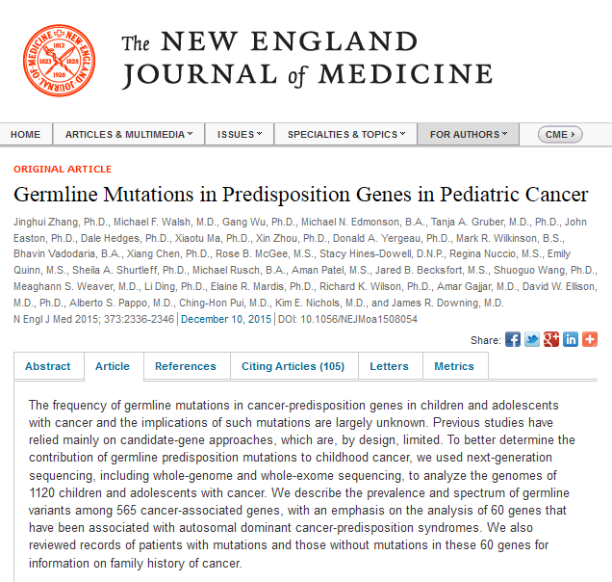
Introduction
Notes:
This all started some years ago with a germline analysis of~1100 pediatric cancer genomes, which was eventually published in the New England Journal in 2015. The challenge we faced was how to efficiently detect and triage potentially pathogenic variants from a huge volume of next-generation sequencing data. A lot of software was written to support this effort, some of which has been now integrated into the PeCan-PIE portal, so now you can use it too.

Slide 3
Variant processing overview
Germline
classification
VCF
Annotation
Review
SNVs and indels
filter to 1021 predisposition genes for cancer and other diseases
Subset clinically-reportable in cancer
“VEP+” pipeline
Predicted class of event and effect on gene
postprocessing for splice enhancements, e.g. TP53 T125T
“Medal Ceremony”
3-tier pathogenicity classification (gold, silver, bronze)
pre-dates ACMG 5-tier
Final decision made by analyst
Formal 5-tier ACMG classification (P, LP, VUS, LB, B)

Slide 4

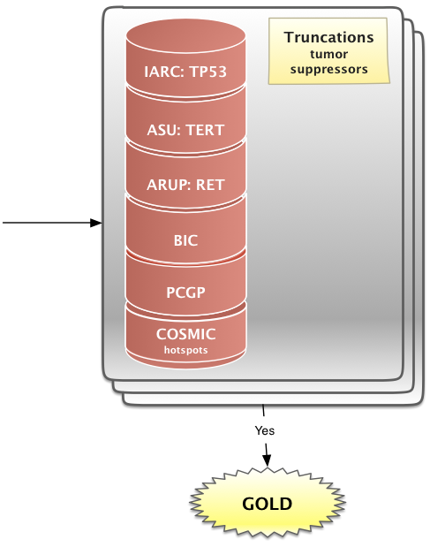
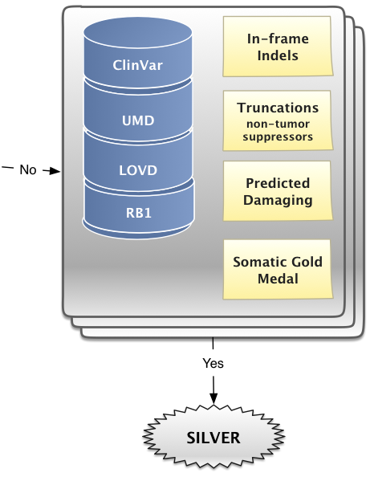
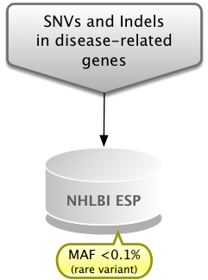
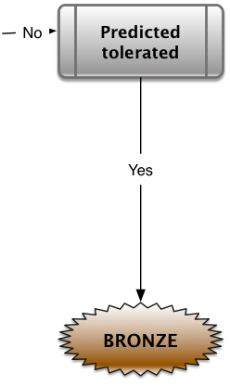
GW/MNE/AP

Slide 5
PeCan PIE

Slide 6
Things you can do with PeCan PIE
Perform web- and cloud-based annotation and classification of SNVs/indels using the same pipelines used by St. Jude clinical sequencing program
Formally classify variants with an interface based on ACMG guidelines
Access a repository of expert curations with supporting evidence and analyst notes
Notes:
ACMG = American College of Medical Genetics and Genomics

Slide 7
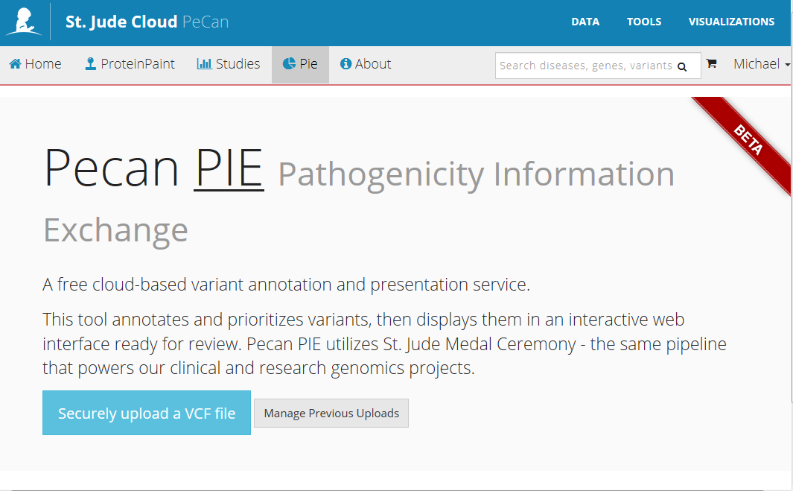
Home
Analyses run on St. Jude Cloud platform
secure DNAnexus backend; login required
Private data
Job access
email notifications
St. Jude pays (small) cloud costs

Slide 8
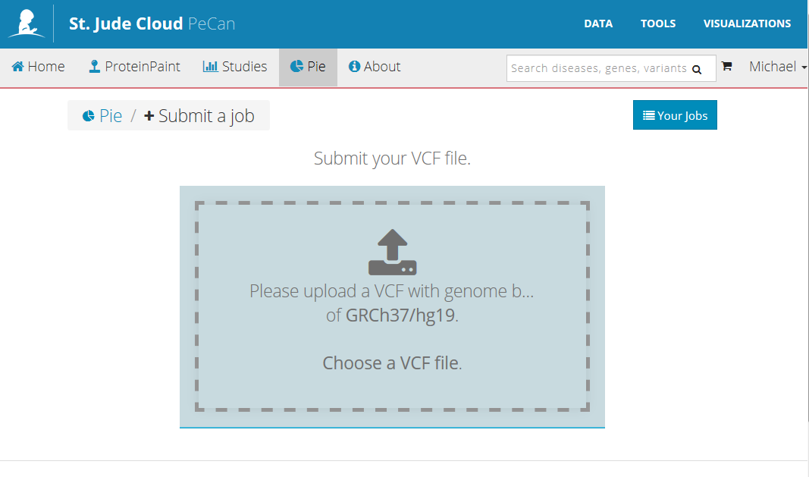
Upload VCF of variants
Notes:
Currently ~30 mb limit
Drag & drop

Slide 9
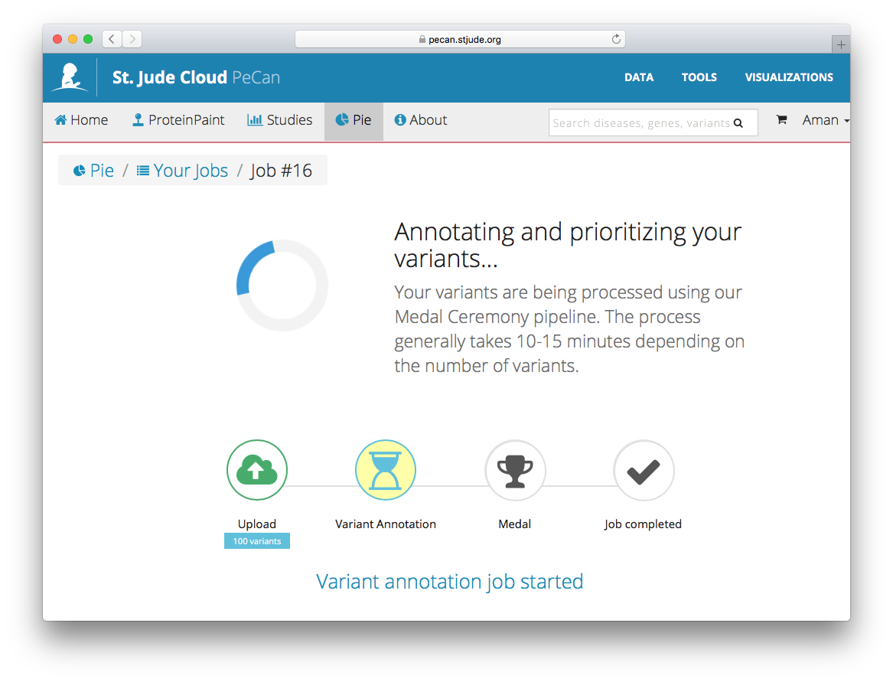
Job processing page
Don’t have to wait: email and browser notifications
filtering example: SJTALL022645 WES:
Step | Count
Raw VCF: unfiltered / noisy | 141,083
Disease-related genes | 9,058
Coding or splice-related | 1,233
Gold, Silver, Bronze | 331
Gold | 15
Notes:
TALL = T-cell acute lymphoblastic leukemia

Slide 10
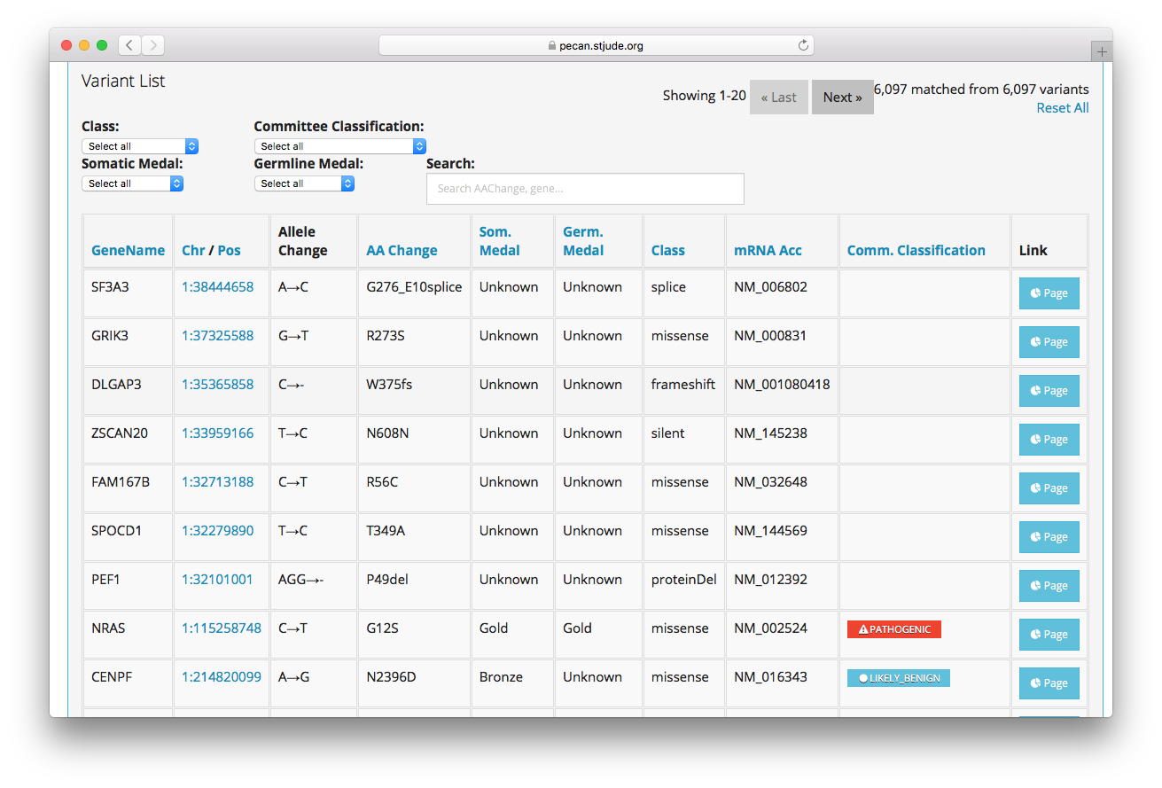
Results: overview
Sort, filter, search
Variant page links

Slide 11
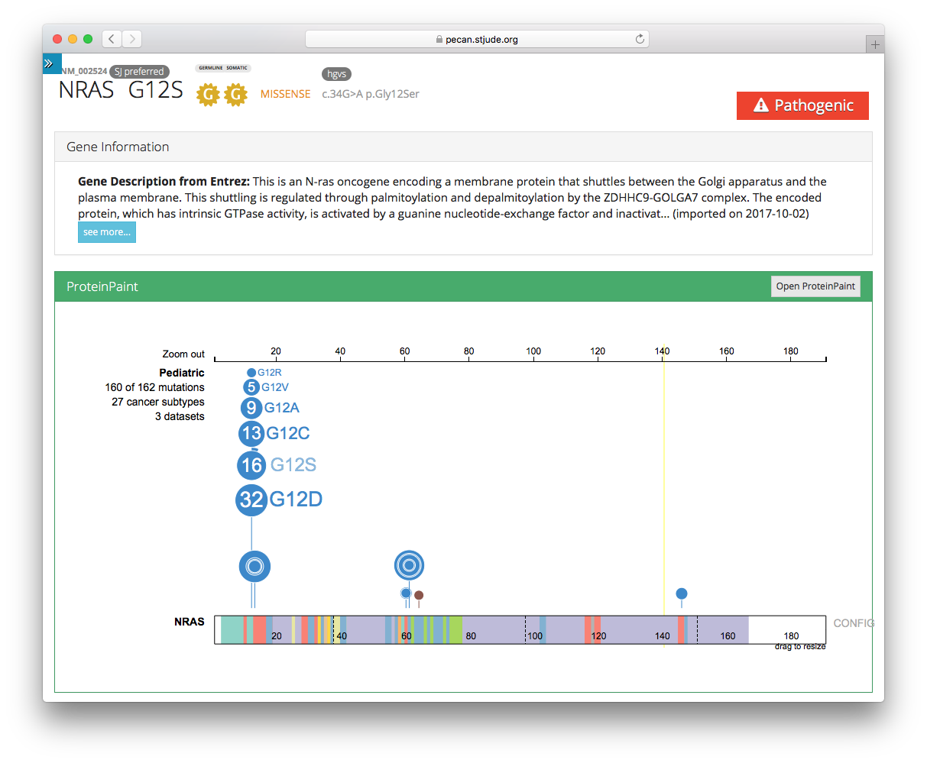

Variant page: gene info, Protein Paint
Variant details
Gene information
Protein Paint
(Zhou et al.,
Nat Genet. 2016)
Notes:
NRAS G12: very rare in germline (1 PCGP), however a hotspot in somatic
Small filled edge to G12S = fraction germline, not contamination

Slide 12
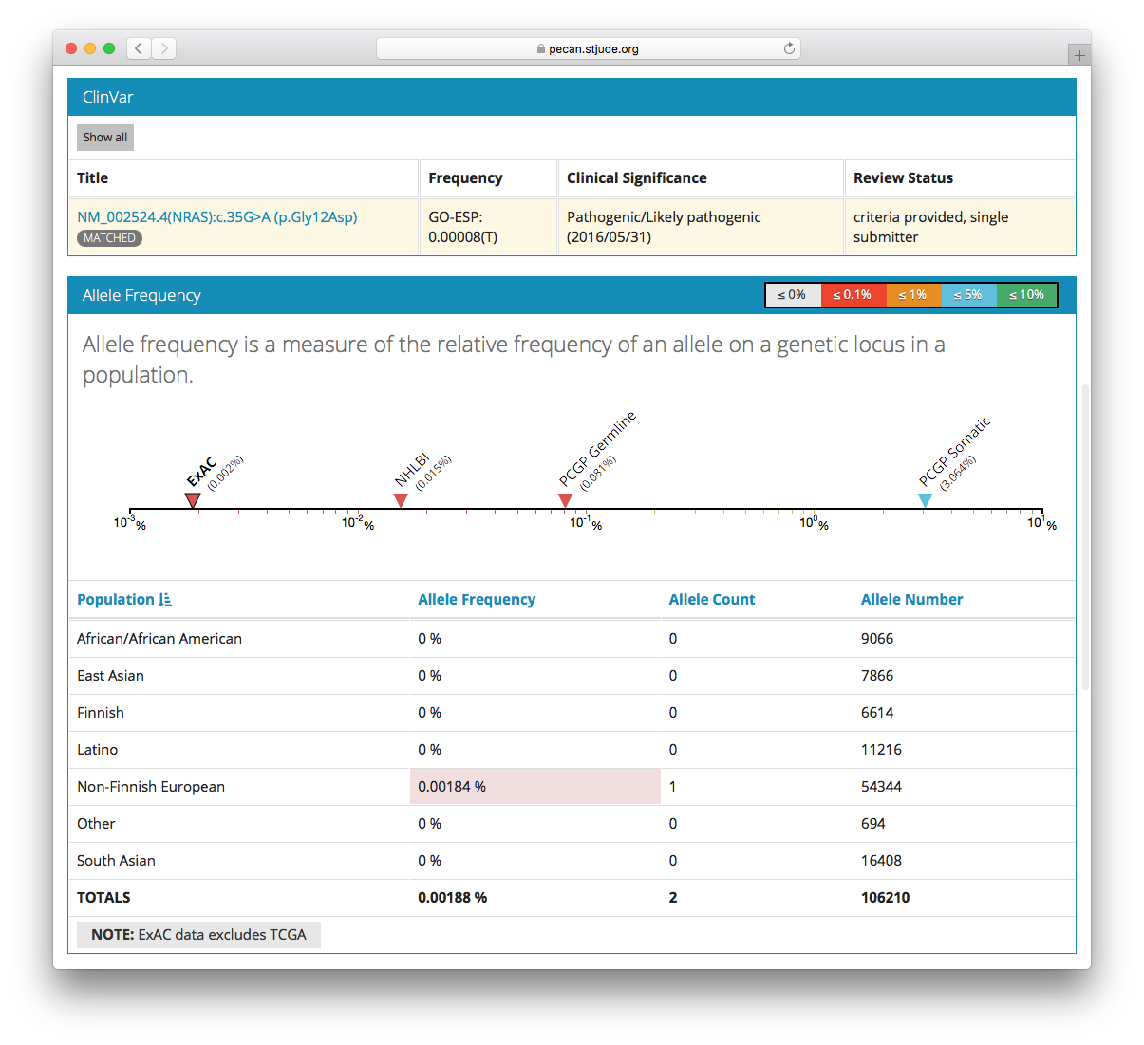
Variant page: ClinVar, population frequency
ClinVar information
Population frequencies
NHLBI ESP 6500
PCGP
ExAC

Slide 13
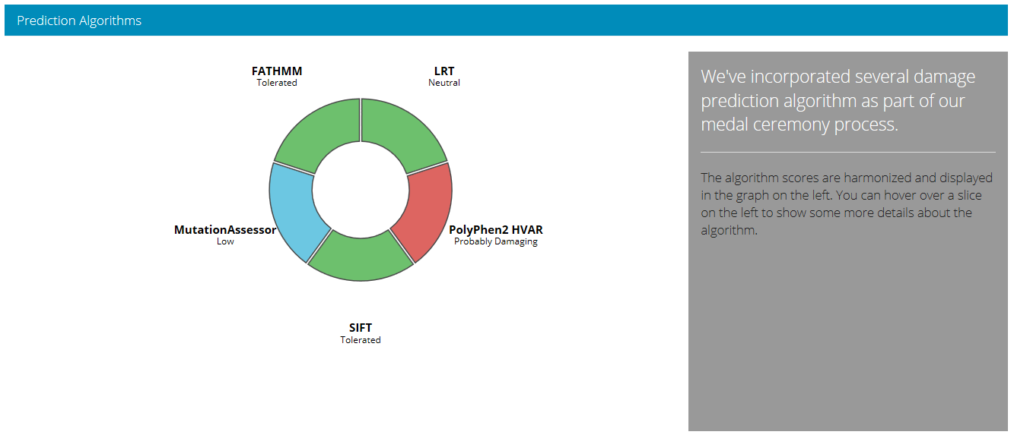
Variant page: damage prediction algorithms
Notes:
dbNSFP

Slide 14
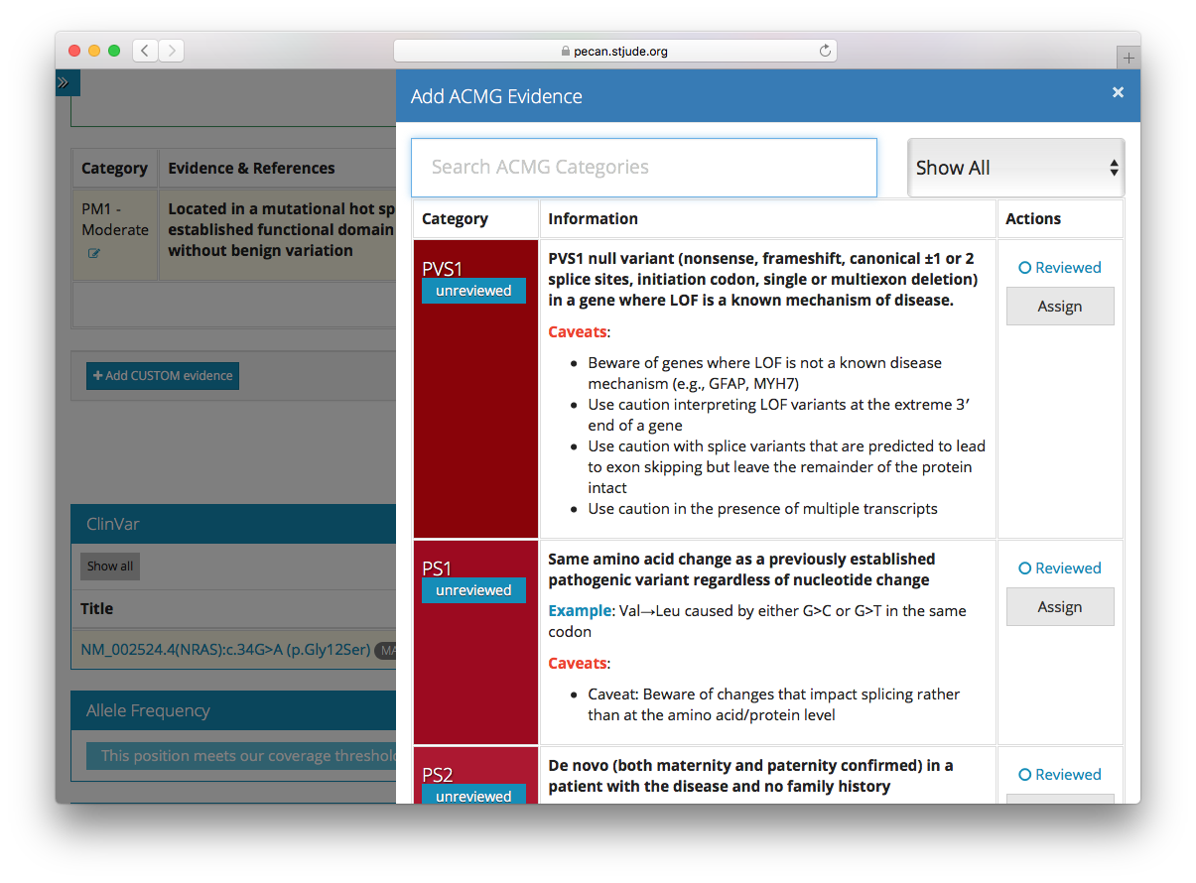
Variant page: ACMG classification tool
Reviewer can evaluate/populate various pathogenicity “tags” as described by ACMG (Richards et al., Genet Med. 2015)
Each tag can be annotated with text, PubMed IDs
Custom evidence can be entered
Based on responses, tool computes recommended 5-tier classification (P/LP/VUS/LB/B)
Lets you see specific reasons and evidence behind final classification

Slide 15


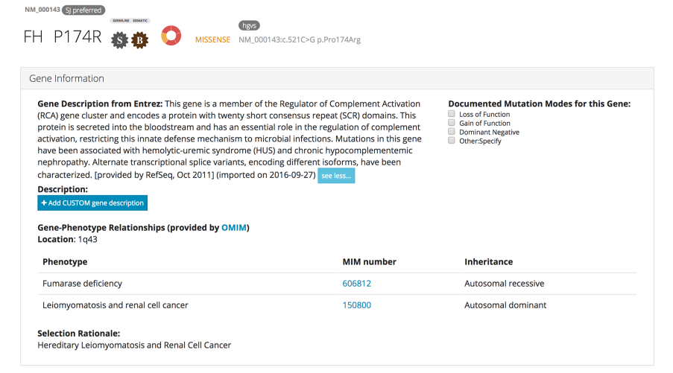
example from St. Jude LIFE project: FH P174R
Genomics Project
Credit: Zhaoming Wang
Notes:
“The FH gene provides instructions for making an enzyme called fumarase (also known as fumarate hydratase). Fumarase participates in an important series of reactions known as the citric acid cycle or Krebs cycle, which allows cells to use oxygen and generate energy. Specifically, fumarase helps convert a molecule called fumarate to a molecule called malate.”
Linked with (1) fumurase deficiency (2) renal cancer

Slide 16
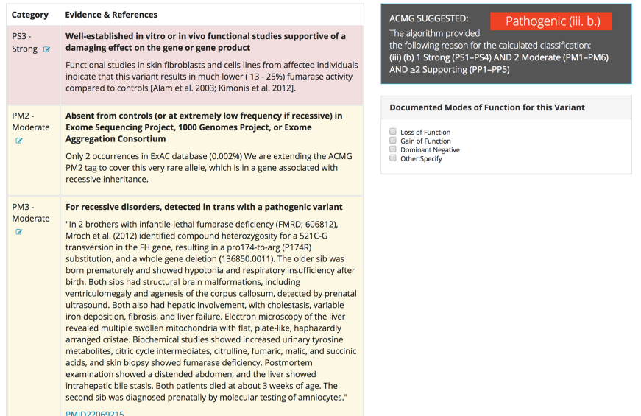
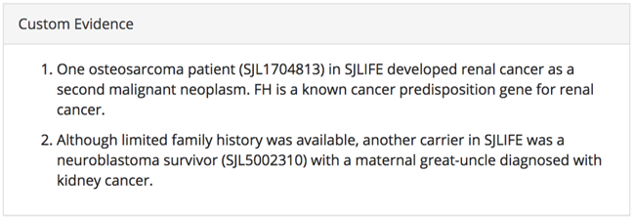
FH P174R: ACMG classification
Genomics Project
Credit: Zhaoming Wang
Notes:
Infantile lethal fumarase deficiency
PMID 22069215, http://onlinelibrary.wiley.com/doi/10.1002/ajmg.a.34344/full

Slide 17
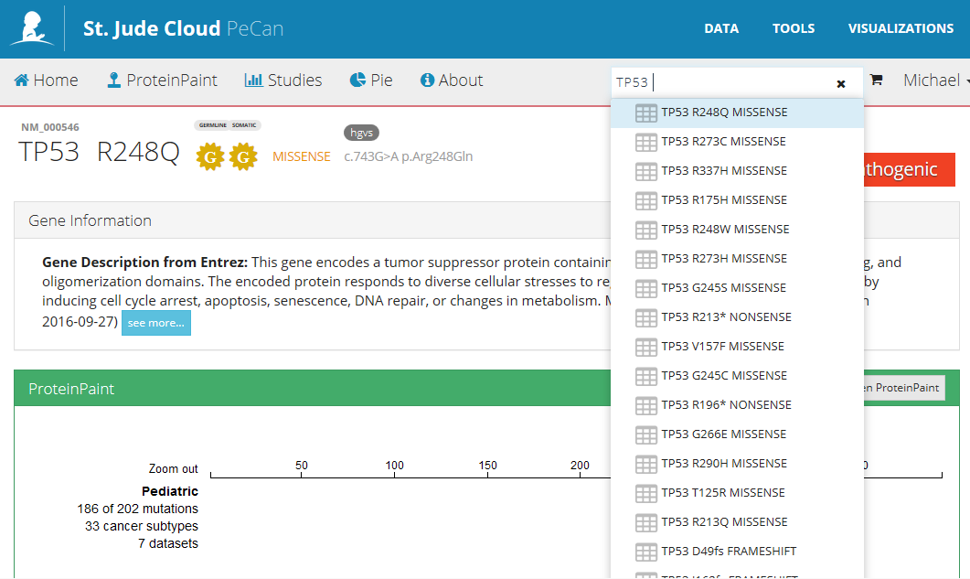
Curated variant reviews
Searchable, indexed by gene and amino acid change
Variant page for each entry

Slide 18
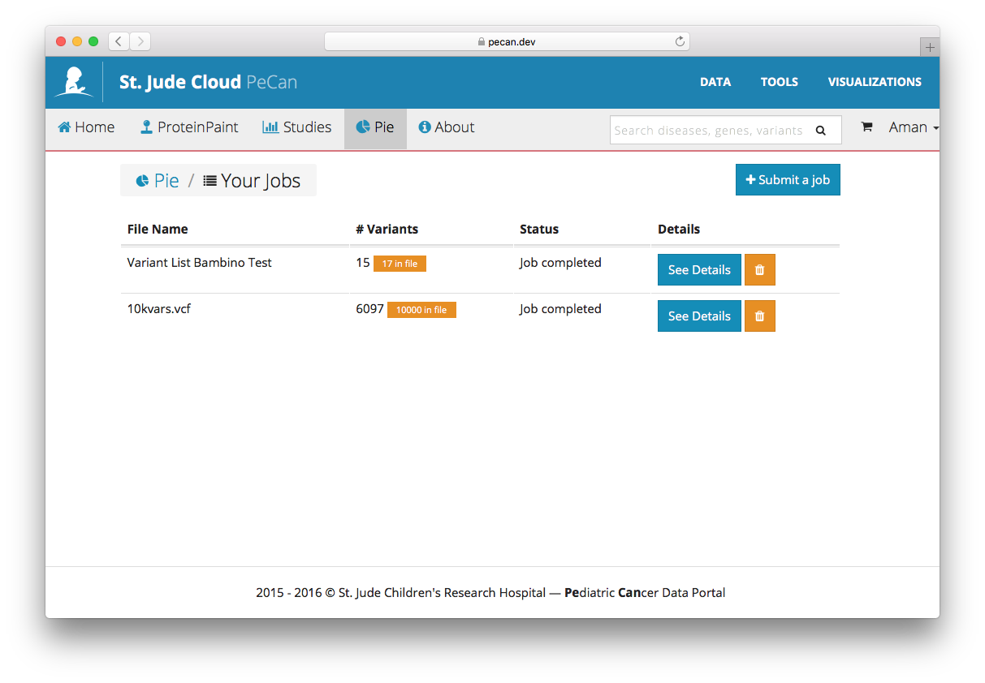
Job queue / history

Slide 19
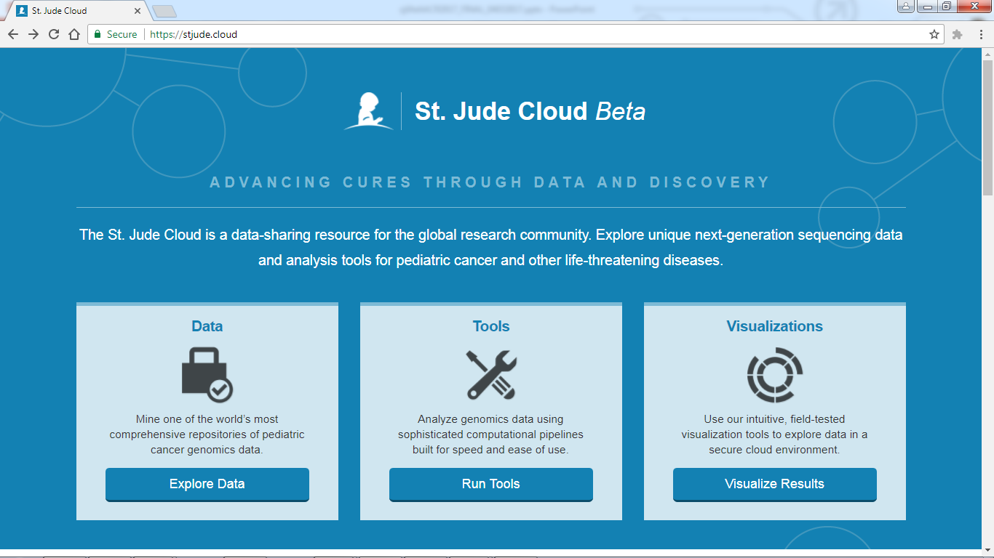
Visit stjude.cloud

Slide 20
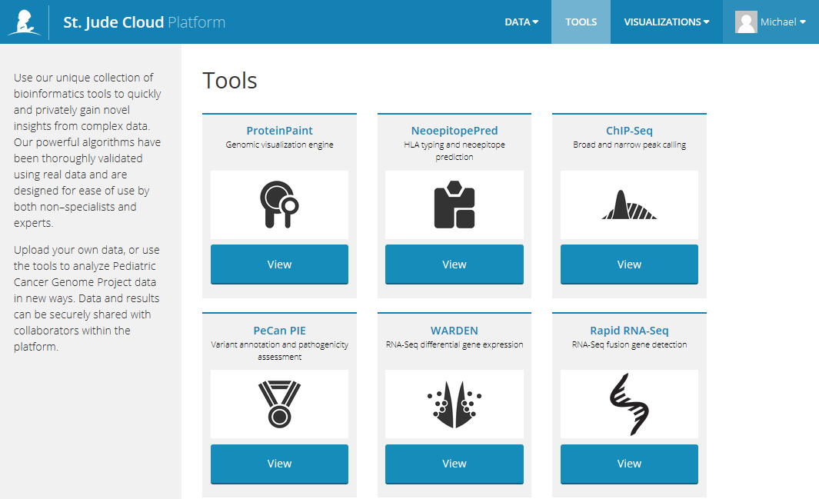
stjude.cloud: Tools

Slide 21
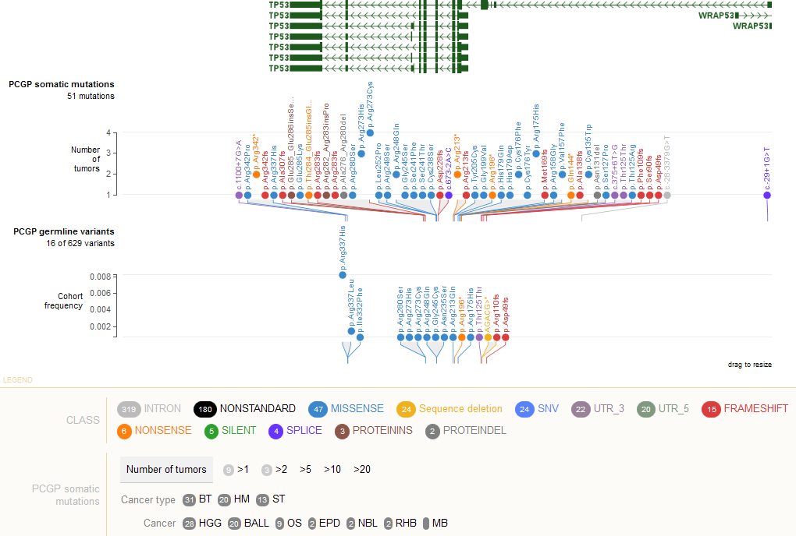
stjude.cloud: Visualizations: PCGP somatic and germline SNV/indel
allele frequency data freely available
Sample-level data and BAM files controlled access
Example view: TP53, filtered to pathogenic variants only

Slide 22
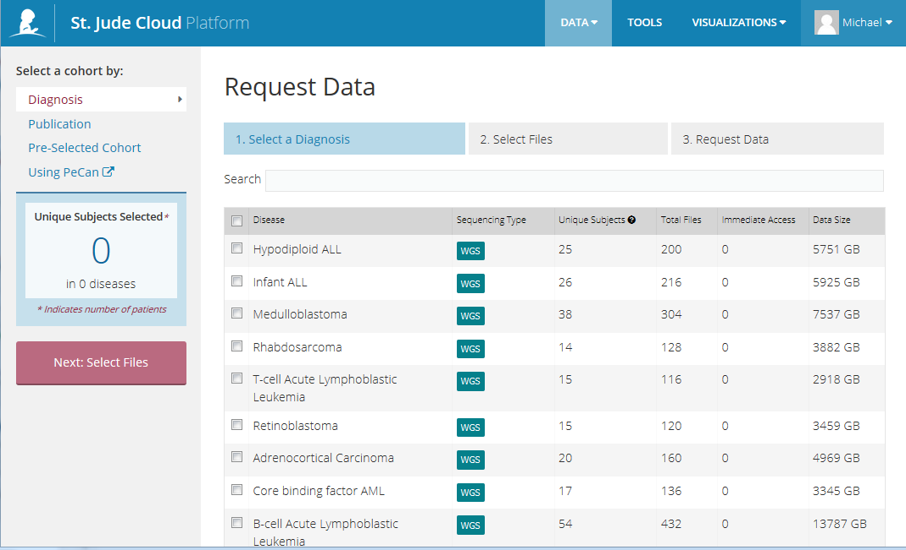
stjude.cloud: data access request

Slide 23
Summary: why PIE?
Efficiently annotate and drill down to classify potentially pathogenic variants
Structured classification process; “show your work”, not a black box
Bespoke:
iteratively developed with researchers, clinical sequencing team and analysts
Not developed in isolation, i.e. “if you build it, they will come”
Research driven: contains project/collaboration results for ~3000 pediatric cancer cases, e.g. St. Jude LIFE, pediatric germline, Genomes for Kids, St. Jude clinical sequencing program
Extensively tested, results published in high-impact journals
Free for non-commercial use
Notes:
We Realize You Have a Choice When It Comes to Variant Classification, and We Thank You For Choosing PeCan-PIE
CADD, REVEL
Pediatric-cancer specific populations
Disease predisposition genes
Data curation (e.g. COSMIC filtering)

Slide 24
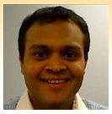
Acknowledgements
Aman Patel
Dale Hedges
Zhaoming Wang
Evadnie Rampersaud
Scott Newman
Xin Zhou
Michael Rusch
Clay McLeod
Mark Wilkinson
Cynthia Pepper
Stephen Rice
Jared Becksfort
Kim Nichols
Gang Wu
Les Robison
James Downing
Jinghui Zhang
wrote the entire UI
Notes:
Scott Newman is here today (poster on 10/18 was “Access, visualize and analyze pediatric genomic data on St. Jude Cloud”)

Slide 26
Extra slides

Slide 27
Somatic SNV/indel Classification
SNV & Indel
NHLBI
1,000 Genomes
Annotation
PCGP
COSMIC
dbNSFP
dbSNP
Gold genes
Silver genes
Gold
Silver
Truncation in tumor suppressor?
Truncation in recurrent/oncogene?
Silver
Silver
Gold
In-frame indel?
Silver
Recurrent mutation in COSMIC/PCGP?
Gold
Silver
Other known mutation?
Silver
Bronze
Other variant
Bronze
Bronze
Gold
Bronze
NHLBI
Bronze
Common variant
Rare variant
Silver

