Slide 1



Utilisation of waste gas from BF stove

Slide 2


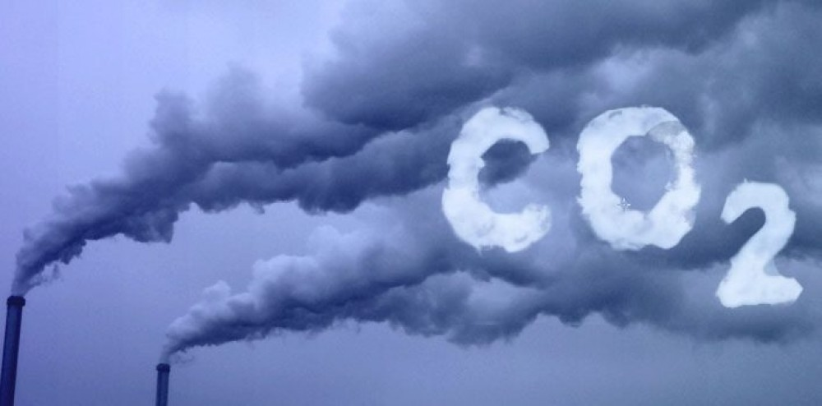

Waste for plant
Poison for environment.
Category- Utilisation of waste gas (CO2+N2) from
blast furnace stoves
Proposal- Reaction of CO2 in waste gas with low
grade aluminium dross to convert into
useful CO and alumina.
Team- Adarsh Raj, Onkar Pushp( BIT Sindri)
Mentor- Dr. Prakash Bansi Abhale(Iron making)

Slide 3

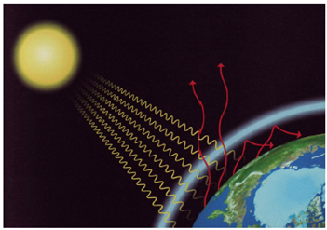
In Ironmaking, BF top gas is burnt in stoves to heat the incoming cold blast and the flue gas containing CO2 and N2 are released to atmosphere through chimney after removal of all the possible heat and dust.
This is leads to production of tons of CO2 daily.
H2
(4%)
Schematic Greenhouse Effect
N2
N2
After burning in O2
About 22%
About 50%
47.3%
52.7%
For TATA STEEL
About 24%
243 million ton CO2 daily
303 million ton N2 daily
Blast furnace gas
Dry Stove Gas

Slide 4
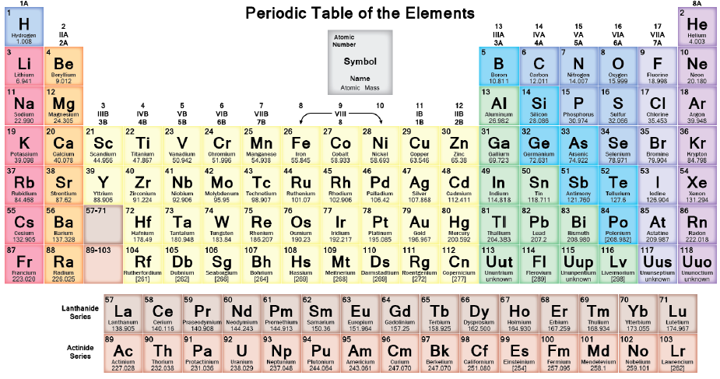
Aim-
Our aim is to utilise this waste gas(CO2+N2).
For utilisation we have to convert them into
usable form using various chemical reactions.
All together nature has provided
118 elements.
But utilisation will be easy if the elements
could be oxidised in CO2 environment.
And metals are the best reducing agents.
But metals with heavy nucleus cannot be used because of low specific energy.
Moreover, the metal used should be cheap and in abundant amount.
This narrows our search to only two metals- Aluminium and Zinc.

Slide 5
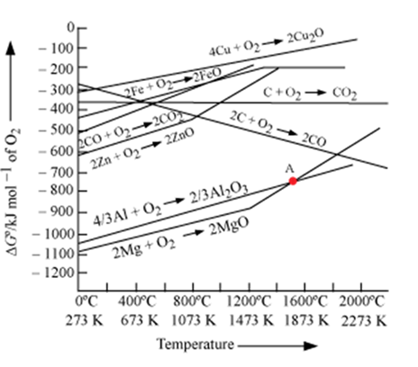
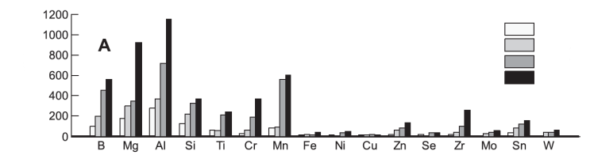
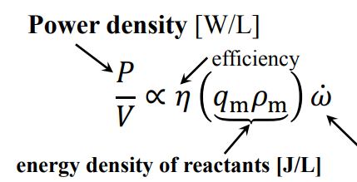
Why aluminium?
Since aluminium is the most abundant metal found on earth’s crust.
Moreover it is a better reducing agent than zinc.
Moreover, its has very high conversion of CO2 into useful CO.
1000⁰ C
900⁰ C
700⁰ C
500⁰ C
Combustion Time( ref: Rossi, Dreizin & law2001)
Environment | Substance | Size(micron) | Time (ms) | %Exp error
Air | Aluminium | 165 | 75 | 9.3
CO2 | Aluminium | 165 | 45 | 11.2
Reaction rate(1/s)

Slide 6
Idea
Aim :
The aim is to use waste CO2 from blast furnace stoves for the production
of Alumina and Carbon Monoxide using cheap aluminium dross.
Comparison with Hall Heroult process:
Hall heroult-
Al₂O₃ + 1.5 C → 2 Al + 1.5 CO₂
Proposed reaction:
Al + 1.5 CO₂ → 0.5 Al₂O₃ + 1.5 C (500C)
Heating above 900C:
Al + 1.5 CO₂
→
0.5 Al₂O₃ + 1.42 CO+ traces of carbon
Our idea is exactly reverse of Hall Heroult Process
Hall Heroult extracts Al from Alumina(found in bauxite)
Our idea converts Al of Aluminium dross into alumina
using waste CO2 gas and gives CO as a byproduct which
is useful for steel industry.

Slide 7
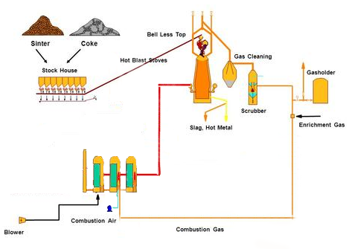
Introduction
1
Current Situation
1. Charge ( Sinter + Coke ) is
fed at the top of the Blast
Furnace
2. Exhaust gas from the top is
cleaned using a system of
Scrubbers, Cyclone
Separators etc.
Then the exhaust gas is burnt
in Regenerative Stoves to
preheat the incoming blast
2
3

Slide 9
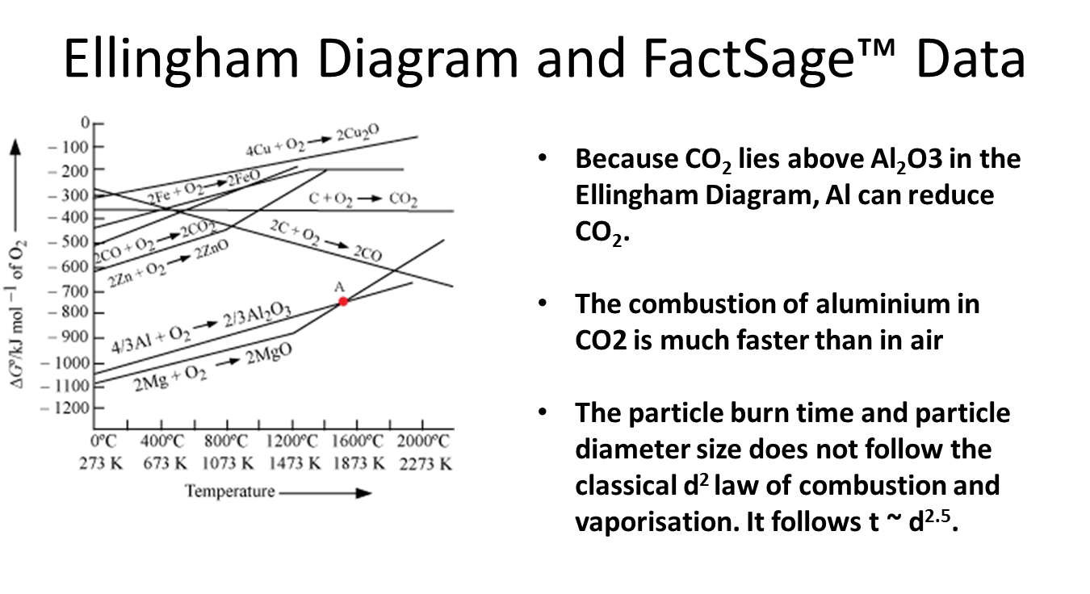

Slide 10
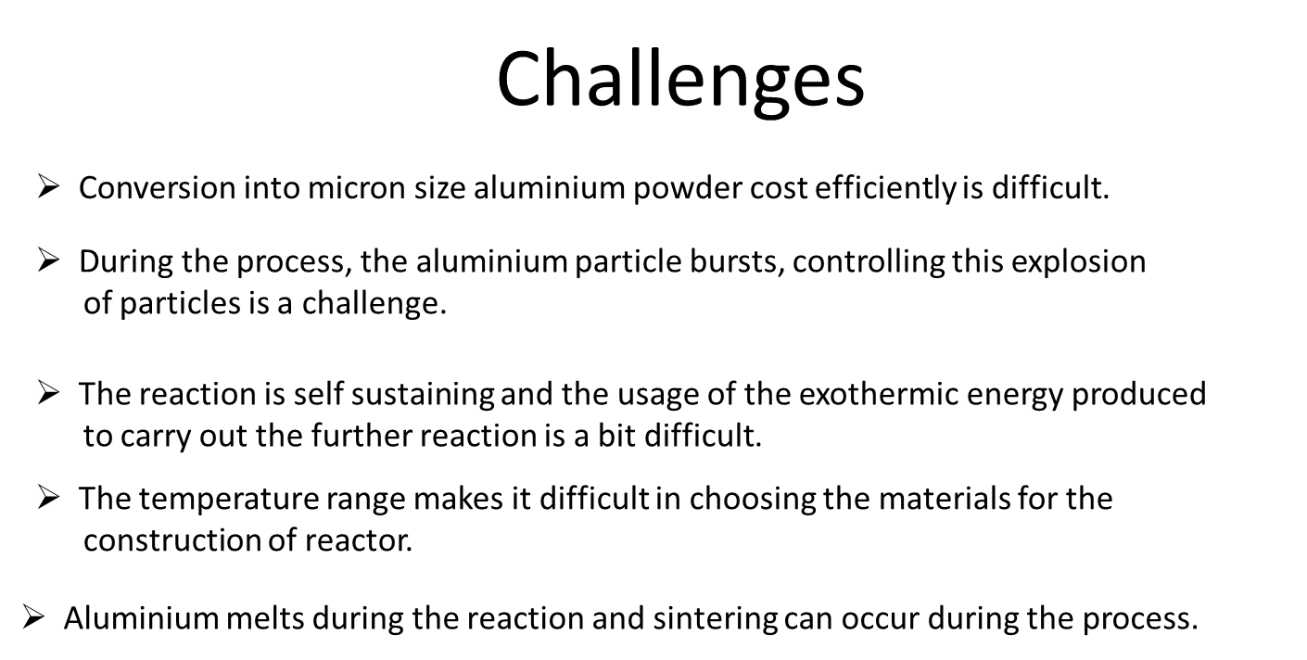

Slide 11
Literature Review
D. S. Sundarama, V. Yanga and V. E. Zarkob,
Y Liu, H Ren, Q J Jiao
Experiment
Oxidation mechanism of micron-sized aluminum particles in Al-CO₂ gradually heating system in a DSC
Ref: IOP Conf. Series: Materials Science and Engineering 248 (2017) 012002
Experiment
Experimental data from several sources were gathered to elucidate the effect of the particle size on the flame temperature of nano-sized aluminum particles.
Ref: Translated from Fizika Goreniya i Vzryva, Vol. 51, No. 2, pp. 37–64
Rossi, Dreizin & Law
Experiment
A micro-arc GEnerator of Monodispersed Metal Droplets (GEMMED) was used to generate uniform droplets of Al metal which is then oxidized to Al₂O₃
Ref: Combust. Sci. and Tech., 2001. Vol. 164. pp. 209-237
Xiaoying Zhu, Mirko Schoenitz, and Edward L. Dreizin (NJIT, 2009)
Experiment
Micron-sized Al particles were subjected to varied heating rates and XRD was used for analysis of the sample.
Ref: J. Phys. Chem. C 2009, 113, 6768–6773
Hong Chun Wu
Experiment
A 20-L apparatus was used to determine 3 dust explosion characteristics: Pmax, (dp/dt)max and MEC .
International Journal of Chemical Engineering
Volume 2010, Article ID 941349, 6 pages
doi:10.1155/2010/941349
Combustion Time( ref: Rossi, Dreizin & law2001)
Environment | Substance | Size(micron) | Time (ms) | %Exp error
Air | Aluminium | 165 | 75 | 9.3
CO2 | Aluminium | 165 | 45 | 11.2

Slide 12
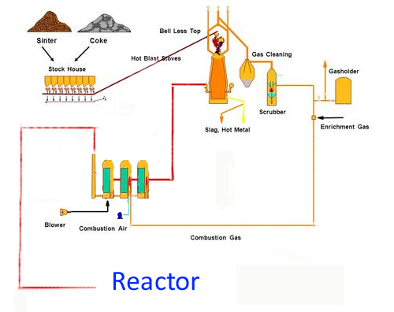
Proposed Process Flow Diagram
1
Current Situation
1. Charge ( Sinter + Coke ) is
fed at the top of the Blast
Furnace
2. Exhaust gas from the top is
cleaned using a system of
Scrubbers, Cyclone
Separators etc.
Then the exhaust gas is burnt
in Regenerative Stoves to
preheat the incoming blast
The exhaust gas from the stoves
is fed to a Reactor
2
3
4

Slide 13
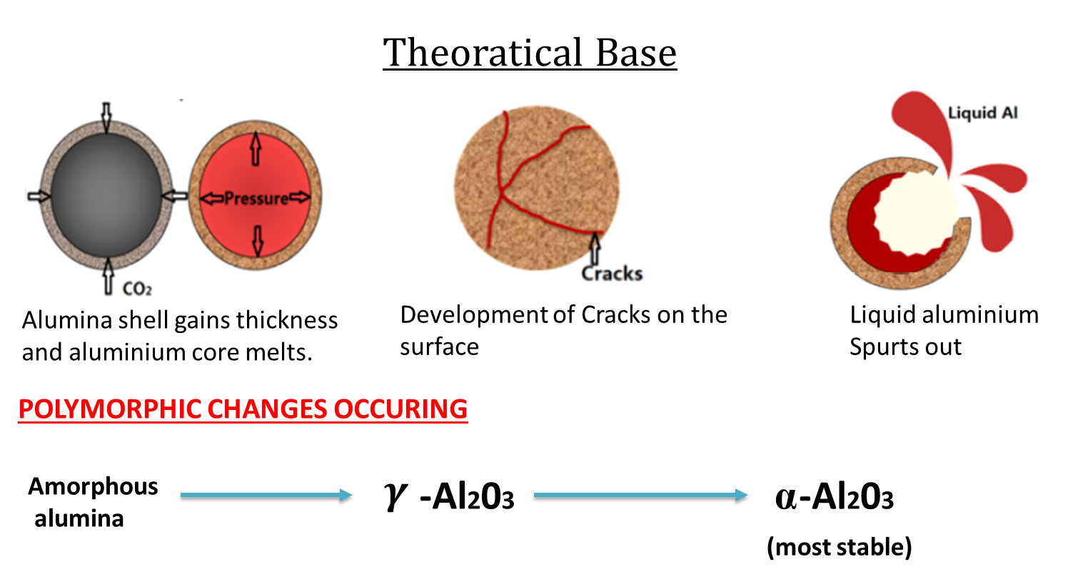

Slide 14
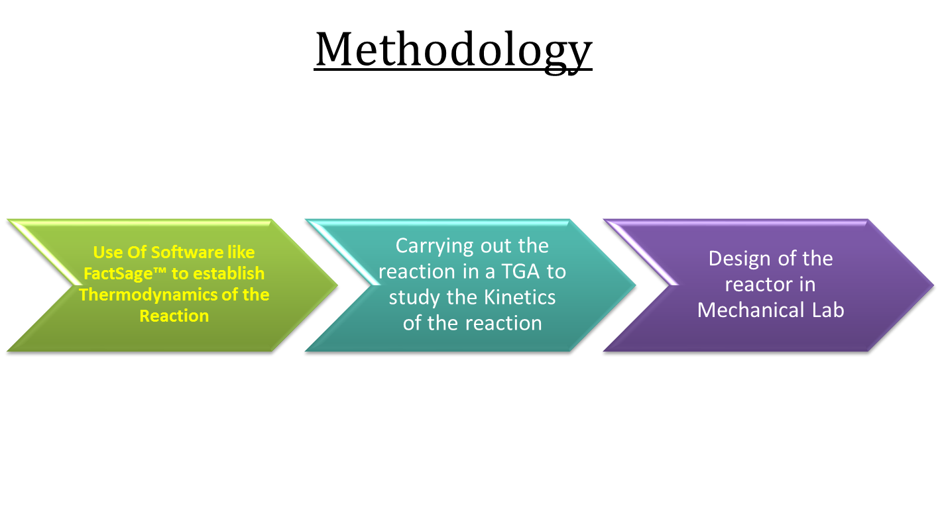

Slide 15
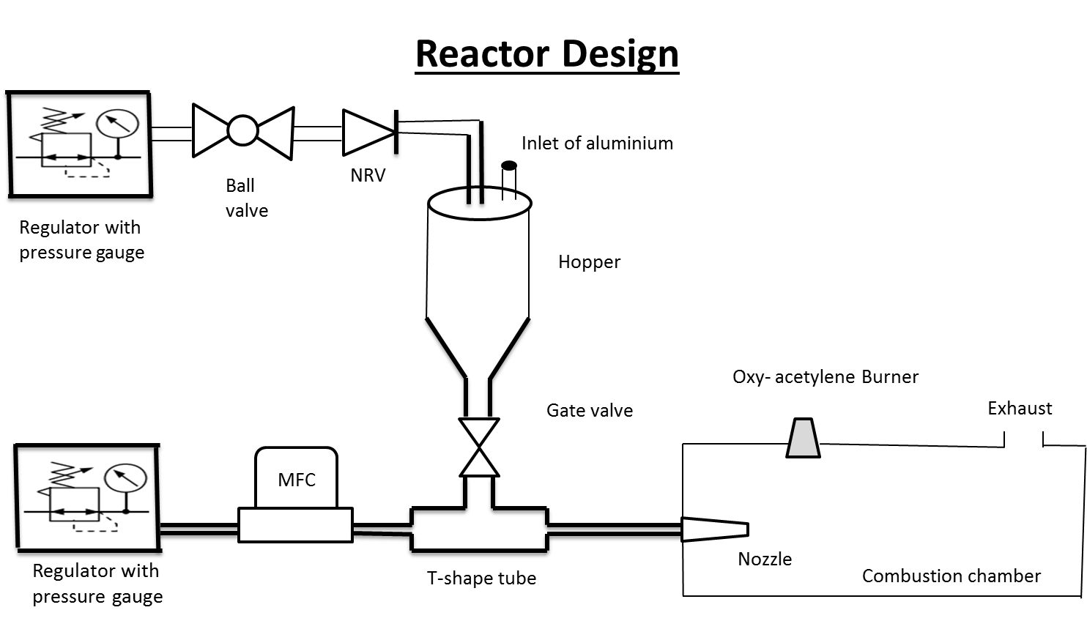

Slide 16
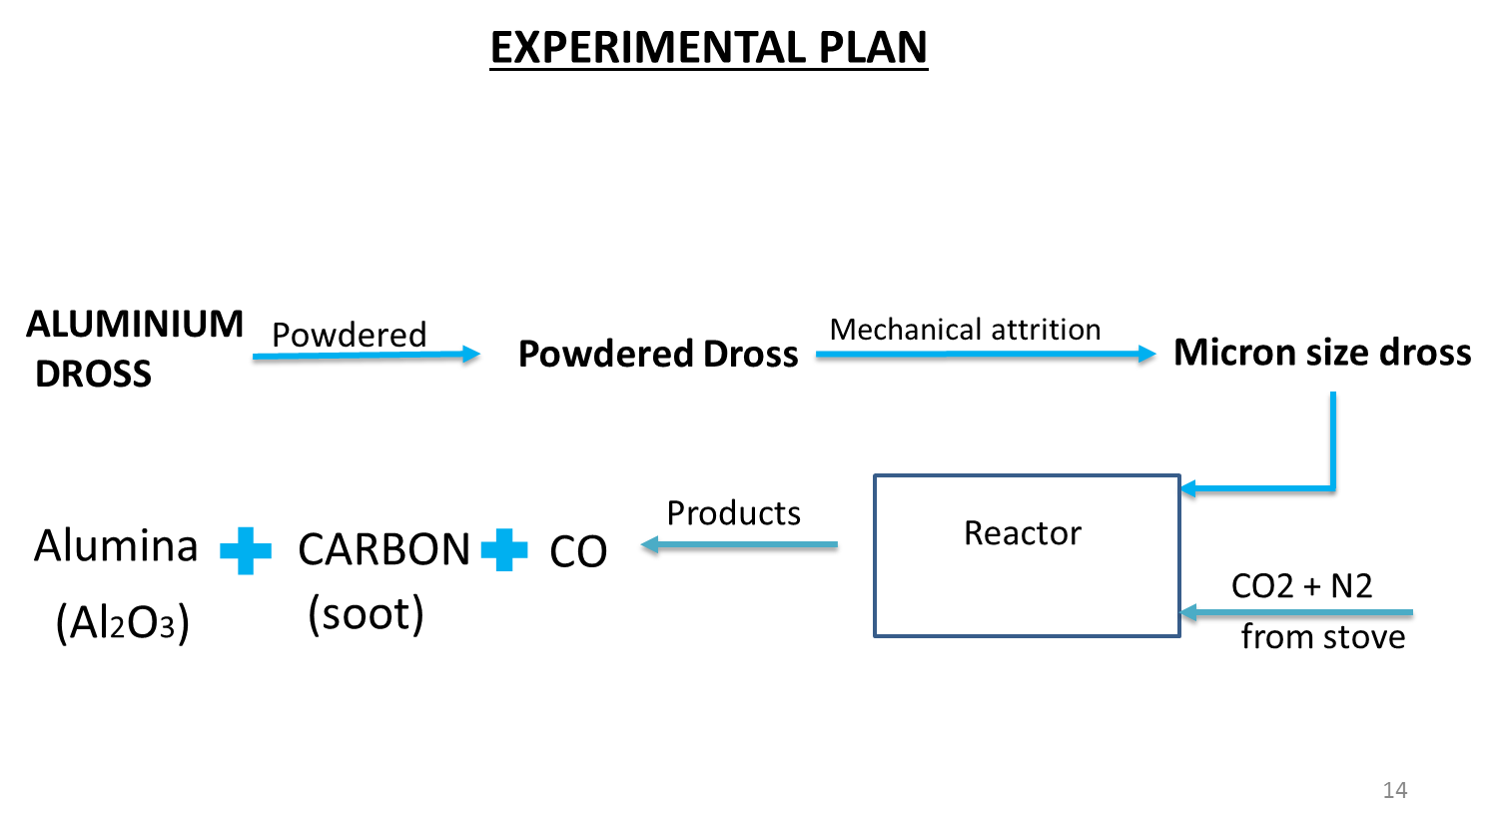

Slide 17
Work Plan
Use FactSage™ to establish Thermodynamics of the process
Conduction of a Crude experiment in Dry Ice
Conducting TGA of samples of Aluminium and it’s dross
SEM of the TGA sample
Flue gas analysis using Blast Furnace Simulator
Reactor Design

Slide 18
Thermodynamic Results
REACTION TEMP( ⁰C) | PRODUCTS ( in moles ) |  |  |  |  |  | ∆H | ∆G | ∆S
 | N₂(gas) | CO₂(gas) | CO(gas) | GRAPHITE(s) | Al₂O₃(s)
500 | 0.78918 | 0.18377 | 2.71 × 10⁻² | 0.73286 | 0.5 |  | -4.89 × 10⁵ | -6.521 × 10⁵ | -6.33 × 10¹
550 | 0.77683 | 0.16525 | 5.79 × 10⁻² | 0.71272 | 0.5 |  | -4.83 × 10⁵ | -6.71 × 10⁵ | -5.15 × 10¹
600 | 0.75693 | 0.1354 | 0.10767 | 0.6788 | 0.5 |  | -4.68 × 10⁵ | -6.91 × 10⁵ | -3.76 × 10¹
650 | 0.73103 | 9.65 ×10⁻² | 0.17243 | 0.63206 | 0.5 |  | -5.54 × 10⁵ | -7.12 × 10⁵ | -2.19 × 10¹
700 | 0.70527 | 5.79 ×10⁻² | 0.23681 | 0.58211 | 0.5 |  | -4.39 × 10⁵ | -7.33 × 10⁵ | -6.41
750 | 0.68645 | 2.96 × 10⁻² | 0.28386 | 0.54324 | 0.5 |  | -4.26 × 10⁵ | -7.56 × 10⁵ | +6.41
800 | 0.67596 | 1.39 × 10⁻² | 0.31 | 0.52063 | 0.5 |  | -4.17 × 10⁵ | -7.78 × 10⁵ | 1.601
850 | 0.67098 | 6.47 × 10⁻³ | 0.32255 | 0.50964 | 0.5 |  | -4.08 × 10⁵ | -8.022 × 10⁵ | 2.34 × 10¹
900 | 0.66873 | 3.09 × 10⁻³ | 0.32817 | 0.50463 | 0.5 |  | -4.01 × 10⁵ | -8.25 × 10⁵ | 2.96 × 10¹
950 | 0.6677 | 1.55 × 10⁻³ | 0.33075 | 0.50232 | 0.5 |  | -3.94 × 10⁵ | -8.49 × 10⁵ | 3.52 × 10¹
1000 | 0.66721 | 8.16 × 10⁻⁴ | 0.33197 | 0.50122 | 0.5 |  | -3.88 × 10⁵ | -8.73 × 10⁵ | 4.04 × 10¹

Slide 19
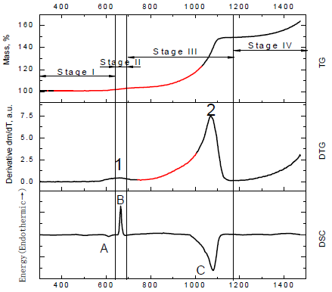
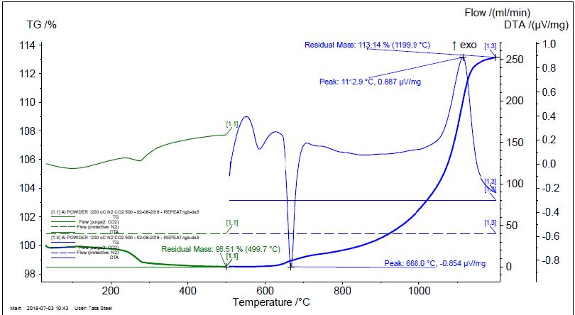
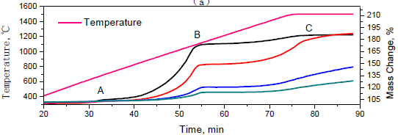
Kinetic Results
The results obtained from TGA are strictly in accordance with theoretical results
The graph rises exponentially from 650 degrees upto 1200 degrees

Slide 20
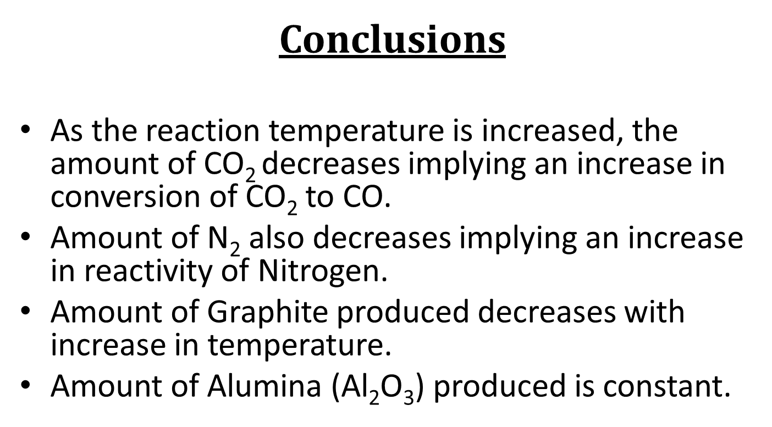

Slide 21
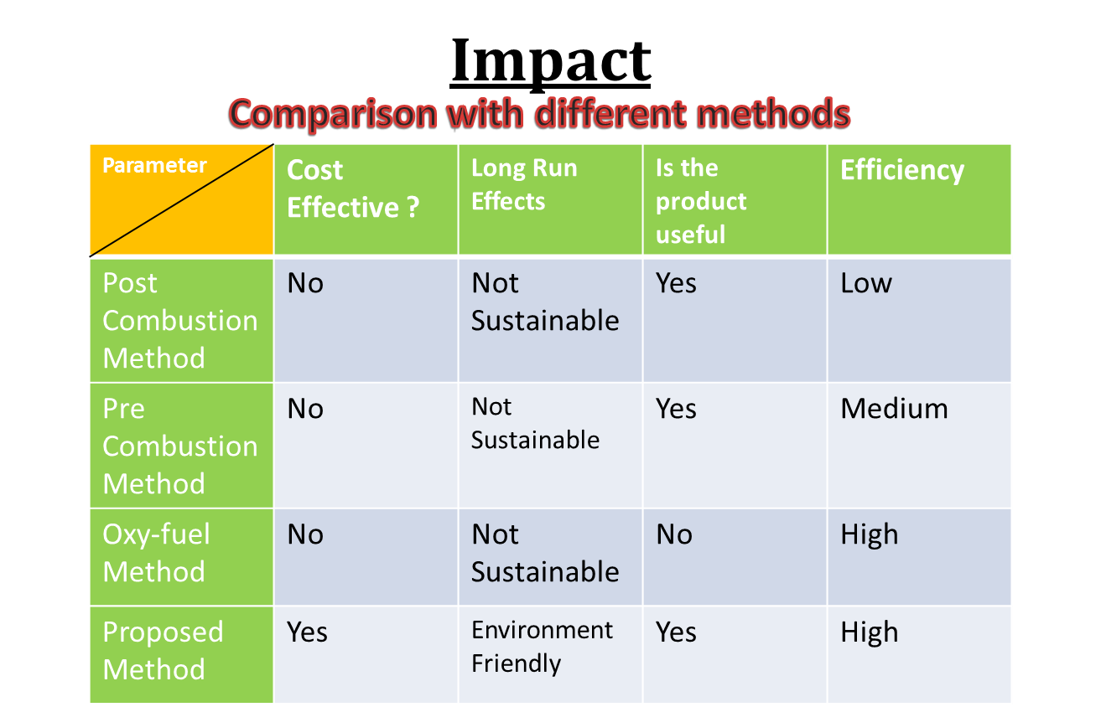

Slide 22
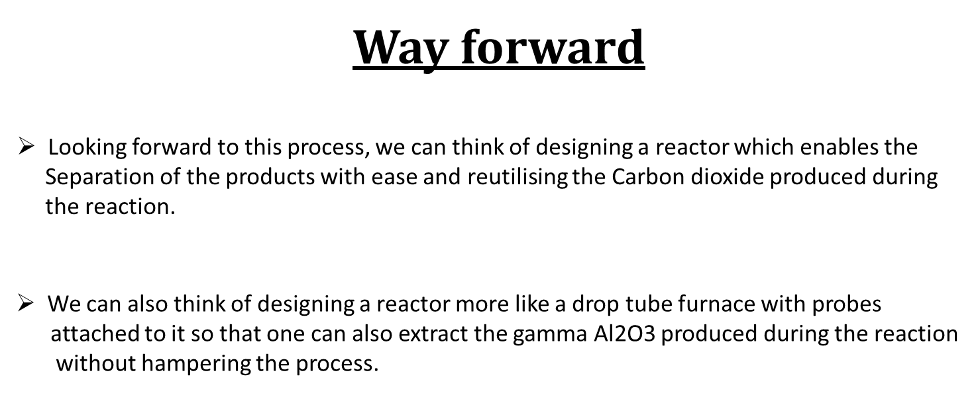

Slide 23
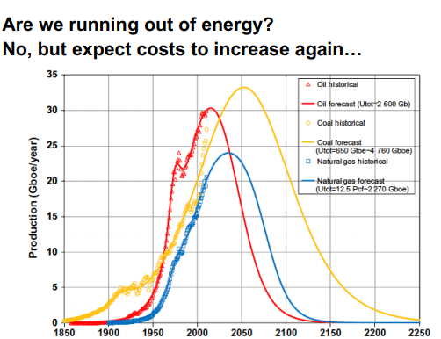
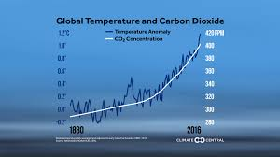
Vision and Benefits of our Idea
The cost of fossil fuels will exponentially rise in future
and thus the iron making process.
The exponential rise in the rate of CO2 is really a threat
In long term. Moreover, due to its high density CO2 will
definitely reside where humanity exists.
Our idea of conversion of CO2 into CO will definitely help in lowering global warming rate because it is not
just limited to steel industries but can be used in any CO2 emitting industry.
The CO produced during this process will help in reducing the amount of coke consumption and thus
it might be helpful in decreasing the cost expenses in long run.

Slide 24
