Slide 1
Feed Forward Neural Network: Handwritten Digit Recognition
Julia, Adam, and Anthony

Slide 2
Our Project
Implement a multi-layered Neural Network to recognize handwritten digits from the MNIST Database of Handwritten Digits
Train the Neural Network with several different parameters to explore the effects of each factor

Slide 3
What we tested
We tested the following factors to see their effect on training:
Learning rate
Different values
Static vs. dynamic
Number of hidden nodes
Number of output nodes
Iterations vs. epochs

Slide 4
Learning rate
Constants:
784 input nodes (1 input node/pixel)
50 hidden nodes (1 hidden layer)
10 output nodes
4 epochs of 30,000 iterations
Variables:
Static learning rates of 0.015, 0.03, 0.07, 0.15
Random learning rate between 0.015 – 0.15
Dynamic learning rate from 0.2 → 0.01

Slide 5
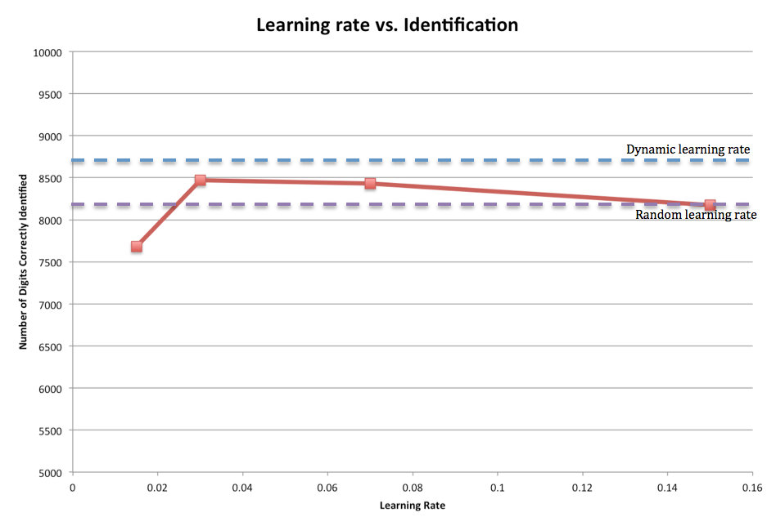

Slide 6
Hidden nodes
Constants:
784 input nodes (1 input node/pixel)
10 output nodes
4 epochs of 30,000 iterations
0.03 learning rate
Variables:
Number of hidden nodes: 15, 30, 50, 80, 100

Slide 8
Output nodes
Constants:
784 input nodes (1 input node/pixel)
50 hidden nodes
4 epochs of 30,000 iterations
0.03 learning rate
Variables:
Number of output nodes: 4 (binary), 10 (decimal)

Slide 9
Issues with 4 output nodes
Binary representation does not allow you to simply take the node with the highest output
Can use threshold to determine which output nodes are considered “triggered”
What is the best way to set the threshold?
Fix attempts
Obtain multiple types of average outputs against target
Compare outputs to each other

Slide 10
How to Test Binary Output?
6 total, all with scaling
Check if correct nodes…
…are above or below the average output
…are above or below the middle output
…are above or below the average output for the specific node minus a constant
…are above or below the average output for the specific node, minus different constants for above or below
…are less than or greater than other nodes, mathematically scaled
… are less than or greater than other nodes, boolean tested

Slide 11
4 Output Node Results
Test
Binary output nodes vs. decimal output nodes
Both 4 epochs of 30,000 iterations
All other variables are the same
Results
Binary output nodes: 7674.1 correct on average (23.259% error)
Decimal output nodes: 8469.8 correct on average (15.302 % error)

Slide 12
Iterations vs. Epochs
Better to train on different images (iterations) or same/similar images (epochs)
Test
50 epochs of 10,000 iterations vs. 1,000 epochs of 500 iterations
Both train on a total of 500,000 images
All other variables are the same
Results
50 epochs, 10,000 iterations: 8962.4 correct on average (10.376% error)
1,000 epochs, 500 iterations: 7410.6 correct on average (12.402% error)
Difficult to draw definite conclusions because of small amount of testing

Slide 13
Conclusions
Best static learning rate around 0.03
Dynamic learning rate worked the best
A larger number of hidden nodes seems to yield better results, but marginally less as the number of hidden nodes increase
Difficulty working with 4 node output made it it hard to compare with 10 node output, however our results and other research tends to agree that 10 node output works better
Cannot make a definite conclusion about iterations vs. epochs

Slide 14
Best Approximation
Constants
784 input nodes
80 hidden nodes
10 output nodes
150 epochs of 10,000 iterations
Dynamic learning rate
Results
Training runtime: 8 hours 25 minutes 37 seconds
9057.9 correct on average (9.421 % error)

Slide 15
Future Investigations
Train on random images rather than iterating through images
Experiment with different dynamic learning formulas (i.e. range, speed of decrease)
Number of hidden layers
Classifying handwritten digits by writer

Slide 16
References
THE MNIST DATABASE. (n.d.). MNIST handwritten digit database, Yann LeCun, Corinna Cortes and Chris Burges. Retrieved May 16, 2014, from http://yann.lecun.com/exdb/mnist/
MNISTReader class written by Gabe Johnson <johnsogg@cmu.edu>

