Slide 1
Team Gliders
ADARSH BALACHANDAR – RA2211026010492
BALAKUMAR RAGURAM – RA2211042010053
YESHWANTH R - RA2211042010017
KIRUTHIKA P - RA2211026010468
SRIKAR SRINIVASAN – RA2211026010509
*VIDEO DEMO at end of ppt

Slide 2
AI-Powered API Monitoring and Anomaly Detection System for Large-Scale Distributed Platforms
APIs are spread across on-prem, cloud, and multi-cloud, making monitoring a nightmare. Errors pop up, response times fluctuate, and predicting failures is tough.
🔹 Logs? Standardized. We use OpenTelemetry + Logstash to collect and unify logs across environments. 🔹 Anomalies? Detected. ML models (Isolation Forest, Prophet) flag performance spikes and predict failures before they happen. 🔹 Alerts? Instant. Kibana dashboards + automated triggers keep teams ahead of issues.
We bring structure to chaos—real-time insights, predictive monitoring, and seamless scaling.

Slide 3
Before we start… How do we standout? Our differentiator
Kafka for Minimal Real-Time Streaming
Why?
Even though we’re sticking with ELK, Kafka will be a failover mechanism for event streaming.
How?
APIs push logs into Kafka topics before sending to ELK.
If ELK fails, Kafka can still temporarily buffer logs.
Logstash pulls logs from Kafka when needed.
Additionally Kafka + ELK is good for storage of vast logs. It helps in reprocessing historical logs as compared to JUST real time ingestion with logstash and Elastic. We have made a demo with Kafka and mongoDB

Slide 4
Prototype Pipeline
🔹Step 1: API Logs & Tracking APIs log response time, errors, and infra details. OpenTelemetry (OTel) grabs logs and sends them to Logstash.
🔹 Step 2: Log Cleanup & Boosting Logstash cleans, formats, and adds extra data (correlation ID, infra details). Logs go to Elasticsearch for fast search & storage.
🔹 Step 3: AI Spots Issues Before They Happen ML models scan Elasticsearch logs for weird patterns & failures. Models we use: ✔️ Isolation Forest → Finds sudden spikes in errors & slowdowns. ✔️ Prophet → Predicts future API failures based on past trends. ML runs as a microservice pulling real-time data.
🔹 Step 4: Live Dashboards & Alerts Kibana shows API health, trends & problem areas. Instant Alerts fire when something goes wrong.

Slide 5
Application Prototype Architecture
[Cross environment API ingestion– Azure, aws, on-prem, etc. with FastAPI] -- > [Kafka Topics]
|
v
[Logstash (ELK)] -----> [Enriched Log Processing]
| |
v v
[Elasticsearch] <---------------- [ML Anomaly Detection]
| |
v v
[Kibana Dashboards and Alerts] ---------------> [Alerting System]
| |
v v
[Ops Dashboard] ---------------> [Slack/Email Alerts]

Slide 6
ML Model
Our ML Model: Smarter API Monitoring
We use a hybrid AI approach to catch issues in real-time and predict failures before they hit production:
🔹 Isolation Forest → Flags sudden spikes in response time & error rates (great for real-time anomaly detection). 🔹 Prophet (Time-Series ML) → Spots long-term trends and predicts future API failures based on patterns.
How It Works: 1️⃣ Logs from Elasticsearch feed into our ML microservice. 2️⃣ Anomalies & predictions are pushed back into Kibana for easy visualization. 3️⃣ Alerts trigger when things go south, helping teams take action fast.

Slide 7
***How we handle varied structure, cross-environment APIs
* Parsing & Normalizing Logs Using Logstash
Why? Each API has different field names and log levels (e.g., AWS logs have requestId, while an On-Prem system might use txn_id).
How? Logstash mutates and renames fields dynamically using its filter plugin.

Slide 8
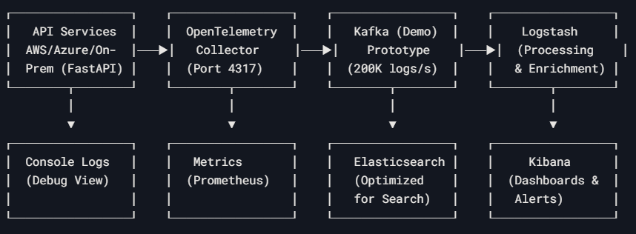

Slide 9
How we plan to scale this into production environment
Taking This to Production
🔹 Built for Scale
Everything runs in microservices, so we can add/remove pieces without breaking stuff.
Docker + Kubernetes → Auto-scales when API traffic spikes.
🔹 Handling Massive Log Volumes
Kafka streams logs fast, no bottlenecks.
Elasticsearch clusters grow as data grows.
Smart log storage → Hot (live), Warm (old but useful), Cold (archive).
🔹 ML
Real-time alerts (Isolation Forest) + trend prediction (Prophet).
ML models retrain automatically so they don’t get outdated.
Can run on GPU servers for speed when needed.
🔹 Reliable & Secure
Role-based access → Only the right people see logs & alerts.
High availability → No single point of failure.
Works on cloud, on-prem, or both (hybrid ready).

Slide 10
VIDEO LINK SHARED AS CANVA DOCUMENT
https://www.canva.com/design/DAGjgflwtV0/VA5Yem-tke5LP_SxoN8IsQ/edit?utm_content=DAGjgflwtV0&utm_campaign=designshare&utm_medium=link2&utm_source=sharebutton
For this demo we have made fastapi+kafka+mongodb prototype in the limited time. Trained a lstm model and checked its validation loss
We intend to use elk, make an alerting system , develop and tune an LSTM model that predicts log anomalies if given time and opportunity.

Slide 11
THANKYOU

