Slide 1

Report Analytics & Dashboard Analytics for Stake-Holders
MENTORS:
Mr.MAHENDRA SINGH
Mr.VITHAL H BYAHATTI
GROUP 5:
GROUP MEMBERS:
Mr. NITHIN K J
MS.SHWETHA . V
MS. SAKSHI. PRASHANT. BARGAJE
MR. TUSHAR RANJAN PANDA
MR.ADITYA MAHENDRA GAWADE
MR. BASAVARAJ
MR.SHAIK RAUF

Slide 2


Report Analytics & Dashboard Analytics for Stake-Holders
01
Opportunity
06
02
05
Lead
04
03

Slide 3
Report Analytics & Dashboard Analytics for Stake-Holders
Opportunity
Expected Amount
Active Opportunities
Conversion Rate
Win Rate
Loss
Trend Analysis
Running Total Expected Vs Commit Forecast Amount over Time
Running Total Active Vs Total Opportunities over Time
Closed Won Vs Total Opportunities over Time
Closed Won vs Total Closed over Time
Expected Amount by Opportunity Type
Opportunities by Industry

Slide 4
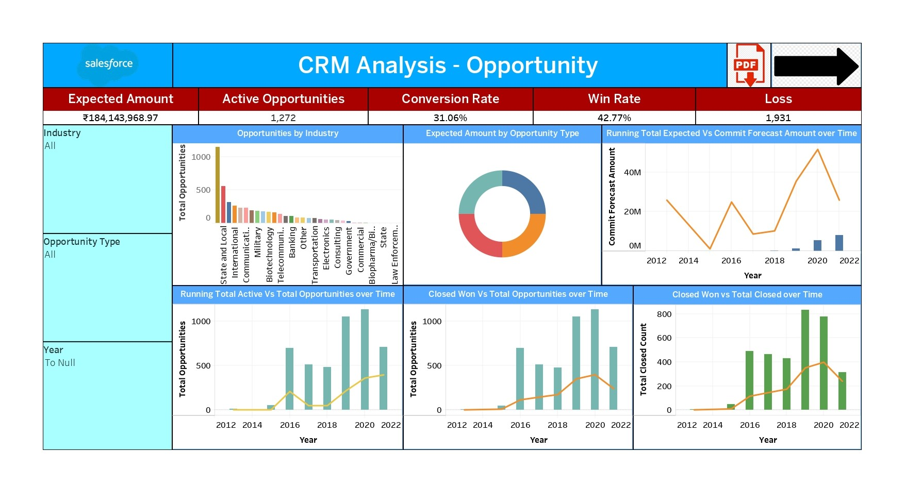

Slide 5
Report Analytics & Dashboard Analytics for Stake-Holders
Lead
Total Lead
Expected Amount from Converted Leads
Conversion Rate
Converted Accounts
Converted Opportunities
Lead By Source
Lead By industry

Slide 6
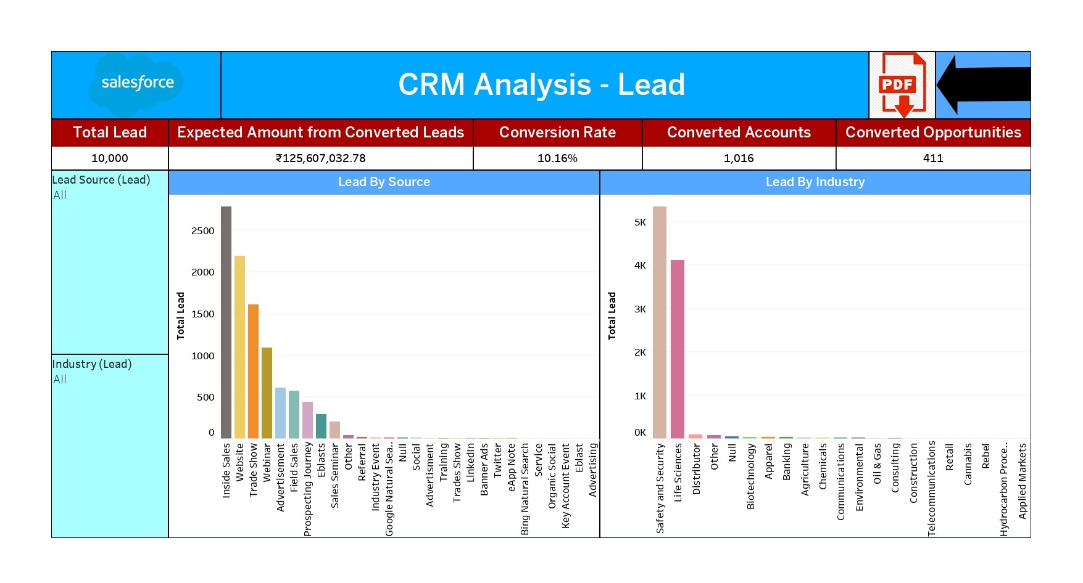

Slide 7
Challenges Faced
Initial Understanding of the Data and Identifying the KPI.
Calculation of conversion Rate.
Selection of suitable chart for the visualization.
The Above Challenges have been overcome with the help of proper guidance from our Mentor Mr. MAHENDRA SINGH and by coordinating within our team.

Slide 8
THANK YOU

