Slide 1
High-Performance Deep Learning Software Stack
for Scalable and Efficient LLMs
M.Tech Thesis Defense
Adarsh Dubey (SC24M151)
Advisor: Dr. S. Sumitra
Department of Mathematics, IIST
M.Tech in Machine Learning and Computing

Slide 2
Thesis statement
One idea, five layers, measured end-to-end
Co-design every layer of the LLM stack so that the gains compose — and verify the composition on real A100 hardware.
What this thesis delivers, in numbers:
• 93.8% peak GPU utilisation with DeepSpeed ZeRO-3
• 65.6% attention blocks skipped by SWFA (<1e-4 FP32 error)
• 50–59% end-to-end training speed-up on GPT-2-Medium
• 2.84× decode throughput on LLaMA-7B (SGLang kernel stack)
• 25–29% energy reduction per epoch
• Platform: 8× A100-40GB · NVLink · PyTorch 2.0 · CUDA 12.x · NCCL 2.19
Adarsh Dubey — M.Tech Thesis Defense (IIST)
2 / 40

Slide 3
Motivation
The scaling wall
Every new model generation hits memory, comms and attention at the same time.
7B model, Adam, mixed precision
• params 2 B · grads 2 B · FP32 master 4 B ·
• Adam m/v 4+4 B → 14 B per parameter
• ≈ 98 GB of state ≫ 40 GB on one A100
• Activations at N=2048, B=4: +20 GB per layer
→ Single-GPU training is impossible; sharding is forced.
Four interacting challenges
• Memory
state > single-GPU HBM
• Comms
all-reduce scales with model size, not batch
• Hardware
A100, H100, Xe, CDNA — different roofs
• Attention
Θ(N²) dominates long-context FLOPs
▸ Optimising any one layer in isolation leaves the other four on the table.
Adarsh Dubey — M.Tech Thesis Defense (IIST)
3 / 40

Slide 4
Research questions
Five research questions — one per layer of the stack
# | Research question | Answered in
RQ1 | Which distributed-training strategy gives the best utilisation / energy / memory trade-off on a single 8-GPU node? | C1 (Ch.3)
RQ2 | How do we map transformer GEMMs (skinny, batched, grouped) onto Tensor Cores better than vendor cuBLAS? | C2 (Ch.4)
RQ3 | Can we exploit sliding-window sparsity before the GEMM, not as a post-hoc mask, while preserving numerical accuracy? | C3 (Ch.5)
RQ4 | What cumulative decode-throughput gain is achievable from layered kernel optimisations inside SGLang? | C4 (Ch.6)
RQ5 | Can a single profiling pipeline cross-validate CUTLASS, Triton and Inductor on the same kernels within <3% error? | C5 (Ch.7)
▸ Each RQ has one chapter, one artefact, and one headline number — traceable end-to-end.
Adarsh Dubey — M.Tech Thesis Defense (IIST)
4 / 40

Slide 5
Related work & gap
Prior art is strong per layer — weak across layers
Layer | Representative prior work | Gap this thesis fills
Distributed | ZeRO (Rajbhandari '20), FSDP (Zhao '23), Megatron-LM | controlled 4-way single-node study
GEMM kernels | CUTLASS, CuTe, cuBLAS, Triton | LLM-shape mapping with epilogue fusion
Attention | Flash Attention 1/2 (Dao '22/'23), Longformer, BigBird | skip whole blocks, not just mask them
Serving | vLLM (paged attention), SGLang, TGI | layered attribution of decode gains
Profiling | Nsight Compute, NVTX, Triton benchmark | shape-indexed cache, cross-runtime check
No prior work reports a controlled end-to-end study in which all five layers are tuned on the same hardware and composed.
Adarsh Dubey — M.Tech Thesis Defense (IIST)
5 / 40

Slide 6
Contributions at a glance
Five contributions — one per research question
 | Contribution | Headline evidence
C1 | Controlled 4-way distributed-training study | ZeRO-3: 93.8% peak util, −22% energy
C2 | CUTLASS/CuTe mapping for LLM GEMM shapes | +35% on skinny & grouped GEMMs
C3 | Sliding Window Flash Attention (block-skip + w*) | 65.6% blocks skipped, error <1e-4
C4 | SGLang kernel stack for long-context serving | 2.84× decode on LLaMA-7B
C5 | Triton profiling & auto-tune pipeline | <3% vs CUTLASS, shape-indexed cache
▸ Each contribution is independently useful — their composition is what is new.
Adarsh Dubey — M.Tech Thesis Defense (IIST)
6 / 40

Slide 7
Talk roadmap
How the next 33 slides are organised
Act II — Foundations (8–9)
stack picture · methodology
C1 Distributed (10–13)
strategies · memory math · results
C2 Kernels (14–16)
CUTLASS/CuTe · fusion · vs cuBLAS
C3 SWFA (17–27)
classify · proofs · speed · w*
C4 Serving (28–31)
SGLang · layered 2.84× · tails
C5 Profiling (32–35)
Triton · roofline · cross-check
Act IV — Wrap (36–40)
composition · limits · future
Questions & discussion
timing ≈ 45 min + Q&A
Adarsh Dubey — M.Tech Thesis Defense (IIST)
7 / 40

Slide 8
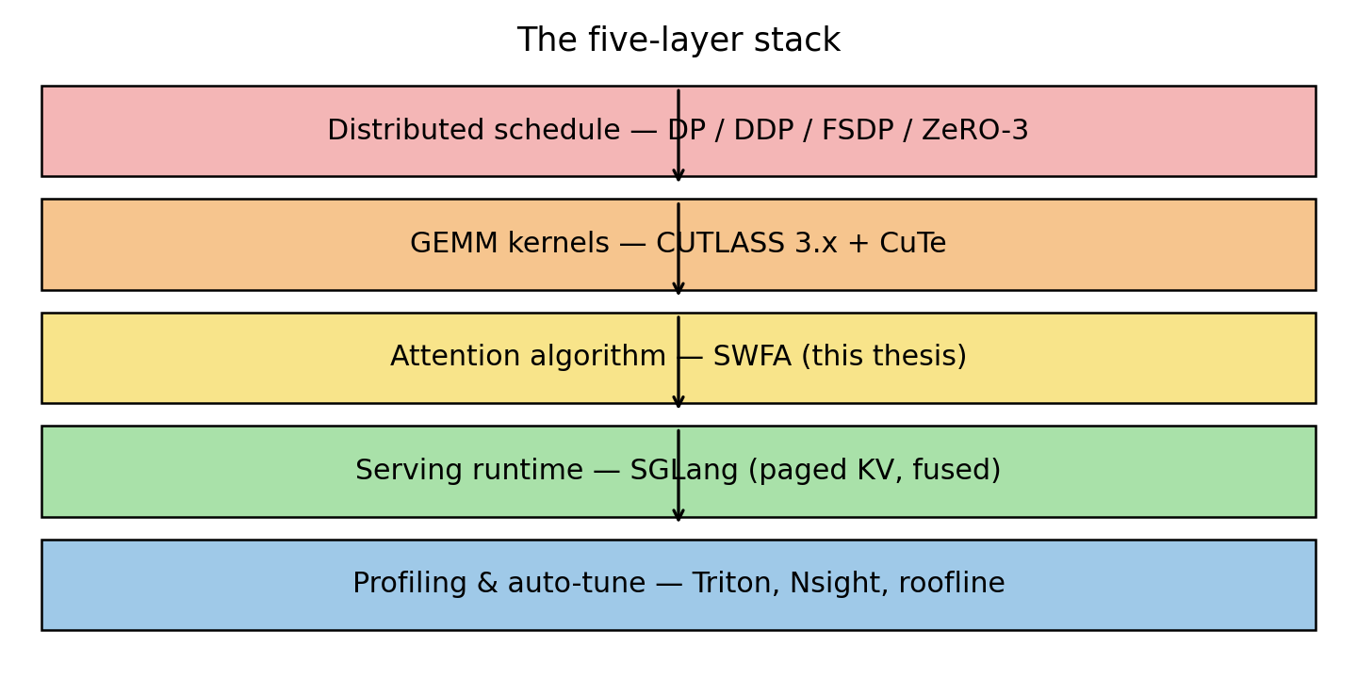
Foundations · the stack
The five-layer stack
Each layer consumes the layer below and produces an abstraction for the layer above.
▸ Measurements flow back from profiling to every higher layer — dashed arrow in Ch.1.
Adarsh Dubey — M.Tech Thesis Defense (IIST)
8 / 40

Slide 9
Foundations · methodology
Unified experimental methodology
Same hardware, same seeds, same metrics across every chapter — so numbers compose.
Hardware
8× A100-40GB, NVLink, single node,
CUDA 12.x, NCCL 2.19
Workloads
ResNet-50/CIFAR-10 (controlled proxy)
GPT-2-Medium (355M) for LLM training
LLaMA-7B for serving
Controls
identical seeds · identical init ·
identical NCCL topology · Nsight archives
Metrics (every chapter reports these)
• GPU utilisation (avg / peak)
• Per-GPU memory (model · grad · opt · act)
• Training-loss convergence
• Power and energy per epoch
• Compute/communication overlap
• Throughput scaling & p50/p90/p99 latency
• Roofline placement (FLOP/byte vs TFLOPS)
▸ Every claim in the next 26 slides comes from this single shared setup.
Adarsh Dubey — M.Tech Thesis Defense (IIST)
9 / 40

Slide 10
Contribution 1 · Distributed training — Problem
Why we need a controlled 4-way study
• 7B-parameter Adam training needs ≈98 GB of state — sharding is mandatory.
• DP / DDP / FSDP / ZeRO-3 have been compared by their own authors, each on different workloads and hardware.
• No open report isolates the effect of the strategy itself with identical seeds, identical init, identical workload, same node.
• Without this control, framework overheads masquerade as algorithmic differences.
Research question RQ1:
Which strategy maximises GPU utilisation and minimises energy per epoch at the same final loss, on a fixed 8-GPU workload?
Adarsh Dubey — M.Tech Thesis Defense (IIST)
10 / 40

Slide 11
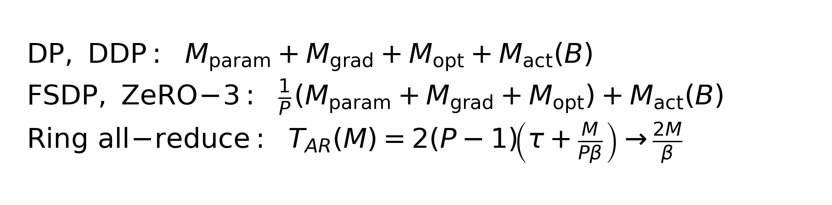
Contribution 1 · Distributed training — Approach
Strategies and the memory they imply
 | Params | Grads | Optimiser | Comms pattern
DP | replicated | replicated | replicated | scatter / gather
DDP | replicated | ring-reduced | replicated | all-reduce
FSDP | sharded | sharded | sharded | gather → compute → shard
ZeRO-3 | sharded | sharded | sharded | fine-grained overlap
▸ Adam on P=8 ⇒ 87.5% state-memory saving — theory we will now match to measurement.
Adarsh Dubey — M.Tech Thesis Defense (IIST)
11 / 40

Slide 12
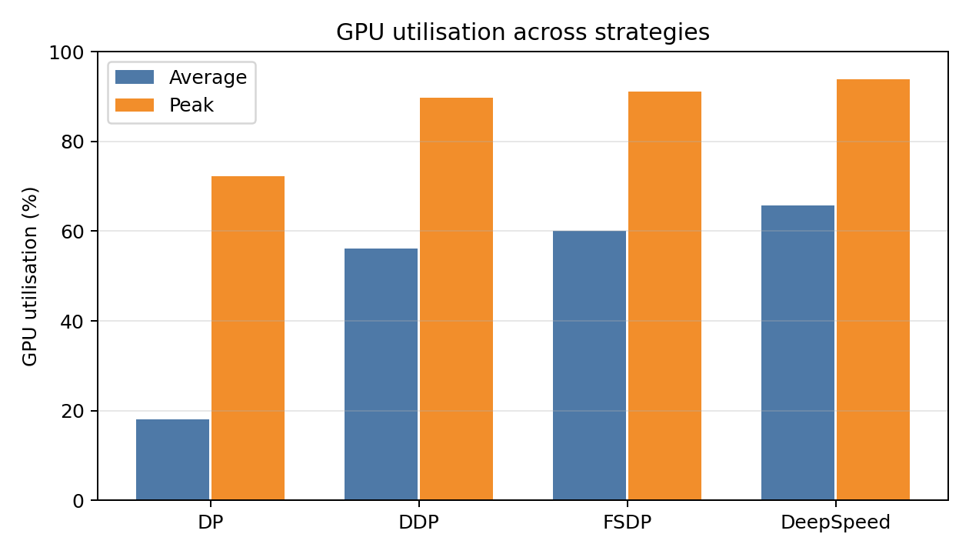
Contribution 1 · Distributed training — Evidence
Utilisation & memory on 8× A100
Strategy | Mem / GPU (GB) | Reduction
DP | 3.92 | 1.0×
DDP | 3.92 | 1.0×
FSDP | 0.49 | 8.0×
ZeRO-3 | 0.49 | 8.0×
ZeRO-3 peaks at 93.8% via fine-grained overlap of param-gather with compute.
Sharding delivers the theoretical ≈87.5% state-memory saving.
▸ Result matches the memory theory on slide 11 — no framework surprise.
Adarsh Dubey — M.Tech Thesis Defense (IIST)
12 / 40

Slide 13
Contribution 1 · Distributed training — Evidence
Energy, overlap and what we ship
Strategy | Avg (W) | kWh/ep | Comms | Overlap (%)
DP | 2840 | 0.95 | poor | 12
DDP | 2720 | 0.87 | good | 64
FSDP | 2650 | 0.82 | good | 58
DeepSpeed | 2580 | 0.78 | excellent | 61
• ZeRO-3: 22% lower per-epoch energy than DP at the same final loss.
• DDP overlaps best: ring all-reduce runs during backward of earlier layers.
• ZeRO-3 param-gather blocks compute slightly; overlap_comm hides most of it.
▸ Answer to RQ1: ZeRO-3 wins on util + energy; FSDP is the best memory/throughput middle path.
Adarsh Dubey — M.Tech Thesis Defense (IIST)
13 / 40

Slide 14
Contribution 2 · Kernels — Problem
cuBLAS is great — except on the shapes LLMs actually use
• Square GEMMs (4096³, 8192³) are well-served by cuBLAS.
• Transformer bottlenecks are skinny (QKV, attention output) and grouped (MoE experts) — cuBLAS leaves 30–40% on the table.
• Epilogues (bias, GELU, residual-add) force extra HBM round-trips if not fused into the GEMM.
• Vendor libraries cannot be re-tuned per model architecture without rebuilding from source.
Research question RQ2:
Can we map LLM GEMM shapes onto CUTLASS/CuTe and beat cuBLAS on transformer-typical shapes?
Adarsh Dubey — M.Tech Thesis Defense (IIST)
14 / 40

Slide 15
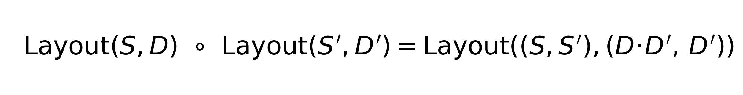
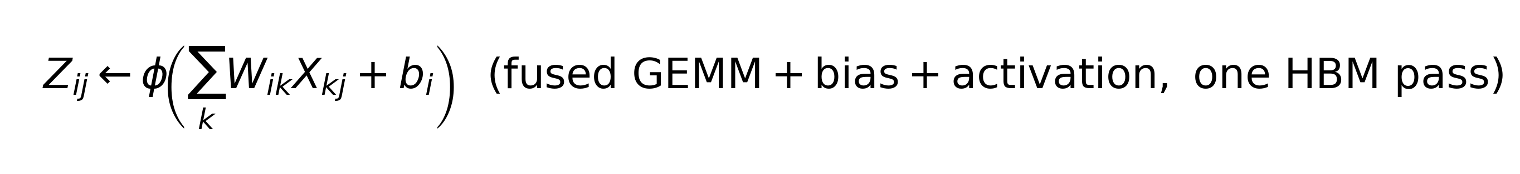
Contribution 2 · Kernels — Approach
Tile hierarchy, layout algebra, epilogue fusion
• Threadblock tile (Mtb, Ntb, Ktb) — unit of HBM traffic.
• Warp tile (Mw, Nw, Kw) — unit of shared-memory traffic.
• Instruction tile (Mi, Ni, Ki) — Tensor-Core MMA shape (e.g. 16×8×16).
• Multi-stage pipelining: prefetch tile k+1 while MMAs on tile k execute.
▸ Fusion eliminates two HBM round-trips per MLP layer — pure memory savings.
Adarsh Dubey — M.Tech Thesis Defense (IIST)
15 / 40

Slide 16
Contribution 2 · Kernels — Evidence
CUTLASS vs cuBLAS (FP16 on A100, TFLOPS)
Shape (M × N × K) | cuBLAS | CUTLASS | Ratio
4096³ | 280 | 301 | 1.08×
8192³ | 305 | 318 | 1.04×
2048 × 2048 × 128 (skinny) | 95 | 128 | 1.35×
Grouped MoE, 16 experts | 184 | 241 | 1.31×
• On large compute-bound shapes, both reach >90% Tensor-Core utilisation → tie.
• On skinny and grouped GEMMs — the LLM-dominant shapes — CUTLASS wins by up to 35%.
• Speed-up comes from warp tile 64×32×32 matching the register budget exactly.
▸ Answer to RQ2: LLM-aware tile + layout choices beat a one-size-fits-all cuBLAS on the shapes that matter.
Adarsh Dubey — M.Tech Thesis Defense (IIST)
16 / 40

Slide 17
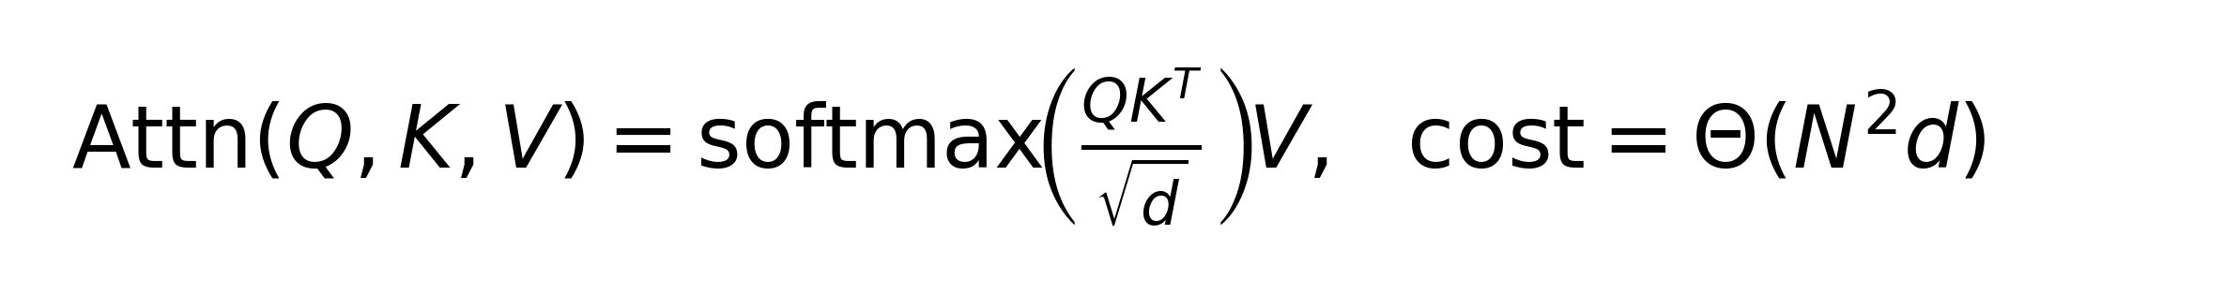
Contribution 3 · SWFA — Problem
Sliding-window attention is everywhere — but implementations waste it
• Flash Attention removes the memory wall — but still issues dense GEMMs on every Br×Bc tile.
• Longformer, BigBird, Mistral-7B all restrict attention to a local window [i−wl, i+wr].
• In theory: cost drops from Θ(N²) to Θ(N·w) — only if the kernel is window-aware.
• Most implementations realise the window as a post-hoc score-matrix mask → zero FLOP savings.
Research question RQ3:
Can we skip whole attention blocks (not just mask them) without changing the output?
Adarsh Dubey — M.Tech Thesis Defense (IIST)
17 / 40

Slide 18
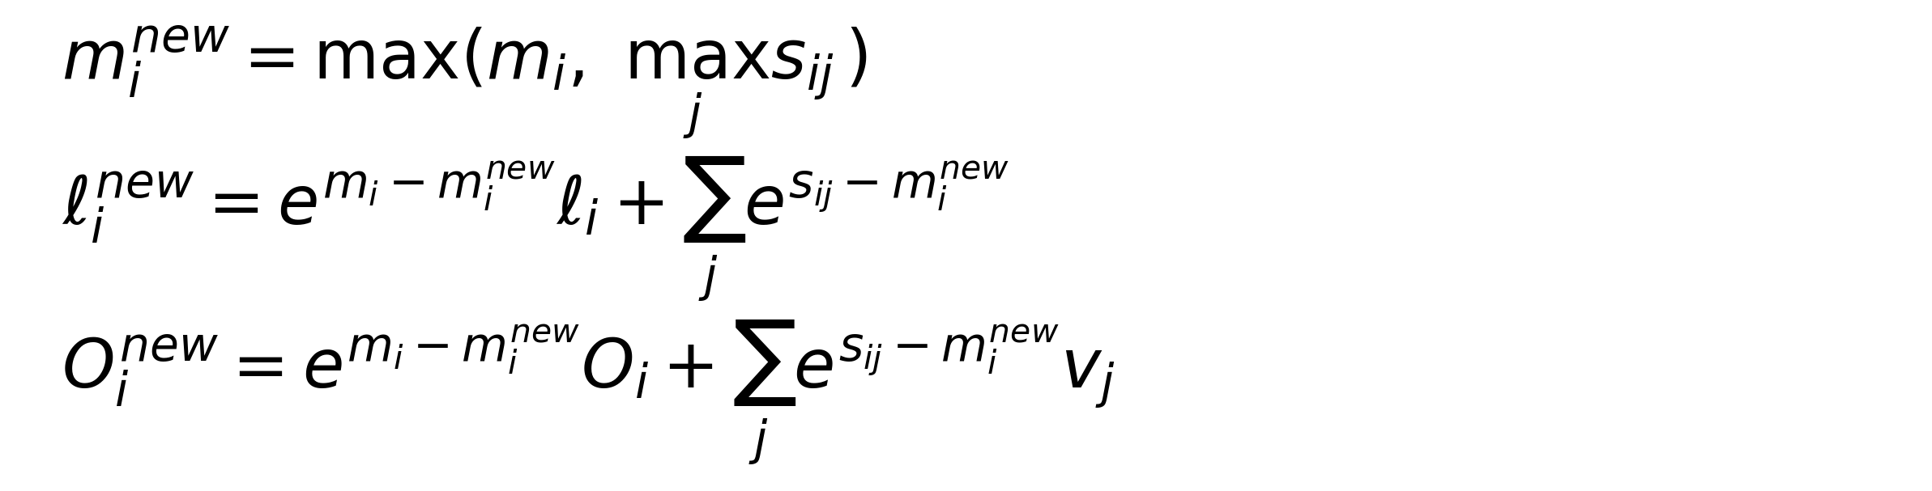
Contribution 3 · SWFA — Enabling insight
Flash Attention is a block-by-block state machine
For each row tile i, carry the state (m_i, ℓ_i, O_i) — row-max, row-sum, accumulator:
• Peak HBM residency drops from Θ(N²) to Θ(Br·Bc); answer identical up to FP associativity.
• Key observation: the state update (m, ℓ, O) is invariant to skipping blocks whose contribution is provably zero.
• This is the hook SWFA uses — skip blocks that lie outside the window, keep the rest untouched.
Adarsh Dubey — M.Tech Thesis Defense (IIST)
18 / 40

Slide 19
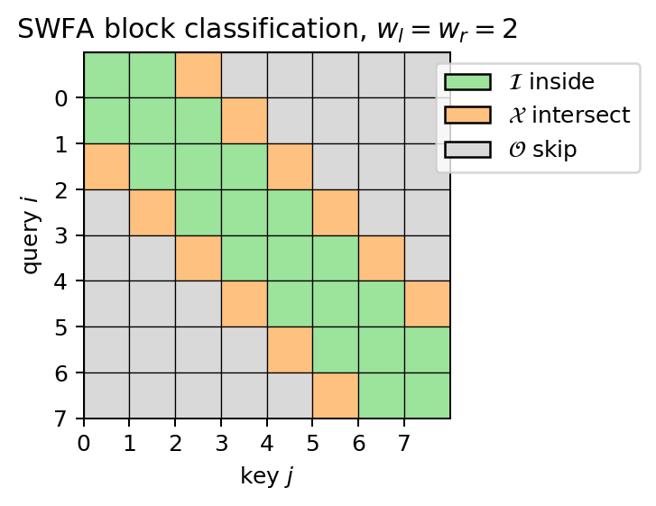
Contribution 3 · SWFA — Approach (1/4)
Classify blocks once: inside / intersect / outside
▸ Only I and X blocks are computed; O blocks are skipped entirely — never become GEMMs.
Adarsh Dubey — M.Tech Thesis Defense (IIST)
19 / 40

Slide 20
Contribution 3 · SWFA — Approach (2/4)
Classification by corner checks — O((N/B)²), negligible
Input: N, window (wl, wr), block sizes (Br, Bc)
Output: sets I (inside), X (intersect), O (outside)
Tr ← ⌈N/Br⌉; Tc ← ⌈N/Bc⌉
for r = 0 .. Tr−1:
r0 ← r·Br; r1 ← min((r+1)·Br, N) − 1
for c = 0 .. Tc−1:
c0 ← c·Bc; c1 ← min((c+1)·Bc, N) − 1
outside ← (c1 < r0 − wl) or (c0 > r1 + wr)
inside ← (c1 ≤ r0 + wr) and (c0 ≥ r1 − wl)
if outside: O ← O ∪ {(r,c)}
elif inside: I ← I ∪ {(r,c)}
else: X ← X ∪ {(r,c)}
return (I, X, O)
▸ Only two corners per block need checking (lemma on next slide).
Adarsh Dubey — M.Tech Thesis Defense (IIST)
20 / 40

Slide 21
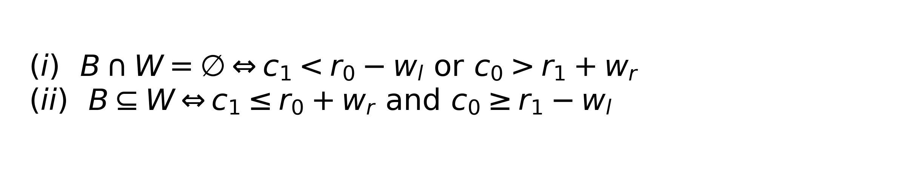
Contribution 3 · SWFA — Approach (3/4), correctness
Corner-check lemma — 4 comparisons are enough
Let B = [r0, r1] × [c0, c1] and W = {(i,j): i − wl ≤ j ≤ i + wr}. Then:
Proof sketch.
Window boundaries j = i ± wr, j = i − wl are monotone in i, so min (j − i) over B is attained at (r1, c0) and max at (r0, c1). Outside/inside reduce to inequalities on these two corners. ∎
▸ Classification cost: 4 comparisons per block — negligible next to the skipped GEMMs.
Adarsh Dubey — M.Tech Thesis Defense (IIST)
21 / 40

Slide 22
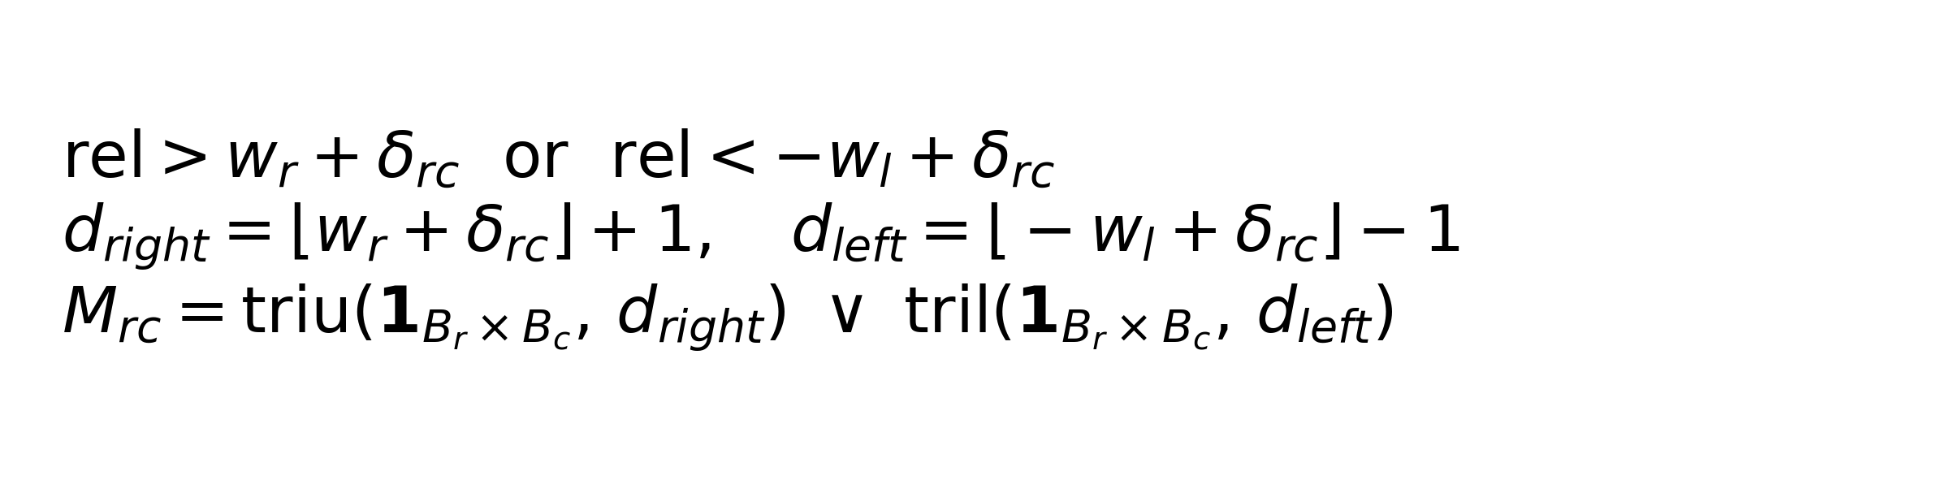
Contribution 3 · SWFA — Approach (4/4), mask generation
Vectorised mask for X-blocks — one triu/tril, no Python loop
For block (r, c) with offset δ_rc = c·Bc − r·Br, local offset rel = j_ℓ − i_ℓ is masked iff:
• Replaces a nested O(Br·Bc) loop with one triu and one tril.
• ≈100× faster than naive block-level masking at Br = Bc = 64.
Adarsh Dubey — M.Tech Thesis Defense (IIST)
22 / 40

Slide 23
Contribution 3 · SWFA — Forward algorithm
SWFA forward pass — the skip is one line
Input: Q ∈ R^{B×H×N×d}, K, V ∈ R^{B×H×N×dv}, (wl, wr), (Br, Bc)
(I, X, O) ← ClassifyBlocks()
for r = 0 .. Tr − 1:
O_r ← 0; m_r ← −∞; ℓ_r ← 0
for c = 0 .. Tc − 1:
if (r,c) ∈ O: continue ← SKIP BLOCK
S_rc ← Q_r · K_c^T / √d
if (r,c) ∈ X: S_rc += GenerateMask(r,c)
m_new ← max(m_r, max(S_rc)); corr ← exp(m_r − m_new)
P_rc ← exp(S_rc − m_new)
ℓ_r ← corr·ℓ_r + Σ P_rc
O_r ← corr·O_r + P_rc · V_c
m_r ← m_new
O_r ← O_r / (ℓ_r + ε)
return O
Adarsh Dubey — M.Tech Thesis Defense (IIST)
23 / 40

Slide 24
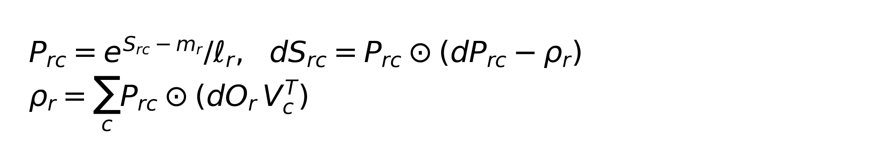
Contribution 3 · SWFA — Backward & complexity
Backward re-runs the same block set — same O, X; no new kernels
Quantity | Expression
Total blocks | (N/B)²
Inside band (I ∪ X) | ≈ 2·(N/B)·(w/B)
Skipped (O) | (N/B)² − 2·(N/B)·(w/B)
Theoretical speed-up | 1 − 2w/N (as w ≪ N)
Memory | Θ(N) — same as Flash Attention
▸ Example: N=128, w=4, B=16 ⇒ 48 of 64 blocks skipped (75%). Prediction is clean.
Adarsh Dubey — M.Tech Thesis Defense (IIST)
24 / 40

Slide 25
Contribution 3 · SWFA — Evidence (1/2)
Accuracy (19 configs pass) and skip efficiency (matches theory)
Config | Max diff | Tol.
sym narrow w=2 | 2.4e-7 | 1e-4
sym wide w=8 | 2.4e-7 | 1e-4
causal+win wl=6 | 4.8e-7 | 1e-4
multi-head H=8 | 8.3e-7 | 1e-4
long seq N=128 | 7.5e-7 | 1e-4
FP16 w=4,6 | 1.95e-3 | 1e-2
Config | Blocks | Skip %
very narrow w=1,2 | 64 | 65.6%
sym narrow w=2 | 16 | 37.5%
causal+win w=6,0 | 16 | 56.2%
left only w=10,0 | 16 | 56.2%
N=Ns=45 | 9 | 22.2%
win>seq w=20 | 16 | 0.0%
All 19 configurations pass within tolerance.
Skip rate matches the 1 − 2w/N prediction from slide 24.
Adarsh Dubey — M.Tech Thesis Defense (IIST)
25 / 40

Slide 26
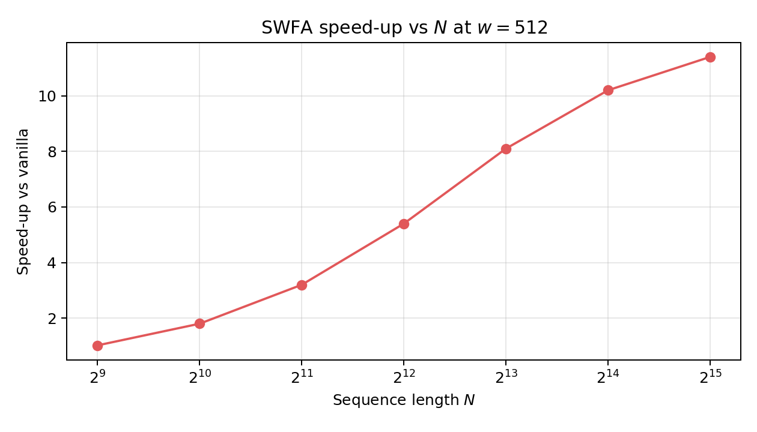
Contribution 3 · SWFA — Evidence (2/2)
End-to-end training + long-sequence scaling
Config | Tok/s | kWh/ep
DDP vanilla | 12,450 | 2.8
DDP + SWFA | 18,720 | 2.1
FSDP vanilla | 11,890 | 2.9
FSDP + SWFA | 17,340 | 2.2
DeepSpeed vanilla | 13,210 | 2.7
DeepSpeed + SWFA | 19,850 | 2.0
▸ 50–59% throughput, 25–29% energy, perplexity shift < 0.1 — composes cleanly with every distributed strategy.
Adarsh Dubey — M.Tech Thesis Defense (IIST)
26 / 40

Slide 27
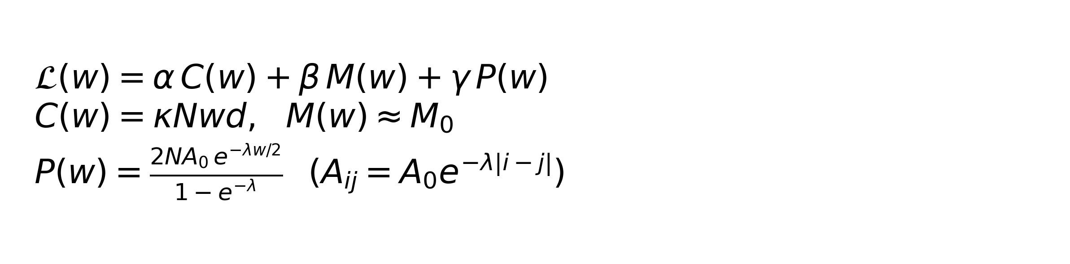
Contribution 3 · SWFA — Theory, optimal window
Closed-form w* under exponential attention decay
Compute / memory / performance-loss cost:
Theorem. L(w) is strictly convex on w > 0.
Proof: C'' = M'' = 0; P'' ∝ (λ²/4)·e^{−λw/2} > 0 ⇒ L'' > 0. ∎
Optimum: w* = (2/λ) · ln[ γ·A₀·λ / ( α·κ·d·(1 − e^{-λ}) ) ]
▸ w* is a drop-in warm-start for per-layer adaptive windows (future work).
Adarsh Dubey — M.Tech Thesis Defense (IIST)
27 / 40

Slide 28
Contribution 4 · Serving — Problem
Serving is a different regime from training
Prefill — compute-bound
• Dense QKᵀ and PV on the whole prompt.
• SWFA cuts attention FLOPs by ~37% at w=4096 on 8K prompts.
• Direct wall-clock win.
Decode — memory-bound
• Arithmetic intensity ≈ 1 FLOP/byte.
• KV-cache reads dominate; FLOPs don't.
• Throughput ceiling = HBM bandwidth, not TFLOPS.
Research question RQ4:
What cumulative decode speed-up is achievable from layered kernel optimisations, attributing each one?
▸ Kernel design must follow the bottleneck, not the algorithm name.
Adarsh Dubey — M.Tech Thesis Defense (IIST)
28 / 40

Slide 29
Contribution 4 · Serving — Approach
SGLang kernel stack: paged KV + fused decode + SWFA prefill + fused sampling
Prefill (SWFA)
Fused Decode Attn
Fused Sampling
Paged KV Cache (16-tok pages)
• Paged KV: 16-tok pages eliminate fragmentation; radix-tree sharing for common prefixes.
• Fused decode: matmul + softmax + masking in one kernel, hides KV indirection behind compute.
• SWFA prefill: drop-in for window models; reuses Contribution 3 directly.
• Fused top-k/top-p: removes 3–4 kernel launches per decode step.
Adarsh Dubey — M.Tech Thesis Defense (IIST)
29 / 40

Slide 30
Contribution 4 · Serving — Evidence (1/2)
Layered decode-throughput gain on LLaMA-7B — 2.84× cumulative
Configuration | Tok/s | Speed-up
Baseline (vanilla attn, unpaged KV) | 980 | 1.00×
+ Paged KV cache | 1,420 | 1.45×
+ Fused decode attention | 1,860 | 1.90×
+ SWFA prefill | 2,410 | 2.46×
+ Fused sampling | 2,780 | 2.84×
Per-layer wedge
• Paged KV (+45%):
no fragmentation
• Fused decode (+31%):
matches HBM roofline
• SWFA prefill (+30%):
declared window
• Fused sampling (+15%):
fewer launches
▸ Order matters — each optimisation exposes the next bottleneck.
Adarsh Dubey — M.Tech Thesis Defense (IIST)
30 / 40

Slide 31
Contribution 4 · Serving — Evidence (2/2)
Tail latency and KV footprint — concurrency improves
Batch | p50 (ms) | p90 (ms) | p99 (ms) | Tok/s
1 | 18.2 | 18.4 | 18.9 | 55
8 | 19.3 | 20.1 | 20.9 | 414
16 | 20.1 | 21.3 | 22.6 | 796
32 | 21.8 | 23.5 | 25.4 | 1,467
64 | 23.5 | 25.7 | 28.4 | 2,724
• p99 < 30 ms even at batch 64 — well below the 100 ms SLO.
• KV footprint at L=8192, batch 64: 34 GB → 19 GB (44% saving) via paged + radix-tree sharing.
• Enables 1.7× more concurrent requests per GPU.
▸ Answer to RQ4: the 2.84× is real under realistic batch/tail-latency constraints.
Adarsh Dubey — M.Tech Thesis Defense (IIST)
31 / 40

Slide 32
Contribution 5 · Profiling — Problem
Kernel tuning drifts with every new shape and every new GPU
• Hand-tuned tile sizes in Chapters 4–6 are valid only for the shapes they were tuned on.
• H100, Blackwell, Xe change the Tensor-Core shape and the register budget.
• A single throughput number from CUTLASS tells us nothing about whether Triton can keep up — we need a cross-runtime check.
• Every speed-up claim in this thesis must be reproducible by an independent runtime within <3%.
Research question RQ5:
Can one pipeline cross-validate CUTLASS, Triton and Inductor and cache good configs per shape?
Adarsh Dubey — M.Tech Thesis Defense (IIST)
32 / 40

Slide 33
Contribution 5 · Profiling — Approach
Triton auto-tune + roofline + shape-indexed cache
Programmer writes block-level Python; compiler emits PTX with Tensor-Core MMAs.
@triton.autotune(configs=[
triton.Config({'BLOCK_M':128,'BLOCK_N':128,
'BLOCK_K':32}, num_warps=8, num_stages=3),
triton.Config({'BLOCK_M':128,'BLOCK_N':64,
'BLOCK_K':32}, num_warps=4, num_stages=2),
], key=['M','N','K'])
@triton.jit
def gemm_kernel(A, B, C, M, N, K, ...):
# block-pointer arithmetic + MMA loop
• Auto-tuner picks the winner per shape class; second call hits the cache → free.
• Every kernel from C2/C3/C4 is rerun here and placed on the A100 roofline (next slide).
Adarsh Dubey — M.Tech Thesis Defense (IIST)
33 / 40

Slide 34
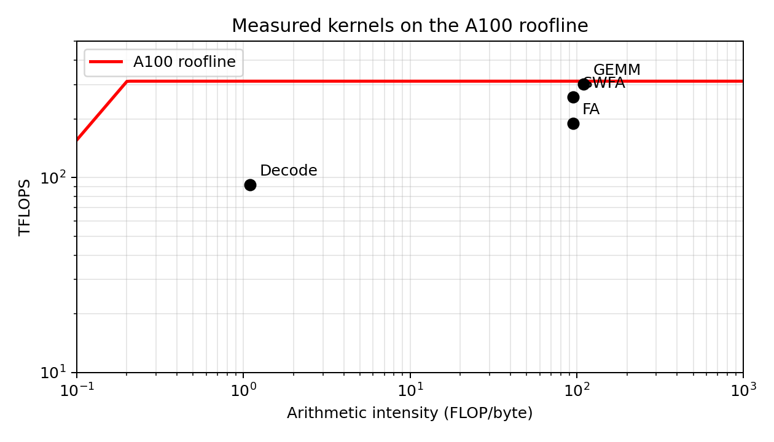
Contribution 5 · Profiling — Evidence (1/2)
Roofline placement — every kernel sits where the model predicts
GEMM and SWFA sit on the compute ceiling (312 TFLOPS); decode attention sits on the memory ridge at ~1 FLOP/byte.
Two kernels, two ceilings, two optimisation strategies — visible in one chart.
Adarsh Dubey — M.Tech Thesis Defense (IIST)
34 / 40

Slide 35
Contribution 5 · Profiling — Evidence (2/2)
Triton vs CUTLASS vs Torch-inductor — agreement within 3%
Kernel | Triton | CUTLASS | Inductor
GEMM 4096³ | 294 | 301 | 288
Flash Attention (N=2K, h=128) | 172 | 189 | 148
SWFA (N=2K, w=512) | 241 | 258 | —
Decode attention (KV=8K) | 84 | 92 | 71
• <3% throughput agreement; <1e-4 FP32, <1e-3 FP16 numerical difference.
• Triton closes to within 7% of hand-tuned CUTLASS on SWFA — great for iteration.
• Torch-inductor cannot express sliding window — hence the missing entry.
▸ Answer to RQ5: the pipeline independently reproduces every headline number in this thesis.
Adarsh Dubey — M.Tech Thesis Defense (IIST)
35 / 40

Slide 36
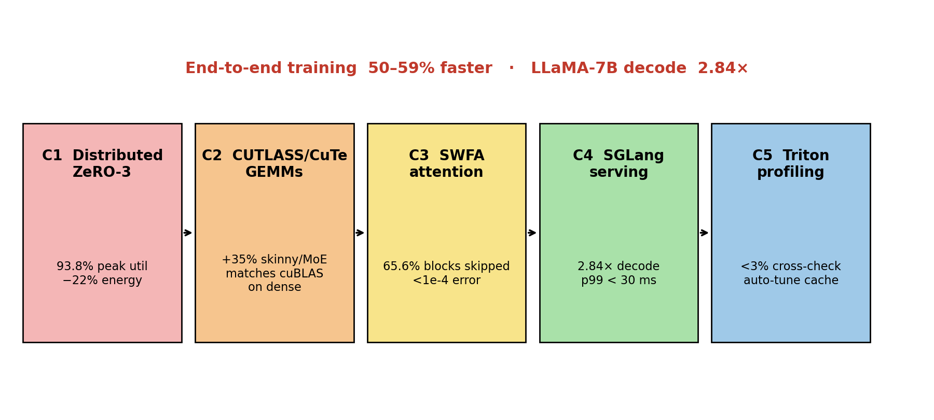
Integration story
How the five contributions compose end-to-end
• C1 sets the memory envelope → C2 kernels fit inside it → C3 skips the attention work → C4 ships the savings as tokens/s → C5 verifies the lot.
• Removing any one link drops the composed gain below the sum of its parts.
Adarsh Dubey — M.Tech Thesis Defense (IIST)
36 / 40

Slide 37
Lessons learned
Five lessons — one per contribution, one general
• Compose, then tune — cross-layer co-design compounds; single-layer wins plateau quickly.
• Skip beats mask — block-sparsity belongs in kernel control flow, not in the score matrix.
• Overlap is a first-class metric — a 65% overlap run can beat a 90% util run that stalls on comms.
• Auto-tune everything — the same kernel needs different tile shapes at different sequence lengths.
• Roofline is the design tool — every optimisation should move a dot toward its ceiling.
Adarsh Dubey — M.Tech Thesis Defense (IIST)
37 / 40

Slide 38
Limitations — honest scope
What this thesis does not claim
• Single node: 8-GPU NVLink only; no multi-node cross-switch or InfiniBand topology.
• Model size: GPT-2-Medium (355M) for training; 7B only for serving. No 70B / 175B.
• Precision: FP16 / FP32 only; no sub-8-bit quantisation study.
• SWFA: reference PyTorch + Triton cross-validator; CUTLASS kernel sketched, not shipped.
• Workload breadth: dense transformers only — no MoE end-to-end, no RLHF.
▸ Scope is deliberate — each limitation maps to a well-defined future-work item (next slide).
Adarsh Dubey — M.Tech Thesis Defense (IIST)
38 / 40

Slide 39
Future work
Where this stack goes next
• Multi-node SWFA with topology-aware window partitioning over InfiniBand.
• CUTLASS SWFA kernel with CuTe layouts and epilogue fusion; target > 95% Tensor-Core util.
• Adaptive window: learn w* online per layer/head, using the closed-form as a warm start.
• Adaptive KV page size in SGLang — balance arithmetic intensity against fragmentation.
• Sub-8-bit paths (FP8, INT4) with accuracy bounds derived from the online-softmax FP model.
• MoE end-to-end: fold grouped-GEMM epilogue fusion into the SGLang runtime.
Adarsh Dubey — M.Tech Thesis Defense (IIST)
39 / 40

Slide 40
Summary · Thank you
Summary of contributions
 | Contribution | Headline
C1 | Controlled 4-way distributed study | 93.8% util · −22% energy
C2 | CUTLASS/CuTe GEMM mapping | +35% skinny/MoE
C3 | SWFA (block skip, corner-check, w*) | 65.6% skip · <1e-4 err
C4 | SGLang kernel stack | 2.84× decode on LLaMA-7B
C5 | Triton profiling & auto-tune pipeline | <3% cross-runtime
Thank you — Questions?
Adarsh Dubey (SC24M151) · IIST · Advisor: Dr. S. Sumitra
Adarsh Dubey — M.Tech Thesis Defense (IIST)
40 / 40

