Slide 1

ADWAIT TORO
FOUNDATIONS OF BUSINESS ANALYTICS

Slide 2
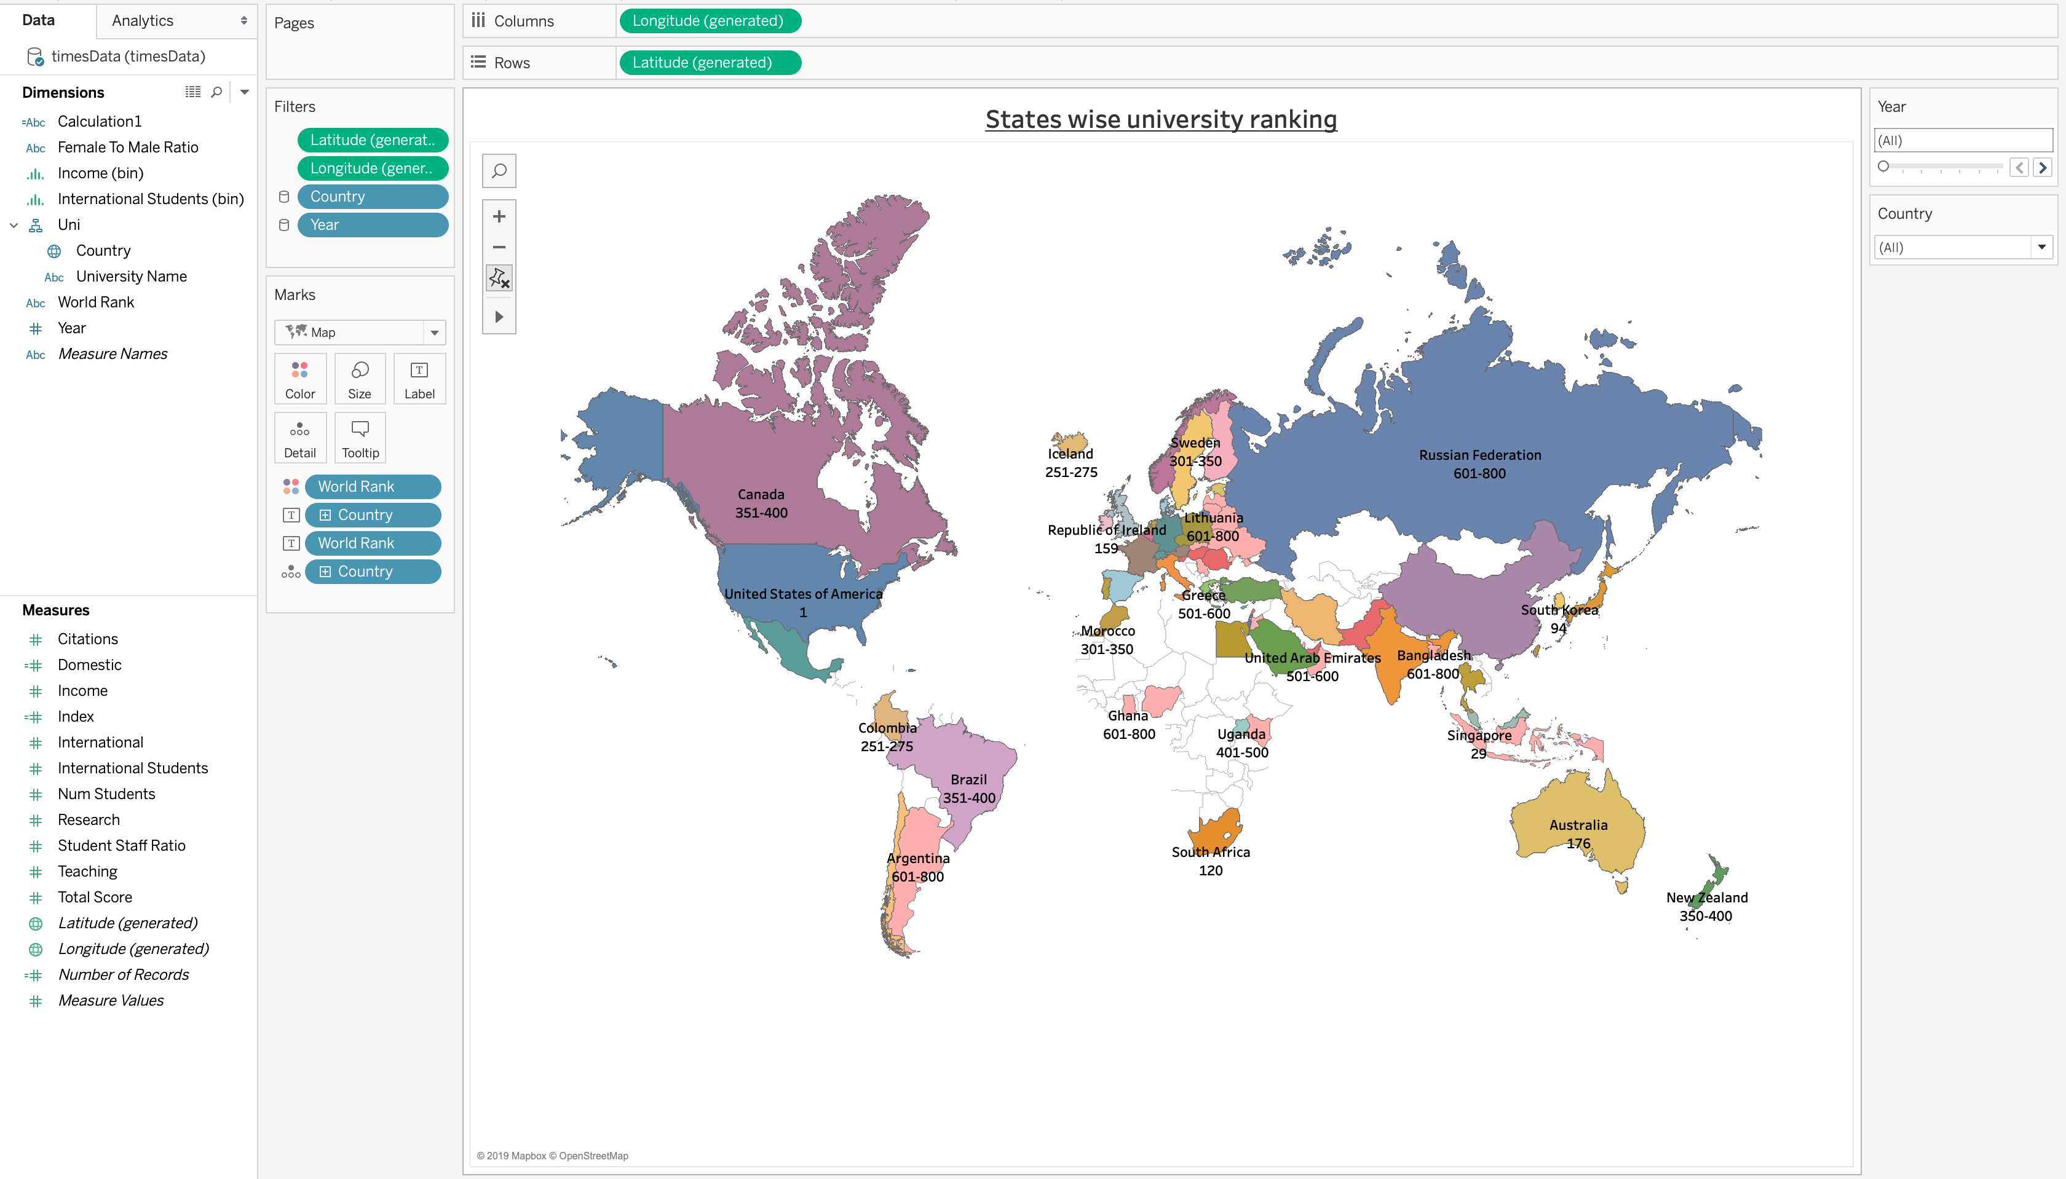

Slide 3
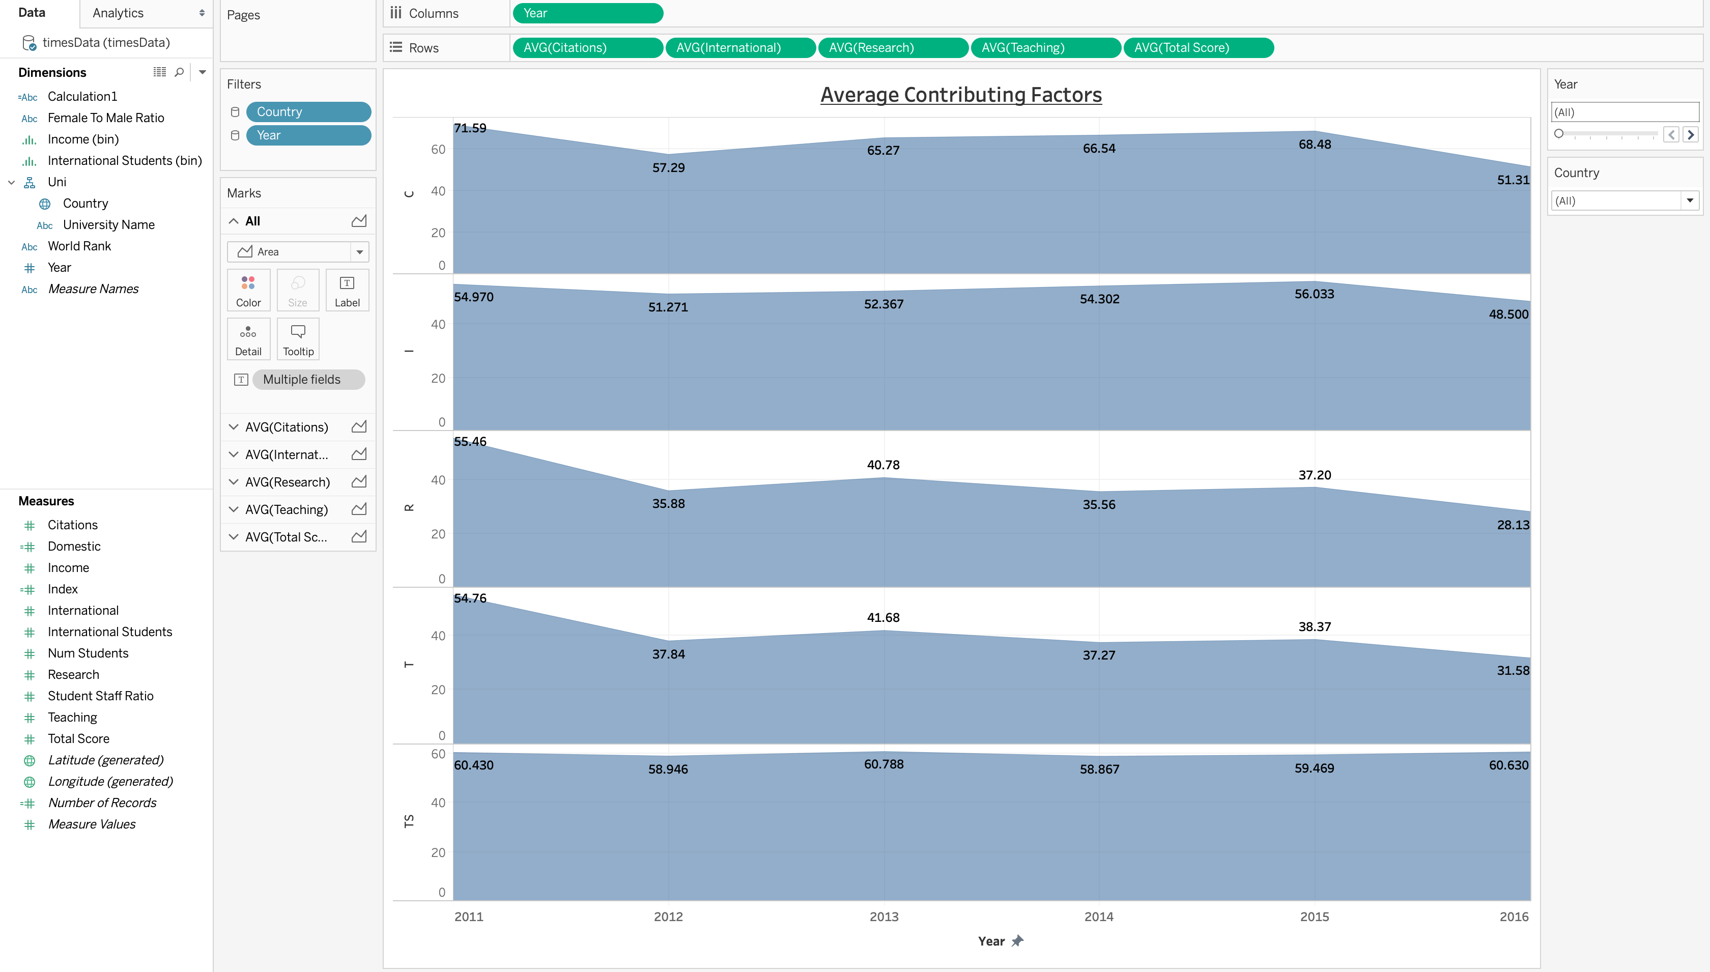

Slide 4
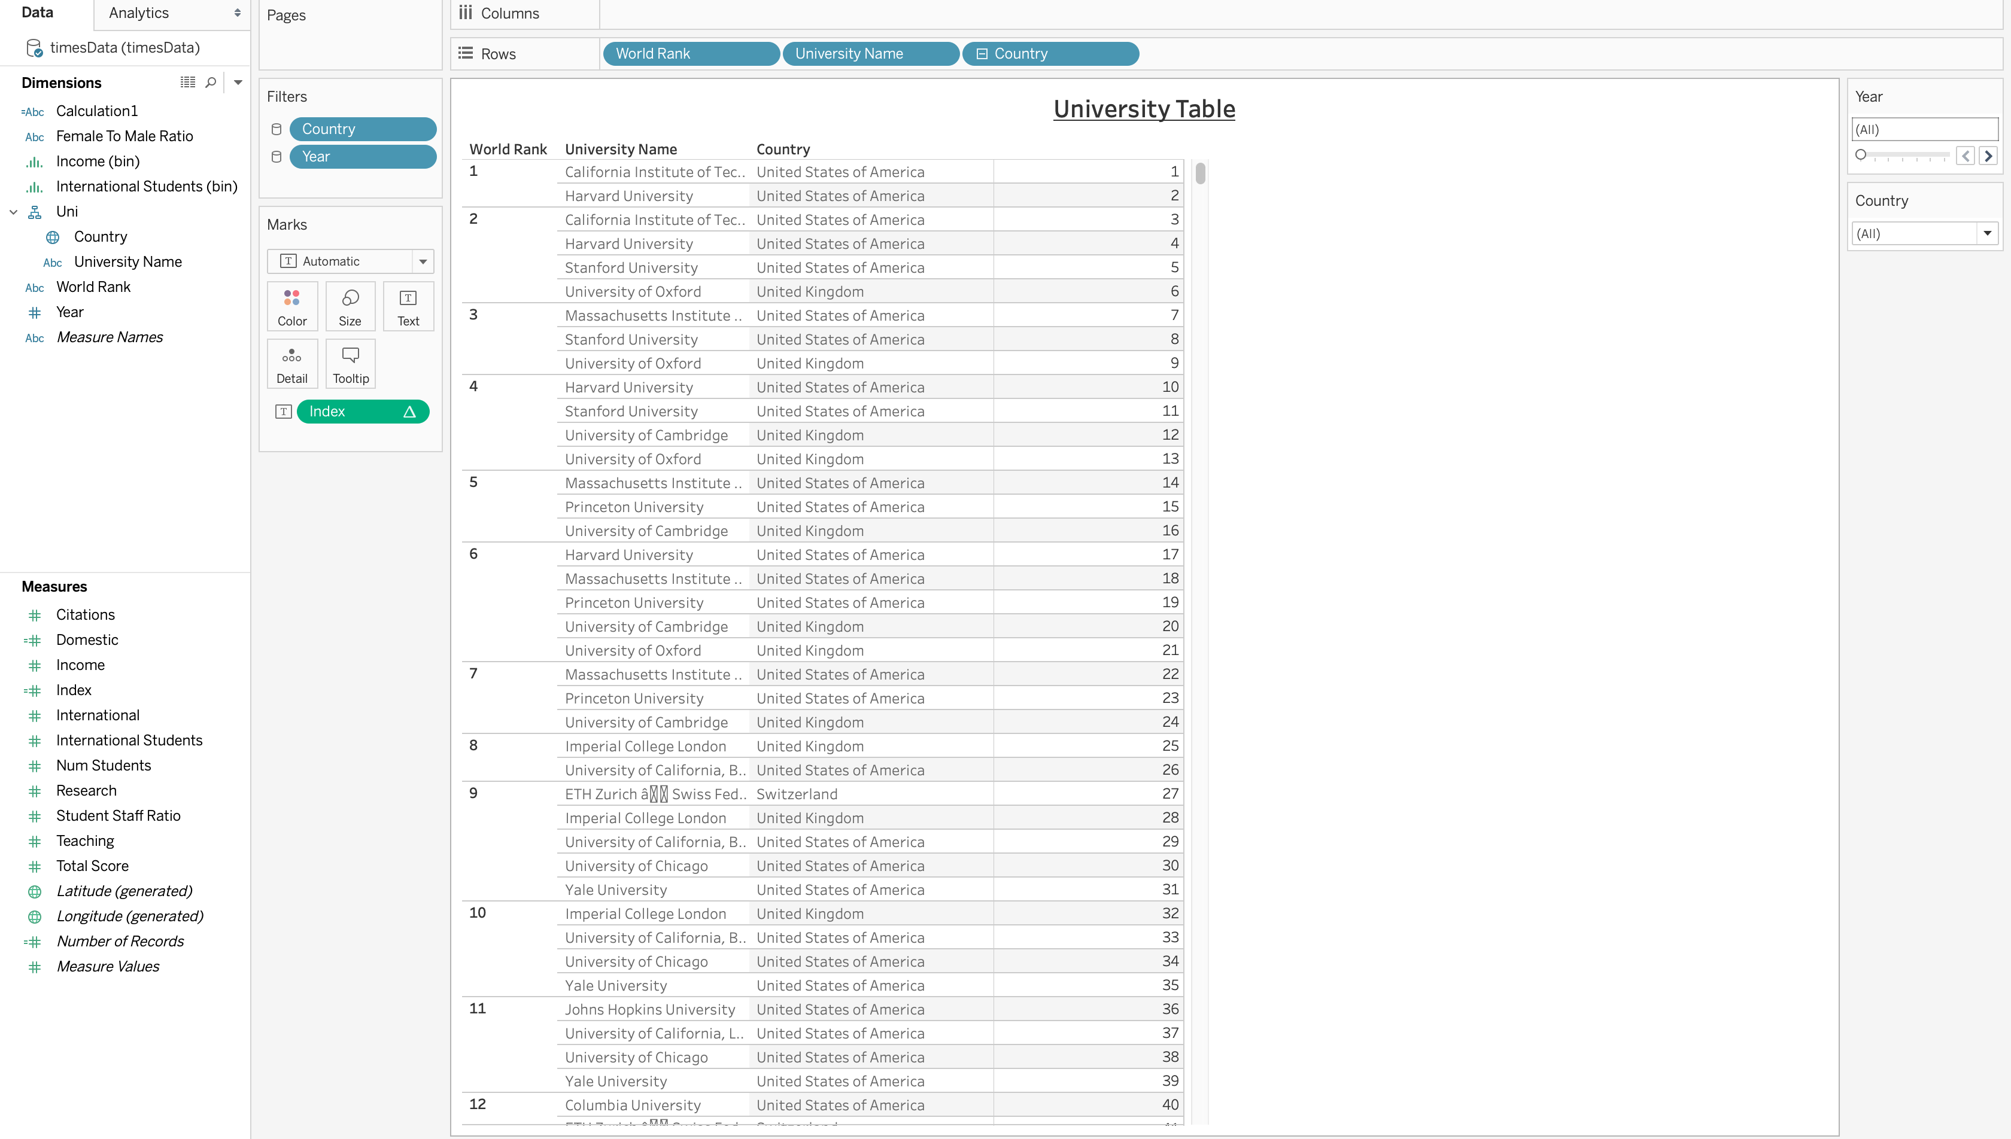

Slide 5
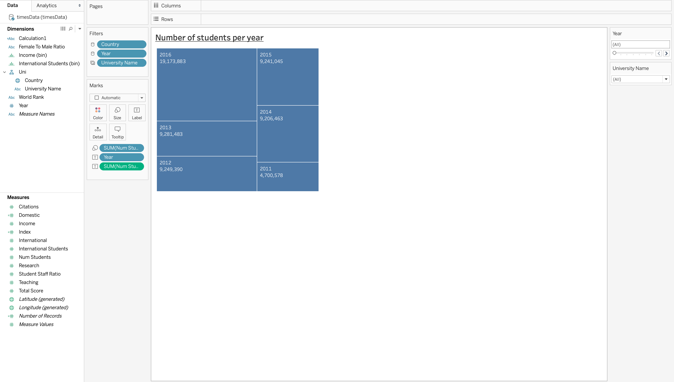

Slide 6
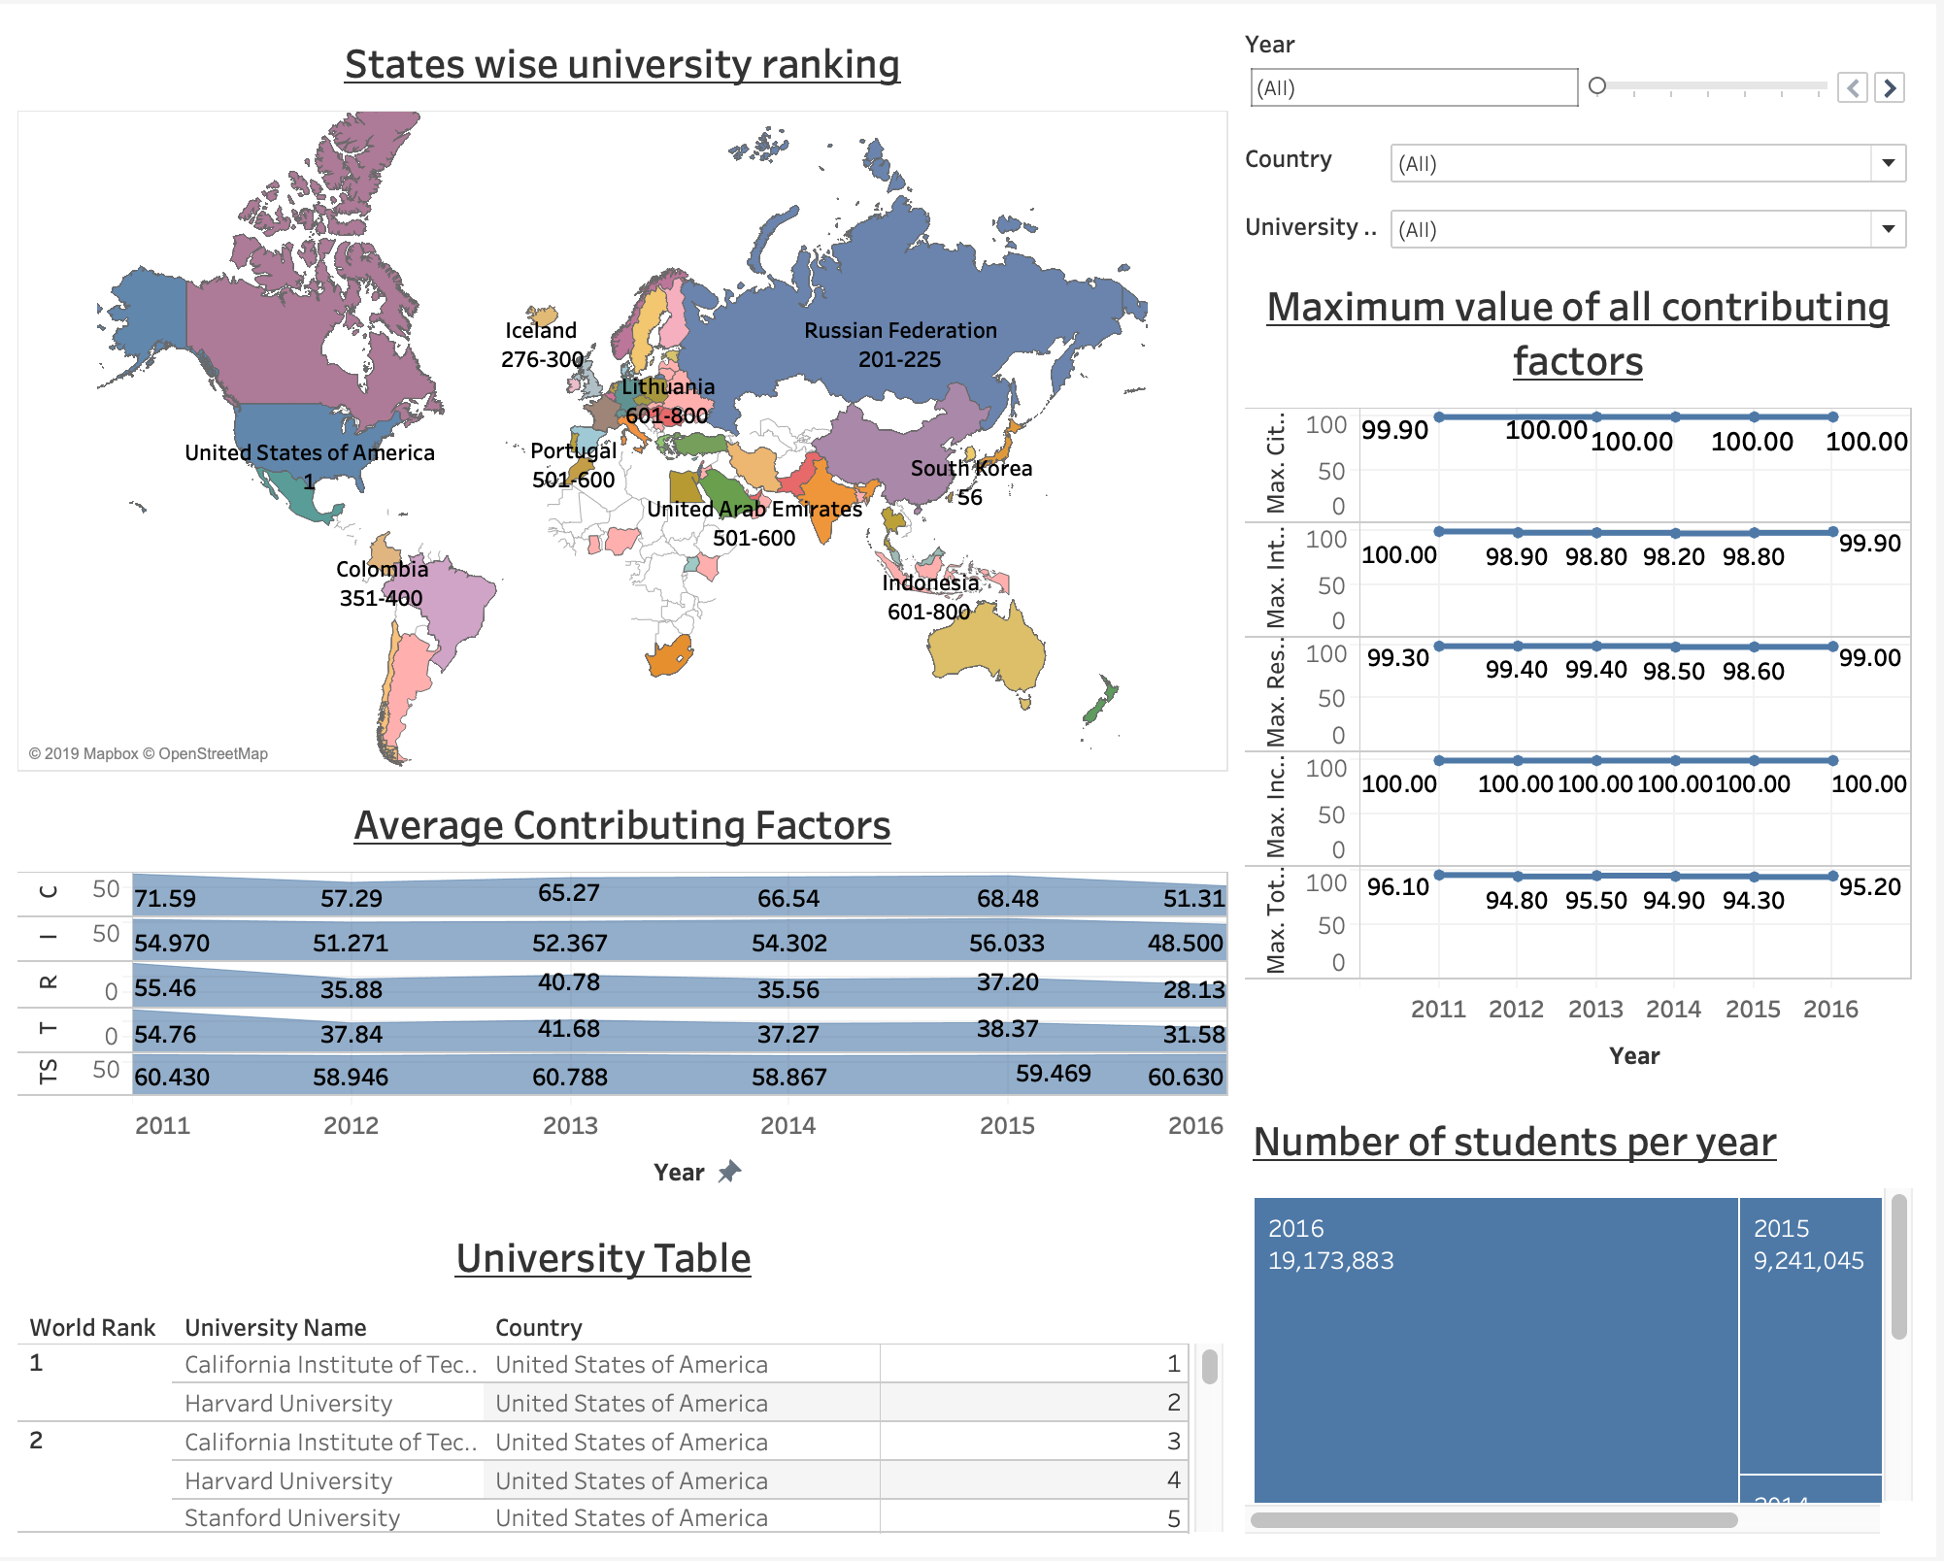

Slide 7
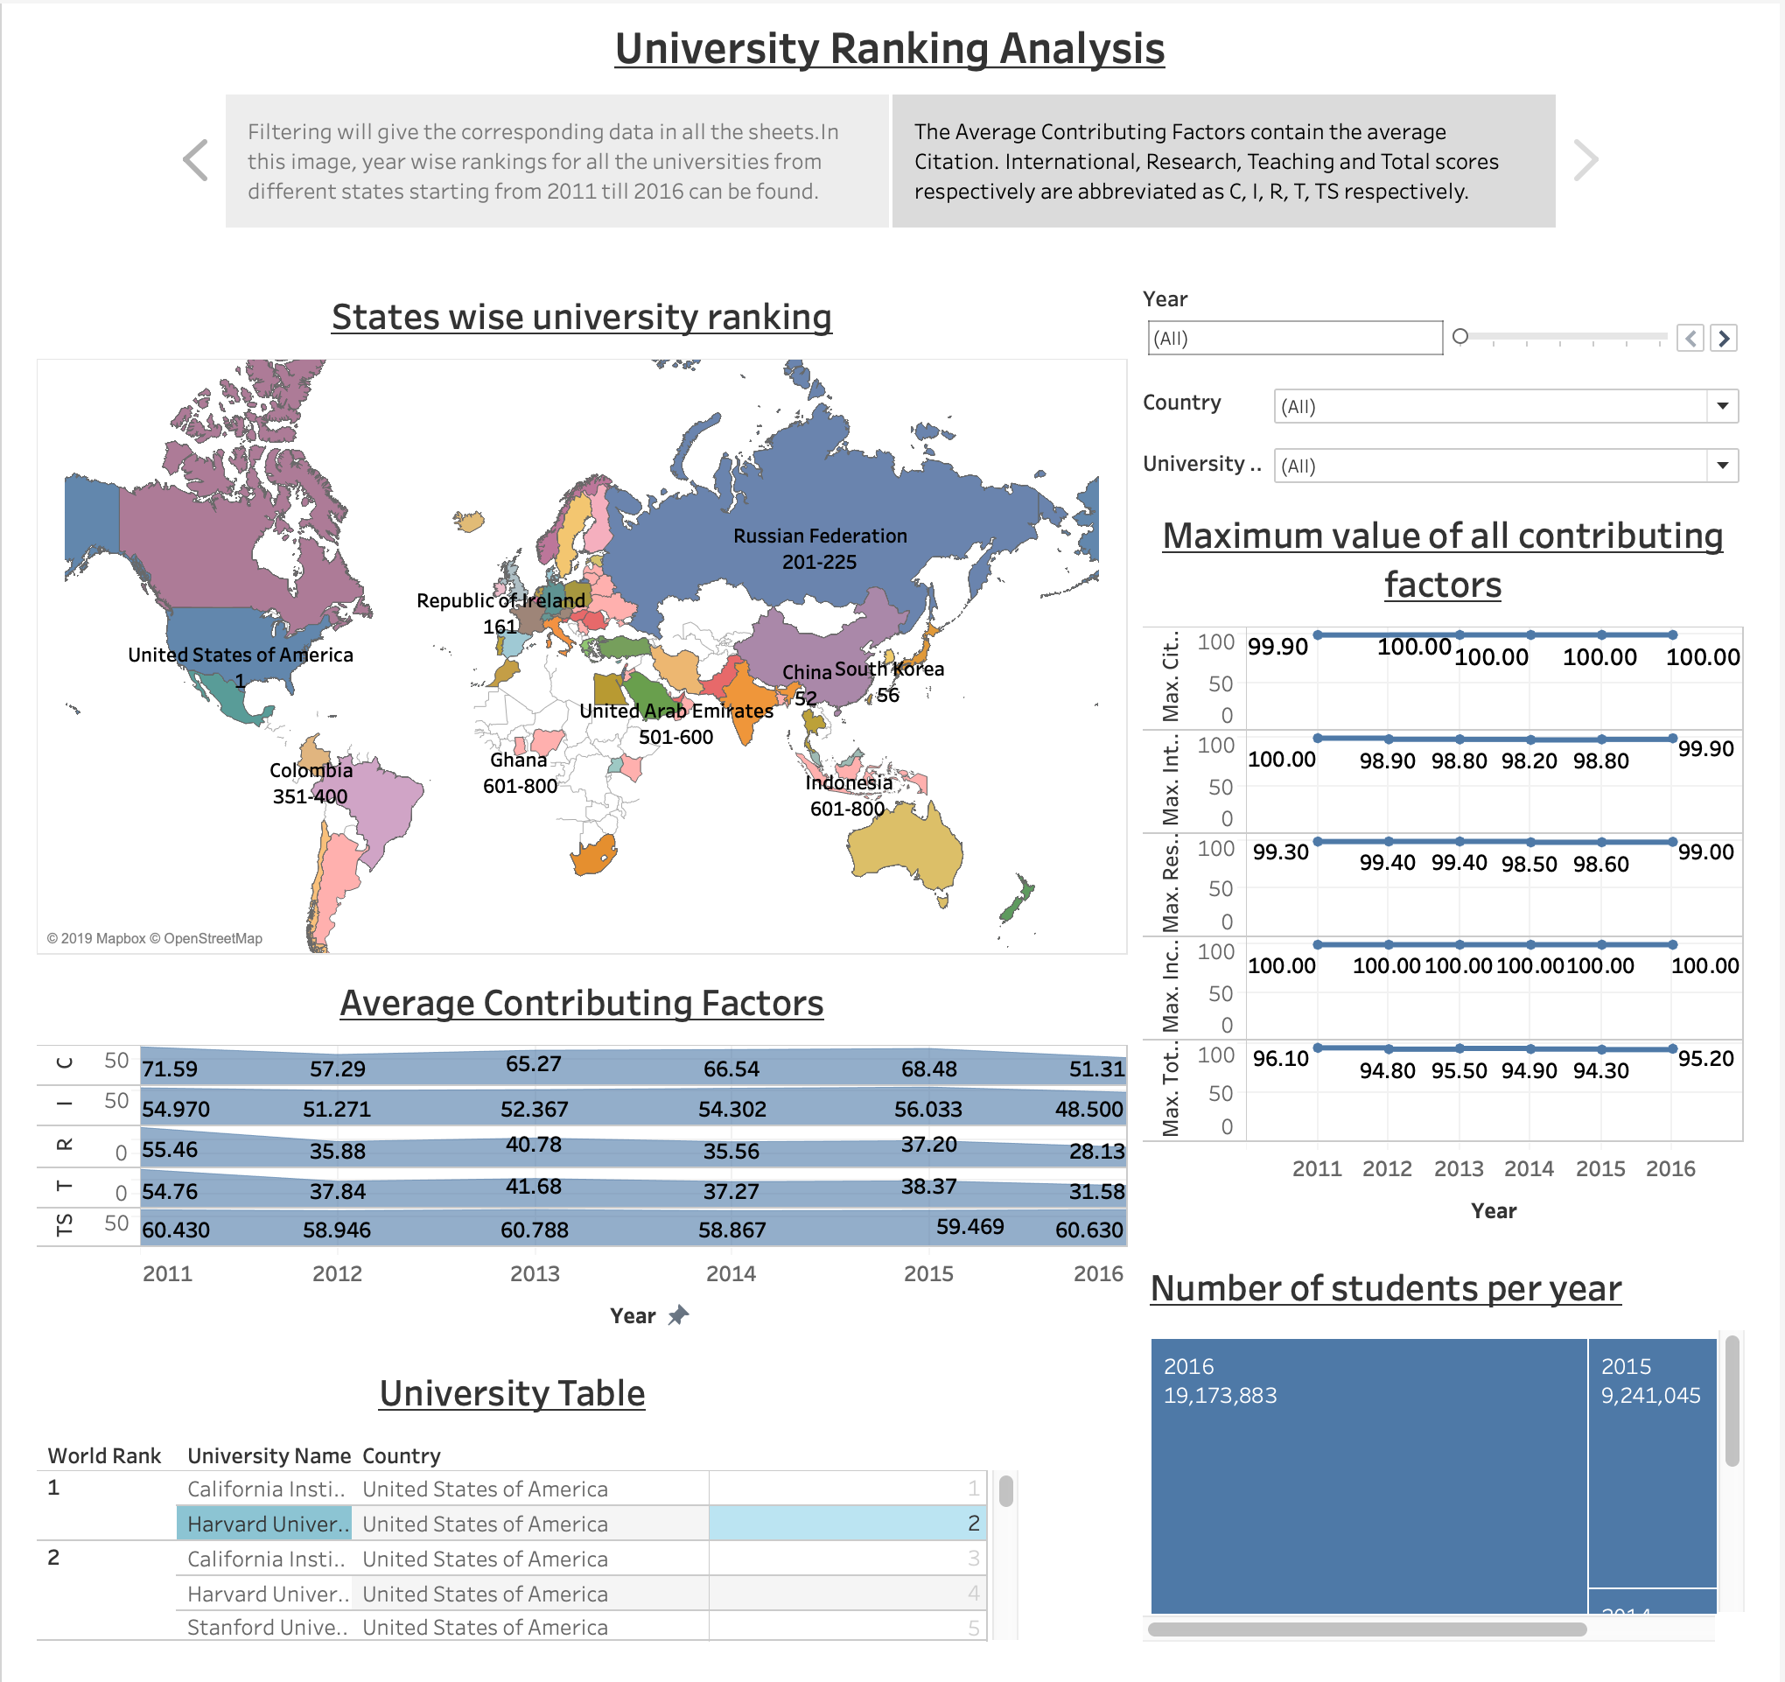

Slide 8
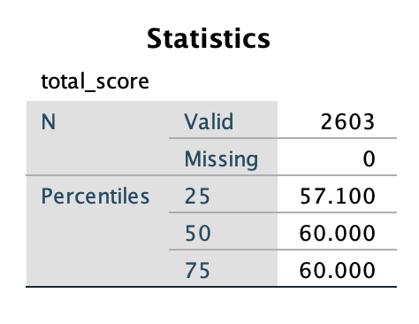
Following were the findings after respective filters were applied on the dashboard :-
In the year 2011, Harvard was ranked 1.After observing from the dashboard, it could be inferred that Harvard had matched all the numerical scores for citations, international, research, total score cumulatively except for the income which fell well below the average with a value of 34.50 as compared to the average of 54.97. The same year, an exactly opposite trend was observed for the lowermost ranked Swedish University of agricultural sciences which had an income value close to 100 but all the other scores falling down well below the average scores observed that year. This proves that, all the scores are critical while calculating the rank for a particular university and no particular score would predict the correct university ranking. Likewise, by applying year wise filters, all the other universities can be compared.
Income in the analysis means the amount of revenue generated by firms and other organizations by knowledge transfer from the university in a sense that these firms provide the university tangible research opportunities making it a kind of two-way exchange. Thus in 2011, Harvard had a large number of total students = 20,152 still it had a low income score of 34.50. Whereas, the number of students for the lowest ranked Swedish University of agricultural sciences was 3,879 – way lower than Harvard. Still it had an income score of 99.90 which was way higher than Harvard. Thus, it can be concluded that the number of students is inversely proportional to the income scores and this alone cannot determine the ranking factor for a university.
Thus, the lower ranked universities should have a good citation score, good staff recruitment should be done to enable recruiting better quality students, the ones looking for quality rather than quantity, invest more efforts and provide funding's so that efficient research could happen within the university. If these universities at least try to maintain their scores above the averages observed, then there is a good chance that universities can climb up the rankings. Number of students is inversely proportional to the income scores whereas the total score cumulatively is directly proportional in determining the rankings of the university to some extent.
Another finding was to detect the outliers. By using the statistical method of quartiles to detect outliers by using a box-plot which was plotted using SPSS, the outlier range for total score was as follows:-
outlier < 52.75 < data points < 64.35.
Following is the image to confirm the
quartiles from SPSS.

