Slide 1
#WarInUkraine
Analyzing the Sentiment Distribution of Tweets about the 2022 War in Ukraine

Slide 2
About Topic: War in Ukraine & Sentiment Analysis
War in Ukraine
On Feb 24, 22, Russia invades Ukraine
Onset of worldwide tensions
Cause direct or indirect impact on people's lives
Sentiment Analysis
Assess the sentiments people have about an event

Slide 3
Data Sources
Primary: Kaggle
Tweets, from Feb 24 to Mar 18
Over 9M tweets collected
The dataset administrator used three processes to collect data:
- Process 1 hashtags: "#SlavaUkraini OR #Russia OR #RussiaUkraineWar OR #Putin OR #RussiaUkraine OR #RussianWar OR #ww3 OR #moscow OR #RussianConflict"
- Process 2 hashtags: "#ukraineunderattack OR #Ukriane OR #Ukraine OR #RussianUkrainianWar OR #UkraineRussia OR #UkraineConflict OR #UkraineWar OR #Kharkiv OR #StopPutinNow"
- Process 3: Geolocation UKRAINE country.
Secondary: The UN Refugee Agency
Number of Refugees fleeing Ukraine, from Feb 24 to Mar 18
Number of Casualties, from Feb 24 to Mar 18

Slide 4
Questions
What are the most common words mentioned on twitter about the Ukrainian war?
What is the sentiment breakdown for Ukraine war tweets?
How sentiment polarity changes over time?
Do sentiment distributions change according to country?
Is polarity related to the number of casualties in the war?
How accurate are Machine Learning models in predicting polarity based on tweet text?

Slide 5
Exploratory
Analysis
Technology: Python (pandas, matplotlib, wordcloud, nltk)

Slide 6
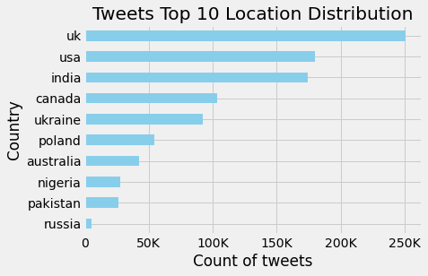
Filter by Language & Location
Total Number of Tweets
# get number
Unique Languages
64
Total of English Tweets
964,329

Slide 7
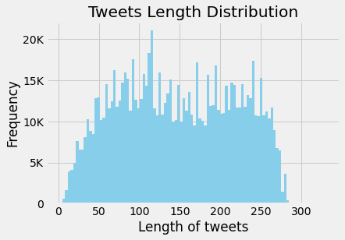
Text Data Cleaning
Notes:
Tweet can contain up to 280 characters

Slide 8
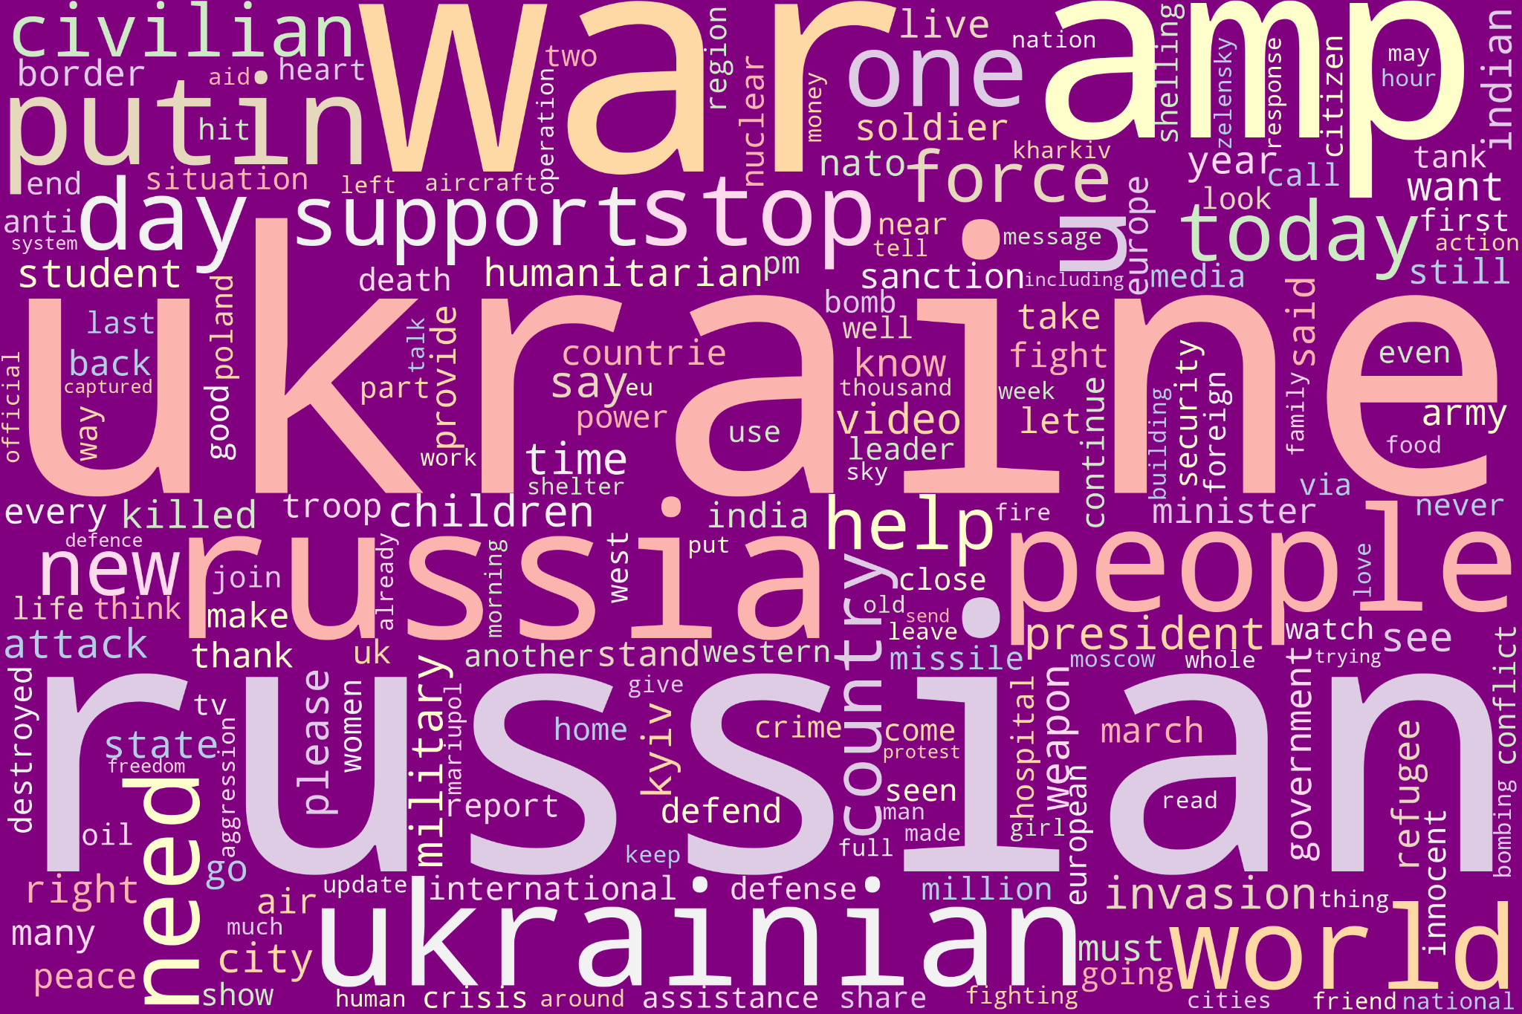

Slide 9
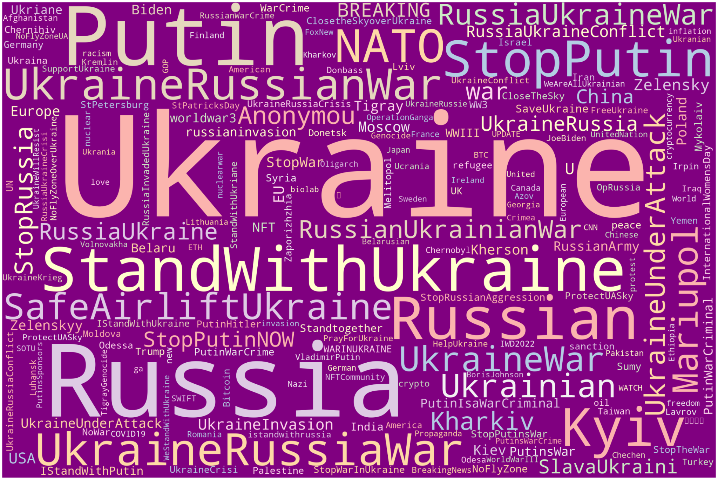
Notes:
State that Twitter sample is biased towards Ukraine supporters

Slide 10
Sentiment
Analysis
crescimento máximo
Technology: Python (pandas, vader, matplotlib)

Slide 11
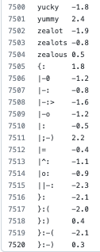
VADER (Valence Aware Dictionary for sEntiment Reasoning)
Sentiment analysis tool tailored to social media
Vader Lexicon: dictionary with a unique list of strings
Known text
(vader lexicon)
Unknown text
(tweets - war in Ukraine)
Correlation

Slide 12
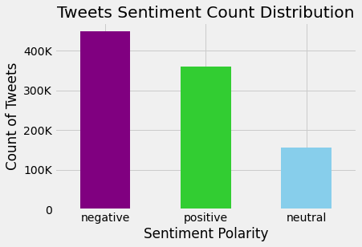
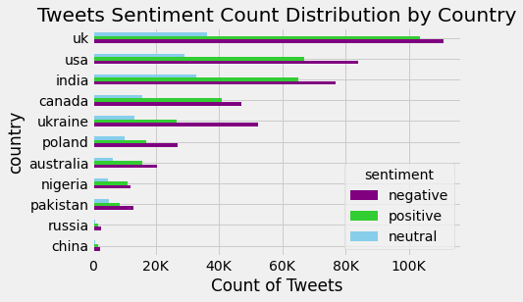
Sentiment Distributions

Slide 13
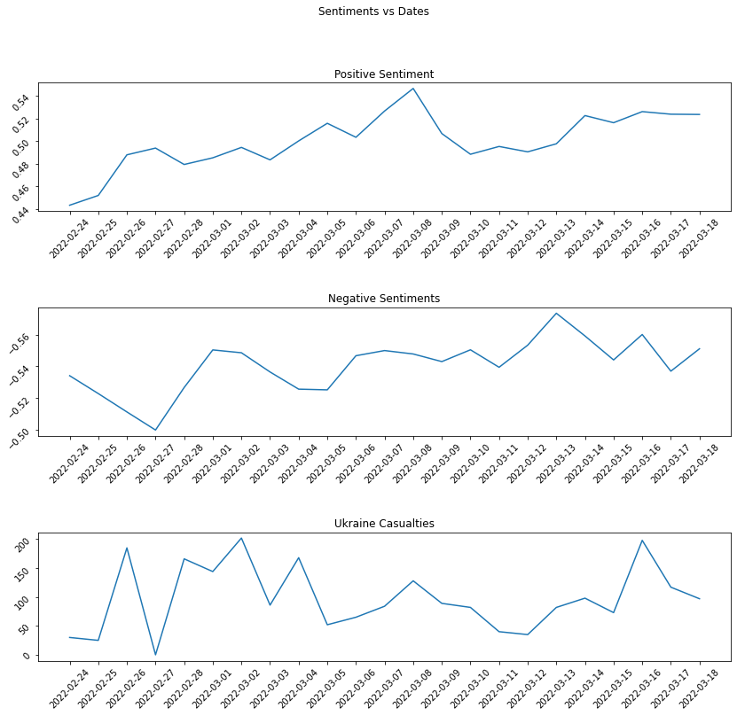
Polarity
across Time

Slide 14
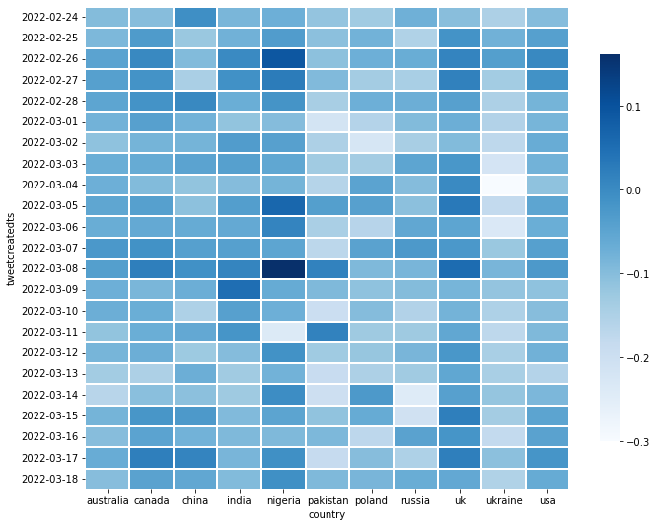
Polarity Heatmap
by Country
and Date

Slide 15
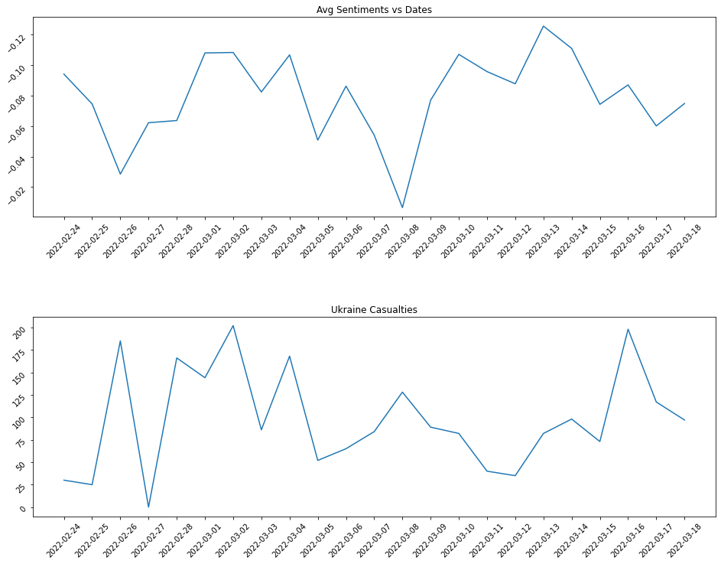
Relation between
Polarity and
Casualties
Notes:
Is there a correlation between ukraine casualties (IV/numerical), date (IV/categorical) and Avg sentiments (DV/numerical)?
Conduct statistical test?

Slide 16
Machine Learning
Technology: Python (pandas, numpy, sklearn, matplotlib, seaborn)

Slide 17
Classification Algorithms
Independent Variables or Features = text (transformed into numerical)
Dependent Variable or Outcome = sentiment (categorical)
Random Forest
Multinomial Naive Bayes
Linear Support Vector Classifier (SVC)
Logistic Regression

Slide 18
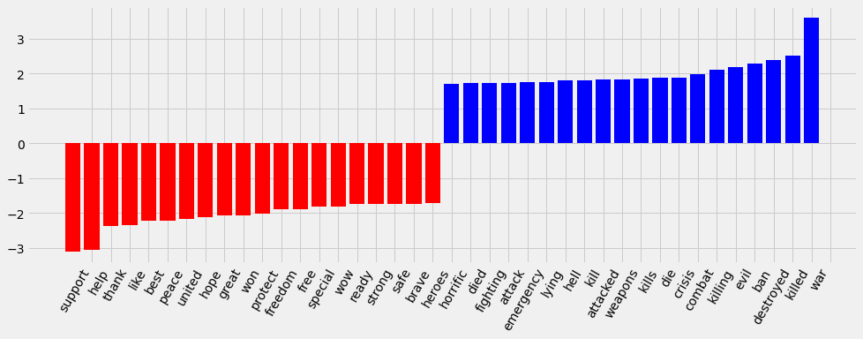
Term Frequency- Inverse Document Frequency (TF-IDF)
Feature Importance
Vectorization method = converts text into numbers
Terms that appear frequently are weighted less
Notes:
For example, 'ukraine' is not one of the most important features even though it's the most frequent
These frequent words do not help much in the classification of positive or negative as it appears frequently in both cases

Slide 19
ML Models: Random Forest
Tweet Texts
Weight 1
Weight 2
Positive
Negative
Positive
Negative
Notes:
Add boxplots

Slide 20
ML Models: Linear SVC
Positive
Negative

Slide 21
ML Models: Multinomial Naive Bayes
Positive
Positive
Negative
Negative
Notes:
Multinomial = more than 2. Good for word counts
Based on probability P(word|positive)

Slide 22
ML Models: Logistic Regression
Positive
Negative

Slide 23
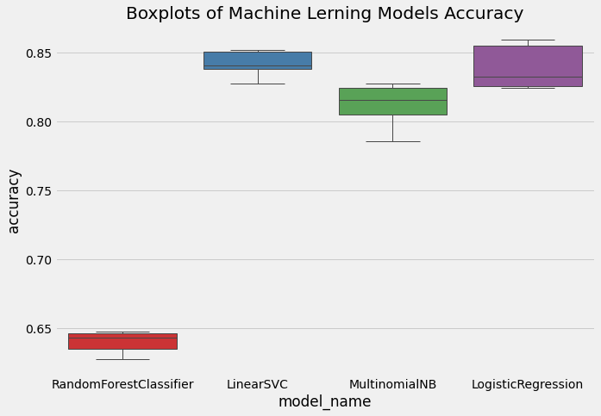
Machine Learning Models
Notes:
Linear SVC and Logistic Regression had best mean accuracy of 84%

Slide 24
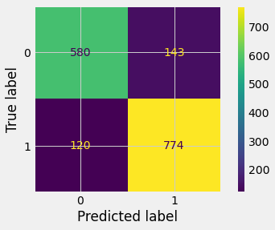
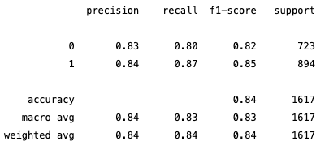
Linear SVC Implementation

Slide 25
Future Analysis
Desafio 1
Desafio 2
Desafio 3
Expandir o público-alvo
Digite seu texto aqui Digite seu texto aqui Digite seu texto aqui Digite seu texto aqui Digite seu texto aqui Digite seu texto aqui.
Ativos por até 30 dias
Digite seu texto aqui Digite seu texto aqui Digite seu texto aqui
Digite seu texto aqui Digite seu texto aqui
Aumentar a conversão
Digite seu texto aqui Digite seu texto aqui Digite seu texto aqui Digite seu texto aqui Digite seu texto aqui.

Slide 26
Content — The presentation tells a cohesive story about their project, including the following:
✓ Selected topic
✓ Reason why they selected their topic
✓ Description of their source of data
✓ Questions they hope to answer with the data
✓ Description of the data exploration phase of the project
✓ Description of the analysis phase of the project
✓ Technologies, languages, tools, and algorithms used throughout the project
✓ Result of analysis
✓ Recommendation for future analysis
✓ Anything the team would have done differently
Slides — Presentations are finalized in Google Slides.
✓ Slides are primarily images or graphics (rather than primarily text)
✓ Images are clear, in high-definition, and directly illustrative of subject matter
Live Presentation
✓ All team members present in equal proportions
✓ The team demonstrates interactivity of dashboard in real time
✓ The presentation falls within any time limits provided by instructor
✓ Submission includes speaker notes, flashcards, or a video of the presentation rehearsal

