Slide 1
#WarInUkraine
Analyzing the Sentiment Distribution of Tweets about the 2022 War in Ukraine

Slide 2
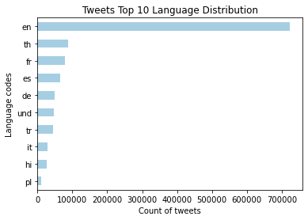
Filter by Language
Total Number of Tweets
1,229,349
Unique Languages
64
Notes:
th = thai, fr = french, es = spanish, de = german, und = undetermined, tr = turkish, it = italian, hi = hindi, pl = polish

Slide 3
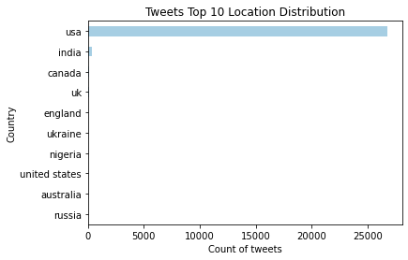
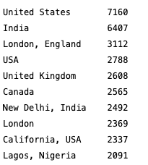
Filter by Location
Total of English Tweets
723,256
Notes:
***Plot will be updated.

Slide 4
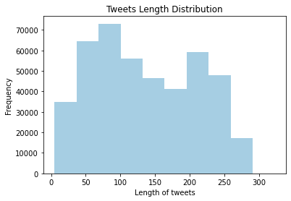
Text Data Cleaning
Notes:
Tweet can contain up to 280 characters

Slide 5
Sentiment
Analysis
crescimento máximo
Aumento de XX% nas vendas

Slide 6
Machine Learning Models
Logistic Regression
Multinomial Naive Bayes
Linear SVC
Text
Text
Text

