Slide 1
#WarInUkraine
Analyzing the Sentiment Distribution of Tweets about the 2022 War in Ukraine

Slide 2
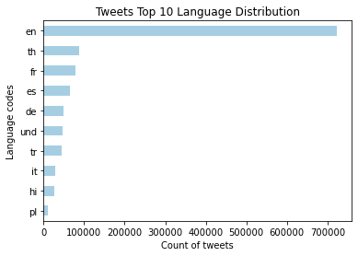
Filter by Language
Total Number of Tweets
1,229,349
Unique Languages
64
Notes:
th = thai, fr = french, es = spanish, de = german, und = undetermined, tr = turkish, it = italian, hi = hindi, pl = polish

Slide 3
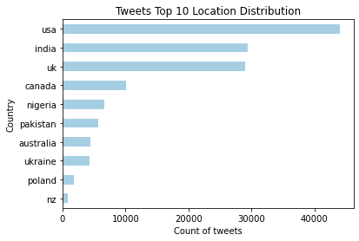
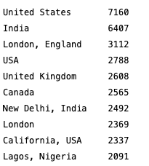
Filter by Location
Total of English Tweets
723,256
Total Tweets
136,766

Slide 4
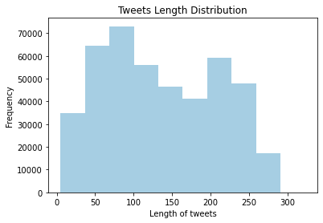
Text Data Cleaning
Notes:
Tweet can contain up to 280 characters

Slide 5
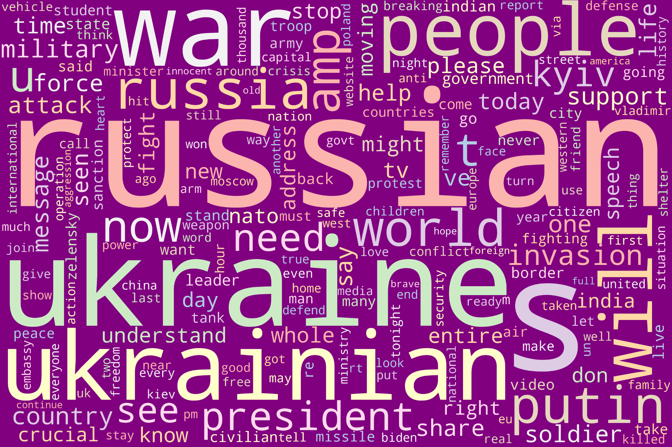
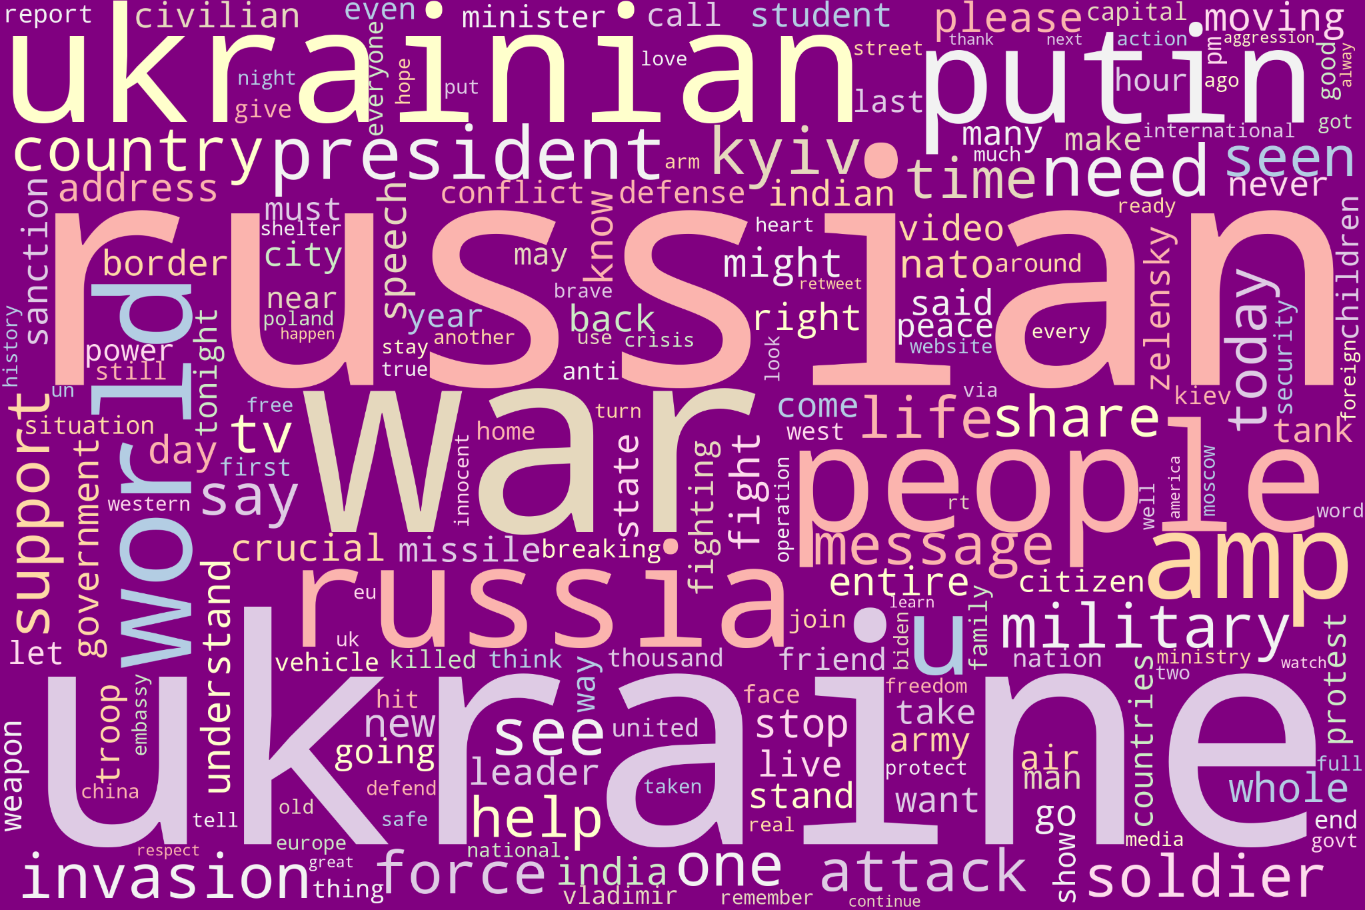
Comparing wordcloud with two methods for removing stopwords:
wordcloud list and nltk list

Slide 6
Sentiment
Analysis
crescimento máximo

Slide 7
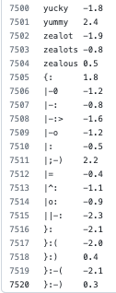
VADER (Valence Aware Dictionary for sEntiment Reasoning)
Sentiment analysis tool tailored to social media
Vader Lexicon: dictionary with a unique list of strings
Known text
(vader lexicon)
Unknown text
(tweets - war in Ukraine)
Correlation

Slide 8
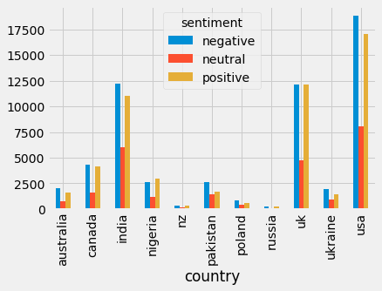
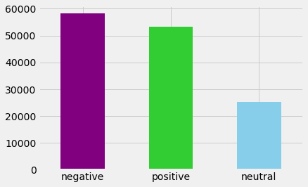
Sentiment Distributions

Slide 9
Heatmap of Sentiments by Country

Slide 10
Polarity across Time

Slide 11
Machine Learning Models
Logistic Regression
Multinomial Naive Bayes
Linear SVC
Text
Text
Text

Slide 12
The presentation outlines the project, including the following:
Segment 2 - Presentation Deliverables
✓ Selected topic
✓ Reason why they selected their topic
✓ Description of their source of data
✓ Questions they hope to answer with the data
✓ Description of the data exploration phase of the project
✓ Description of the analysis phase of the project
Segment 3 - Presentation Deliverables
✓ Technologies, languages, tools, and algorithms used throughout the project

