Slide 1
ECE 554: Minilab 1
Getting started on AUP-ZU3 Board with Vivado and PYNQ
(PS-PL communication)
DEPARTMENT OF ELECTRICAL AND COMPUTER ENGINEERING
UNIVERSITY OF WISCONSIN-MADISON

Slide 2
Minilab 1 Description
Objectives:
  Create and package a custom AXI IP in Vivado.
  Understand AXI protocol.
  Create a board design to test the custom IP via PS-PL communication.
  Understand resource utilization reports.
  Use PYNQ to develop a driver for the custom IP.
The lab is structured into two parts:
  Part 1: Design and test a custom AXI IP design in Verilog/System Verilog
  Part 2: Use PYNQ to do software development for PS-PL communication

Slide 3
Create a project
Follow the instructions from Minilab0 to create a new main project in Vivado.
Name the project “minilab1”.
Go to Tools->Create and Package New IP
Select “Create a new AXI4 Peripheral”
Name the IP as “minilab1_ip”, add description as “Minilab1 AXI IP”, choose IP location according to your preference.

Slide 4
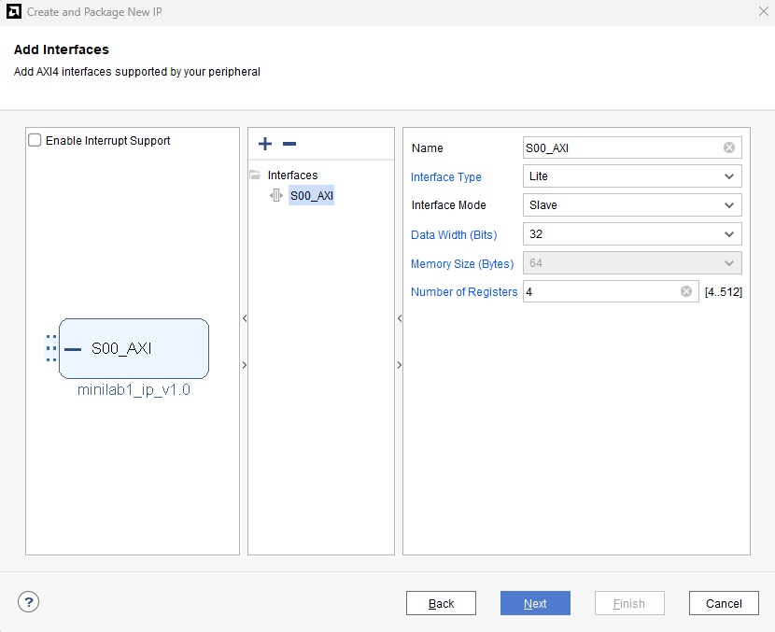
Create an IP project
Choose the default settings as shown. Click Next.
This will create an “AXI-Lite Slave IP”.
A slave IP can only respond to incoming requests but cannot send outgoing requests.
Here is a link to a simple explanation of AXI: AXI Basics 1 - Introduction to AXI
Select “Edit IP” and click Finish.
This will create two files, one for the top-level module and the other for the MMIO module based on the AXI-Lite Slave protocol.

Slide 5
What to Code (In the IP Project)
Add a Block RAM IP by using the “Block Memory Generator” from Window->IP Catalog (various shortcuts including that for IP Catalog are present under the Flow Navigator window)
Generate a single-port ROM. The image size is 1024x600. Select Native interface type. Set the port width to 8 bits. Use an enable input port. The data should appear a cycle after the enable is HIGH based on the address.
A COE file with an image encoded in RGB332 format (8-bit pixels) is provided. Use it to initialize the ROM.
For details about the configuration of block RAM, consult the product guide, accessible by clicking on the “Documentation” button on the upper left corner of the IP window.
When done configuring, click OK. This will generate all files related to the IP.
Department of Electrical and Computer Engineering

Slide 6
What to Code (In the IP Project)
Like Minilab0, design a Verilog module “bram_ctrl” to read data from the BRAM IP.
To use the IP in your code, get the IP instantiation template from the .veo file under “IP Sources” tab underneath the Sources window.
Add the bram_ctrl module to the top-level and connect it to receive inputs from and send outputs to the AXI-Lite interface
Write a testbench to simulate and verify the design.
After the design passes verification, package the IP and close the project. The IP can be updated, if needed, later by right clicking on the IP block in the block diagram and selecting “Edit in IP Packager”.
Department of Electrical and Computer Engineering

Slide 7
Create Board Design (In the main project)
Go to Flow→Create Block Design. Name it “minilab1”.
Click on the “+” button inside the “Diagram” window that opened.
Type “zynq” in the search bar and select “Zynq UltraScale+ MPSoC”
Double click on the Zynq UltraScale+ MPSoC IP to customize it. We will be using “AXI HPM0 LPD” in this minilab to communicate between PS and PL.
Go to Window→IP Catalog. The custom AXI IP that we created will be under “AXI Peripheral”. Double click on it and add it to your block design.

Slide 8
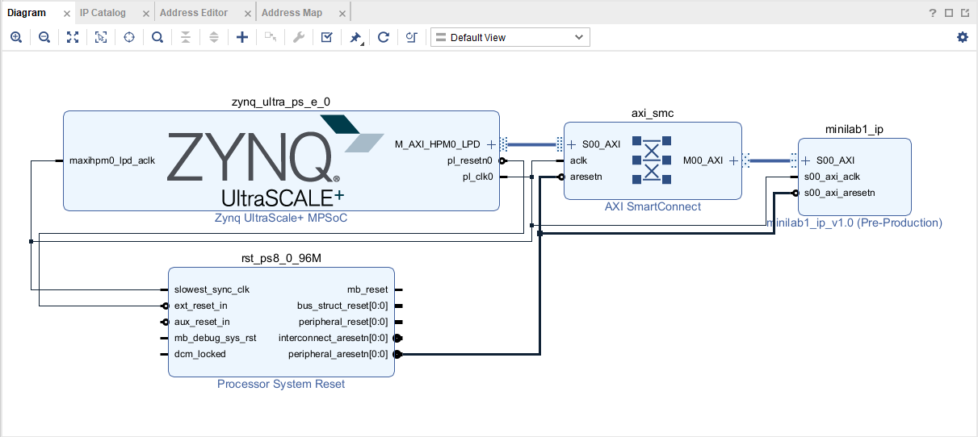
Create Board Design (In the main project)
Click on “Run Connection Automation”. Select all, then click OK. Vivado will automatically insert necessary blocks for reset and interconnect management. It will also connect all the selected nets. (Note: This tool is unreliable when the block design becomes complex, so use it with caution)
The final block design should look like as shown.
Go to Tools→Validate Design. There should not be any errors.
Right click on the block design file (.bd) under Design Sources and select “Create HDL Wrapper”. Click OK. Vivado will auto-create the top-level Verilog log file for synthesis.
Synthesize and implement the design. Since we are not using any peripherals, we don’t need any pin constraints.
Generate the bitstream.

Slide 9
PYNQ Software
After booting the board with the SD card, open a jupyter server on the PS.
Create a “usr/minilab1” folder. Copy the .bit and .hwh files from the project directory.
Copy the provided jupyter notebook that has the skeleton code to the folder.
PYNQ is an open-source embedded software development platform.
PYNQ was created as python alternative to the C-based development platform Vitis from AMD (Xilinx) since it is faster to develop and prototype using python. However, since C is a lower-level programming language than python, code developed in C is usually faster.
For more details, refer to PYNQ Introduction — Python productivity for Zynq (Pynq) v1.0
In this minilab, you will be using the MMIO interface to interact with IP from the PS: MMIO — Python productivity for Zynq (Pynq) v1.0
Find the necessary details to write the driver code for the IP by searching for “MEMRANGE” in the .hwh file. The same details can be also obtained from Window->Address Editor in Vivado.

Slide 10
Demo and Report
You must demo your working designs to the instructor (George) or the TA (Abhishek) by the end of lab period on 02/03 to avoid any penalty. Demos should be done in teams. See Grading for more details.
Create a repository with the name "ECE554SP26_Minilab1" on Github. Upload all .v/.sv and IP files to your individual Github accounts. If you don't have a Github account yet, please create one and become familiar with Git commands.
  Github: Getting Started
  Git Cheat Sheet
The report should be submitted individually and should have your Github repository info and details about how you created that the repository and added the files. It should also have your simulation log and a snapshot of the waveform showing a part of the AXI protocol from Vivado. In addition, discuss briefly the reason behind the differences in resource utilization between the resource usage reports from Synthesis and Implementation.

