Slide 1
CS 513 KDD
Prudential Life Insurance Assessment Guided By: Prof. Khashayar Dehnad
Team Members:
Shreya Mahadik (10467745)
Parth Ambalkar (10467986)
Pinak Pathak (10472891)
Aditi Duggal (10460663)

Slide 2


AGENDA
PROBLEM STATEMENT
DATASET
DATA PRE-PROCESSING
(EDA)
MACHINE LEARNING MODELS
MODEL EVALUATION
CONCLUSION

Slide 3
PROBLEM STATEMENT
The process of life insurance purchase is complicated and involves risk analysis at multiple levels and various medical exams.
Prudential wants to make the process quicker, less labor intensive and automated.
By using predictive modeling, we are classifying the risk profiles of the customer based on their information.

Slide 4


DATASET
Train.csv has 59k rows and 128 columns

Slide 5

DATA PREPROCESSING
ANALYSIS OF INPUT AND TARGET VARIABLES
HANDLING MISSING DATA
BALANCING THE IMBALANCED DATA
SPLITTING THE
DATASET
EDA

Slide 6
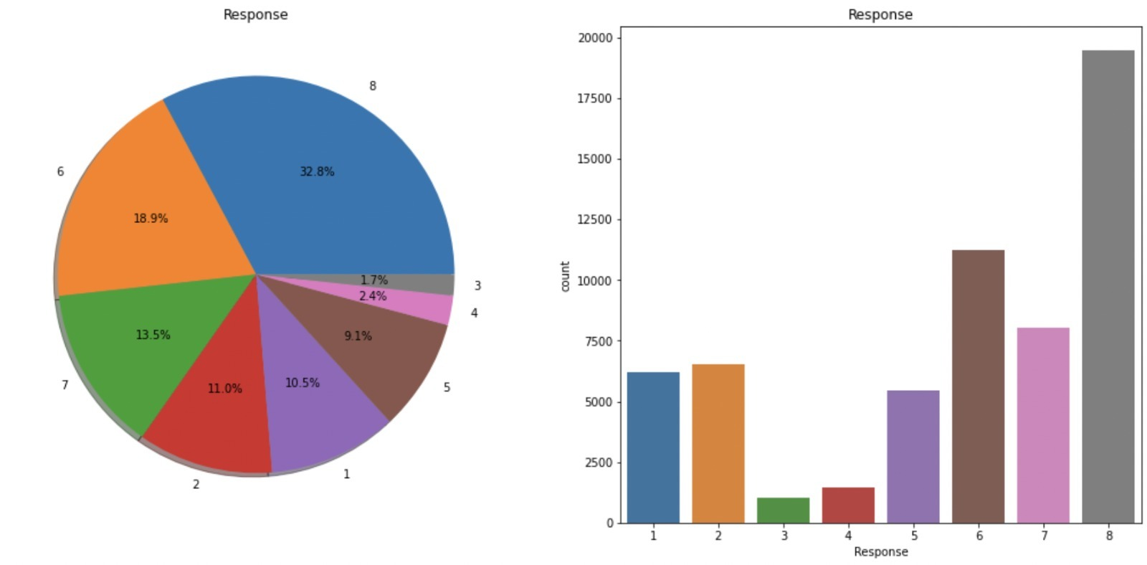
Exploratory Data Analysis
Basic Information About The Dataset
In all, there are 8 target variables.
Wherein the 8th variable has the highest COUNT.
As this is a classification model the target variables were bifurcated into 2 classes:
0 (1st -7th Feature)
1 (8th Feature)

Slide 7
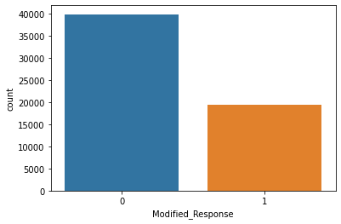
Exploratory Data Analysis
Here, data is still imbalanced, and the classification model classes are:
0(8th Feature)
1(1st -7th Feature)

Slide 8
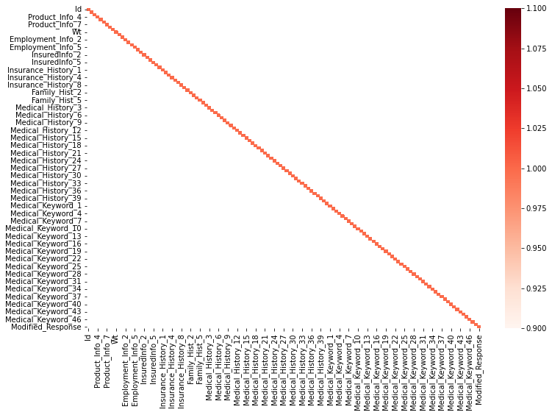
CORRELATION Matrix of entire dataset

Slide 9
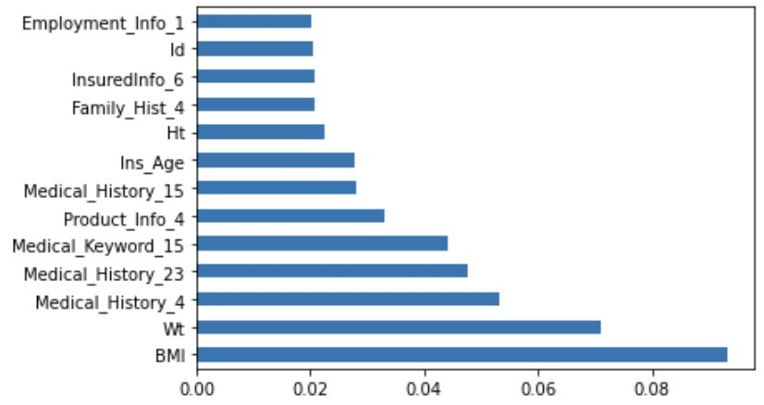
Exploratory Data Analysis
Categorical and Numerical features were analyzed
Out of the entire feature set, 12 best features were selected after the Correlation Matrix was found.

Slide 10
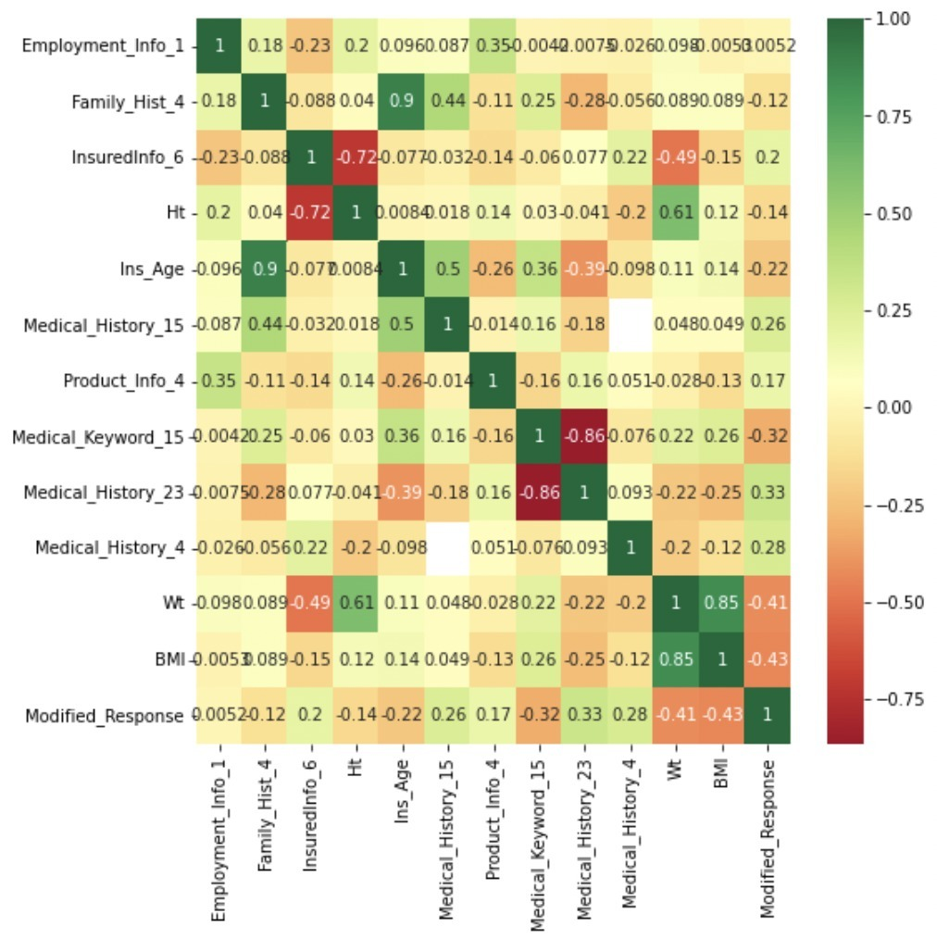
Correlation matrix of 12 features

Slide 11
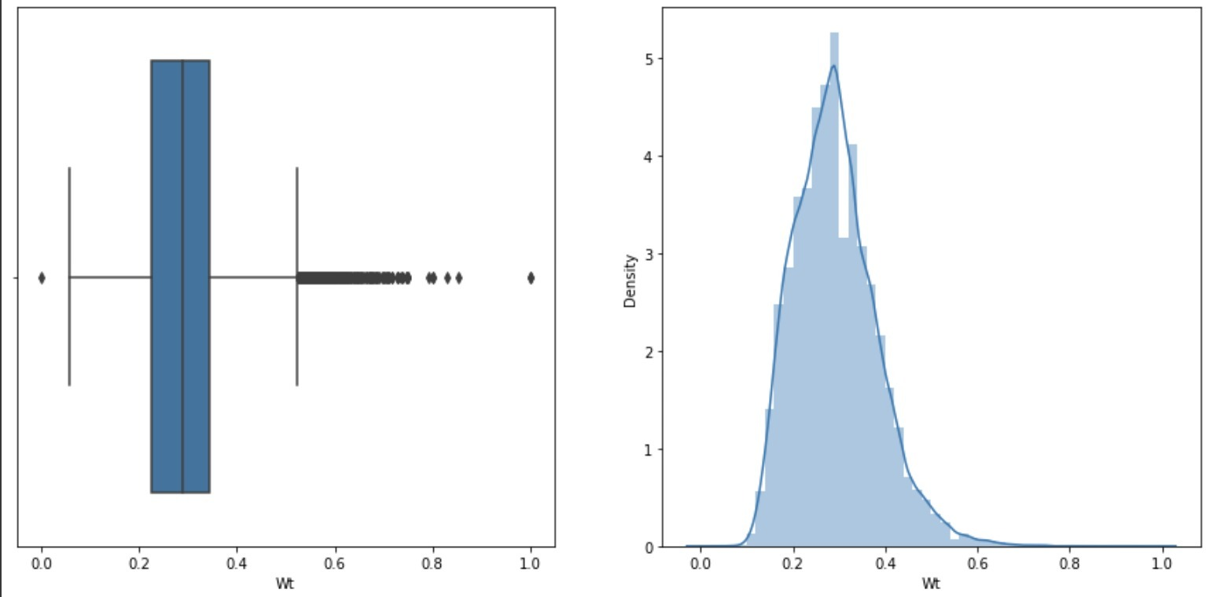
weight

Slide 12
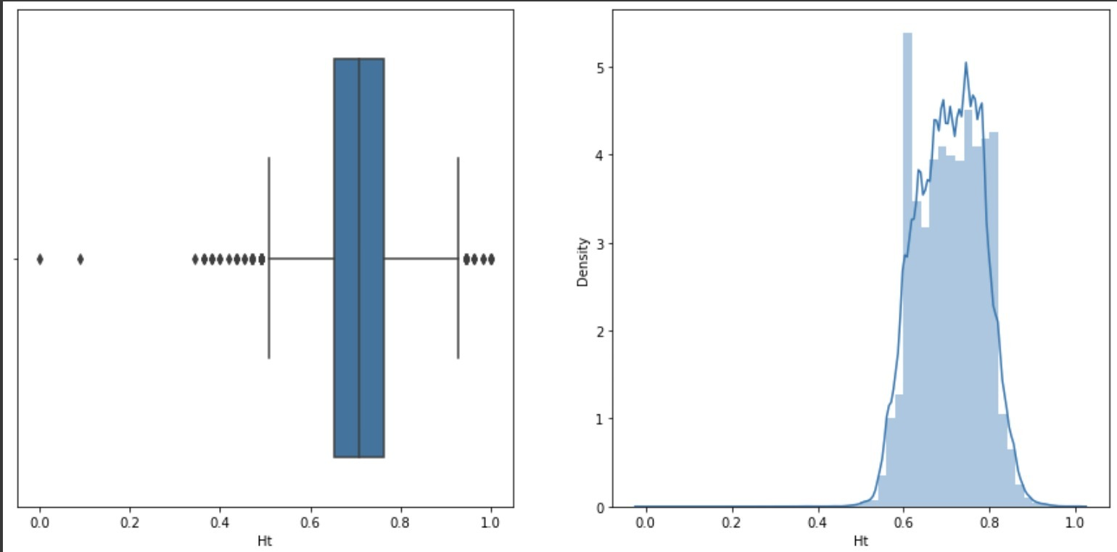
height

Slide 13
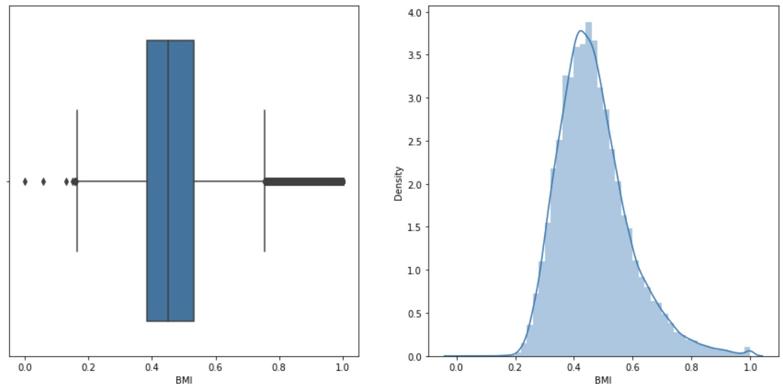
bmi

Slide 14
Classification Algorithms implemented
KNN
NAÏVE BAYES
DECISION TREES-C5.0
DECISION TREES-CART
RANDOM FOREST
ANN

Slide 15
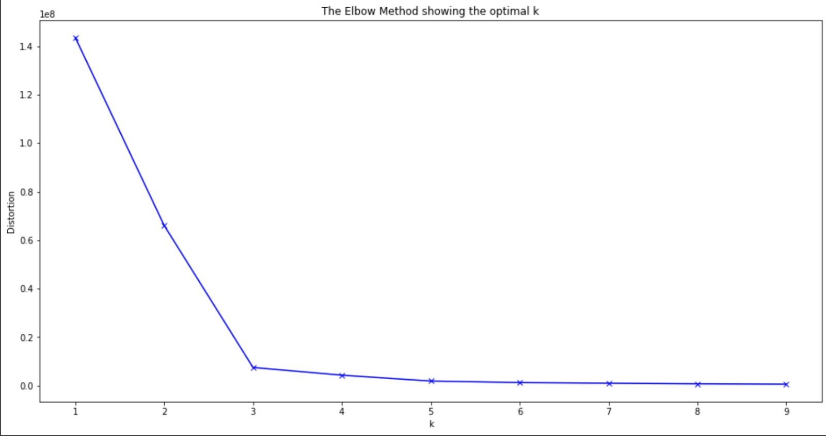
ELBOW DIAGRAM: to find the ideal number of clusters

Slide 16
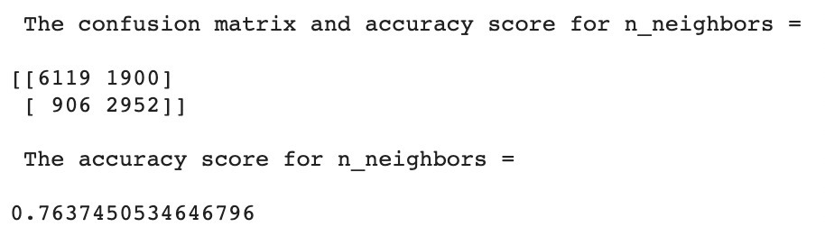
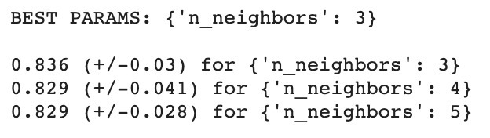
K Nearest Neighbors Algorithm
ACCURACY
BEST PARAMETERS

Slide 17
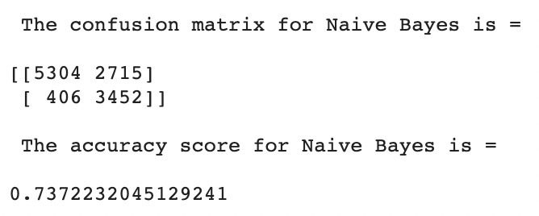
Naive Bayes Algorithm
ACCURACY

Slide 18
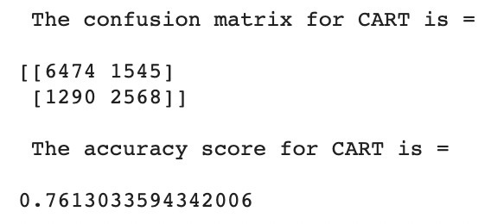
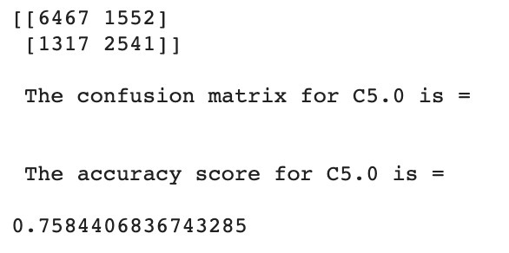
Decision Tree Classifier
ACCURACY
CART
C 5.0

Slide 19
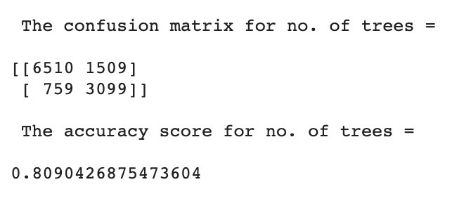
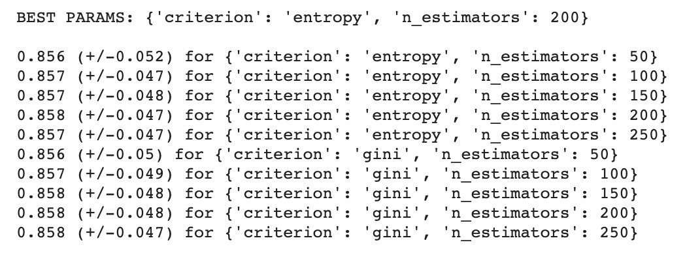
Random Forest Classifier
ACCURACY
BEST PARAMETERS

Slide 20
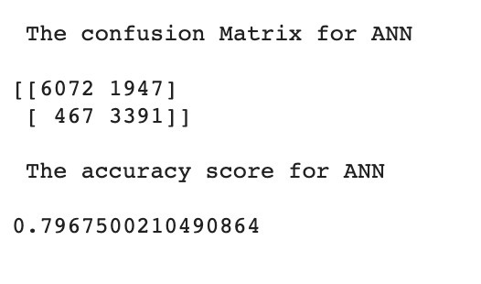
Artificial Neural Network
ACCURACY

Slide 21
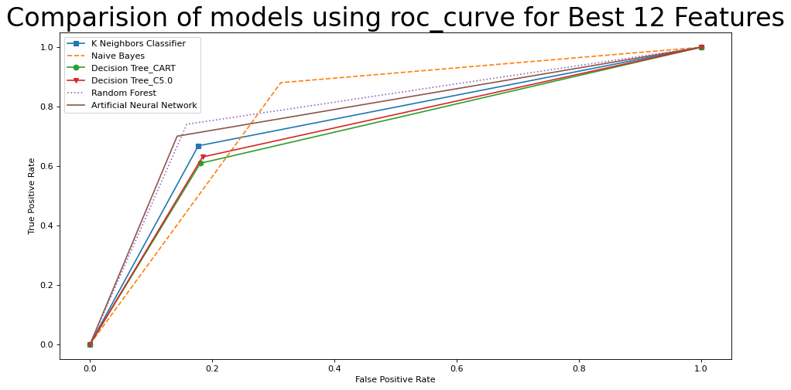
Comparison of models using ROC curve

Slide 22
Comparison of models by their accuracy and AUC
SR.NO. | MODELS | MODEL ACCURACY | AUC
0 | KNN | 0.763745 | 0.764113
1 | NAÏVE BAYES | 0.737223 | 0.778097
2 | CART | 0.761303 | 0.736481
3 | C5.0 | 0.758441 | 0.732546
4 | RANDOM FOREST | 0.809043 | 0.807544
5 | ANN | 0.796750 | 0.818077

Slide 23

WHICH MODEL TO CHOOSE?

Slide 24
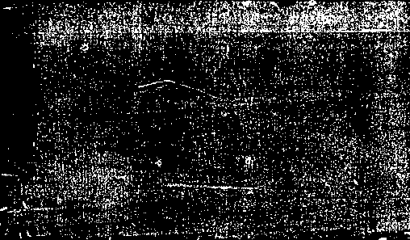
Conclusion
Based on Accuracy as Evaluation Metric, RANDOM FOREST performs well.
Based on ROC/AUC as Evaluation Metrics ANN performs best.

Slide 25

Thank you!
ANY QUESTIONS?

