Slide 1
FRAUDAR: Bounding Graph Fraud in the Face of Camouflage
Team Name: BTF
Team Member: Lizhi Zeng(304593058)
Dui Lin(504759948)
Pei Jiang(604685278)
Zhiming Zhuang(204593426)
Yang Guo(104588741)

Slide 2

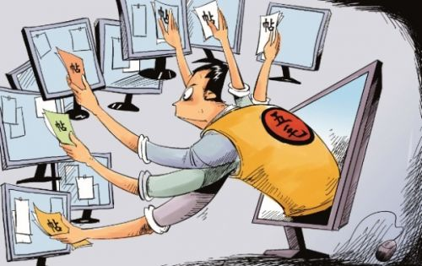
What is Fraud?
Fraud involves one or more persons who intentionally act secretly to deprive another of something valuable, for their own benefit.
In recent years, the development of new technologies provide further ways in which criminals may commit fraud.
e.g. Fake Reviews, Fake Followers
Notes:
For example, a politician may purchase fake followers on Twitter, or a product’s reviews on Amazon may be fake.

Slide 3
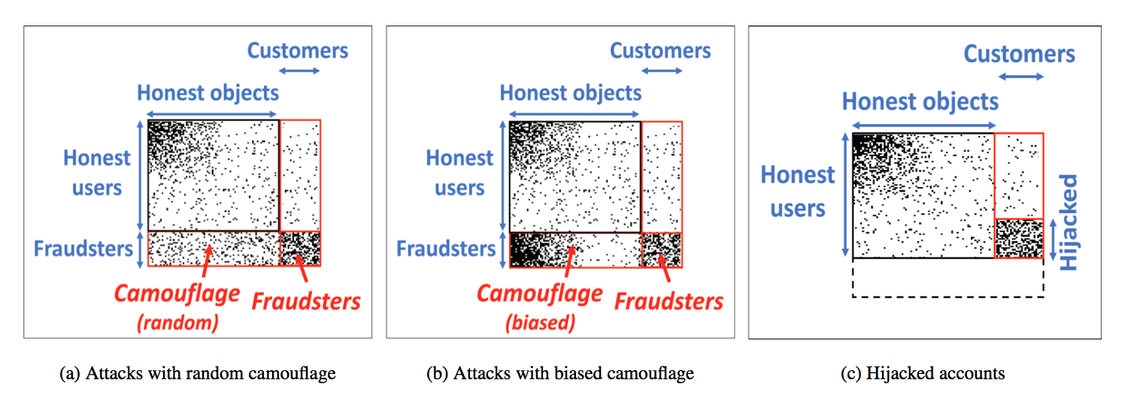
Signs of Frauds
Notes:
It is related to detect dense subgraph.
This picture shows adjacency matrix of the review graph. So rows here represent users and columns represent products. And the dark dots represent reviews. So the frauds are at the bottom. They append by a group of customers who add fake reviews for some products. They are on the bottom right of the matrix. This density region can be detected by a few algorithms
The question that we are interested in is that detect these regions and avoid what we call camouflage.
Fraudsters must add many edges.
Fraudsters create unusually large and dense regions in the adjacency matrix of the graph.
Fraudsters add links to popular items/idols. This behavior is called ‘camouflage’.

Slide 4
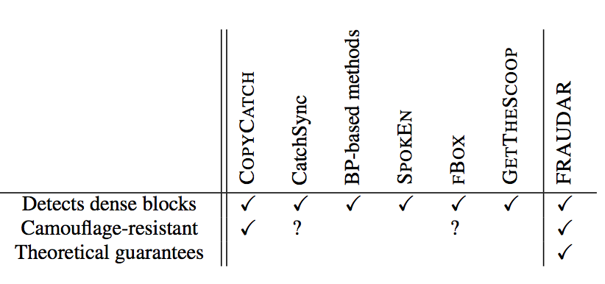
Related Works -- Dense Subgraph Detection
Greedy approximations(Charikar, 2000)
Optimal quasi-cliques(Tsourakakis et al., 2013)
Cross graph quasi-cliques (Pei et al., 2005)
CatchSync (Jiang et al., 2014)
……
Notes:
there is a lot of excellent works on dense graph detection. including these four papers.
They
Try to identify dense subgraphs of nodes that are sparsely connected to the remaining graph.
Do not account for camouflage, In other words, fraudsters can evade these methods by adding reviews or follows with honest targets to make themselves look normal.
And here is the comparison between these algorithms.

Slide 5

This paper: FRAUDAR Algorithm
Camouflage resistant.
Give provable limits on undetectable fraud. Provides
upper bounds on the effectiveness of fraudsters.
Effective in real-world data.
Notes:
mainly differs from the existing literatures , is this paper focus on camouflage resistance, as well as, theoretical guarantee.

Slide 6

Dfn: Suspicious Metrics
Products
Products
The metric g is given by: ,
where S is union of a subset of users
and a subset of products, f is total suspiciousness.
Users
A
Users
A
B
B
g(A, B) = 5
g(A, B) = 20
Notes:
I am going to introduce our proposed algorithm. But at first let me clarify some definitions.
So Suspicious Metrix is actually a function that takes in a subset of products and users, which are given as A and B here and it will calculate a value which indicates how suspicious we believe in these users and products.
And the dark part in this picture represents the abnormal dense subgraph, which are coming from fraudsters
Our goal is that Suspicious Metrics should return a higher value in the case of the unusual subgraphs over here

Slide 7
Dfn: Camouflage-resistance
g is camouflage-resistant if g(A,B) does not decrease when camouflage is added to A.
Products
Products
Users
Users
Camouflage
Same g!
g(A,B) = 50
g(A,B) = 50
Notes:
Let’s talk about camouflage-resistance
camouflage-resistance is that when we add more egdes in this region in a normal way, the value of g should not decrease. The idea behind this is that we want make it hard for the fraudsters to hide themselves by adding camouflage.

Slide 8
Dfn: Average suspiciousness
g(A, B) = (sum of node susp.) + (sum of edge susp.) / |A| + |B|
Products B
Node Score
g(A,B) = (10+25) / 7
3 | 2 | 2 | 2
3 | 0 | 2 | 2
3 | 2 | 2 | 2
2
Users A
2
2
1
1
1
1
Notes:
So now we can define the average suspiciousness in a numerical way. The number outside the table represent the node suspiciousness and the number inside the table represents the edge suspiciousness. Now we sum up all the node of A and B and we can get 10 as the node score.

Slide 9
Dfn: Average suspiciousness
g(A, B) = (sum of node susp.) + (sum of edge susp.) / |A| + |B|
Missing Edge
Products B
Edge Score
g(A,B) = (10+25) / 7
3 | 2 | 2 | 2
3 | 0 | 2 | 2
3 | 2 | 2 | 2
2
Users A
2
2
1
1
1
1
Notes:
And then we sum up all the edges of A and B, and be aware that 0 means there is no edge between two corresponding nodes. Ok, now we get 25 as edge score, and we divide the sum of node score and edge score by the number of nodes.

Slide 10
Why we choose this metric form?
Axiom 1: (Node Suspiciousness). A subset consisting of higher suspiciousness nodes is more suspicious than one consisting of lower suspiciousness nodes, if the other conditions are fixed.
Axiom 2: (Edge Suspiciousness). Adding edges within a subset increases the suspiciousness of the subset if the other conditions are fixed.
Axiom 3: (Size). Assuming node and edge weights are all equal, larger subsets are more suspicious than smaller subsets with the same edge density.
Axiom 4: (Concentration). A subset with smaller size is more suspicious than one with the same total suspiciousness but larger size.
Notes:
So now…. That is because the suspicious metrix could satisfy the four axioms of a general suspicious matrix and in the meanwhile, it could be optimized in three ways: scalable, offers theoretical guarantee, is rubust to camouflage

Slide 11


Two Theorems
Theorem 1: The density metric defined can satisfy previous axioms 1 to 4
Theorem 2: Let A, B be the set of users and objects returned by Fraudar. Then:
where g.opt is the maximum value of g, i.e.
Notes:
Therefore, we have two theorems here, the theorem 1 is what I have just talked about. And from the second theorem, with the suspicious metrix, our FRAUDAR is guaranteed to return a solution at least half of the optimum value.

Slide 12
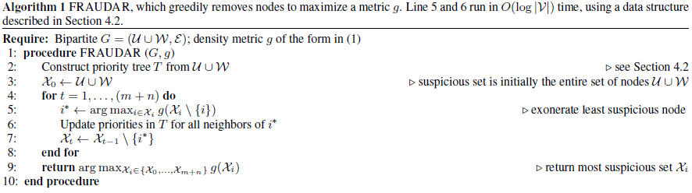
Algorithm to perform in near-linear time
Notes:
Our algorithm is able to perform in roughly linear time.
Basically we use greedy algorithm in the iteration and priority tree to store the data;
We start with the entire set of nodes containing all the users and products, then repeatedly remove the node that results in the highest value of g, which is evaluated on the remaining set of nodes.
You can see the loop in Line 4 take O(m+n) times and line 5 to 7 takes O(log(V)) time to update remaining maximum g value for each time, here V denotes the number of leaves in priority tree. So in total, the algorithm takes time of O((m+n)*log(V))

Slide 13
Edge Weights and Camouflage Resistance
Recall that a density metric g is camouflage resistant if g(A ∪ B) does not decrease when any amount of camouflage is added by an adversary with fraudulent users A and customers B.
They do not allow fraudulent users to make themselves less suspicious by adding camouflage edges such as edges toward honest objects.
Notes:
In this section, we show how we can select metrics within this class that are resistant to camouflage,

Slide 14

Edge Weights and Camouflage Resistance
Recall metrics of the form that where
Key point:
Instead of treating every edge equally, we assign a lower weight cij when the target object j has high degree.
Notes:
This is because objects of very high degree are not necessarily suspicious (since highly popular objects commonly exist). Thus, this weighting allows us to put greater emphasis on objects within unexpectedly dense subgraphs, rather than just high degree objects.

Slide 15
Edge Weights and Camouflage Resistance
Formally, define a column-weighting as a choice of weighting in which each cij is a function of the respective column sum, i.e. cij = h(dj) for some function h.
We recommend using h(x) = 1/ log(x + c), where c is a small constant to prevent the denominator from becoming zero, or excessive variability for small values of x.
Notes:
If we consider the adjacency matrix with rows representing users and columns representing objects, we would like to downweight columns with high column sum (column-weighting).

Slide 16
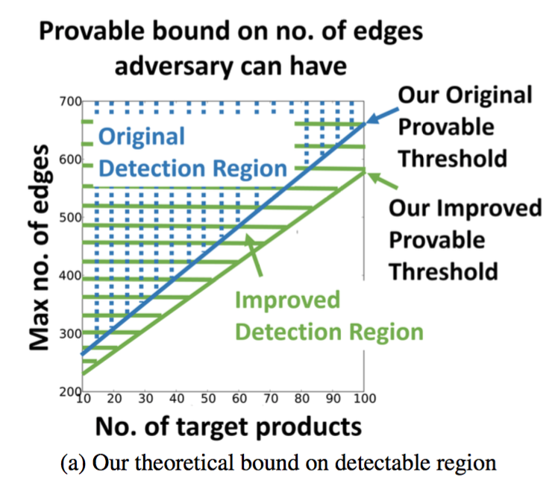

Implications: Bounding Fraud
Theorem 4: Let (A‘, B’) be the block detected by FRAUDAR. Then the number of edges that a fraudulent block of size (m0,n0) can have without being detected is at most
2(m0 + n0)glog(A‘ ∪ B’) log(m0 /λ + c)
In other words, this algorithm will detect a fraudulent block without fail if it contains more edges than this threshold.

Slide 17
Experiments By Applying FRAUDAR
Goals: Try to answer the following questions:
Q1. Illustration of our Theorem: How strong are the theoretical bounds?
Q2. Evaluation on synthetic data: How accurate is our algorithm?
Q3. Effectiveness in real-world data: Does it detect true fraud in real-world data?
Q4. Scalability: Is it scalable with larger data size?
Notes:
Now we move on to the experiments by applying our algorithm:
Basically, we want to answer following four questions from four perpectives.
How strong are the theoretical bounds?
How accurate is our algorithm under different types of camouflage attacks?
Does FRAUDAR detect true fraud in real-world graphs?
Is it scalable with large data size?

Slide 18
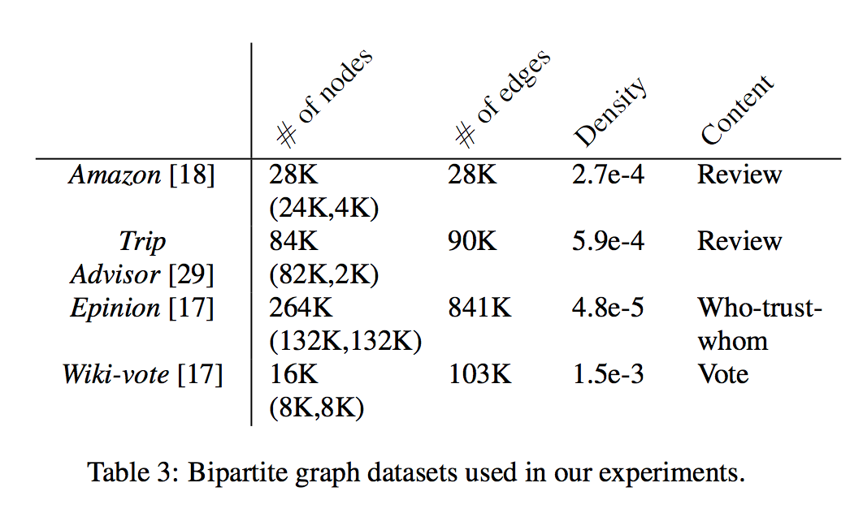
Experiment Settings
Datasets: Amazon, Trip Advisor, Epinion and
Wiki-vote
Here we mainly demonstrate the results from
Amazon datasets
Notes:
Here, We test FRAUDAR on a variety of real-world datasets (from Amazon, Trip Advisor, Epinion and Wiki-vote).
To test the accuracy of our method, we use synthetic attacks and inject them into our Amazon dataset, including random camouflage, biased camouflage and hijacked accounts.

Slide 19
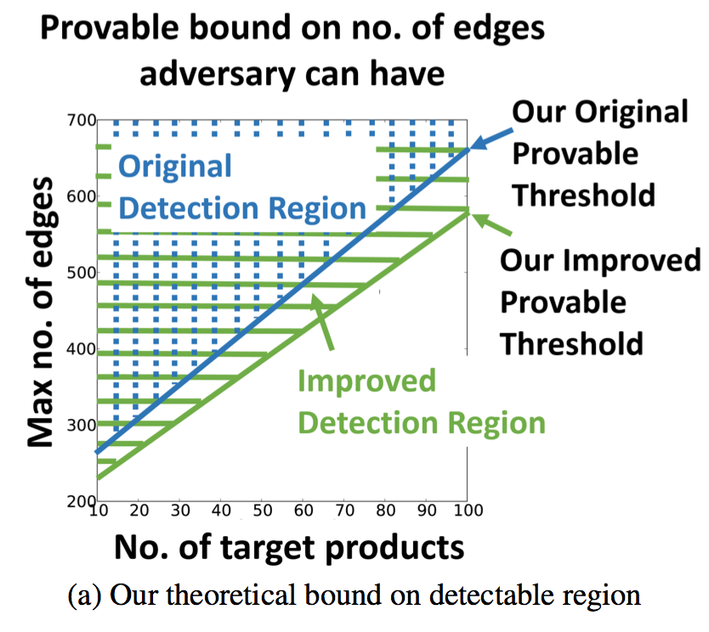
Q1. How strong are the theoretical bounds?
Log-weighted scheme provides stronger bounds
Groups of adversaries stand out more, resulting in stronger bounds on how many edges an adversary can have
Notes:
FROM the right graph, we have drew two conclusions:
Log-weighted scheme provides stronger bounds, because the bound is lower, an adversary should have fewer edges in order not to be detected
Groups of adversaries stand out more, which will results in stronger bounds on how many edges an adversary can have

Slide 20
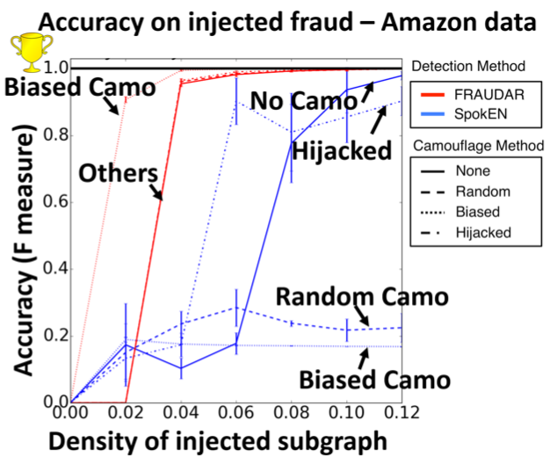
Q2. How accurate is our algorithm?
Notes:
How accurate is our algorithm? FRAUDAR works robustly and efficiently against all four attacks, comparing with the previous algorithm named spoken. And it can achieve F-measures of over .95 on all four scenarios for the densities of subgraph at least .04.

Slide 21
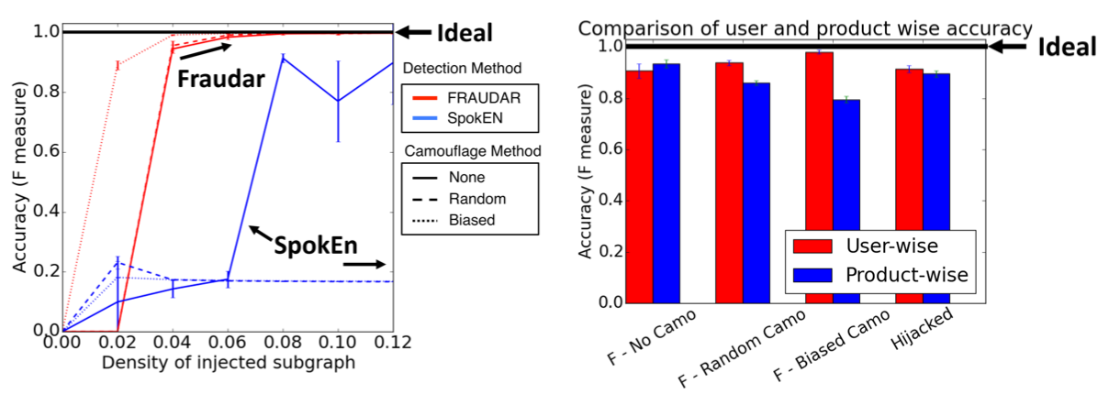
Q2. How accurate is our algorithm? (Cont.)
Dfn.: “reverse camouflage” -> edges from honest users to fraudulent products
Notes:
in the left graph: We conducted another experiment using an attack model where we add edges between honest users and the fraudulent target nodes, but with sparser density compared to the fraud blocks. We added random edges to this region, with half the density of the fraud blocks.
You can see from the left picture: the FRAUDAR outperforms competitors in multiple settings. The vertical axis represents accuracy of fraud detection on Amazon data in the experiment with “reverse camouflage”.
in the right graph: To show that FRAUDAR is effective both at catching fraudulent users accounts as well as fraudulent objects, we next separately evaluate the fraud detection of both fake users and fake targets using F measure. With comparison of accuracy on fake users and targets under four different camouflage attacks, we find out that FRAUDAR has similar and high accuracy both in detecting fraudulent users and fraudulent products.

Slide 22
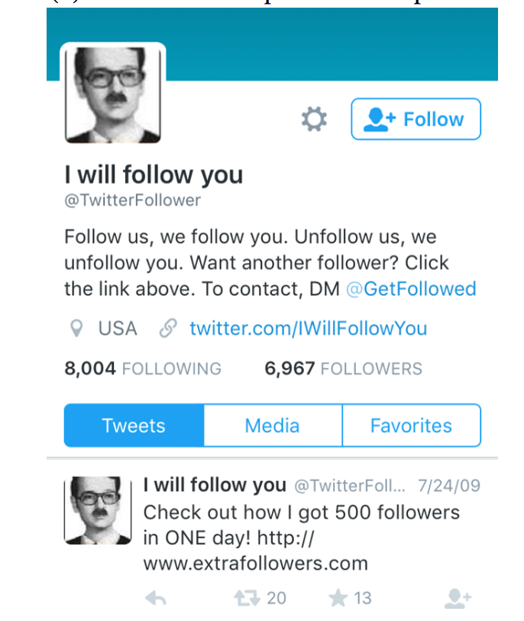
Q3. Does it detect true fraud in real-world data?
Twitter graph with 41.7 million users and 1.47 billion follows;
FRAUDAR detected a dense subgraph of size 4031 followers by 4313 followees with 68% density;
Verified by hand labelling based on established criteria and clear signs of fraud exhibited by a majority of the detected users.
Notes:
The Answer is Yes. Indeed, a majority of the detected accounts had tweets advertising and promoting follower-buying services, and the tweets such as the pic on right side, had not been removed or suspended for 7 years since the data was collected. That is very disappointing.

Slide 23
Q3. Does it detect true fraud in real-world data?
Further investigate the suspicious block:
Randomly sampled 125 followers and 125 followees in the detetcted block
One control group containing 100 randomly selected non-detected users
One degree-matched control group of size 100, matching the follower count of users in the detected group
Shuffle the detected users with the control groups randomly and hide group memberships from labellers, labeling users in a “blind” manner
Notes:
And if we go further to investigate the suspicious block by four steps:
Randomly sampled some followers and followees in the detetcted block
we use One control group containing part of non-detected users, who are randomly selected
we use another degree-matched control group to match the follower count of users in the detected group
Then, we shuffle the detected users with the control groups randomly and hid group memberships from labellers, which labels users in a “blind” manner
We also contain the URLs of two known follower-buying services, TweepMe and TweeterGetter, showing that they had advertised these follower-buying services through tweets.

Slide 24
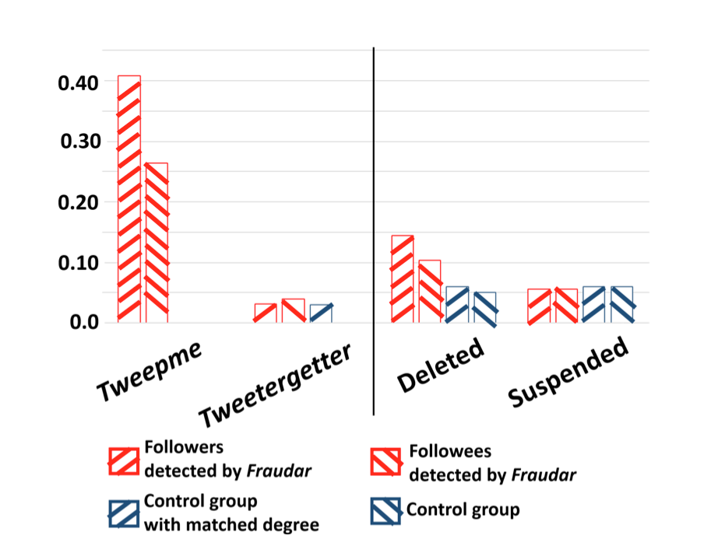
Q3. Does it detect true fraud in real-world data?
Users with tweets advertising follower-buying services
Notes:
And we find out that our FRAUDAR detects a large, clearly fraudulent block in Twitter. A majority of the detected accounts were either deleted, suspended, or contained known follower-buying services, TweepMe and TweeterGetter. In comparison, the control groups had much less detected fraud.

Slide 25
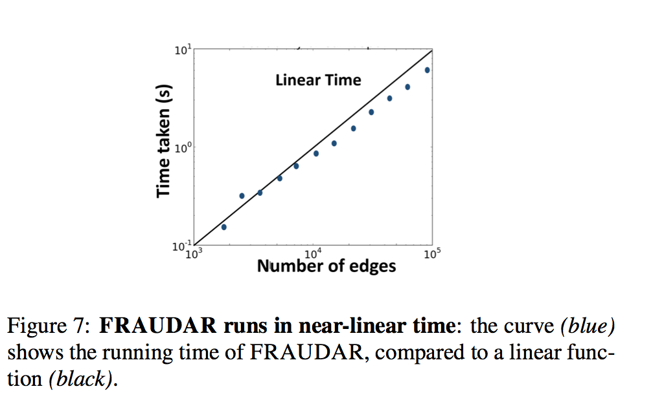
Q4.Is it scalable with larger data size?
Notes:
And the fourth problem about scalability, that is pretty straightforward. But here we used the Trip Advisor dataset, and subsampled user nodes in several proportions. And The Slope is parallel to the main diagonal, which indicates linear growth.

Slide 26
Main Contributions
Novel Metrics: Satisfies intuitive “axioms”
Theoretical Guarantees: Extends the upper bound on undetectable fraud
Effectiveness: Outperforms other methods on real- world graphs
Scalability: Runs near-linearly in the input size.
Notes:
This paper proposed FRAUDAR, a fraud detection algorithm which convincingly bounds the amount of fraud, even under the attack of camouflage. So our main contributions can be concluded in four parts:
we propose,
we prove,
we have an effective algo..
Our algo has tremendous scalability and it can handle large datasets and runs in a near-linear time

Slide 27
Future Works
Spot patterns other than bipartite cores.
e.g. consider the connection between a fraudster and another fraudster
Improve the accuracy by considering dynamic features
e.g. special behavior patterns over time
Notes:
Finally, we have two suggestions for the future work.
consider the connection between a fraudster subgraph and another fraudster subgraph
we can explore more special behavior patterns, which is not constant and can change overtime.

Slide 28
Thank you!

