Slide 1
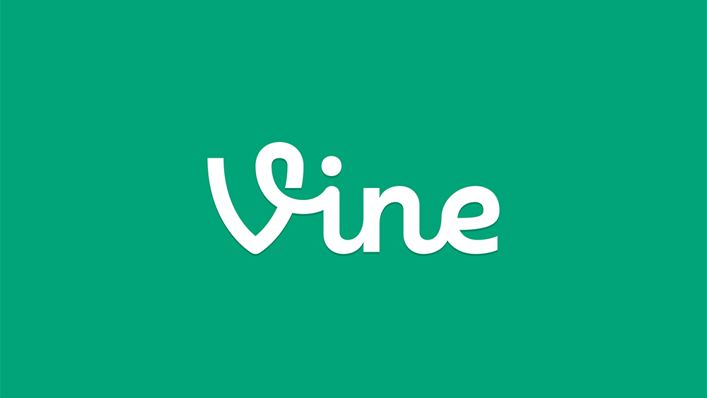
Why Vine Failed
Auto-generated with Python for Microsoft PowerPynt

Slide 2
Overview
What is Vine?

Slide 3
Vine Overview
Founded in June 2012 (Dom Hofmann, Rus Yusupov, Colin Kroll) Acquired by Twitter for ~$30M, Oct 2012
A short-form video app for sharing 6-second looping videos.
Launch: Jan 2013 • Peak: ~200M users (2015) • Shutdown: Jan 2017

Slide 4
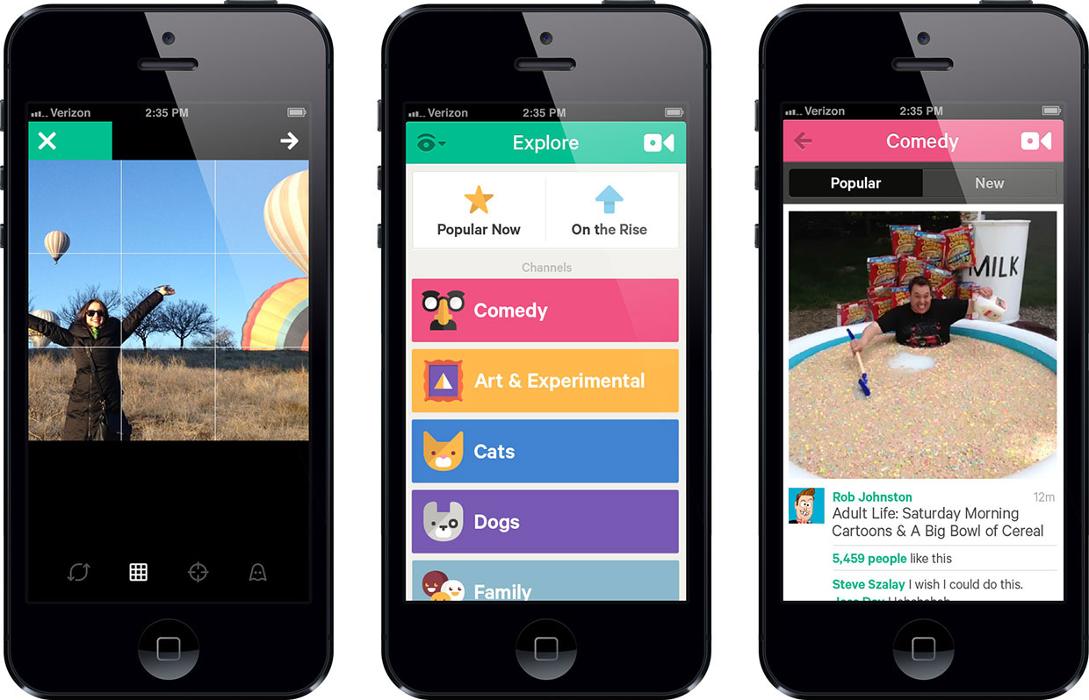
Core Platform Features
6-second looping videos
Easy uploading and browsing on mobile
Instant sharing to Twitter/Facebook
Simple interface, minimal editing features
Allowed multiple 'takes' per vine

Slide 5
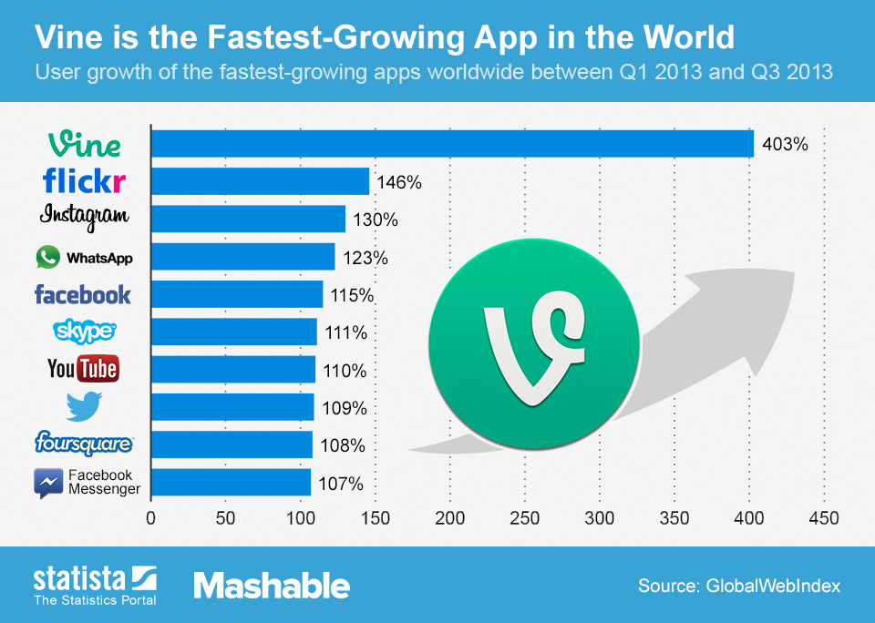
Key Milestones & Growth
Launch: Jan 2013 on iOS, later Android/Xbox
Reached 40M users within a year
Trendsetting among comedians, musicians, and meme creators
Extremely young user base (teens, Gen Z)
Acquired by Twitter before launch

Slide 6
Peak Popularity
Attracted celebrities and brands for viral content
Became a meme powerhouse, launching internet stars
Many creators broke out to mainstream fame
Community culture: 'Viners', collaborations, trends
Daily active users peaked around 30M in 2014-2015

Slide 7
Competitive Pressures
Instagram launched video ~6 months after Vine
Snapchat took over ephemeral creativity
Rise of Musical.ly/TikTok: longer content, more flexibility
Other platforms had monetization built-in
YouTube and IG attracted top Vine creators

Slide 8
Business Model Issues
No revenue sharing or creator funds
No ad network or influencer partnerships
Extremely limited monetization options for top users
Relied solely on parent (Twitter) for financial support
No innovation in paid features or expansion

Slide 9
Positioning
Short videos became less distinctive over time
Lacked editing/effects: TikTok became more creative
Brand did not adapt to creator needs
Celebrity and advertising appeal faded in late years
No response to algorithmic content discovery revolution

Slide 10
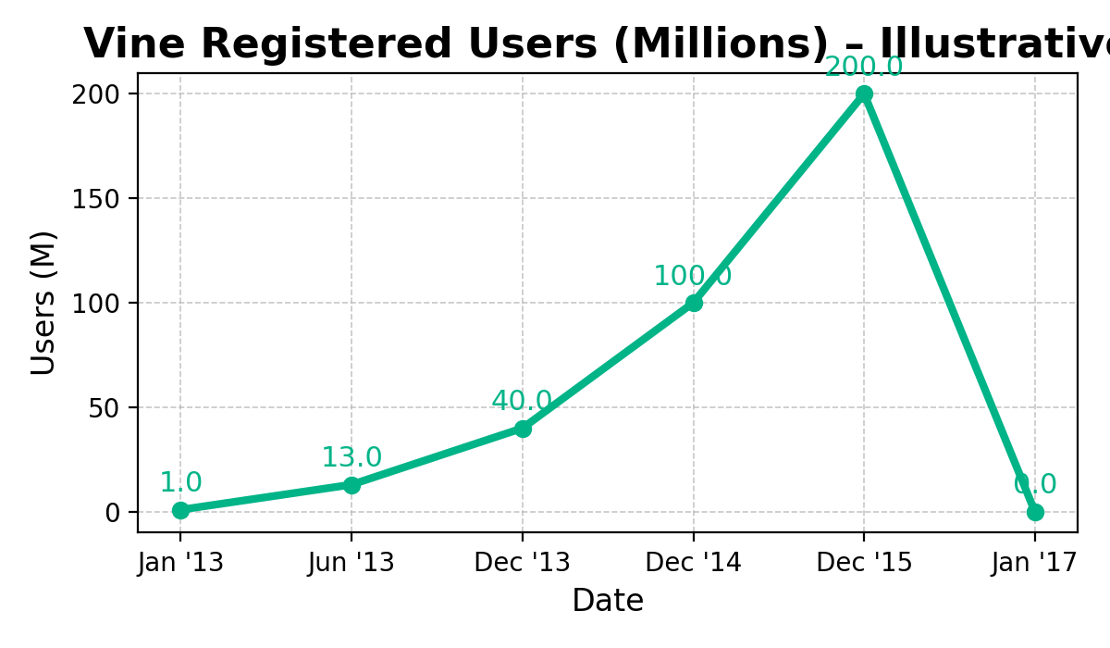
Growth Signal (Illustrative)

Slide 11
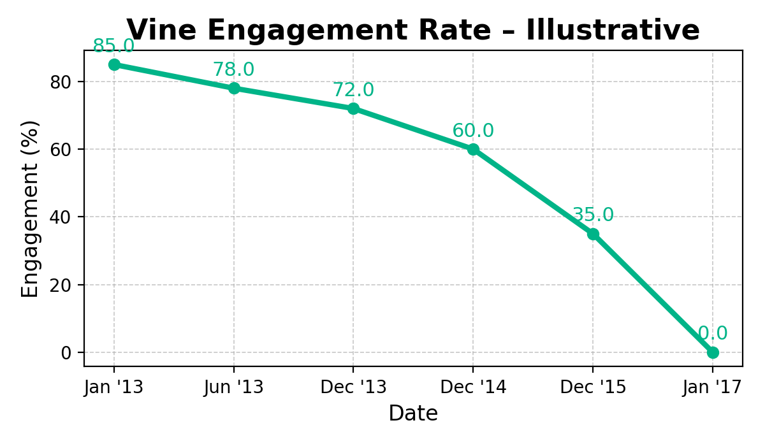
Engagement Decline (Illustrative)

Slide 12
Execution & Org Gaps
Slow to adapt to feature requests (e.g., longer clips)
Weak outreach/support for top creators
Leadership turnover post-acquisition
Poor integration with Twitter ecosystem
Minimal feedback loops for user engagement

Slide 13
Missed Opportunities
Could not pivot to trends like vines on YouTube
Neglected tools for remixing and duets
Few attempts at international growth

Slide 14
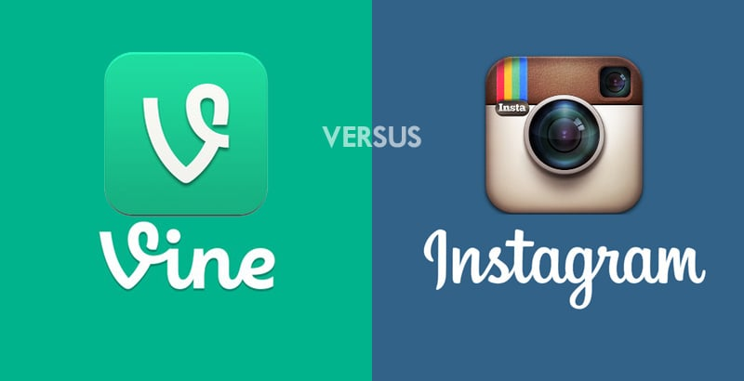
What People Said
“Vine made us stars, but didn’t help us make a living.”
— Popular former Viner

Slide 15
How Instagram and TikTok beat Vine
Longer videos and better editing tools
Algorithmic content recommendation and discovery
Direct and indirect monetization opportunities
Richer social network, discovery, and sharing

Slide 16

Thank You
Generated with python-pptx + matplotlib
Team: <your names here>
GitHub repo: <link here>

