Slide 1
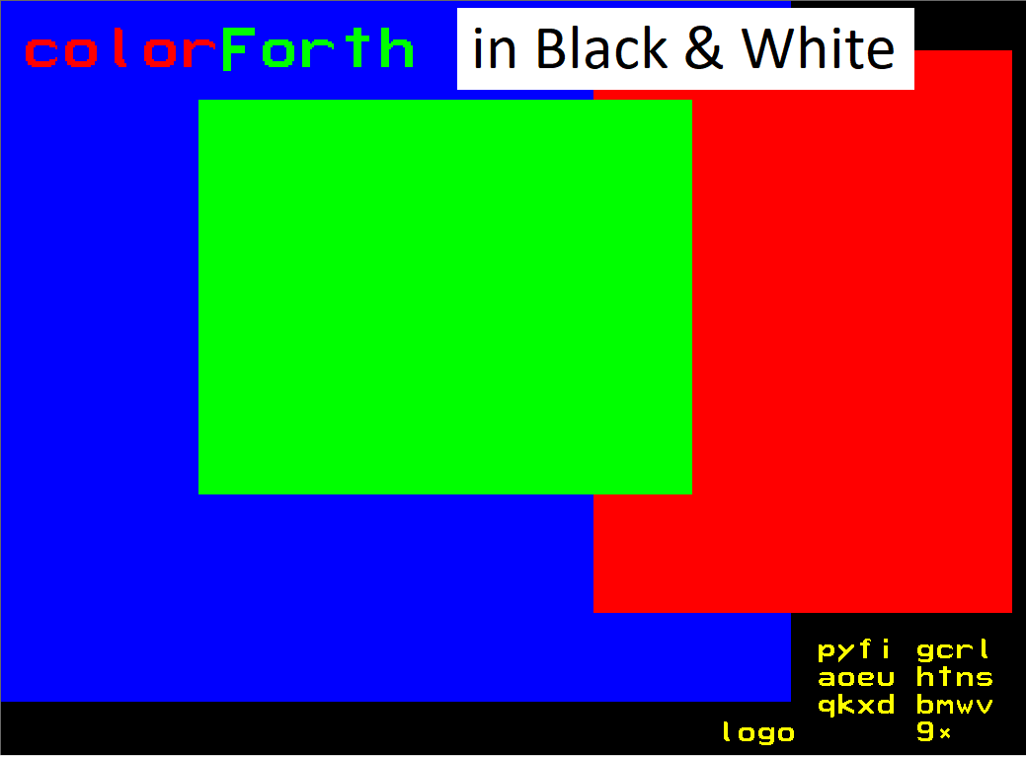

Slide 2
Shortening the Conceptual Gap

Slide 3
Shortening the Conceptual Gap
Edsger Dijkstra in his 1968 paper Go To Statement Considered Harmful states that:
“we should […] do our utmost to shorten the conceptual gap between the static program and the dynamic process […]”

Slide 4
Shortening the Conceptual Gap
Edsger Dijkstra in his 1968 paper Go To Statement Considered Harmful states that:
“we should […] do our utmost to shorten the conceptual gap between the static program and the dynamic process […]”
… which I interpret as “shorten the conceptual gap between source text and program execution”.

Slide 5
Shortening the Conceptual Gap
Edsger Dijkstra in his 1968 paper Go To Statement Considered Harmful states that:
“we should […] do our utmost to shorten the conceptual gap between the static program and the dynamic process […]”
… which I interpret as “shorten the conceptual gap between source text and program execution”.
That is, make it as easy as possible for someone reading the source to create a conceptual model of what the program will do when it runs.

Slide 6
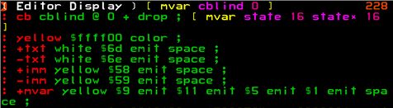
When Chuck Moore created colorForth one of his intentions was to use colour to replace punctuation:

Slide 7
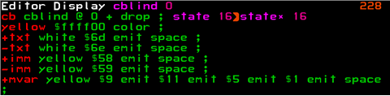
Like this :

Slide 8
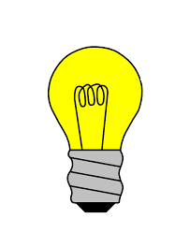
While the use of colour to replace punctuation is an interesting idea…

Slide 9

While the use of colour to replace punctuation is an interesting idea…

Slide 10
…it ultimately fails as a general-purpose programming language because a surprisingly high percentage of people are colour-blind.

Slide 11

…it ultimately fails as a general-purpose programming language because a surprisingly high percentage of people are colour-blind.

Slide 12
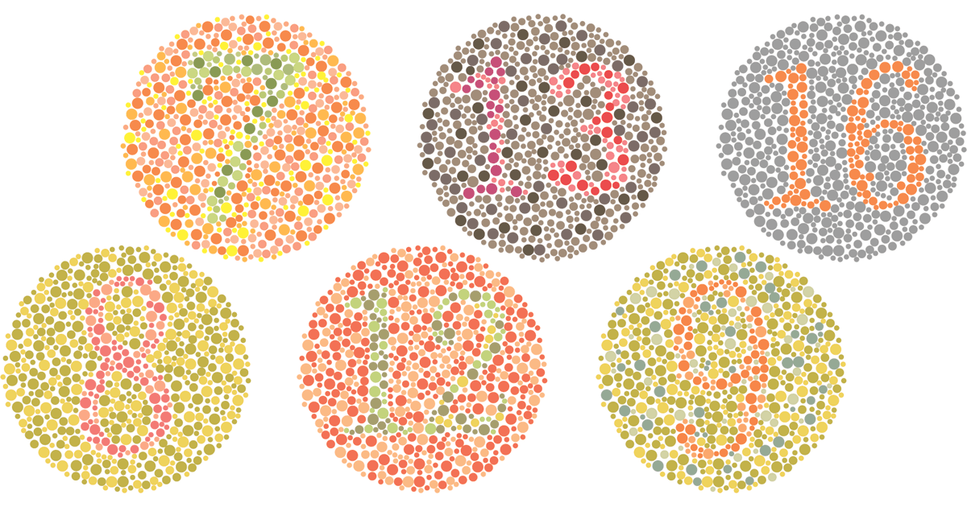
…it ultimately fails as a general-purpose programming language because a surprisingly high percentage of people are colour-blind.

Slide 13
…it ultimately fails as a general-purpose programming language because a surprisingly high percentage of people are colour-blind.
So why the interest in colorForth?

Slide 14
While the name “colorForth”, the coloured representation colorForth and the colourful appearance of the display all emphasise colour (spelled “color” in the USA), in fact the fundamental principles in colorForth go way beyond colour.

Slide 15
While the name “colorForth”, the coloured representation colorForth and the colourful appearance of the display all emphasise colour (spelled “color” in the USA), in fact the fundamental principles in colorForth go way beyond colour.
Colour in this context is just one way of conveying meta-information about a computer program.

Slide 16
While the name “colorForth”, the coloured representation colorForth and the colourful appearance of the display all emphasise colour (spelled “color” in the USA), in fact the fundamental principles in colorForth go way beyond colour.
Colour in this context is just one way of conveying meta-information about a computer program.
This meta-data can be used to control what the user sees in the editor, what the compiler compiles or what the interpreter does.

Slide 17
The colorForth colours and their meanings :
dd colour_orange ; 0 extension token, remove space from previous word, do not change colour
dd colour_yellow ; 1 yellow "immediate" word
dd colour_yellow ; 2 yellow "immediate" 32 bit number in the following pre-parsed cell
dd colour_red ; 3 red forth wordlist "colon" word
dd colour_green ; 4 green compiled word
dd colour_green ; 5 green compiled 32 bit number in the following pre-parsed cell
dd colour_green ; 6 green compiled 27 bit number in the high bits of the token
dd colour_cyan ; 7 cyan macro wordlist "colon" word
dd colour_yellow ; 8 yellow "immediate" 27 bit number in the high bits of the token
dd colour_white ; 9 white lower-case comment
dd colour_white ; A first letter capital comment
dd colour_white ; B white upper-case comment
dd colour_magenta ; C magenta variable
dd colour_silver ; D
dd colour_blue ; E editor formatting commands
dd colour_black ; F

Slide 18
I am looking forward to discovering new ways of simplifying the total colorForth system by

Slide 19
I am looking forward to discovering new ways of simplifying the total colorForth system by
adding carefully controlled complexity into certain key areas :

Slide 20
I am looking forward to discovering new ways of simplifying the total colorForth system by
adding carefully controlled complexity into certain key areas :
Version control

Slide 21
I am looking forward to discovering new ways of simplifying the total colorForth system by
adding carefully controlled complexity into certain key areas :
Version control
Multi-language

Slide 22
I am looking forward to discovering new ways of simplifying the total colorForth system by
adding carefully controlled complexity into certain key areas :
Version control
Multi-language
Multi-user

Slide 23
I am looking forward to discovering new ways of simplifying the total colorForth system by
adding carefully controlled complexity into certain key areas :
Version control
Multi-language
Multi-user
Test framework

Slide 24
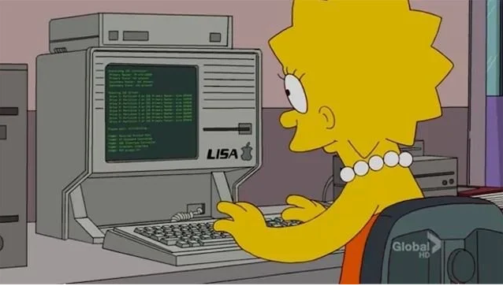

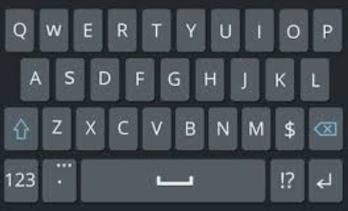
Editor
File
Compiler
: squared ( n -- n ) dup * ;
include
Output
OS
Traditional Text Editor Forth

Slide 25
Editor
File
Compiler
Parser
: squared ( n -- n ) dup * ;
include
Output
OS
Traditional Text Editor Forth

Slide 26
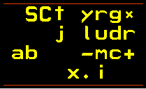
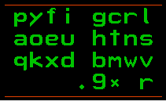
Editor F4
squared n-n dup * ;
Block
load
Compiler
<r>squared <w>n-n <g>dup <g>* <g>;
Output
Hardware
colorForth native mode

Slide 27
Editor F4
: squared ( n – n ) dup * ;
Block
load
Compiler
<r>squared <w>n-n <g>dup <g>* <g>;
Output
Hardware
colorForth colour-blind mode

Slide 28
Editor F7
: zum-quadrat ( n – n ) dup * ;
Block
load
Compiler
<r>squared <w>n-n <g>dup <g>* <g>;
Output
Hardware
colorForth Deutsch

Slide 29
The possibilities are endless
because

Slide 30
The possibilities are endless
because
„colorForth is infinitely powerful“

Slide 31
The possibilities are endless
because
„colorForth is infinitely powerful“

Slide 32
The possibilities are endless
because
„colorForth is infinitely powerful“
Questions?

Slide 33
The possibilities are endless
because
„colorForth is infinitely powerful“
www.inventio.co.uk/cf2019

