Slide 1

Air quality
The air we breathe is loaded with tiny particulates made up of chemicals, allergens, dust, smoke, or soil in the form of (microscopic) solids, gases or liquids. The particulates, or atmospheric particulate matter (PM) are separated into a number of groupings like: pm0.5, pm1.0, pm2.5, pm4.0 and pm10. The groupings are summed up. So: PM10 includes all particulates with a diameter of 10 um or less. ( See: https://en.wikipedia.org/wiki/Particulates )

Slide 2
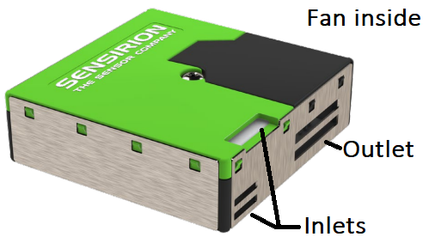
The SPS30
The SPS30 is a calibrated optical particulate matter sensor that measures:
1) The mass concentration is measured in ug/m3 for: pm1.0, pm2.5, pm4.0 and pm10
2) The number concentration is measured in #/cm3 for: pm0.5, pm1.0, pm2.5, pm4.0 and pm10.
3) The typical particle size is measured in um.
The data can be retrieved from a serial port or from an i2c port.
Information and downloads at: https://sensirion.com/products/catalog/SPS30/

Slide 3
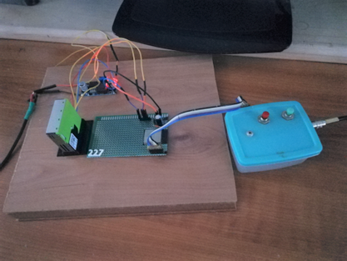
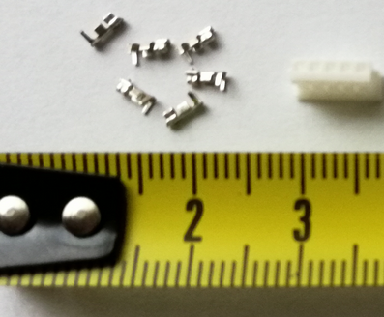
Software extensions for Cforth of Mitch Bradley - A serial port interface to communicate with the sensor. - A driver for the sensor - A ring buffer to keep data records.
Standalone configuration
- An ESP32 break out board - The SPS30 - A standard for the SPS30. - A power supply to get 5V for the SPS30 and 3V for the ESP32. - A female plug ZHR-5 from JST (has very small bus contacts).

Slide 4

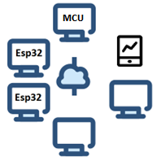
Steps for the SPS30
Measuring the particulates involves a little process
The first record is shown after 11 seconds and is not very accurate.
After 2 cycles the process takes about 3 minutes. That involves:
- start-measurements \ wake up the sensor
- wait-for-status-register
- warming-up \ to get fresh air inside the sensor
- take-samples \ take 5 samples
- Add record to ring buffer \ add the average of the 5 samples
- wait-and-sleep-sensor \ Put the SPS30 in sleep mode until 3 minutes have past \ then the current for the SPS30 drops from 80 mA to 50 uA
Other tasks at the same time:
1) Run a web server
2) Communicate with other systems in the network
2) Show what is going on
3) Allow interactions with the process

Slide 5
