Slide 1
Forth2020 Zoom
colorForth
cf2022 what’s new in 2022
2022 Apr 09

Slide 2
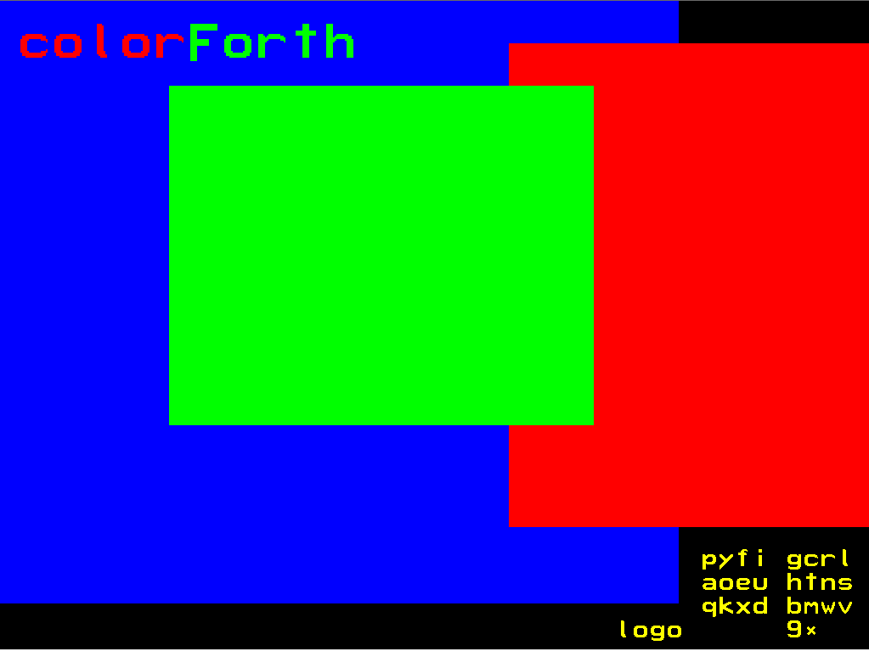

Slide 3
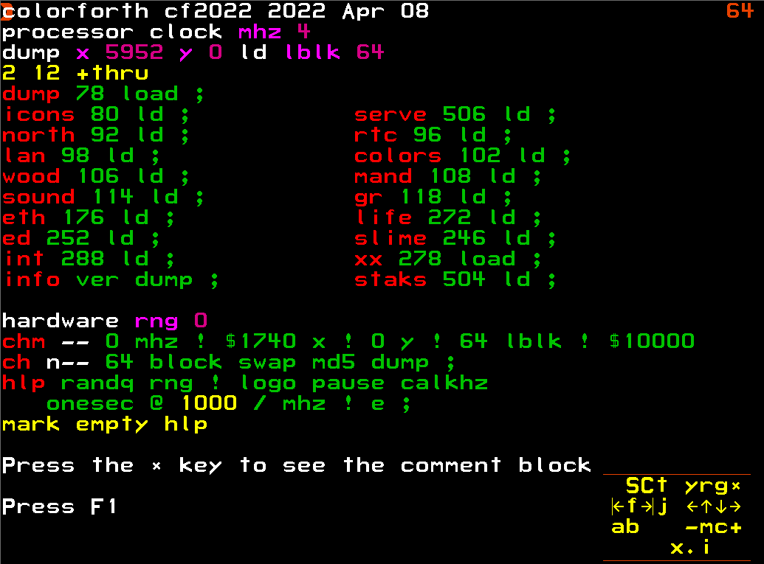

Slide 4
What's new in colorForth : cf2022

Slide 5
What's new in colorForth : cf2022
The font is now in ASCII order, even though Shannon-Fano encoded names are still used internally.

Slide 6
What's new in colorForth : cf2022
The font is now in ASCII order, even though Shannon-Fano encoded names are still used internally.
Yes, you heard it right : ASCII !!!!

Slide 7
What's new in colorForth : cf2022
The font is now in ASCII order, even though Shannon-Fano encoded names are still used internally.
Yes, you heard it right : ASCII !!!!
‘A’ is 65, not 5, just like the rest of the world.

Slide 8
What's new in colorForth : cf2022
The font is now in ASCII order, even though Shannon-Fano encoded names are still used internally.
Yes, you heard it right : ASCII !!!!
‘A’ is 65, not 5, just like the rest of the world.
Shannon_Fano encoding
0123456789ABCDEF0123456789ABCDEF0123456789ABCDEF0123456789ABCDEF01234567 index
db "rtoeanismcylgfwdvpbhxuq0123456789j-k.z/;'!+@*,? RTOEANISMCYLGFWDVPBHXUQ" ASCII

Slide 9
What's new in colorForth : cf2022
The font is now in ASCII order, even though Shannon-Fano encoded names are still used internally.
Yes, you heard it right : ASCII !!!!
‘A’ is 65, not 5, just like the rest of the world.
Shannon_Fano encoding
0123456789ABCDEF0123456789ABCDEF0123456789ABCDEF0123456789ABCDEF01234567 index
db "rtoeanismcylgfwdvpbhxuq0123456789j-k.z/;'!+@*,? RTOEANISMCYLGFWDVPBHXUQ" ASCII
But only for the font….

Slide 10
What's new in colorForth : cf2022
The font is now in ASCII order, even though Shannon-Fano encoded names are still used internally.
The cf2022.nasm code is now better documented. It is not yet perfect

Slide 11
What's new in colorForth : cf2022
The font is now in ASCII order, even though Shannon-Fano encoded names are still used internally.
The cf2022.nasm code is now better documented. It is not yet perfect
cf2022 has four tasks (threads) in a co-operative multi-tasking system
main task handles the keyboard/keypad
draw task displays on the screen and the two server tasks
serv1 and
serv2 are there to handle serial and Ethernet comms.

Slide 12
What's new in colorForth : cf2022
The font is now in ASCII order, even though Shannon-Fano encoded names are still used internally.
The cf2022.nasm code is now better documented. It is not yet perfect
cf2022 has four tasks (threads) in a co-operative multi-tasking system
main task handles the keyboard/keypad
draw task displays on the screen and the two server tasks
serv1 and
serv2 are there to handle serial and Ethernet comms.
A new App: staks shows the stack usage for all four tasks (threads).

Slide 13
What's new in colorForth : cf2022
The font is now in ASCII order, even though Shannon-Fano encoded names are still used internally.
The cf2022.nasm code is now better documented. It is not yet perfect
cf2022 has four tasks (threads) in a co-operative multi-tasking system
main task handles the keyboard/keypad
draw task displays on the screen and the two server tasks
serv1 and
serv2 are there to handle serial and Ethernet comms.
A new App: staks shows the stack usage for all four tasks (threads).
A new Word chm (check MD5) shows the MD5 hash for blocks 64 to 127, the system blocks. This checks that the colorForth system has been copied onto the USB stick correctly. The current system shows “EWROPC”.

Slide 14
What’s cf2022 all about?

Slide 15
What’s cf2022 all about? Why????

Slide 16
What’s cf2022 all about? Why????
Chuck Moore from Fireside chat Nov 2020
https://www.youtube.com/watch?v=81bkIqPpe0g 34:33
Sean: Why do you think Forth has failed to go mainstream?
Chuck: I used to think about that a great deal.
I think that what happens in the world is largely a matter of luck, unpredictable, unrelated to quality or cost - it's just a fad, and some fads stick, and some fads don't.
I don't think that there is any need for Forth to become a mainstream language.
I think it is a very excellent niche language, and a personal language.
It can be used to advantage by people like us, without requiring that the whole world give us permission.

Slide 17
What’s cf2022 all about? Why????
Chuck Moore from Fireside chat Nov 2020
https://www.youtube.com/watch?v=81bkIqPpe0g 34:33
Sean: Why do you think Forth has failed to go mainstream?
Chuck: I used to think about that a great deal.
I think that what happens in the world is largely a matter of luck, unpredictable, unrelated to quality or cost - it's just a fad, and some fads stick, and some fads don't.
I don't think that there is any need for Forth to become a mainstream language.
I think it is a very excellent niche language, and a personal language.
It can be used to advantage by people like us, without requiring that the whole world give us permission.
Why not?

Slide 18
What’s cf2022 all about? Why????
Chuck Moore from Fireside chat Nov 2020
https://www.youtube.com/watch?v=81bkIqPpe0g 34:33
Sean: Why do you think Forth has failed to go mainstream?
Chuck: I used to think about that a great deal.
I think that what happens in the world is largely a matter of luck, unpredictable, unrelated to quality or cost - it's just a fad, and some fads stick, and some fads don't.
I don't think that there is any need for Forth to become a mainstream language.
I think it is a very excellent niche language, and a personal language.
It can be used to advantage by people like us, without requiring that the whole world give us permission.
Why not? No need to follow everyone else…

Slide 19
What’s cf2022 all about? Why????
Programming a PC or Laptop as a Real Time Embedded System

Slide 20
What’s cf2022 all about? Why????
Programming a PC or Laptop as a Real Time Embedded System
No Operating System

Slide 21
What’s cf2022 all about? Why????
Programming a PC or Laptop as a Real Time Embedded System
No Operating System – not easy to lock users in and charge them money without an Operating System.

Slide 22
What’s cf2022 all about? Why????
Programming a PC or Laptop as a Real Time Embedded System
No Operating System
No File System

Slide 23
What’s cf2022 all about? Why????
Programming a PC or Laptop as a Real Time Embedded System
No Operating System
No File System – not easy to lock people in and charge them money without a File System.

Slide 24
What’s cf2022 all about? Why????
Programming a PC or Laptop as a Real Time Embedded System
No Operating System
No File System
No Version Control System

Slide 25
What’s cf2022 all about? Why????
Programming a PC or Laptop as a Real Time Embedded System
No Operating System
No File System
No Version Control System – how can you provide Version Control without Files and without an Operating System?

Slide 26
What’s cf2022 all about? Why????
Programming a PC or Laptop as a Real Time Embedded System
No Operating System
No File System
No Version Control System – how can you provide Version Control without Files and without an Operating System?
I don’t know.

Slide 27
What’s cf2022 all about? Why????
Programming a PC or Laptop as a Real Time Embedded System
No Operating System
No File System
No Version Control System – how can you provide Version Control without Files and without an Operating System?
I don’t know. Yet.

Slide 28
Version Control : the challenge is on.
Storage
Distribution
User interface
09.04.2022
colorForth cf2022 : what’s new in 2022
28

Slide 29
Version Control : the challenge is on.
Storage
Think DropBox, OneDrive, GoogleDrive…
Distribution
User interface
09.04.2022
colorForth cf2022 : what’s new in 2022
29

Slide 30
Version Control : the challenge is on.
Storage
Think DropBox, OneDrive, GoogleDrive…
Distribution
Internet, UDP/IP
User interface
09.04.2022
colorForth cf2022 : what’s new in 2022
30

Slide 31
Version Control : the challenge is on.
Storage
Think DropBox, OneDrive, GoogleDrive…
Distribution
Internet, UDP/IP – not TCP/IP
User interface
09.04.2022
colorForth cf2022 : what’s new in 2022
31

Slide 32
Version Control : the challenge is on.
Storage
Think DropBox, OneDrive, GoogleDrive…
Distribution
Internet, UDP/IP
User interface
Tortoise SVN, Git, Fossil
09.04.2022
colorForth cf2022 : what’s new in 2022
32

Slide 33
Version Control : the challenge is on.
Storage
Think DropBox, OneDrive, GoogleDrive…
Distribution
Internet, UDP/IP
User interface
Tortoise SVN, Git, Fossil – not Git, it is too complicated.
09.04.2022
colorForth cf2022 : what’s new in 2022
33

Slide 34
Version Control : the challenge is on.
cf2022 needs windows
09.04.2022
colorForth cf2022 : what’s new in 2022
34

Slide 35
Version Control : the challenge is on.
cf2022 needs windows
lm and rm
09.04.2022
colorForth cf2022 : what’s new in 2022
35

Slide 36
Version Control : the challenge is on.
cf2022 needs windows
lm and rm
leftmargin and rightmargin
09.04.2022
colorForth cf2022 : what’s new in 2022
36

Slide 37
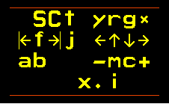
Version Control : the challenge is on.
cf2022 needs windows
lm and rm
leftmargin and rightmargin
09.04.2022
colorForth cf2022 : what’s new in 2022
37

Slide 38
Version Control : the challenge is on.
cf2022 needs windows
lm and rm
leftmargin and rightmargin
The problem has already been solved ☺
09.04.2022
colorForth cf2022 : what’s new in 2022
38

Slide 39
Version Control : the challenge is on.
cf2022 needs Internet
09.04.2022
colorForth cf2022 : what’s new in 2022
39

Slide 40
Version Control : the challenge is on.
cf2022 needs Internet
Ethernet port – relatively easy
09.04.2022
colorForth cf2022 : what’s new in 2022
40

Slide 41
Version Control : the challenge is on.
cf2022 needs Internet
Ethernet port – relatively easy
Wifi hardware and USB – relatively hard
09.04.2022
colorForth cf2022 : what’s new in 2022
41

Slide 42
Version Control : the challenge is on.
cf2022 needs Internet
Ethernet port – relatively easy
Wifi hardware and USB – relatively hard
UDP/IP – relatively easy, code already exists
09.04.2022
colorForth cf2022 : what’s new in 2022
42

Slide 43
Version Control : the challenge is on.
cf2022 needs Internet
Ethernet port – relatively easy
Wifi hardware and USB – relatively hard
UDP/IP – relatively easy, code already exists
Don’t even think about TCP!
09.04.2022
colorForth cf2022 : what’s new in 2022
43

Slide 44
Version Control : the challenge is on.
cf2022 needs Crypto
09.04.2022
colorForth cf2022 : what’s new in 2022
44

Slide 45
Version Control : the challenge is on.
cf2022 needs Crypto
MD5 done
09.04.2022
colorForth cf2022 : what’s new in 2022
45

Slide 46
Version Control : the challenge is on.
cf2022 needs Crypto
MD5 done
SHA-3 available for ANS Forth
09.04.2022
colorForth cf2022 : what’s new in 2022
46

Slide 47
Version Control : the challenge is on.
cf2022 needs Crypto
MD5 done
SHA-3 available for ANS Forth – that is why cf2022 needs ASCII
09.04.2022
colorForth cf2022 : what’s new in 2022
47

Slide 48
The possibilities are endless
because
„colorForth is infinitely powerful“
Die Möglichkeiten sind endlos
weil

Slide 49
The possibilities are endless
because
„colorForth ist unendlich leistungsfähig“
Die Möglichkeiten sind endlos
weil

Slide 50
Shortening the Conceptual Gap
Verkürzung der konzeptionellen Lücke

Slide 51
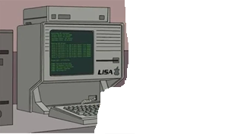

Shortening the Conceptual Gap
Verkürzung der konzeptionellen Lücke

Slide 52
Shortening the Conceptual Gap
Verkürzung der konzeptionellen Lücke

Slide 53
Shortening the Conceptual Gap
Verkürzung der konzeptionellen Lücke

Slide 54
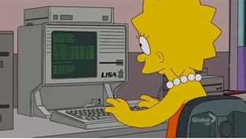
Shortening the Conceptual Gap
Verkürzung der konzeptionellen Lücke

Slide 55


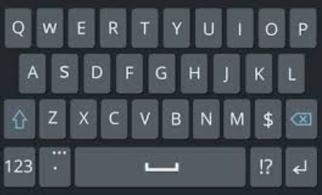
Editor
File
Compiler
: squared ( n -- n ) dup * ;
include
Output
OS
Traditional Text Editor Forth

Slide 56
Editor
File
Compiler
Parser
: squared ( n -- n ) dup * ;
include
Output
OS
Traditional Text Editor Forth

Slide 57
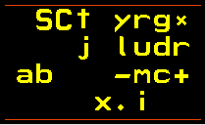
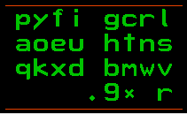
Editor F4
squared n-n dup * ;
Block
load
Compiler
<r>squared <w>n-n <g>dup <g>* <g>;
Output
Hardware
colorForth native mode

Slide 58
Editor F4
: squared ( n – n ) dup * ;
Block
load
Compiler
<r>squared <w>n-n <g>dup <g>* <g>;
Output
Hardware
colorForth colour-blind mode

Slide 59
Editor F7
: zum-quadrat ( n – n ) dup * ;
Block
load
Compiler
<r>squared <w>n-n <g>dup <g>* <g>;
Output
Hardware
colorForth Deutsch

Slide 60
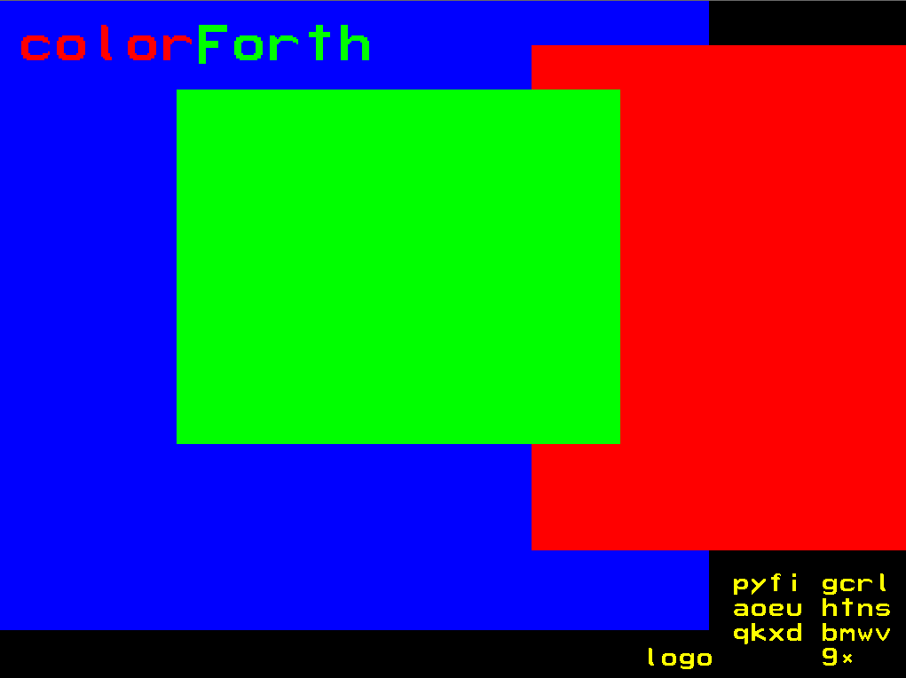

Slide 61
Questions? Fragen?

Slide 62
www.inventio.co.uk/colorforth

