Slide 1
Machine Learning in HealthCare
Practical Session: Freezing of Gait Detection
Po-Kai Yang
po-kai.yang@kuleuven.be
Dynamical Systems, Signal Processing and Data Analytics (STADIUS), Group T Leuven Campus

Slide 2
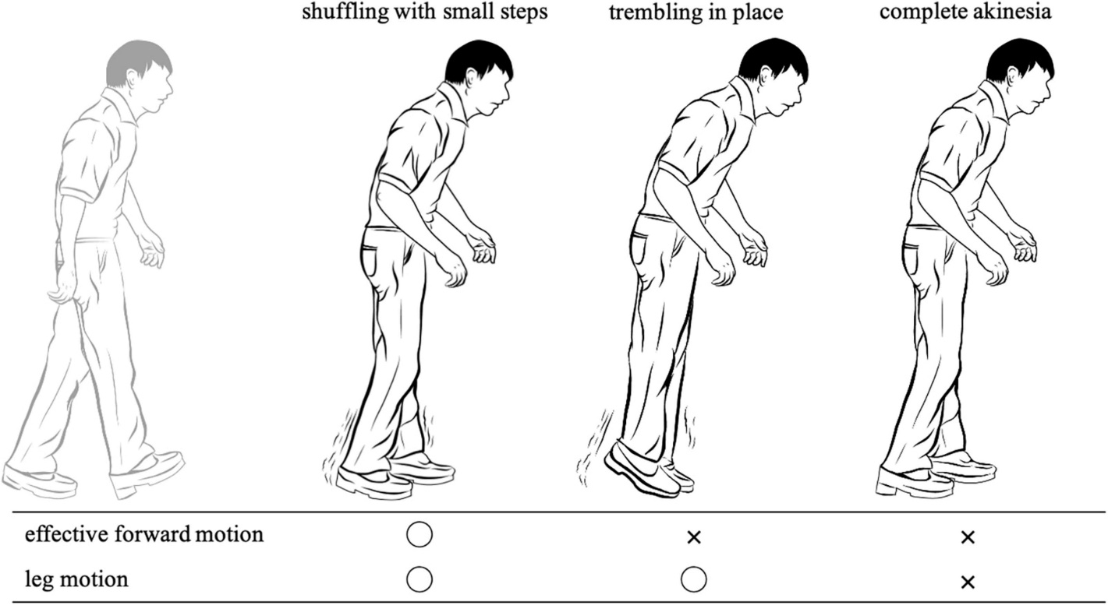
Context
Freezing of Gait (FOG)
Defined as “ a brief, episodic absence or marked reduction of forward progression of the feet despite the intention to walk” (Nutt et al. 2011)
Figure 1. Three phenotypes of freezing of gait according to leg movements.
Nutt, J.G., Bloem, B.R., Giladi, N., Hallett, M., Horak, F.B., Nieuwboer, A.: Freezing of gait: moving forward on a mysterious clinical phenomenon. The Lancet. Neurology 10, 734–744 (2011). doi:10.1016/S1474-4422(11)70143-0

Slide 3
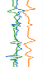

Context
Freezing of Gait (FOG) Detection
Window-based methods
This assignment
Groundtruth of each window
Majority Voting: [0,0,1,1,0,0,0] -> 0
Centered label: [0,0,1,1,0,0,0] -> 1
Sample-based methods
Groundtruth of each example
Experts’ sample-wise annotation
Model
Non-FOG
Non-FOG
FOG
Non-FOG
Model

Slide 4

Dataset
Chest
Public dataset from O’Day et al.
Seven subjects
Six IMUs
Sampling rate: 128Hz
3-axis accelerometer; 3-axis gyroscope
Data in this assignment
3-axis accelerometer from the lumber IMU
Window-size = 2 sec (256 samples)
Lumber
Ankle
Foot
O’Day, J., Lee, M., Seagers, K. et al. Assessing inertial measurement unit locations for freezing of gait detection and patient preference. J NeuroEngineering Rehabil 19, 20 (2022). https://doi.org/10.1186/s12984-022-00992-x

Slide 5
Deep Learning Model
1D Convolutional Neural Network
Model architecture from O’Day et al.
Input: (256,3)
1D Conv (17,3)
#filters=16
1D Conv (17,16)
#filters=16
1D MaxPooling
size=2
Fully Connected Layer
#nodes=10
ReLU
50% Dropout
ReLU
50% Dropout
FOG Probability

Slide 6
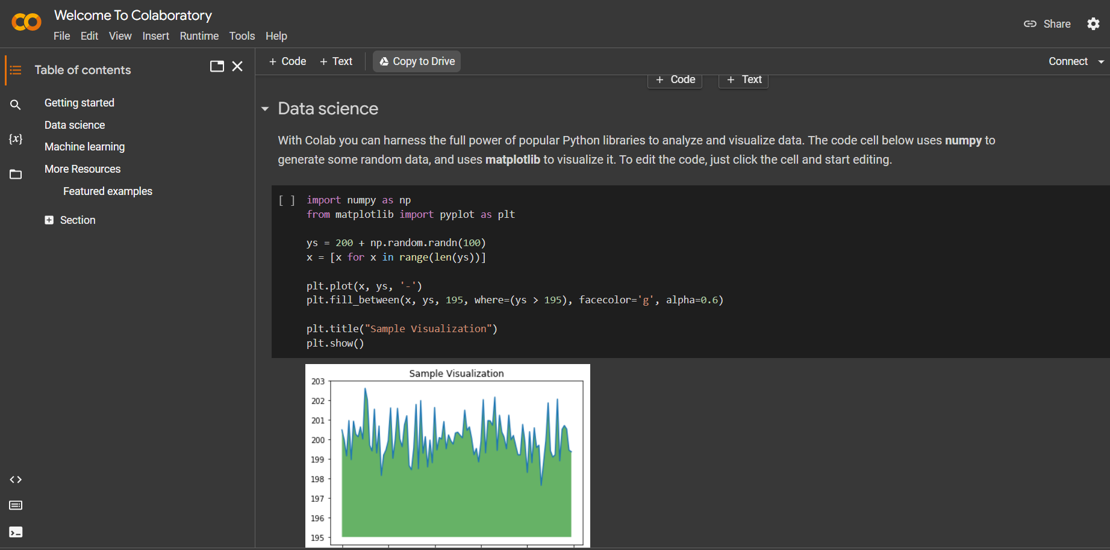
Frameworks
Tensorflow
Keras API
Google Colab
Keras vs Tensorflow vs Pytorch: Key Differences Among Deep Learning https://www.simplilearn.com/keras-vs-tensorflow-vs-pytorch-article

Slide 7
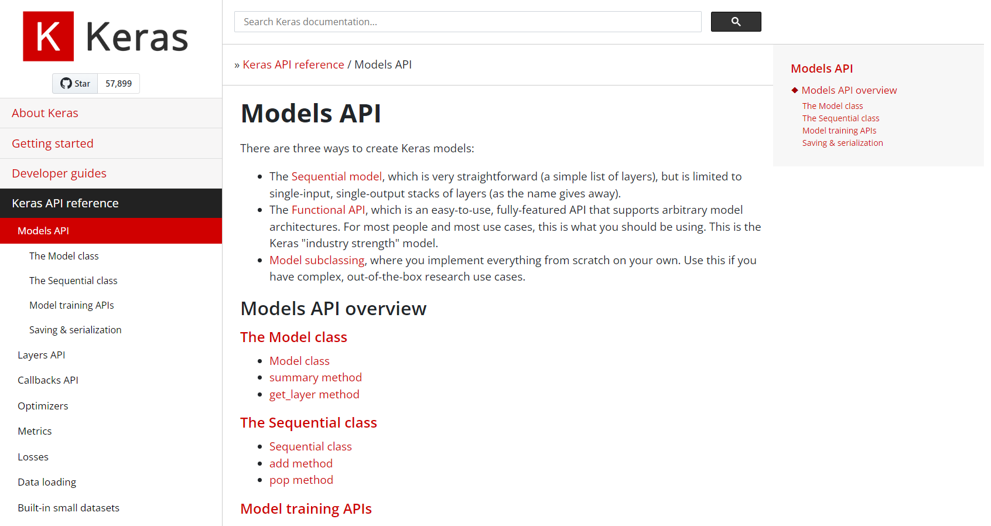
Keras API
https://keras.io/api/models/

Slide 8
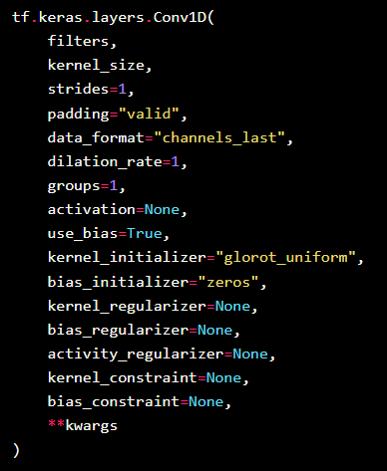
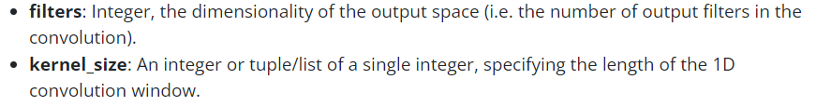
Keras API
Conv1D layer
https://keras.io/api/layers/convolution_layers/convolution1d/

Slide 9
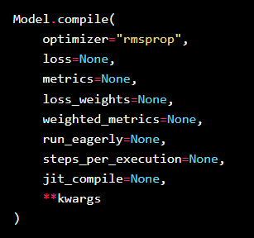

Keras API
https://keras.io/api/models/model_training_apis/
Specify the optimizer
Model Training
Model compile
Optimizer:
Gradient descent
Adam*
More information: https://medium.com/mlearning-ai/optimizers-in-deep-learning-7bf81fed78a0
Model fit

Slide 10
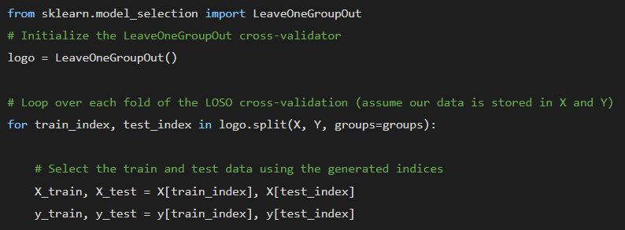
Scikit-Learn
https://scikit-learn.org/stable/modules/generated/sklearn.model_selection.LeaveOneGroupOut.html
https://scikit-learn.org/stable/modules/generated/sklearn.metrics.f1_score.html
Model Evaluation
Leave-one-subject-out Cross Validation
Similar as K-Fold, with K = #subjects
F1 Score

Slide 11
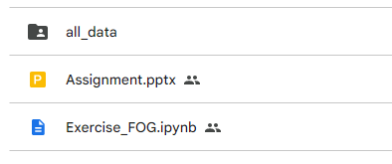
Google Colab Notebook
Drive: https://shorturl.at/vBEF2
Download and Upload the “Project” folder to your own google drive
Questions are written in Bold
Fill in code with a TODO
Grading:
Report
Evaluation
Submission deadline: 19 May for the project, 26 May for the review
Contact: po-kai.yang@kuleuven.be

Slide 12
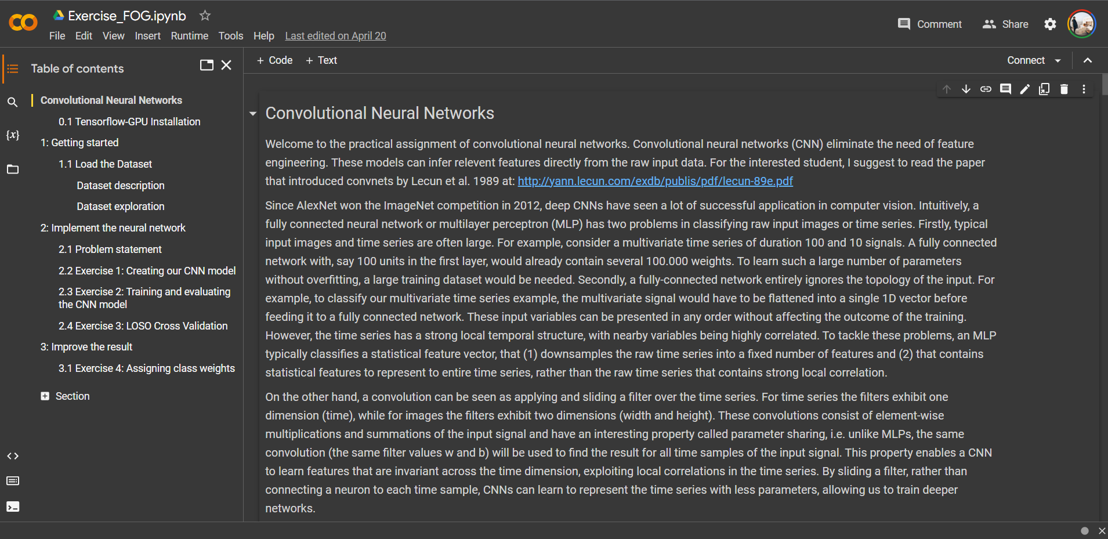
Google Colab Notebook

Slide 13
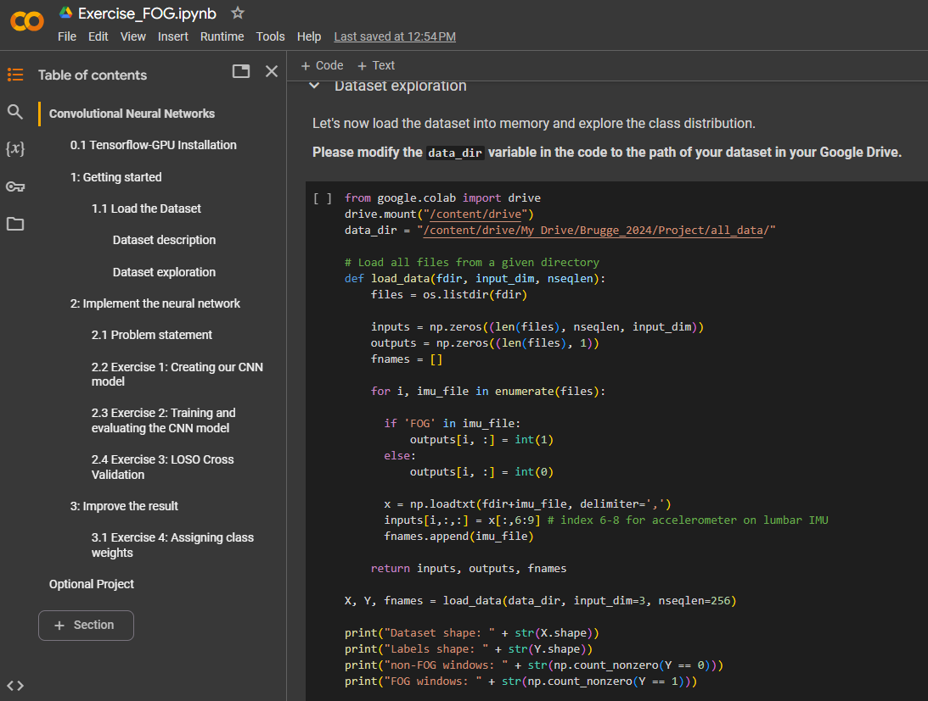
Google Colab Notebook

