Slide 1

Breaking Bread Together Presented by Sweta Rout, Atefeh Morsali, and Aditya Duneja North Carolina State University December 2018

Slide 2
Outlines
Introduction
Problem Statement
Methodology
Main components
Reactive
Proactive + Reactive
Classification
Hypothesis
Evaluation
Data set
Hypothesis evaluation
Conclusion

Slide 3
Introduction
Social Isolation
A lack of meaningful relationships
Felt strongly in cases of
A new or unfamiliar environment such as moving to a new neighborhood, starting a different job and studying for a new degree
An individual is required to cope with stresses, failures or disappointments, or the loss of family member
In these cases, social contacts or social interactions become of paramount importance

Slide 4
Problem Statement
Technology has already started playing a major role in combating social loneliness with Internet of things (IoT) enabled smart homes, conversation agents like Alexa that connect our family members and friends and robotic pets that show emotions
The major focus with such technologies has been on predicting social isolation rather than taking appropriate actions to remediate it across people in all age groups
Propose an idea that uses IoT enabled sensors to determine individual’s interest and preferences, based on the food habit, to recommend social interactions to isolated people to help remediate social loneliness

Slide 5
Main components
Methodology
IoT device Raspberry Pi
- To collect data specific to an individual
Motion Sensor
- To calculate number of times the main door has been opened and closed
Heat sensor
- To calculate the number of meals cooked by an individual
Bluemix Cloud
- Data analysis and classification based on various food groups
DialogFlow
- A chat bot to interact with the user to record the social isolation level and make recommendations
MAS events

Slide 6
Methodology
Reactive (By chat bot)
User knows he is socially isolated
User initiates the chat bot and answer specific questions; for example, number of meals cooked per day, cuisine preferences, age and gender
chat bot makes a query with his replies to the cloud
A cloud based classifier (based on SVM method) classifies the user into one of the food group classes
Cloud returns a list of users that belong to the same class
Chat bot
Food Preferences
Cloud
SVM Classification
MAS events
Recommendation
Reactive
6

Slide 7
Methodology
Proactive + Reactive (Cloud notifications)
User doesn’t realize that he is socially isolated
The motion sensor and the heat sensor are used to determine if there are multiple people at home when the stove is on and the number of meals cooked per day, respectively
Data (the number of meals cooked, number of meals ate alone at home and number of meals ate outside) is recorded on cloud and a social isolation level (SIL) is calculated
Notifications is sent to the user saying that the user is isolated
could connect with other people who belong to the same food group of user
The cloud will also send a link to start the chat bot for better suggestions which are based on cooking habits as well as food preferences (cooking habits are recorded using the sensors and food preferences are recorded by the chat bot)
MAS events
7
7

Slide 8
Methodology
Raspberry Pi
Isolation Level
Cooking Habits
Cloud
Chat bot
Food Preferences
SVM Classification
Recommendation
Proactive + Reactive

Slide 9
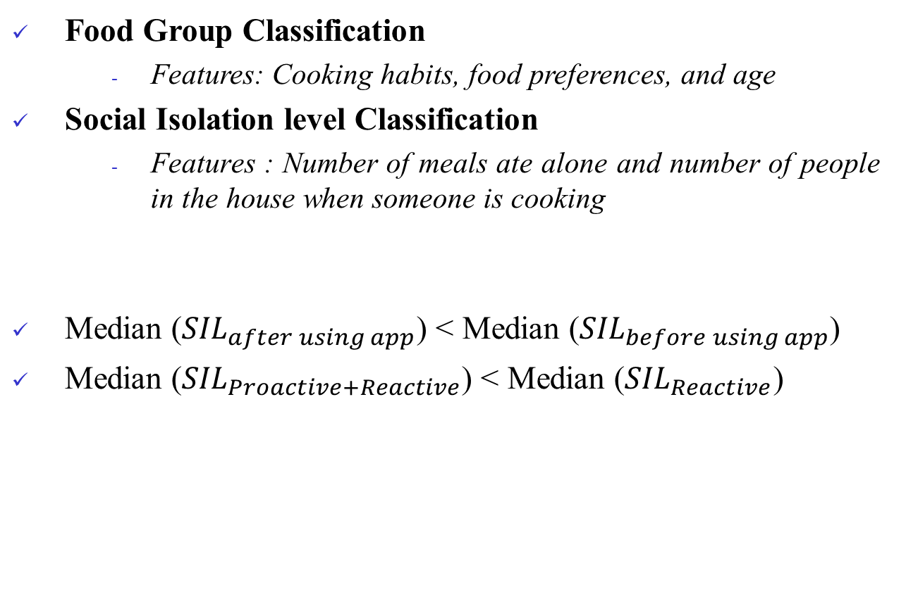
Methodology
Classification (SVM Classification)
Food Group Classification
Features: Cooking habits, food preferences, and age
Social Isolation level Classification
Features : Number of meals ate alone and number of people in the house when someone is cooking
Median (${SIL}_{after using app}$) < Median (${SIL}_{before using app}$)
Median (${SIL}_{Proactive+Reactive}$) < Median (${SIL}_{Reactive}$)
Hypothesis
MAS events
9
9
9

Slide 10
Evaluation
Evaluation
Data set
Sample set of 10 users
Compute social isolation level before and after using the app
Sl. No | Name | Initial SIL | Method
1 | User1 | 0 | Proactive + Reactive
2 | User2 | 1 | Reactive
3 | User3 | 2 | Proactive + Reactive
4 | User4 | 3 | Proactive + Reactive
5 | User5 | 3 | Reactive
6 | User6 | 3 | Proactive + Reactive
7 | User7 | 3 | Proactive + Reactive
8 | User8 | 4 | Proactive + Reactive
9 | User9 | 4 | Reactive
10 | User10 | 5 | Proactive + Reactive
MAS events
MAS events
10
10
10
10
10
10
10

Slide 11

Evaluation
Evaluation
Hypothesis evaluation
Median (${SIL}_{after using app}$) < Median (${SIL}_{before using app}$)
Sl. No | Name | Initial SIL | Final SIL
1 | User1 | 0 | 0
2 | User2 | 1 | 1
3 | User3 | 2 | 2
4 | User4 | 3 | 1
5 | User5 | 3 | 2
6 | User6 | 3 | 1
7 | User7 | 3 | 1
8 | User8 | 4 | 2
9 | User9 | 4 | 3
10 | User10 | 5 | 3
MAS events
MAS events
11
11
11
11
11
11
11

Slide 12
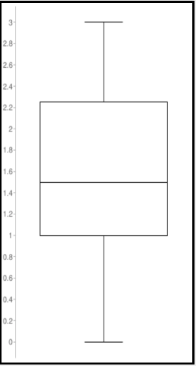
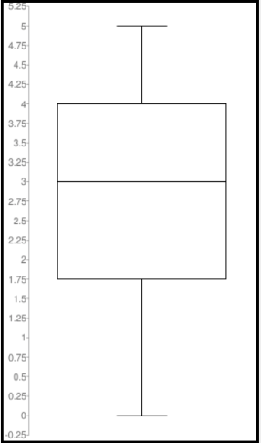
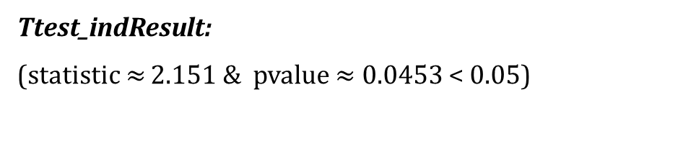
Evaluation
Evaluation
Hypothesis evaluation
Median (${SIL}_{after using app}$) < Median (${SIL}_{before using app}$)
MAS events
MAS events
Ttest_indResult:
(statistic $≈$ 2.151 & pvalue $≈$ 0.0453 < 0.05)
12
12
12
12
12
12
12
12

Slide 13

Evaluation
Evaluation
Hypothesis evaluation
Median (${SIL}_{Proactive+Reactive}$) < Median (${SIL}_{Reactive}$)
Proactive + Reactive
Sl. No | Name | Initial SIL | Final SIL
1 | User1 | 0 | 0
2 | User3 | 2 | 2
3 | User4 | 3 | 1
4 | User6 | 3 | 1
5 | User7 | 3 | 1
6 | User8 | 4 | 2
7 | User10 | 5 | 3
Proactive + Reactive
median = 1
Ttest_indResult:
statistic = 2.041,
pvalue = 0.04385 < 0.05
Reactive
Median = 2
Ttest_indResult:
statistic = 0.6325,
pvalue = 0.5614 > 0.05
MAS events
MAS events
Reactive
Sl. No | Name | Initial SIL | Final SIL
1 | User2 | 1 | 1
2 | User5 | 3 | 2
3 | User9 | 4 | 3
13
13
13
13
13
13
13
13

Slide 14
Conclusion
Both hypothesis were evaluated and were correct
There is no significant improvement in the social isolation level using Reactive only. Maybe, the reason for such results is not enough data available for reactive method
14

Slide 15
Questions?

