Slide 1

Do People* Like Anime Adaptations**?
*People who rank anime and manga online
**Anime that have a manga with the same title

Slide 2


Nerds do not like change.
Source: Personal experience.

Slide 3
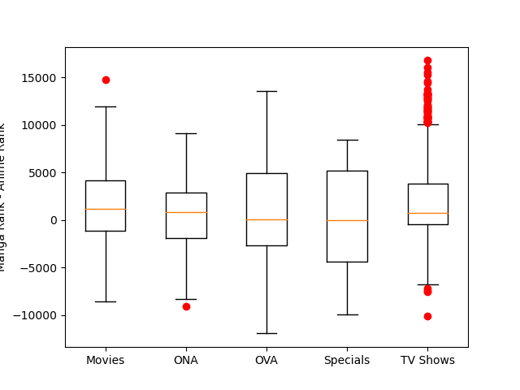
So Which Is Better?

Slide 4
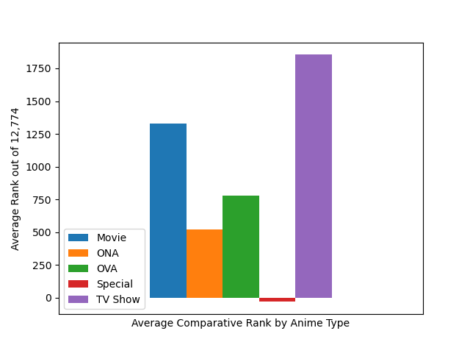
Maybe There Is A Winner…

Slide 5
The Fine Print
A biased population
Chicken vs Egg
Exclusively eponymous

