Slide 1



Method
Phase I
3
Analyser Module
1
SUT
Test Data Generation Module
Pre-processing
Test data
Rule mining
2
MT Module
Test data (transformed)
MRs Checker
Input transformations
Report/Rules
Set of MRs

Slide 2

Method
Phase II
Regression Test Suite
Test Suite Generation Module
Report/Rules
( from Phase I )
Set of MRs

Slide 3
Phase I
3
Analyser Module
1
SUT
Test Data Generation Module
Inspection of some sample values
Pre-processing
Test data
b) <100% cases
a)
2
MT Module
Rule mining (predefined data type relations)
Test data (transformed)
MRs Checker
Test data transformations
Tester feedback:
Qualifying MR’s verdict:
a) Incorrect (Faulty SUT)
b) Correct
b.1) MR not violated (positive test)
b.2) MR violated (negative test)
Set of MRs
Mapped relations
Rules
b) 100% cases
Repeat Phase I as long case a) is present

Slide 4
Phase I
Phase II
3
Analyser Module
1
SUT
Test Suite Generation Module
Test Data Generation Module
Inspection of some sample values
Pre-processing
Regression Test Suite
Test data
b) <100% cases
a)
2
MT Module
Rule mining (predefined data type relations)
Test data (transformed)
MR Checker
Test data transformations
Tester feedback:
Qualifying MR’s verdict:
a) Incorrect (Faulty SUT)
b) Correct
b.1) MR not violated (positive test)
b.2) MR violated (negative test)
RULES
Set of MRs
Mapped relations
b) 100% cases
RULES
Repeat Phase I as long case a) is present

Slide 5
Phase II
Regression Test Suite
Test Suite Generation Module
RULES

Slide 6

Phase I
3
Analyser Module
1
SUT
Test Data Generation Module
Pre-processing
Test data
User feedback 1
Inspection of some sample values
2
MT Module
Rule mining
Test data (transformed)
MRs Checker
Input transformations
User feedback 2
Inspection of the rules generated.
Set of MRs
Report/Rules
The cycle stops when all faults have been fixed.
Phase II
Regression Test Suite
Test Suite Generation Module
Report/Rules
( from Phase I )
Set of MRs

Slide 7
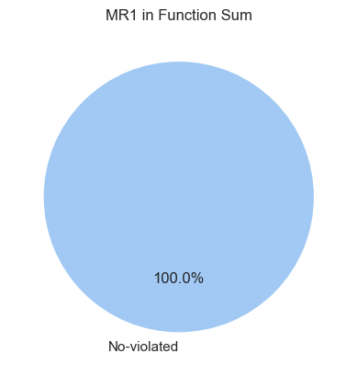
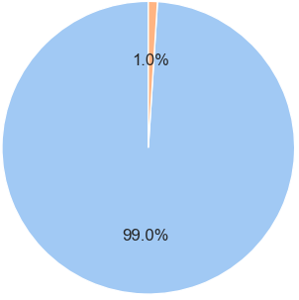
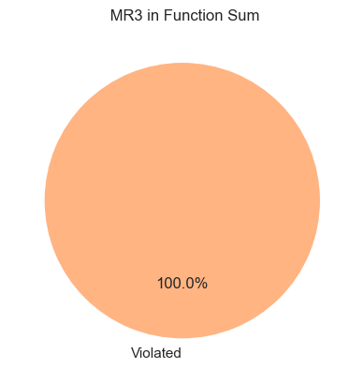

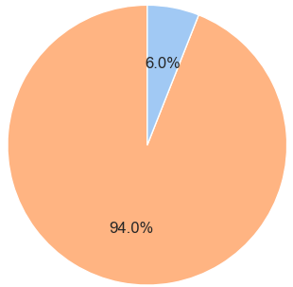
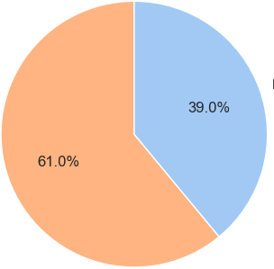
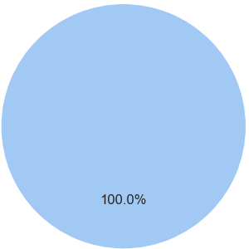

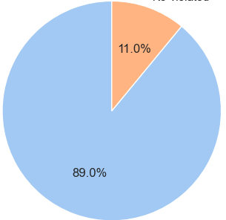
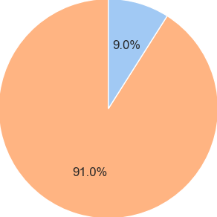
MR₁ in Function ADD
MR₂ in Function ADD
MR₃ in Function ADD
MR₄ in Function ADD
MR₁ in Function SUB
MR₂ in Function SUB
MR₃ in Function SUB
MR₄ in Function SUB
MR₁ in Function MUL
MR₂ in Function MUL
MR₃ in Function MUL
MR₄ in Function MUL
Violated
Not violated

Slide 8
Method
1
SUT
3
Test Data Generation Module
Analyser Module
Test data
2
MT Module
Test data (transformed)
MR Checker
Input transformations
Set of MRs

Slide 9


Set of MRs
List of
parameters
Test data
- low (l)
- high (h)
- input type (it)
- t_{end} (t)
- output (o)
1
a
2
b
InputGenerator.py
InputTransformer.py
Contains test data and transformed test data
b
Executer_<method>.py
c
3
Executer_<method>.py
Executer_<method>.py
Executer_<method>.py
Executer_<method>.py
Contains the outputs from Test data and outputs from transformed test data executions
Set of MRs
c
4
d
Contains the test data, the transformed test data for each MR, and the verdict of the MR-Checker for each MR
MR-Checker.py
d
5
e
Contains information on how often each of the applied MRs is violated or not violated per each method.
Analiser.py

