Slide 1

Passive Testing Using Fuzzing + Metamorphic Testing
Alejandra Duque-Torres

Slide 2



Scenario No. 1
The big difference between both scenarios is that in the first one, the developer can easily summarize or search the keywords based on his own knowledge about the system, which is not possible in the second scenario.
PLUGIN:
Conect to the DB_MR
Filter by key word
Provide MRs based on the key words
Database of Metamorphic Relations
Keywords
Query
List of possible MRs
Query - Response
Scenario No. 2
How to build the missing knowledge of scenario two and extract from that knowledge "key words" to suggest MRs?
PLUGIN:
Conect to the DB_MR
Filter by key word
Provide MRs based on the key words
Database of Metamorphic Relations
System Knowledge Extractor
“Keywords”
Query
Query
Response
2
2
List of possible MRs
2
Source code

Slide 3
Instead of suggesting MRs by searching for keywords/regular expressions in a database, we check at the input/output level if MR applies or not. Then find a "pattern" that allows you to answer the following question:
Why with this input/output combination is this MR always violated or always passed (Not violated)?
Why with this input/output combination is this MR sometimes violated or sometimes passed (Not violated)?
Can the system input/output relation and information after applying a set of MRs (violated/not-violated) from multiple sequences of system executions tell us anything about the MRs applied (feedback)?

Slide 4



Passive Testing Using Fuzzing + Metamorphic Testing
Workflow - Overview
Context creator
(code instrumentation)
Report
- Test data I/O
- Test data (transformed) I/O
ANALISER
Fuzzer
Test data
Input transformations
Test data (transformed)
MRs Checker
MR_id -> Violated/ Not-Violated
Set of MRs
(Generics)

Slide 5
(Sep. 15)
Passive Testing Using Fuzzing + Metamorphic Testing
Workflow – Toy Example
Context creator
Inputs: Int numbers
Operand ‘+’ and ‘-’
Python
Report
ANALISER
Exploratory clusters algorithms
(k-means)
System that performs the addition operation, and the subtraction operation between two int numbers
Fuzzer
Input transformations
Test data (transformed)
MRs Checker
MR_1
MR_2
MR_3
MR_4

Slide 6
Passive Testing Using Fuzzing + Metamorphic Testing
Workflow – Toy Example
MR_1: Permutation of the input -> The output must remain equal
MR_2: Multiply by a constant > 1 -> the output must increase
MR_3: Adding a positive constant to each operand -> the output must remain equal
MR_4: Subtracting a constant from each operand -> the output must remain equal
examples – a,b is element of {0,1,..,9}
( a + b ) = c TRANSFORMATION MR_1 ( b + a ) = c -> 0% violated
( a + b ) = c TRANSFORMATION MR_2 ( a*d ) + ( b*d ) > c -> 1% violated
( a + b ) = c TRANSFORMATION MR_3 ( a+d ) + ( b+d ) = c -> 100% violated
( a + b ) = c TRANSFORMATION MR_4 ( a-d ) + ( b-d ) = c -> 100% violated
( a - b ) = c TRANSFORMATION MR_1 ( b - a ) = c -> 90% violated
( a - b ) = c TRANSFORMATION MR_2 ( a*d ) - ( b*d ) > c -> 55% violated
( a - b ) = c TRANSFORMATION MR_3 ( a+d ) - ( b+d ) = c -> 0% violated
( a - b ) = c TRANSFORMATION MR_4 ( a-d ) - ( b-d ) = c -> 0% violated
Notes:
( a + b ) = c TRANSFORMATION MR_2 ( a*d ) + ( b*d ) > c -> 1% violated ( a = 0 , b = 0)
( a - b ) = c TRANSFORMATION MR_1 ( b - a ) = c -> 99% violated (NOT violated case: a = b = 0)
( a - b ) = c TRANSFORMATION MR_2 ( a*d ) - ( b*d ) > c 90% violated (NOT violated b = 0)
MR2 - d = 2
MR3 – d = 1
MR4 – d = 3

Slide 7
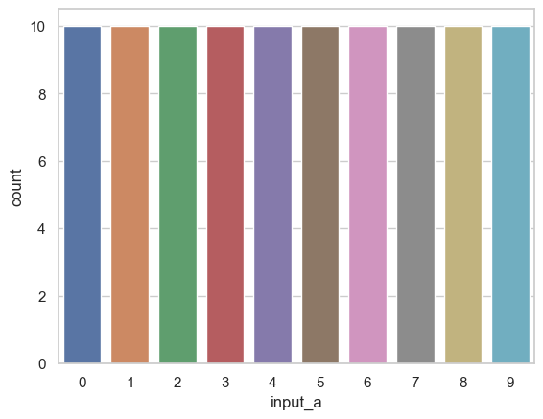

(input_a, input_b) with perfect uniform distribution, also perfect combination
 | 0 | 1 | 2 | 3 | 4 | 5 | 6 | 7 | 8 | 9
0 | (0,0) | (0,1) | (0,2) | (0,3) | (0,4) | (0,5) | (0,6) | (0,7) | (0,8) | (0,9)
1 | (1,0) | (1,1) | (1,2) | (1,3) | (1,4) | (1,5) | (1,6) | (1,7) | (1,8) | (1,9)
2 | (2,0) | (2,1) | (2,2) | (2,3) | (2,4) | (2,5) | (2,6) | (2,7) | (2,8) | (2,9)
3 | (3,0) | (3,1) | (3,2) | (3,3) | (3,4) | (3,5) | (3,6) | (3,7) | (3,8) | (3,9)
4 | (4,0) | (4,1) | (4,2) | (4,3) | (4,4) | (4,5) | (4,6) | (4,7) | (4,8) | (4,9)
5 | (5,0) | (5,1) | (5,2) | (5,3) | (5,4) | (5,5) | (5,6) | (5,7) | (5,8) | (5,9)
6 | (6,0) | (6,1) | (6,2) | (6,3) | (6,4) | (6,5) | (6,6) | (6,7) | (6,8) | (6,9)
7 | (7,0) | (7,1) | (7,2) | (7,3) | (7,4) | (7,5) | (7,6) | (7,7) | (7,8) | (7,9)
8 | (8,0) | (8,1) | (8,2) | (8,3) | (8,4) | (8,5) | (8,6) | (8,7) | (8,8) | (8,9)
9 | (9,0) | (9,1) | (9,2) | (9,3) | (9,4) | (9,5) | (9,6) | (9,7) | (9,8) | (9,9)

Slide 8
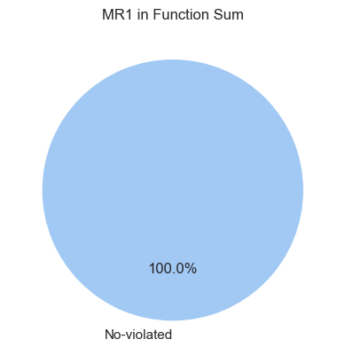
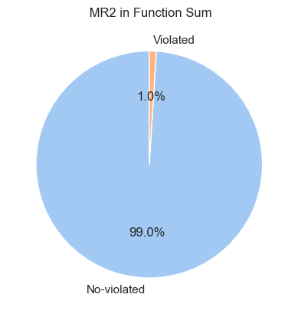
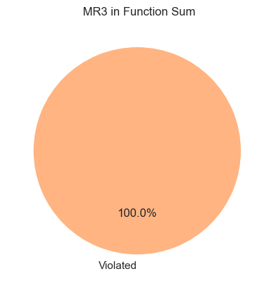

Preliminary results add/sum operation
MR_1: Permutation of the input -> The output must remain equal
MR_2: Multiply by a constant > 1 -> the output must increase
MR_3: Adding a positive constant to each operand -> the output must remain equal
MR_4: Subtracting a constant from each operand -> the output must remain equal
MR_1: ( a + b ) = c TRANSFORMATION MR_1 ( b + a ) = c -> 0% violated
MR_2: ( a + b ) = c TRANSFORMATION MR_2 ( a*d ) + ( b*d ) > c -> 1% violated (this is when a = 0 and b = 0)
MR_3: ( a + b ) = c TRANSFORMATION MR_3 ( a+d ) + ( b+d ) = c -> 100% violated
MR_4: ( a + b ) = c TRANSFORMATION MR_4 ( a-d ) + ( b-d ) = c -> 100% violated
Notes:
( a + b ) = c TRANSFORMATION MR_2 ( a*d ) + ( b*d ) > c -> 1% violated ( a = 0 , b = 0)
We did not get the 1% of violation since there is not case when input_a = 0 and input_b = 0, the inputs were generated randomly

Slide 9
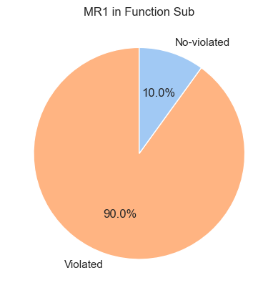
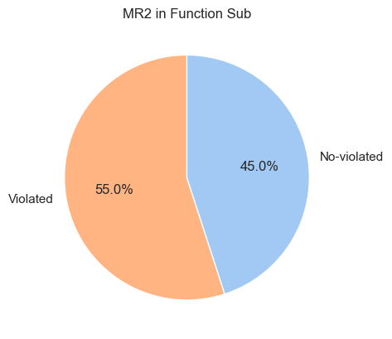
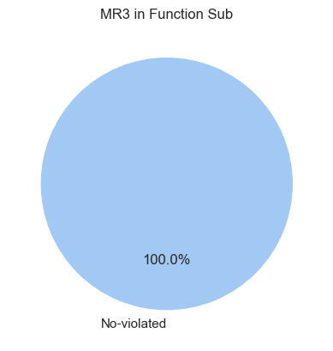

Preliminary results sub operation
MR_1: Permutation of the input -> The output must remain equal
MR_2: Multiply by a constant > 1 -> the output must increase
MR_3: Adding a positive constant to each operand -> the output must remain equal
MR_4: Subtracting a constant from each operand -> the output must remain equal
( a - b ) = c TRANSFORMATION MR_1 ( b - a ) = c -> 90% violated
( a - b ) = c TRANSFORMATION MR_2 ( a*d ) - ( b*d ) > c -> 55% violated
( a - b ) = c TRANSFORMATION MR_3 ( a+d ) - ( b+d ) = c -> 0% violated
( a - b ) = c TRANSFORMATION MR_4 ( a-d ) - ( b-d ) = c -> 0% violated
Notes:
( a + b ) = c TRANSFORMATION MR_2 ( a*d ) + ( b*d ) > c -> 1% violated ( a = 0 , b = 0)
We did not get the 1% of violation since there is not case when input_a = 0 and input_b = 0, the inputs were generated randomly

Slide 10
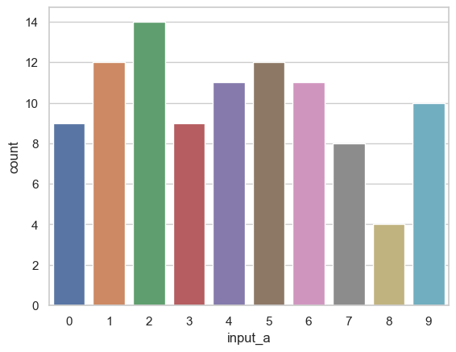
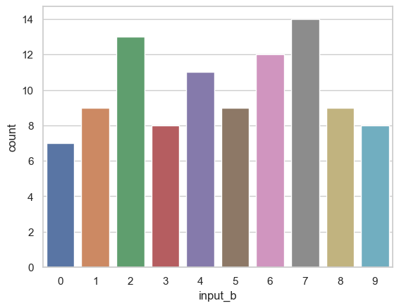
Input_a: 100 elements of {0,1,…,9}
Input_b: 100 elements of {0,1,…,9}
Value | Frequency | Value | Frequency
‘0’ | 9 | ‘5’ | 12
‘1’ | 12 | ‘6’ | 11
‘2’ | 14 | ‘7’ | 8
‘3’ | 9 | ‘8’ | 4
‘4’ | 11 | ‘9’ | 10
Value | Frequency | Value | Frequency
‘0’ | 7 | ‘5’ | 9
‘1’ | 9 | ‘6’ | 12
‘2’ | 13 | ‘7’ | 14
‘3’ | 8 | ‘8’ | 9
‘4’ | 11 | ‘9’ | 8
Constant was randomly generated
Const = 6

Slide 11

Preliminary results add/sum operation
MR_1: Permutation of the input -> The output must remain equal
MR_2: Multiply by a constant > 1 -> the output must increase
MR_3: Adding a positive constant to each operand -> the output must remain equal
MR_4: Subtracting a constant from each operand -> the output must remain equal
MR_1: ( a + b ) = c TRANSFORMATION MR_1 ( b + a ) = c
MR_2: ( a + b ) = c TRANSFORMATION MR_2 ( a*d ) + ( b*d ) > c -> (this is violated when a = 0 and b = 0)
MR_3: ( a + b ) = c TRANSFORMATION MR_3 ( a+d ) + ( b+d ) = c -> 100% violated
MR_4: ( a + b ) = c TRANSFORMATION MR_4 ( a-d ) + ( b-d ) = c -> 100% violated
Notes:
( a + b ) = c TRANSFORMATION MR_2 ( a*d ) + ( b*d ) > c -> 1% violated ( a = 0 , b = 0)
We did not get the 1% of violation since there is not case when input_a = 0 and input_b = 0, the inputs were generated randomly

Slide 12
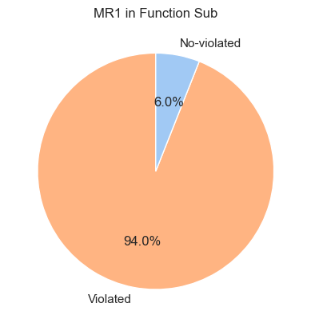
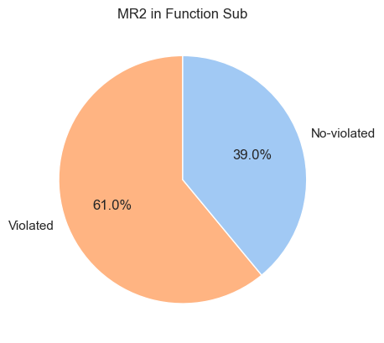
Preliminary results sub operation
MR_1: Permutation of the input -> The output must remain equal
MR_2: Multiply by a constant > 1 -> the output must increase
MR_3: Adding a positive constant to each operand -> the output must remain equal
MR_4: Subtracting a constant from each operand -> the output must remain equal
( a - b ) = c TRANSFORMATION MR_1 ( b - a ) = c (this is not violated when a = b)
( a - b ) = c TRANSFORMATION MR_2 ( a*d ) - ( b*d ) > c
( a - b ) = c TRANSFORMATION MR_3 ( a+d ) - ( b+d ) = c -> 0% violated
( a - b ) = c TRANSFORMATION MR_4 ( a-d ) - ( b-d ) = c -> 0% violated
Notes:
( a + b ) = c TRANSFORMATION MR_2 ( a*d ) + ( b*d ) > c -> 1% violated ( a = 0 , b = 0)
We did not get the 1% of violation since there is not case when input_a = 0 and input_b = 0, the inputs were generated randomly

Slide 13
MR_1: Permutation of the input -> The output must remain equal
( a - b ) = c TRANSFORMATION MR_1 ( b - a ) = c -> 90% violated
10% of No violations is for the inputs (0,0)(1,1)(2,2)…(9,9)
(a,b) | output | MR1_inputs | MR1_output | MR1_checker
(4,4) | 0.0 | (4,4) | 0.0 | No-violated
(8,8) | 0.0 | (8,8) | 0.0 | No-violated
(6,6) | 0.0 | (6,6) | 0.0 | No-violated
(9,9) | 0.0 | (9,9) | 0.0 | No-violated
(2,2) | 0.0 | (2,2) | 0.0 | No-violated
(9,9) | 0.0 | (9,9) | 0.0 | No-violated

Slide 14
MR_2: Multiply by a constant > 1 -> the output must increase
( a - b ) = c TRANSFORMATION MR_2 ( a*d ) - ( b*d ) > c
This is not violated when input a > b or b = 0
(a,b) | const | output | MR2_inputs | MR2_output | MR2_checker
(9,2) | 6 | 7.0 | (54,12) | 42.0 | No-violated
(8,1) | 6 | 7.0 | (48,6) | 42.0 | No-violated
(7,2) | 6 | 5.0 | (42,12) | 30.0 | No-violated
(5,0) | 6 | 5.0 | (30,0) | 30.0 | No-violated
(2,1) | 6 | 1.0 | (12,6) | 6.0 | No-violated
(7,6) | 6 | 1.0 | (42,36) | 6.0 | No-violated

Slide 15
