Slide 1

Metamorphic Testing – Full Test Automation
Alejandra Duque-Torres

Slide 2
Test Oracle Problem
The oracle problem arises when the System Under Test (SUT) lacks an oracle or when developing one to verify computed outputs is practically impossible
SUT
Comparator
Test inputs
Pass/fail
Test oracle
Metamorphic Testing (MT)
MT differs from traditional testing approaches in that it examines the relations between input-output pairs of consecutive SUT executions rather than the outputs of individual SUT executions

Slide 3
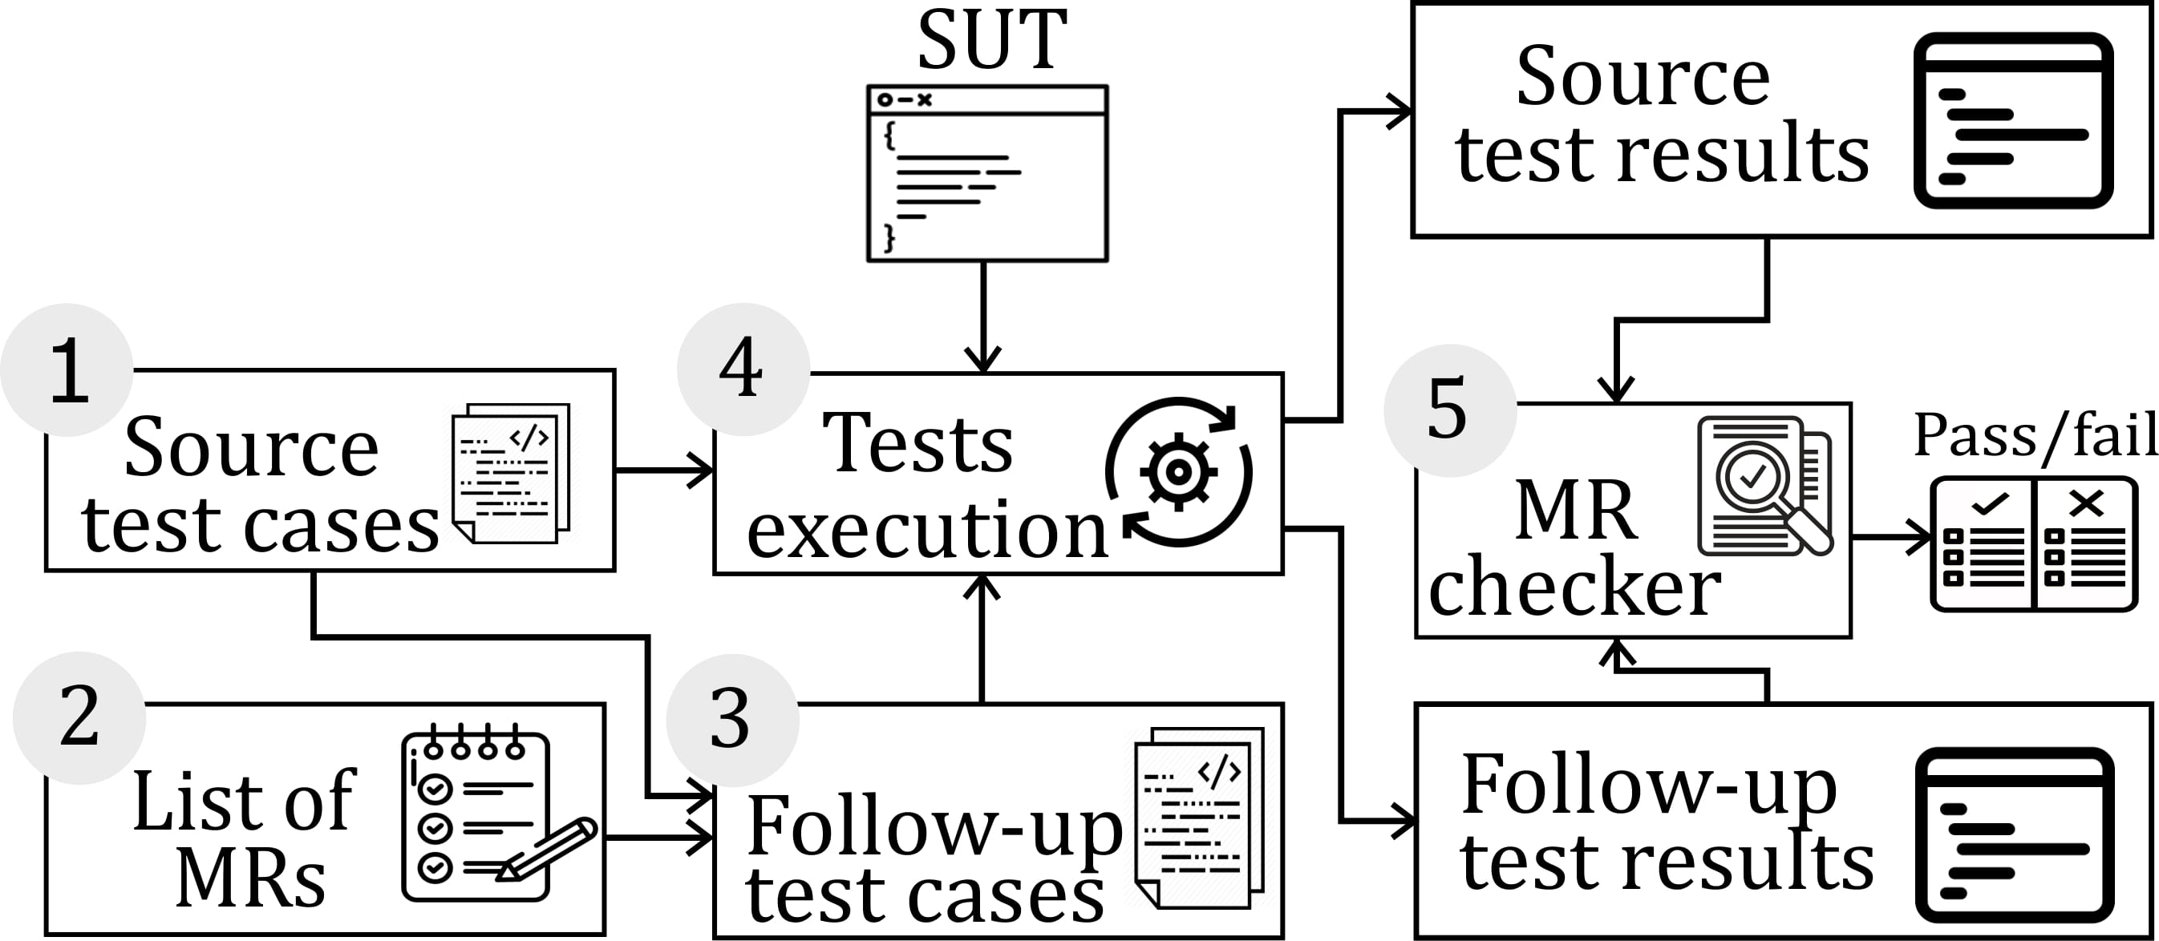
MT workflow
Create a set of initial tests or source test cases.
Identify an appropriate list of Metamorphic Relations (MRs) that the SUT should satisfy.
Create follow-up test cases by applying the input transformations required by the identified MRs in Step 2 to each source test case.
Execute the corresponding initial and follow-up test case pairs.
Check whether the output change complies with the change predicted by the MR.

Slide 4
MT workflow
Create a set of initial tests or source test cases.
Identify an appropriate list of Metamorphic Relations (MRs) that the SUT should satisfy.
Create follow-up test cases by applying the input transformations required by the identified MRs in Step 2 to each source test case.
Execute the corresponding initial and follow-up test case pairs.
Check whether the output change complies with the change predicted by the MR.
The generation of MRs is the key point for the successful application of metamorphic testing, but not the only one. Automating the whole testing process (MR generation + test case generation + test case execution) is a challenge.

Slide 5
What have we done so far?
2. Identify an appropriate list of Metamorphic Relations (MRs) that the SUT should satisfy.
A. Duque-Torres, D. Pfahl, R. Ramler and C. Klammer, "A Replication Study on Predicting Metamorphic Relations at Unit Testing Level," 2022 IEEE International Conference on Software Analysis, Evolution and Reengineering (SANER), 2022, pp. 709-719, doi: 10.1109/SANER53432.2022.00088.
A. Duque-Torres, D. Pfahl, C. Klammer and S. Fischer, "Using Source Code Metrics for Predicting Metamorphic Relations at Method Level," 2022 IEEE International Conference on Software Analysis, Evolution and Reengineering (SANER), 2022, pp. 1147-1154, doi: 10.1109/SANER53432.2022.00132.
A. Duque-Torres, and D. Pfahl, "Inferring Metamorphic Relations from JavaDocs: A Deep Dive Into the MeMo Approach," Submitted to PROFES2022.

Slide 6
What have we done so far?
A. Duque-Torres, and D. Pfahl, "Inferring Metamorphic Relations from JavaDocs: A Deep Dive Into the MeMo Approach," Submitted to PROFES2022.
How to infer MRs from software documentation?
K. Rahman, I. Kahanda, and U. Kanewala, “MRPredt: Using text mining for metamorphic relation prediction,” in Proceedings of theIEEE/ACM 42nd International Conference on Software Engineering Workshops. New York, NY, USA: Association for Computing Machinery, 2020, pp. 420–424.
X. Lin, M. Simon, Z. Peng and N. Niu, "Discovering Metamorphic Relations for Scientific Software From User Forums," in Computing in Science & Engineering, vol. 23, no. 2, pp. 65-72, 1 March-April 2021
A. Blasi, A. Gorla, M. D. Ernst, M. Pezz`e, and A. Carzaniga, “Memo: Automatically identifying metamorphic relations in javadoc comments for test automation,” Journal of Systems and Software, vol. 181, p. 111 041, 2021

Slide 7
How to infer MRs from software documentation?
A. Blasi, A. Gorla, M. D. Ernst, M. Pezz`e, and A. Carzaniga, “Memo: Automatically identifying metamorphic relations in javadoc comments for test automation,” Journal of Systems and Software, vol. 181, p. 111 041, 2021
MeMo, a technique and a tool to automatically infer equivalence MRs from code comments written in natural language.
Equivalence MRs example: array.clear() = array.removeAll()

Slide 8
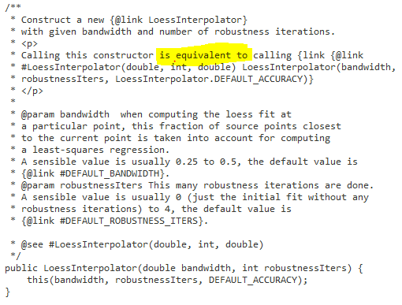
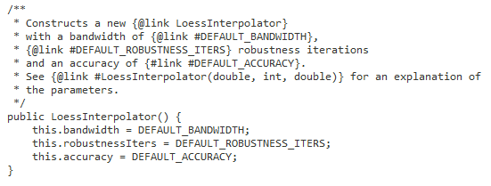
MeMo, MR finder
“Is the given sentence in the comment also expressing an equivalence?”
Example of a JavaDoc comment expressing an equivalence relation
Example of a JavaDoc comment which does not express an Equivalence Relation
Library Commons Math, Class Interpolation, Method LoessIterpolator
Library Commons Math, Class Interpolation, Method LoessIterpolator

Slide 9
"Inferring Metamorphic Relations from JavaDocs: A Deep Dive Into the MeMo Approach,” Conclusion
Experiments indicate that approach performance is only as good as vocabulary and sentence normalisation.
Perhaps it is not necessary, such a specialized procedure, just by having a set of words that express the equivalence, the sentences that contain that word could be filtered.
Remark!
The approach uses JavaDocs from libraries that are already super well tested. A generalization of the approach beyond those libraries needs further and deeper evaluations.

Slide 10
What can we conclude?
"A Replication Study on Predicting Metamorphic Relations at Unit Testing Level,"
It is possible to match metrics with specific predefined MRs, using information extracted from the CFG
"Using Source Code Metrics for Predicting Metamorphic Relations at Method Level,"
It is possible to match the source code metrics with specific predefined MRs
"Inferring Metamorphic Relations from JavaDocs: A Deep Dive Into the MeMo Approach,"
It is possible to extract some knowledge using software documentation to create “equivalent” MR

Slide 11


What now?
Scenario No. 1
This is a developer who knows very well what he is doing. Also, he know what and how to test his system.
He want to use MT approach
He doesn't want to spend a lot of time and energy thinking up MRs and creating them from scratch.
Is there a repository where I can find MR that have been used in similar systems than mine?
or even better, Is there any plugin/system that suggest MRs based on a brief description of my system (e.g., keywords)?

Slide 12

Is there a repository where I can find MR that have been used in similar systems than mine?
X. Xie, J. Li, C. Wang and T. Y. Chen, "Looking for an MR? Try METWiki Today," 2016 IEEE/ACM 1st International Workshop on Metamorphic Testing (MET), 2016, pp. 1-4, doi: 10.1145/2896971.2896976.
X. Xie, J. Li, C. Wang and T. Y. Chen, "Looking for an MR? Try METWiki Today," 2016 IEEE/ACM 1st International Workshop on Metamorphic Testing (MET), 2016, pp. 1-4, doi: 10.1145/2896971.2896976.
http://www.metwiki.net/

Slide 13
What are the problems with METWiki?
Some of the MRs are not ‘easy’ to understand
Its web site is really bad, with a lot of problems, e.g., there are some pages that does not download.
It seems that the project was abandoned and it has not been update since 2016

Slide 14
Is there any plugin/system that suggest MRs based on a brief description of my system (e.g., keywords)?
Not yet!

Slide 15
Is there any plugin/system that suggest MRs based on a brief description of my system (e.g., keywords)?
PLUGIN:
Conect to the DB_MR
Filter by key word
Provide MRs based on the key words
Database of Metamorphic Relations
Keywords
Query
List of possible MRs
Query - Response

Slide 16

Scenario No. 2
This is a developer/tester who is new to the project and doesn't know the system
He wants or was asked to use MT approach
He doesn't want to spend a lot of time and energy thinking up MRs and creating them from scratch. On top of that he first will to figure out what the system is doing, and then think and create the MRs
They only knowledge that he has about the system is the code itself, and a brief Documentation (e.g., user stories, requirements, etc)
Is there any plugin/system that suggest MRs based on source code, or documentation of the system?
Not yet!

Slide 17
Scenario No. 1
Scenario No. 2
vs
The big difference between both scenarios is that in the first one, the developer can easily summarize or search the keywords based on his own knowledge about the system, which is not possible in the second scenario.
How to build the missing knowledge of scenario two and extract from that knowledge "key words" to suggest MR?

Slide 18


How to build the missing knowledge in scenario two, and extract from that knowledge "keywords" to suggest MRs?
PLUGIN:
Conect to the DB_MR
Filter by key word
Provide MRs based on the key words
Database of Metamorphic Relations
Software
documentation
System Knowledge Extractor
“Keywords”
Query
Query
Response
List of possible MRs
Source code
18

Slide 19
Research questions scenario No.1:
RQ1: How to present/describe in an understandable and generic way MRs to the end user?
RQ2: How good are the MRs suggested in terms of finding bugs?
RQ3: if we have an initial test suite, is it possible to augment the test suite using MT with the suggested MRs? How much will bug detection capability increase by using the suggested MRs to augment the initial test suite?

Slide 20

Create the DB:
Find ‘generic MRs’ , e.g., Permutation, exclusion, etc.
How to present/describe in an understandable and generic way MRs to the end user?
Key paper:
S. Segura, A. Durán, J. Troya and A. R. Cortés, "A Template-Based Approach to Describing Metamorphic Relations," 2017 IEEE/ACM 2nd International Workshop on Metamorphic Testing (MET), 2017, pp. 3-9, doi: 10.1109/MET.2017.3.

Slide 21
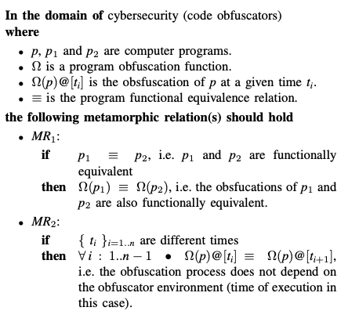
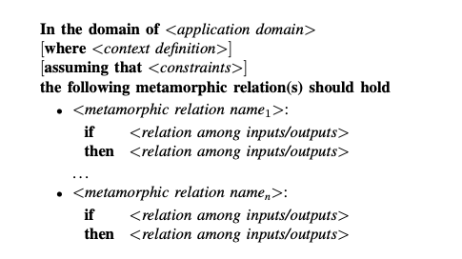
S. Segura, A. Durán, J. Troya and A. R. Cortés, "A Template-Based Approach to Describing Metamorphic Relations," 2017 IEEE/ACM 2nd International Workshop on Metamorphic Testing (MET), 2017, pp. 3-9, doi: 10.1109/MET.2017.3.

Slide 22
Create the Plugin:
User interface, in which the user provide some “key words”, and receive a set of MRs.
Evaluate with a hopefully not so trivial example
To think: in this scenario, we have to find some system that we know.
RQ3: if we have an initial test suite, is it possible to augment the test suite using MT with the suggested MRs? How much will bug detection capability increase by using the suggested MRs to augment the initial test suite?
To think: can we use some automatic generation tool Randoop/Evosuit/Pynguin to generate the initial test suit, and then augment the test suite using MT with the suggested MRs?

Slide 23
Research questions scenario No.2:
RQ1: How to build the missing knowledge in scenario two, and extract from that knowledge "key words" to suggest MRs?
RQ2: How good are the MRs suggested in terms of finding bugs?
RQ3: if we have an initial test suite, is it possible to augment the test suite using MT with the suggested MRs? How much will bug detection capability increase by using the suggested MRs to augment the initial test suite?

Slide 24
How to build the missing knowledge in scenario two, and extract from that knowledge "key words" to suggest MRs?
Key papers:
Tian, F., & Treude, C. (2022). Adding Context to Source Code Representations for Deep Learning. arXiv preprint arXiv:2208.00203.
Feng, Z., Guo, D., Tang, D., Duan, N., Feng, X., Gong, M., ... & Zhou, M. (2020). Codebert: A pre-trained model for programming and natural languages. arXiv preprint arXiv:2002.08155.
M. Moser and J. Pichler, "eknows: Platform for Multi-Language Reverse Engineering and Documentation Generation," 2021 IEEE International Conference on Software Maintenance and Evolution (ICSME), 2021, pp. 559-568, doi: 10.1109/ICSME52107.2021.00057.

Slide 25
if we have an initial test suite, is it possible to augment the test suite using MRs? How much will bug detection capability increase by using the MRs to augment the initial test suite?
Toy example:
Triangle Class, this class receives as input 3 integers, and returns the type of triangle based on sides and based on its angles. It also returns the area.
sideClass()
angleClass()
area()

Slide 26
Toy example:
Triangle Class, this class receives as input 3 integers, and returns the type of triangle based on sides and based on its angles. It also returns the area.
sideClass()
angleClass()
area()
possible()
//checks whether the triangle is possible public static Boolean possible(int a, int b, int c) { return a + b > c && a + c > b && b + c > a; }

Slide 27
The following metamorphic relations should hold
MR1:
If the sides of a triangle are a, b, c
THEN triangleType(a,b,c) == traingleType(b,c,a) == triangleType(c,a,b)
MR2:
If the sides of a triangle are a, b, c
THEN triangleArea(a,b,c) == triangleArea(b,c,a) == triangleArea(c,a,b)
MR3:
If the sides of a triangle are a, b, c
THEN triangleArea(a,b,c) < triangleArea(Constant*b, Constant*c, Constant*a)

Slide 28
Initial test suite
@Test public final void testSideClassMR1() { assertEquals(TriangleClass.sideClass(0,1,1),TriangleClass.sideClass(1,0,1));
assertEquals(TriangleClass.sideClass(0,1,1),TriangleClass.sideClass(1,1,0));} @Test public final void testSideClass2MR1() { assertEquals(TriangleClass.sideClass(1, 2, 3), TriangleClass.sideClass(2, 3, 1)); assertEquals(TriangleClass.sideClass(1, 2, 3), TriangleClass.sideClass(3, 2, 0));} @Test public final void area1_MR2() { assertEquals(TriangleClass.area(1, 2, 3), TriangleClass.area(2, 3, 1)); assertEquals(TriangleClass.area(5, 4, 3), TriangleClass.area(3, 4, 5));} @Test public final void area2_MR3() { Double a = TriangleClass.area(5, 4, 3); Double b = TriangleClass.area(10, 8, 6); assertTrue(a < b ); }
@Test public final void testSideClass() { assertNull(TriangleClass.sideClass(0,1,1)); } @Test public final void testSideClass2() { assertNull(TriangleClass.sideClass(1, 2, 3)); } @Test public final void area1() { assertNull(TriangleClass.area(1, 2, 3)); }

