Slide 1

Metamorphic Testing – Full Test Automation
Aleja Duque-Torres

Slide 2
Test Oracle Problem
The oracle problem arises when the System Under Test (SUT) lacks an oracle or when developing one to verify computed outputs is practically impossible
SUT
Comparator
Test inputs
Pass/fail
Test oracle
Metamorphic Testing (MT)
MT differs from traditional testing approaches in that it examines the relations between input-output pairs of consecutive SUT executions rather than the outputs of individual SUT executions

Slide 3
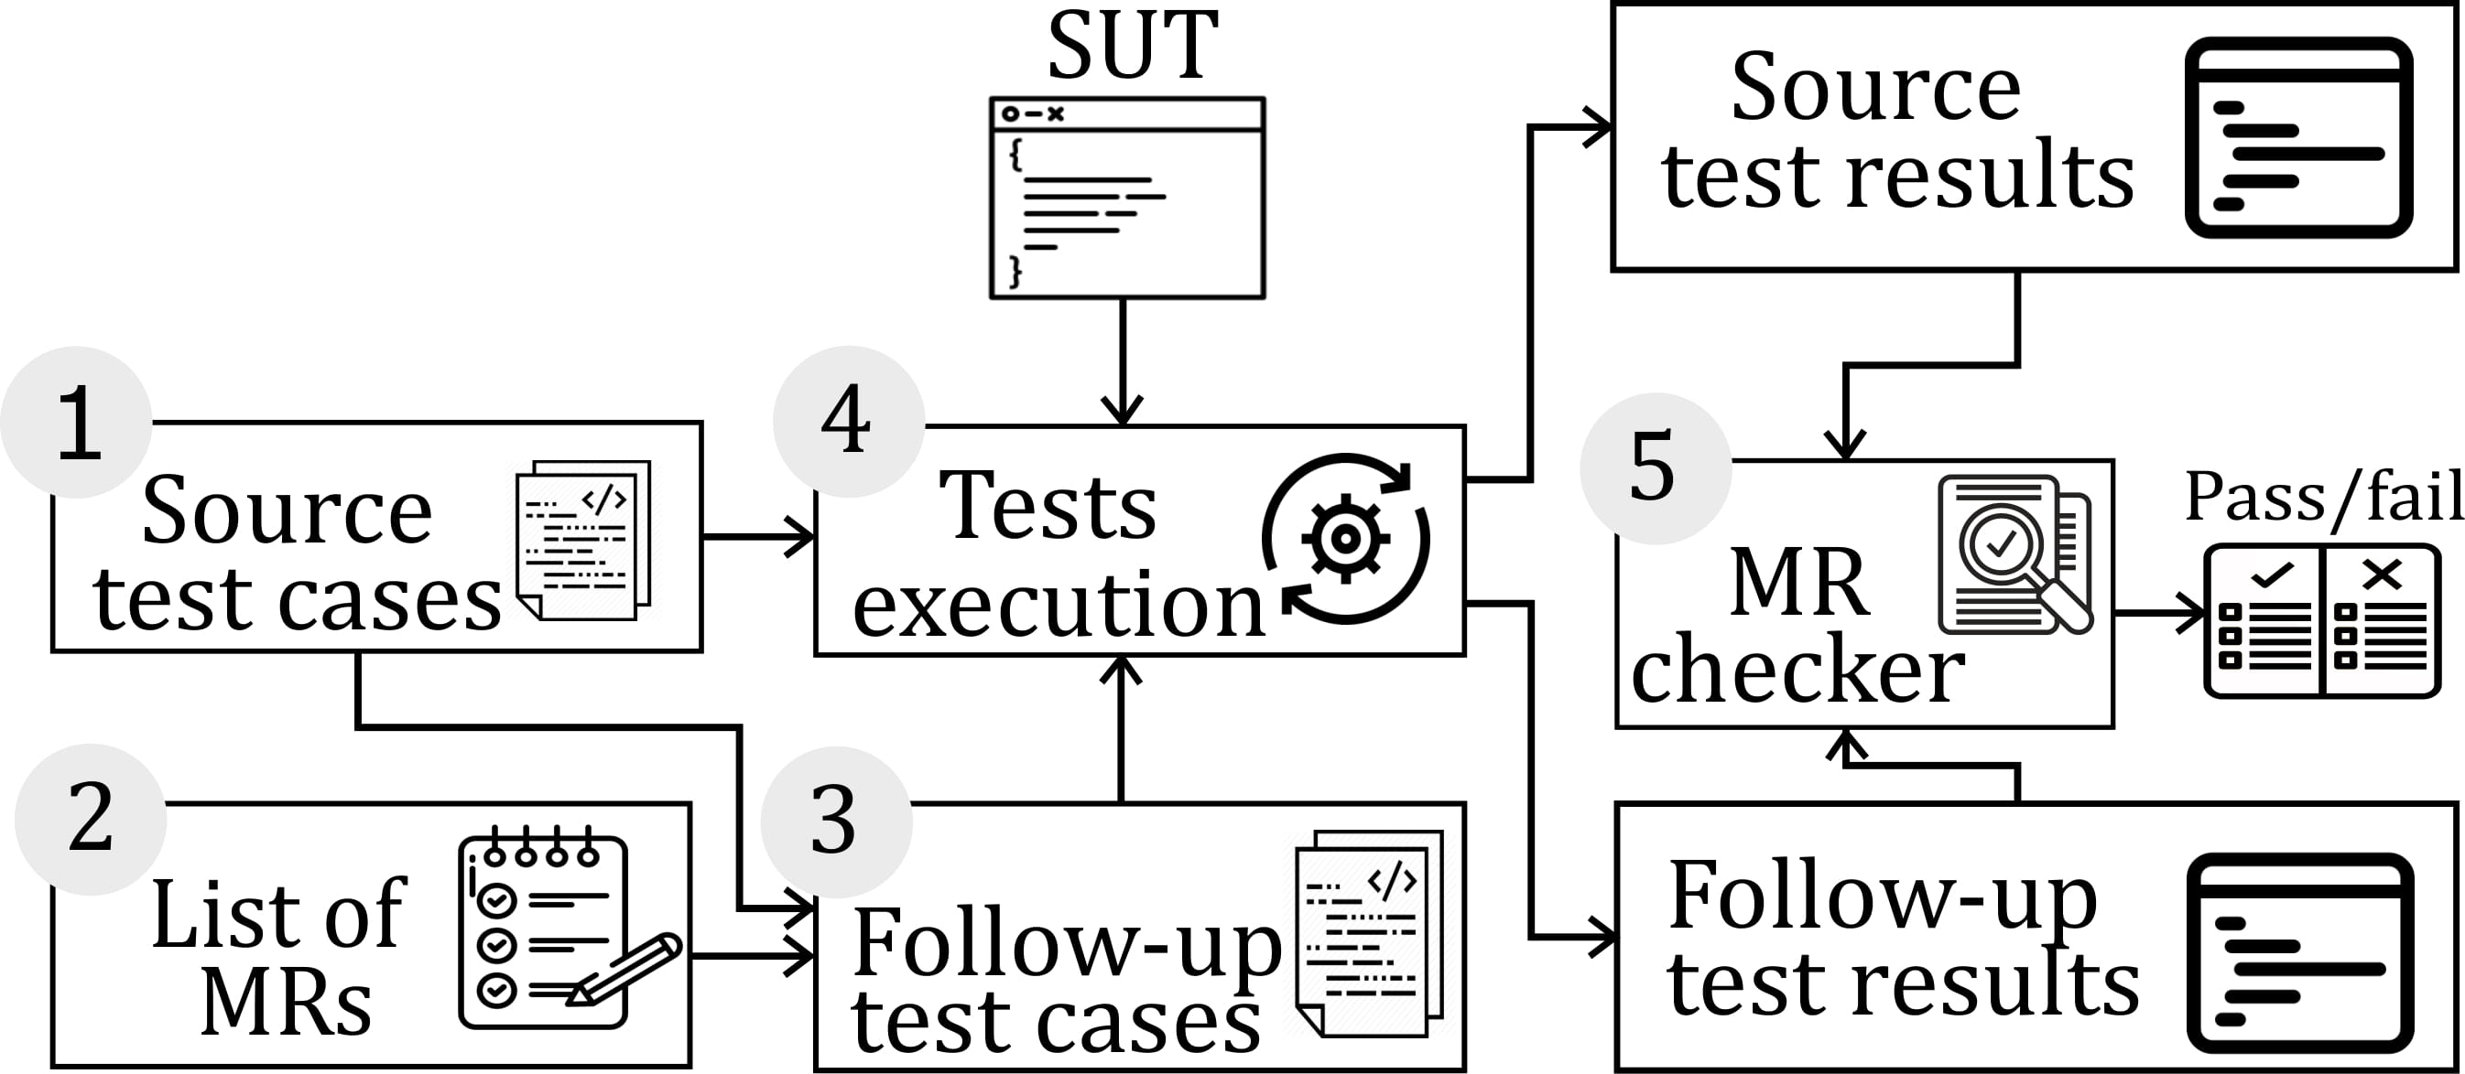
MT workflow
Create a set of initial tests or source test cases.
Identify an appropriate list of Metamorphic Relations (MRs) that the SUT should satisfy.
Create follow-up test cases by applying the input transformations required by the identified MRs in Step 2 to each source test case.
Execute the corresponding initial and follow-up test case pairs.
Check whether the output change complies with the change predicted by the MR.

Slide 4
MT workflow
Create a set of initial tests or source test cases.
Identify an appropriate list of Metamorphic Relations (MRs) that the SUT should satisfy.
Create follow-up test cases by applying the input transformations required by the identified MRs in Step 2 to each source test case.
Execute the corresponding initial and follow-up test case pairs.
Check whether the output change complies with the change predicted by the MR.
The generation of MRs is the key point for the successful application of metamorphic testing, but not the only one. Automating the whole testing process (MR generation + test case generation + test case execution) is a challenge.

Slide 5
Toy example:
Triangle Class, this class receives as input 3 integers, and returns the type of triangle based on sides and based on its angles. It also returns the area.
sideClass()
angleClass()
area()
possible()
//checks whether the triangle is possible public static Boolean possible(int a, int b, int c) { return a + b > c && a + c > b && b + c > a; }

Slide 6
The following metamorphic relations should hold
MR1:
If the sides of a triangle are a, b, c
THEN triangleType(a,b,c) == traingleType(b,c,a) == triangleType(c,a,b)
MR2:
If the sides of a triangle are a, b, c
THEN triangleArea(a,b,c) == triangleArea(b,c,a) == triangleArea(c,a,b)
MR3:
If the sides of a triangle are a, b, c
THEN triangleArea(a,b,c) < triangleArea(Constant*b, Constant*c, Constant*a)

Slide 7
Initial test suite
@Test public final void testSideClassMR1() { assertEquals(TriangleClass.sideClass(0,1,1),TriangleClass.sideClass(1,0,1));
assertEquals(TriangleClass.sideClass(0,1,1),TriangleClass.sideClass(1,1,0));} @Test public final void testSideClass2MR1() { assertEquals(TriangleClass.sideClass(1, 2, 3), TriangleClass.sideClass(2, 3, 1)); assertEquals(TriangleClass.sideClass(1, 2, 3), TriangleClass.sideClass(3, 2, 0));} @Test public final void area1_MR2() { assertEquals(TriangleClass.area(1, 2, 3), TriangleClass.area(2, 3, 1)); assertEquals(TriangleClass.area(5, 4, 3), TriangleClass.area(3, 4, 5));} @Test public final void area2_MR3() { Double a = TriangleClass.area(5, 4, 3); Double b = TriangleClass.area(10, 8, 6); assertTrue(a < b ); }
@Test public final void testSideClass() { assertNull(TriangleClass.sideClass(0,1,1)); } @Test public final void testSideClass2() { assertNull(TriangleClass.sideClass(1, 2, 3)); } @Test public final void area1() { assertNull(TriangleClass.area(1, 2, 3)); }

Slide 8
What have we done so far?
2. Identify an appropriate list of Metamorphic Relations (MRs) that the SUT should satisfy.
A. Duque-Torres, D. Pfahl, R. Ramler and C. Klammer, "A Replication Study on Predicting Metamorphic Relations at Unit Testing Level," 2022 IEEE International Conference on Software Analysis, Evolution and Reengineering (SANER), 2022, pp. 709-719, doi: 10.1109/SANER53432.2022.00088.
A. Duque-Torres, D. Pfahl, C. Klammer and S. Fischer, "Using Source Code Metrics for Predicting Metamorphic Relations at Method Level," 2022 IEEE International Conference on Software Analysis, Evolution and Reengineering (SANER), 2022, pp. 1147-1154, doi: 10.1109/SANER53432.2022.00132.
A. Duque-Torres, and D. Pfahl, "Inferring Metamorphic Relations from JavaDocs: A Deep Dive Into the MeMo Approach," Submitted to PROFES2022.

Slide 9
What can we conclude?
"A Replication Study on Predicting Metamorphic Relations at Unit Testing Level,"
It is possible to match metrics with specific predefined MRs, using information extracted from the CFG
"Using Source Code Metrics for Predicting Metamorphic Relations at Method Level,"
It is possible to match the source code metrics with specific predefined MRs
"Inferring Metamorphic Relations from JavaDocs: A Deep Dive Into the MeMo Approach,"
It is possible to extract some knowledge using software documentation to create “equivalent” MR

