Slide 1
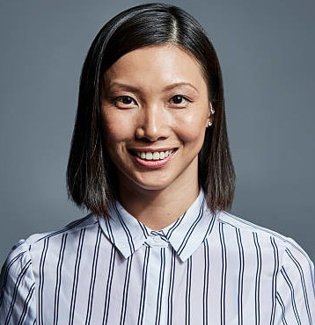

Aduri Akter
Web Developer
Experience
Contact
Junior Web Disigner at IIST Institute.
Junior Web Developer at Engineers Computing & Computers(ECC) LTD.
01846592780
adoriayesha05@gmail.com
Educational Qualification
Kazipara, Mirpur-10, Dhaka-1216
Diploma in Cmputer Engineering
Profile
Dhaka Mohila Polytechnic Institute (DMPI)
To secure a challenging position in my career by filly utilizing & skills creating a Positive atomosphere and enhanced my skills more,aswell as contribute to the success of company.
CGPA : Appeard
Training Title: Web Development
Secondary School Certificate(SSC)
Sk Md Miar Hossain High School
GPA:4.77
Skills
Refference

