Slide 1
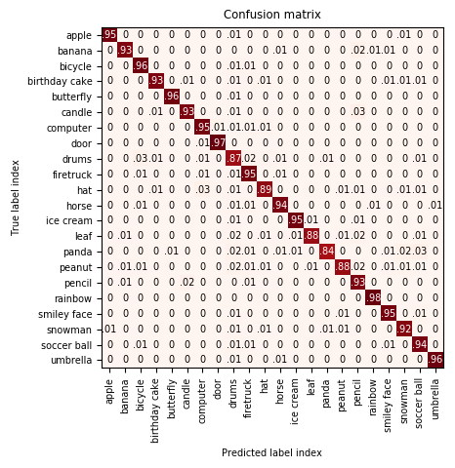
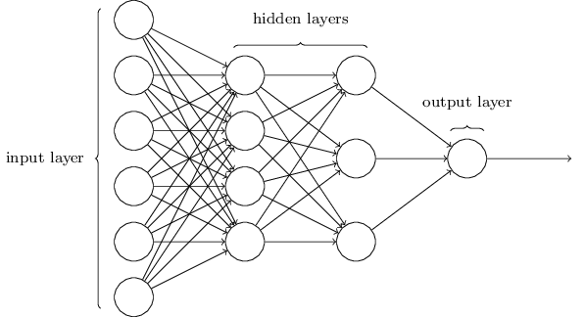
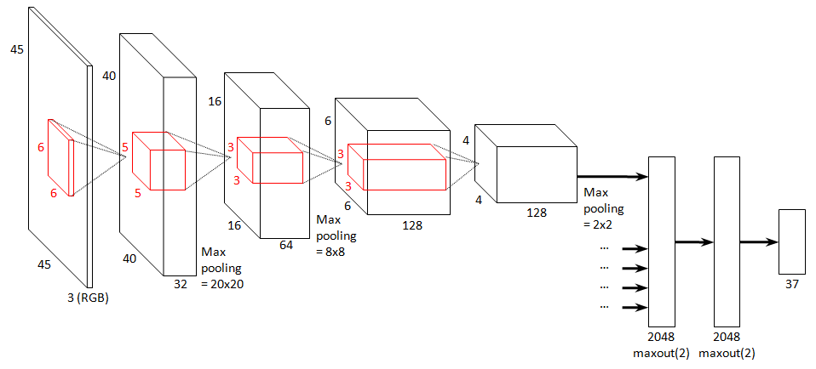
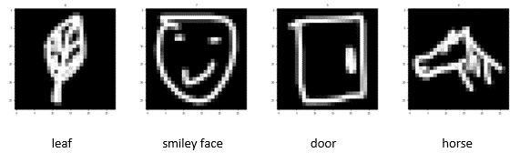
Classification Models for Sketch Drawings
Aparajita Dutta¹, Sarah Saki Robinson²
¹Department of Electrical Engineering, Stanford University
²Department of Computer Science, Stanford University
ABSTRACT
METHODS
RESULTS (continued)
Numerous papers have been published, analyzing various algorithms for image classification on photographs. Majority of publications on image classification perform experiments on pictures where the objects in images are easily identifiable. Here, we explore a case where the images of objects are not as easily identifiable by humans.
We apply different classification techniques to a dataset of sketch drawings to find what model performs best.
Multi-class Logistic Regression
Generalization of Logistic Regression
Sigmoid logistic function is replaced by the SoftMax function
Naïve Bayes
Based on applying Bayes Theorem
Assumes conditional independence between feature pairs
Below is the confusion matrix for the CNN model’s performance on the test set.
Multi-Layer Perceptron (MLP)
Simple Neural Network
Our model: 2 fully-connected hidden layers with ReLU activation and an output layer with SoftMax activation
Convolutional Neural Network (CNN)
Regularized version of MLP
2 different models: 3 convolutional layers with one dense layer and 2 convolutional layers with 3 dense layers
OBJECTIVE
Take a hand-drawn image of an object and accurately identify it.
Examples of the compressed image inputs and their respective outputs are shown below.
RESULTS
CONCLUSION
Baseline: Majority classifier. Log loss = 33.003, Accuracy 4.447%
Oracle: Human classifier. Log loss = 1.099, Accuracy = 96.818%
Method comparison: Performed both general and model-wise hyperparameter tuning to pick the best model for each method. The 4 methods were applied on the validation set. Results are compared below.
CNN performed the best on the validation set. On the test set, it achieved log loss = 2.414 and 93.01% accuracy!
The demo application uses this CNN model to try and accurately classify the doodle input from the user. The performance of the demo app is much lower than the results above. This is due to the difference in data format between the training data and user input.
Deep learning methods performed better than traditional methods in most cases because they can learn more about the drawings, with the use of hidden layers.
CNN performs very well on image data as it can extract information from smaller parts of the image.
DATASET
Used the Google QuickDraw dataset^{[1]}.
Images of simplified drawings, centered and formatted to a 28 x 28 grayscale bitmap.
A small subset containing 22 objects was chosen for this project; namely: Apple, Banana, Bicycle, Birthday Cake, Butterfly, Candle, Computer, Door, Drums, Firetruck, Hat, Horse, Ice Cream, Leaf, Panda, Peanut, Pencil, Rainbow, Smiley Face, Snowman, Soccer Ball and Umbrella.
Data was then split in a 60:20:20 ratio into the training, development and test sets.
Method | Train Loss | Test Loss | Accuracy | Precision | Recall
Logistic Reg | 9.9290 | 10.2584 | 0.7030 | 0.70 | 0.70
Naïve Bayes | 15.6298 | 15.5872 | 0.5487 | 0.56 | 0.55
MLP | 4.5148 | 5.2632 | 0.8476 | 0.86 | 0.85
CNN | 2.1749 | 2.3804 | 0.9311 | 0.93 | 0.93
Note: All methods were implemented using Scikit-learn^{[2]} and Keras^{[3]}.
REFERENCES
[1] Jongejan, J., Rowley, H., Kawashima, T., Kim, J. & Fox-Gieg, N. (2016) The Quick, Draw! - A.I. Experiment. https://quickdraw.withgoogle.com/data
[2] Pedregosa, F., Varoquaux, G., Gramfort, A., Michel, V., Thirion, B., Grisel, O., Blondel, M., Prettenhofer, P., Weiss, R., Dubourg, V., Vanderplas, J., Passos, A., Cournapeau, D., Brucher, M., Perrot, M. & Duchesnay, E. (2011) Scikit-learn: Machine Learning in Python. Journal of Machine Learning Research, vol. 12, pp. 2825–2830.
[3] Chollet, F. (2015) Keras.https://keras.io.
MLP and CNN images: https://www.peculiar-coding-endeavours.com/assets/

