Slide 1
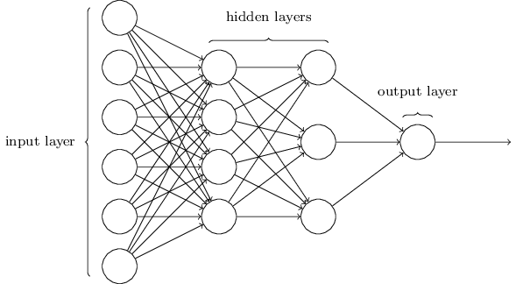
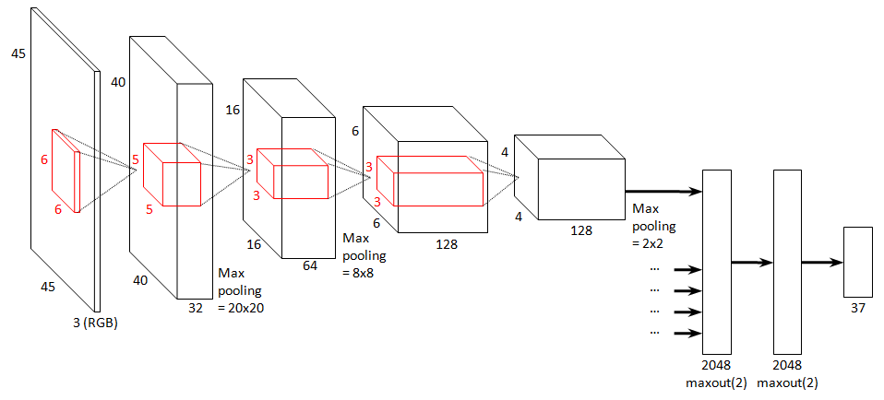
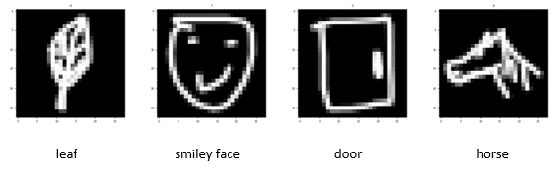
Classification Models for Sketch Drawings
Aparajita Dutta¹, Sarah Saki Robinson²
¹Department of Electrical Engineering, Stanford University
²Department of Computer Science, Stanford University
INTRODUCTION
METHODS
RESULTS (continued)
Numerous papers have been published, analyzing various algorithms for image classification on photographs. Majority of publications on image classification perform experiments on photographs where the objects in images are easily identifiable by the human eye. Here, we explore a case where the images of objects are not as easily identifiable by humans. We apply different classification techniques to a dataset of sketch drawings to find what model performs best.
Multi-class Logistic Regression
Generalization of Logistic Regression
Uses sigmoid logistic function is replaced by the SoftMax function
Naïve Bayes
Based on applying Bayes Theorem
Assumes conditional independence between feature pairs
Below is the confusion matrix for the CNN model’s performance on the test set:
Multi-Layer Perceptron (MLP)
Simple Neural Network
Our model: 2 full-connected hidden layers with ReLU activation and output layer with SoftMax activation.
Convolutional Neural Network
Regularized version of MLP
Our model: 3 convolutional layers with 2 x 2 max pooling and output layer with SoftMax activation.
OBJECTIVE
The objective is to take a hand-drawn image of an object and accurately identify it. Some examples of the compressed image inputs and their respective outputs are shown below.
RESULTS
Note: All methods were implemented using Scikit-learn^{[2]} and Keras^{[3]}.
Baseline: Majority classifier. Log loss = 33.003, accuracy 4.447%
Oracle: Human classifier. Log loss = 1.099, accuracy = 96.818%
Method comparison: Performed both general and model-wise hyperparameter tuning to pick the best model for each method. The 4 methods were applied on the validation set. Results are compared below.
CNN performed the best on the validation set and was then run on the test set, where it achieved log loss = ___ and ___% accuracy!
The demo application uses this CNN model to try and accurately classify the doodle input from the user. From our experimentation we see the model achieves a ____ % accuracy on the demo app. This is due to the difference in data format between the training data and user input.
CONCLUSION
DATASET
Deep learning methods performed much better then traditional methods because they can learn more about the image with the use of hidden layers.
CNN performs very well on image data as it can extract information from smaller parts of the image.
For this project, we used the Google QuickDraw dataset^{[1]}. The dataset contains images of many simplified drawings, centered and formatted to a 28 x 28 grayscale bitmap. Although the data was available for over 300 different objects, only a small subset containing 22 objects was chosen for this project; namely: Apple, Banana, Bicycle, Birthday Cake, Butterfly, Candle, Computer, Door, Drums, Firetruck, Hat, Horse, Ice Cream, Leaf, Panda, Peanut, Pencil, Rainbow, Smiley Face, Snowman, Soccer Ball and Umbrella.
The data was then split in a 60:20:20 ratio into the training, development and test sets.
Method | Train Loss | Test Loss | Accuracy | Precision | Recall
Logistic Reg | 9.9290 | 10.2584 | 0.7030 | 0.70 | 0.70
Naïve Bayes | 15.6298 | 15.5872 | 0.5487 | 0.56 | 0.55
MLP
CNN
REFERENCES
[1] Jongejan, J., Rowley, H., Kawashima, T., Kim, J. & Fox-Gieg, N. (2016) The Quick, Draw! - A.I. Experiment. https://quickdraw.withgoogle.com/data
[2] Pedregosa, F., Varoquaux, G., Gramfort, A., Michel, V., Thirion, B., Grisel, O., Blondel, M., Prettenhofer, P., Weiss, R., Dubourg, V., Vanderplas, J., Passos, A., Cournapeau, D., Brucher, M., Perrot, M. & Duchesnay, E. (2011) Scikit-learn: Machine Learning in Python. Journal of Machine Learning Research, vol. 12, pp. 2825–2830.
[3] Chollet, F. (2015) Keras.https://keras.io.
MLP and CNN images: https://www.peculiar-coding-endeavours.com/assets/

