Slide 1
H1B-VISA PETITION 2011-2016 ANALYSIS
ITMD-527 : Data Analytics
Abhishek Dutta (A20379160)

Slide 2
Introduction
H1-B Visa is an employment based visa for temporary international workers in USA. For in international / foreign worker to get an H-1B visa their employer must sponsor them by giving a job and filing a petition for them in the US immigration department.
It is on basis of specialty occupations or as fashion models of distinguished merit and ability. A specialty occupation requires the theoretical and practical application of specialized knowledge and a bachelor's degree or the equivalent in the specific specialty like - science, medicine, health care, education and business specialties,etc).
Our motivations comes from analyzing about different factors such as which location files more number of H1-B petitions , get the list of top profiles that has maximum number of certified petition status and which profiles have maximum number of denied status.This shows us the demand for profiles/Job Titles based on location and other such analysis related to H1-B Visa petitions.

Slide 3
Objectives
To analyze the employers who file most H1B visa applications
To analyze percentage share out of 31000 applications for employers with most of applications
To analyze the maximum number of applications for the employers location wise
To analyze the trending jobs and related salaries for which H1B visas are applied
Comparison of wages offered by high-applicant employers to rest of the industry.
To analyze the percentages of visa applications certified, withdrawn or denied
To build multiple linear regression model and predict the certified and denied status for H1B visa

Slide 4
Data Description
The Office of Foreign Labor Certification (OFLC), generates the data for different visa types this data is program data and we are planning to take this disclosure data and would analyze about the H-1B visa type from 2011-2016.
Columns:
CASE_STATUS: Is the status certified-Visa granted , Denied –Visa rejected etc.
Employer Name: Name of the Employer that is filling visa for the applicant.
SOC_NAME: Basically the department .Whether a technical background or Non technical.
JOB_TITLE :Designation or the Role/Profile of the employee whose visa is filed.
FULL_TIME_POSITIONS:Is it a Full time or not a full time position for which visa is filed.
PREVAILING_WAGES: Income earned by the title holder.
YEAR: Year of the H1-B Visa petition file.
WORKSITE: This contains the location of the Employer(City and State)
REGION: We have divided the locations and categorized it into regions eg: East , West, North East and likewise.
LON: Longitude of the location
LAT: Latitude of the location

Slide 5
Data cleaning
There are many entries containing NA values , therefore we have removed those rows from our dataset in order to get a data helpful for our analysis by using na.omit in R.
We have categorized our data –Worksite containing city and state into Region South, East , West , North West etc. in order to simplify our analysis while creating a model.
SOC_NAME give us the department under which the Job_Title is held we have bifurcated it to Technical and Non –Technical while implementing it in our model for simplification.

Slide 6
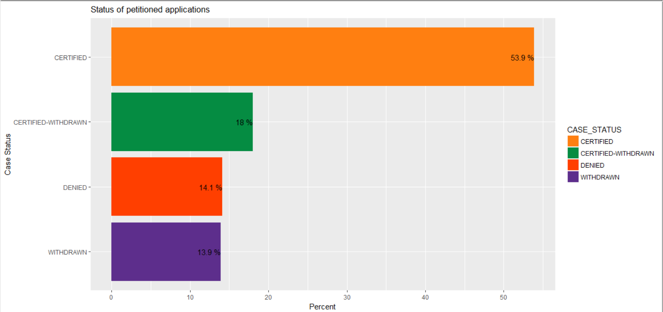
CASE STATUS VS PERCENTAGE VALUE
This figure shows us the percentage wise categorization of the different visa status such as CERTIFIED=53.9%,CERTFIED WITHDRAWN=18%,DENIED=14.1% and WITHDRAWN=13.9% , from our dataset.
The Graph tells us that as per our dataset the % of CERTIFIED status is more than 50% and that most of the visa applicants got their Visa certified during 2011-2016.

Slide 7
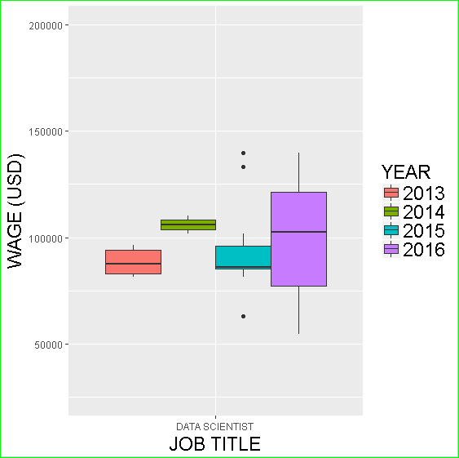
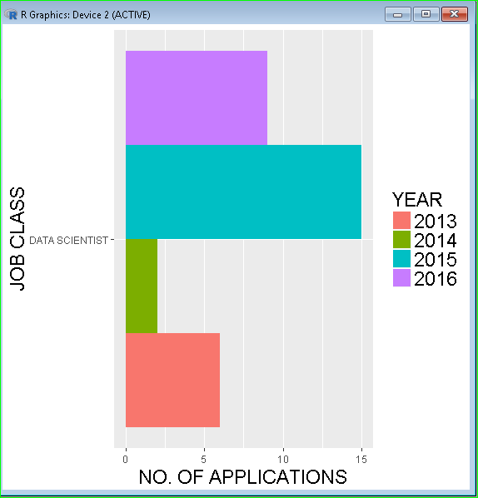
DATA SCIENTIST WAGES AND APPLICANTS.
CASE1:Here we have picked up the Job title Data Scientist as it is the profile with highest wages and we have shown variation in this Job Title =Data scientist wages over 2011-2016.
CASE 2:In the graph we see the Data scientist vs No. of applicants year by year .We can figure out from the graph that 2015 shows us a great amount of Data scientist applicants in comparison to other years.

Slide 8
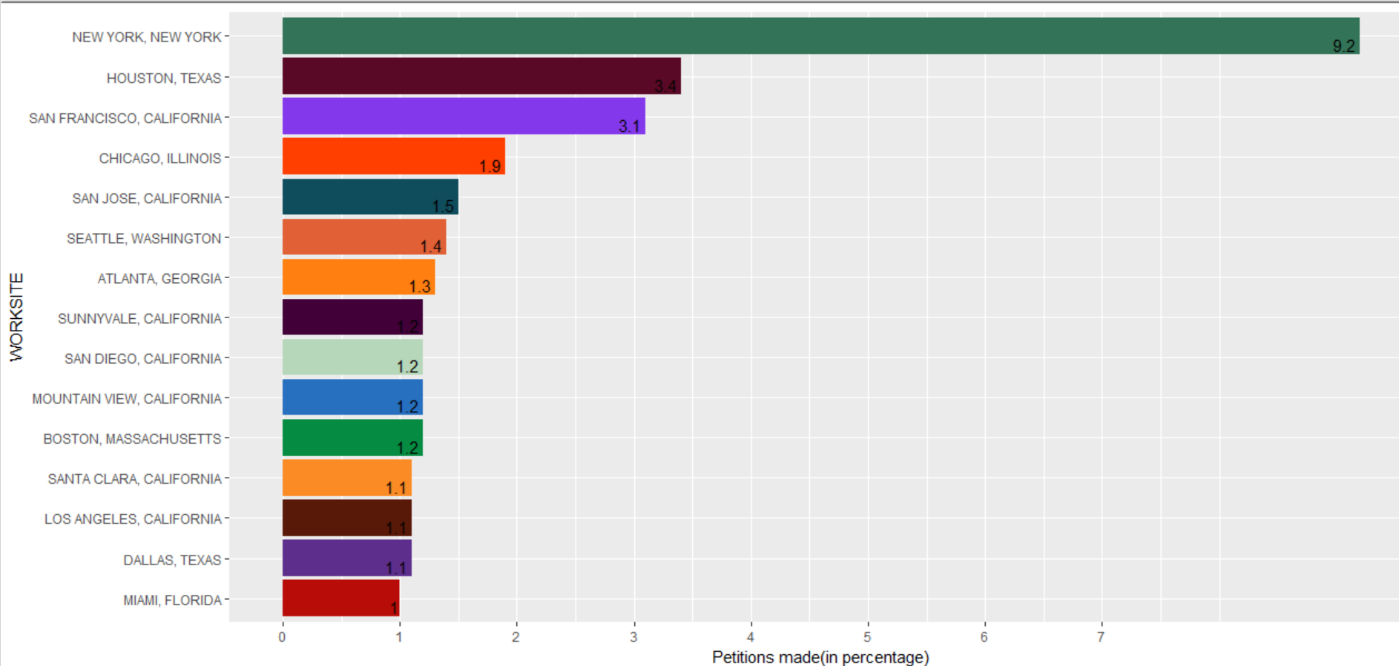
WORKSITE VS PETITIONS MADE
This graph tells us about the percentage of petitions made with respect to the Worksites where the employer is based.
From the graph we can clearly see that NEW YORK has the maximum percentage of Petitions being filed this also tells us that there are many companies in NEW YORK and also big companies as they have good amount of Visa Quota available.

Slide 9
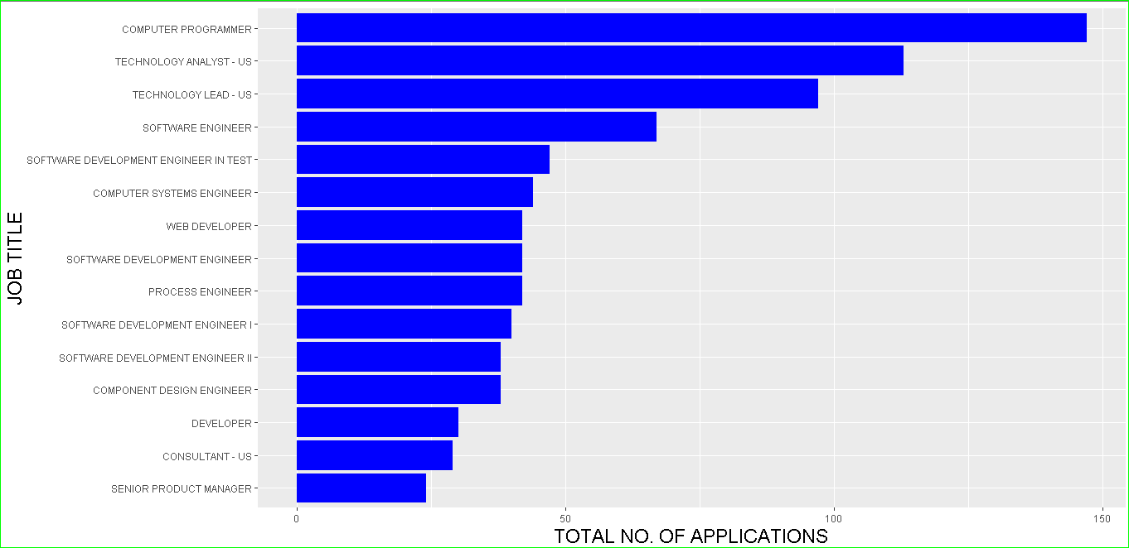
JOB TITLE VS NO. OF APPLICANTS
This Graph tells us about the Job Title vs Total no. of applications. As per the graph we can see that Total number of applications were the most for Computer programmers and then Technology Analyst and so on.
This tells us that employers file more Visa application for Computer programmer and technical roles than other non technical roles. As all top 15 roles in the graph belong to Computer/IT field.

Slide 10
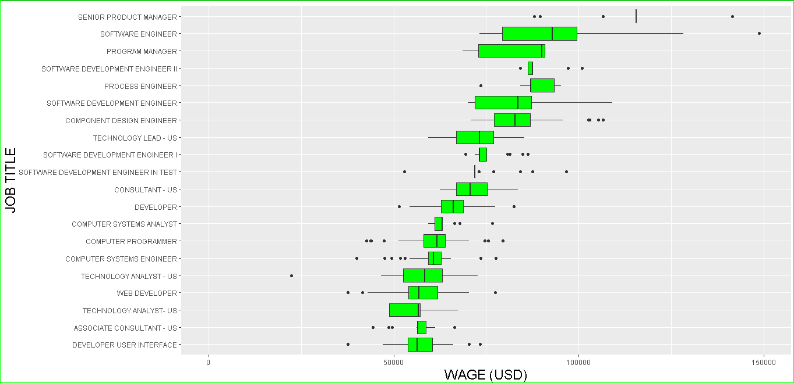
JOB TITLE VS WAGE
In this graph we see that top 20 Job titles with maximum no. of wages is taken and represented .From the graph we can make out that Software Engineers are highly paid.

Slide 11
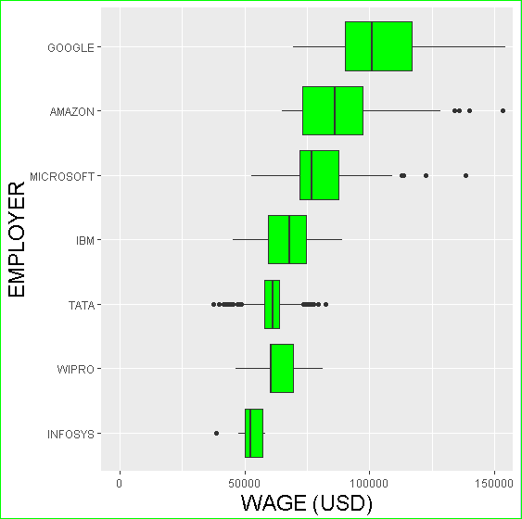
Employer vs WAGE
This graph tells us about the wages that the employers offer and as per it Google pays the highest wages and then amazon and so on.

Slide 12
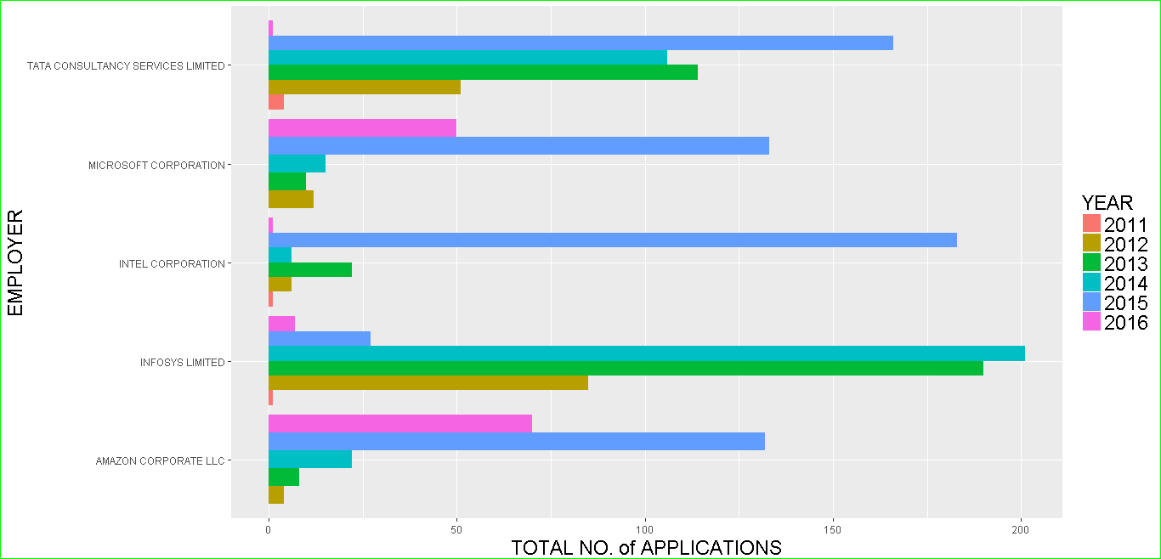
Employer vs Total no. of Applications.
This Graph tells us about the Employers and the total number of Applications for H1-B visa filed by them over the period 2011-2016,
From the graph we can say that Infosys in the year 2014 filed maximum number of H1-B Visas for it employees.

Slide 13
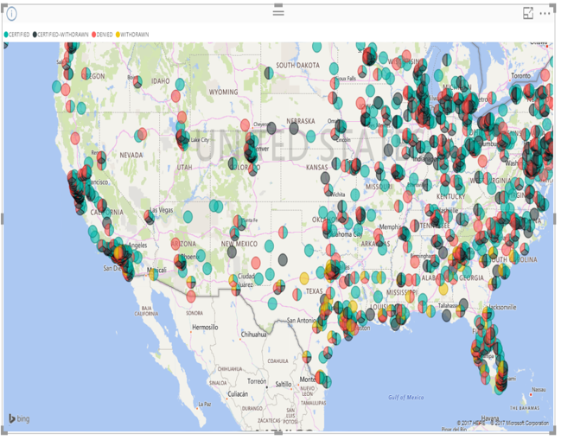
Location wise CASE STATUS projected on USA map.
From the Map we can make out the distribution of VISA status all over USA.This tells us that most of the Visa petitions filing is done from the companies in the NORTH EAST and EAST of USA.

Slide 14
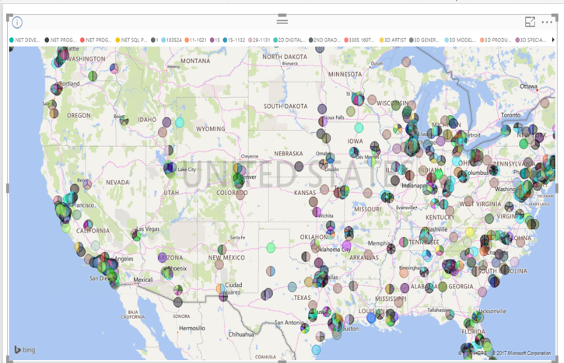
Location wise JOBS projected on USA map.
The Map shows us the spread of the JOB and the profiles over the US.

Slide 15
BUILDING OUR MODEL

Slide 16
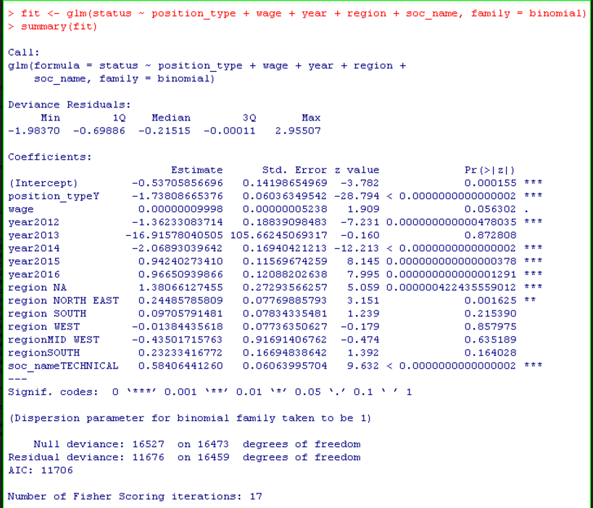
Building the model taking the variables.

Slide 17
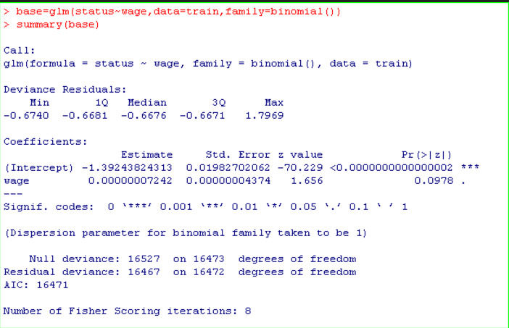
We have used this Base model in order to use in Forward and Best Subset Model.

Slide 18
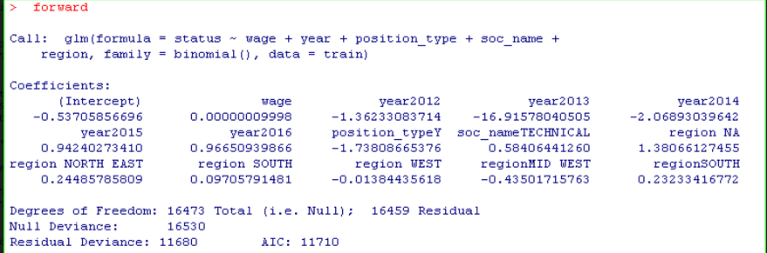
Forward Selection

Slide 19
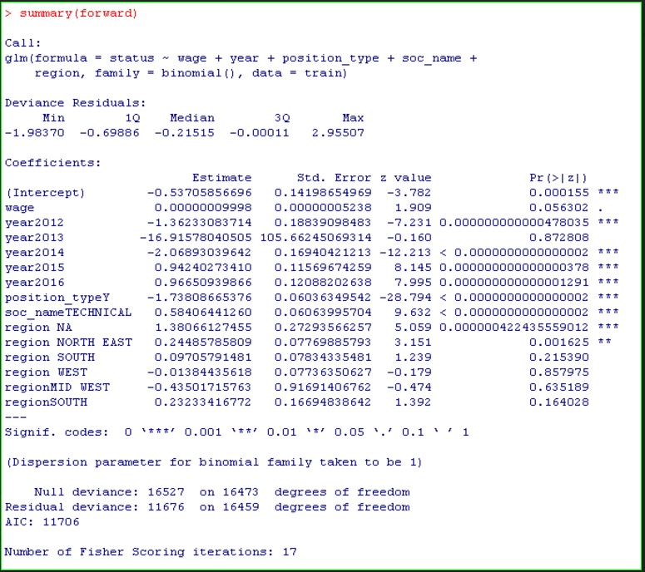
Summary for the Forward Selection Model

Slide 20
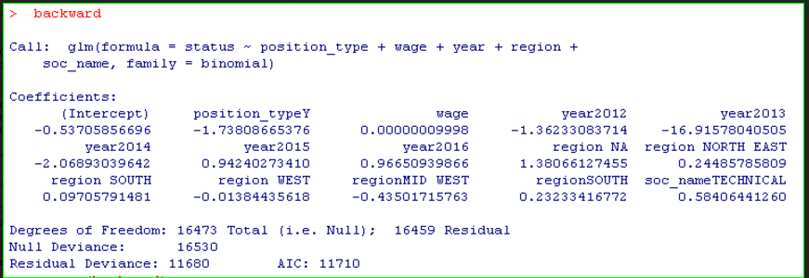
Backward Model

Slide 21
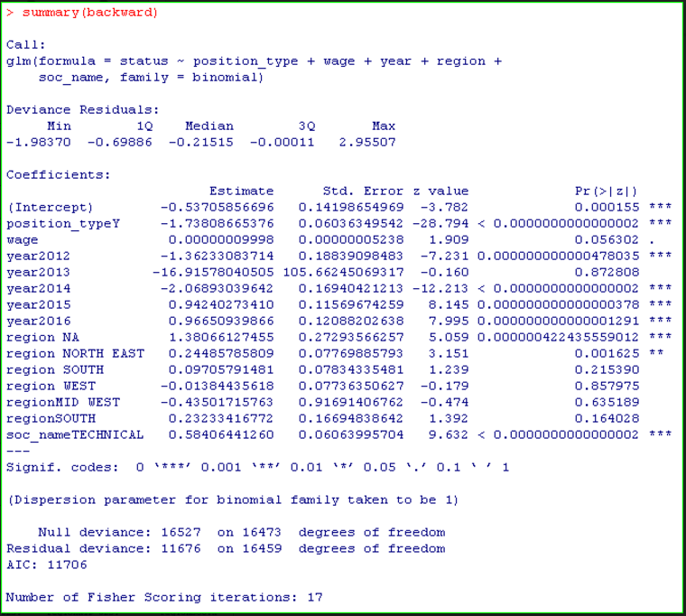
Summary for Backward Model

Slide 22
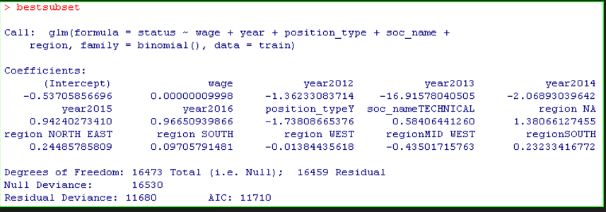
Best Subset Model

Slide 23
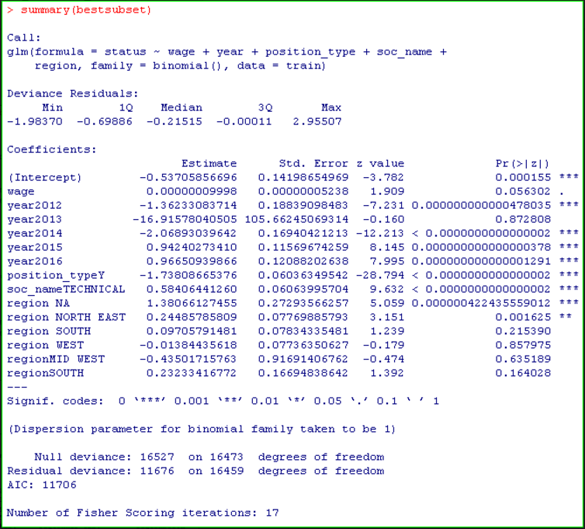
Summary for Best subset Model

Slide 24
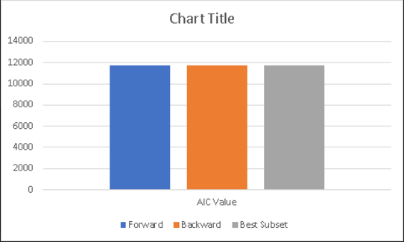
AIC value comparison Plot

Slide 25
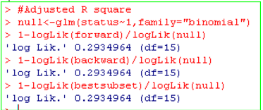
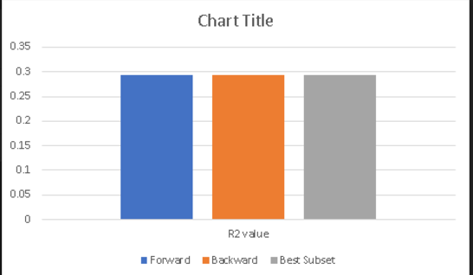
Adjusted R square for forward , backward and best subset and its plot.

Slide 26
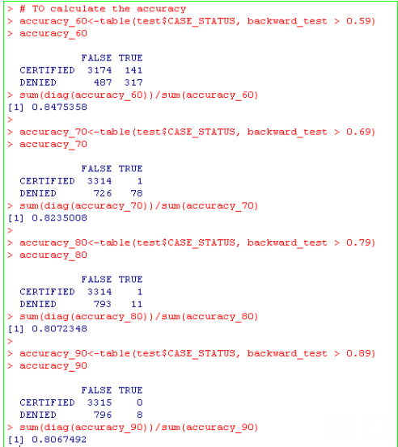
Accuracy check for Backward Model

Slide 27
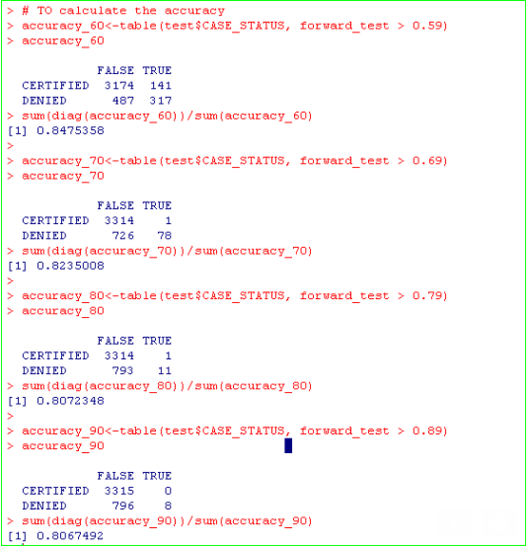
Accuracy check for Forward Model

Slide 28
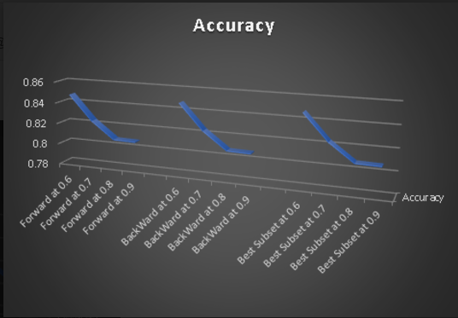
Accuracy Plot

Slide 29
Thank You!

