Slide 1
SENTIMENTAL ANALYSIS ON PRESIDENT TRUMP
ITMD-525D : Data Mining
Abhishek Dutta(A20379160)

Slide 2
INTRODUCTION
Sentiment analysis is the detection of attitudes or emotions conveyed in a body of text. It is a subset of a larger field of study called Natural Language Processing (NLP).
Examples : Movie reviews: Is this review positive or negative? How many stars?
Twitter sentimental analysis is the process to determine emotional tone behind a series of words used to gain understanding of attitudes, emotions and opinions .
Why Sentimental Analysis? Shifts in sentiments of the social media has shown correlation with the shift in trend of the stock market.
Example: Obama administration used sentimental analysis to gauge the public opinion and accordingly made some policy announcements and campaign ahead of the 2012 elections.

Slide 3
OBJECTIVE
To perform sentimental analysis on the tweets about President Donald Trump
Analyze positive and negative tweets about Mr. Trump’s actions
Example:
Negative => #PresidentTrump is someone that’s at the top of the pyramid with corruption beneath him.
Positive => I love #PresidentTrump I think he is doing a Great job!

Slide 4
STEP BY STEP PROCESS FLOW
Collect Data From Twitter
Clean Tweets Data
Label the Data
Test
Extract Important Features
Cross Validation
Classify

Slide 5
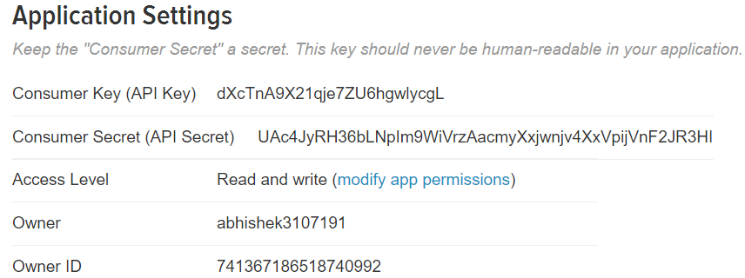
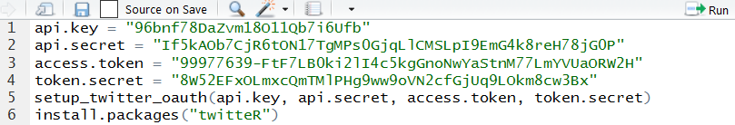
Collecting Data from Twitter
Navigate to http://apps.twitter.com .

Slide 6

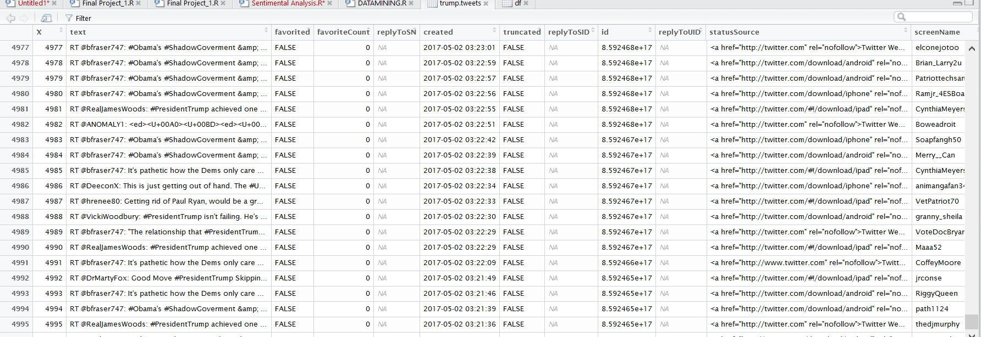
Extracting the 5000 tweets on which we are going to perform our Sentimental Analysis.

Slide 7
Data Cleaning
Tweets are messy! They often times contain multiple hashtags (#), hyperlinks, photos, videos, emoji’s etc. Also there are retweets (RT’s).GSUB functions replaces the matches of string.
clean.text = function(some_txt){ some_txt = gsub("(RT|via)((?:\\b\\W*@\\w+)+)", "", some_txt)
some_txt = gsub("@\\w+", "", some_txt) – REMOVES @
some_txt = gsub(“#\\w+", "", some_txt) some_txt = gsub("[[:punct:]]", "", some_txt)- Removes hash tags
some_txt = gsub("[[:digit:]]", "", some_txt) ---Removes emoticons
some_txt = gsub("http\\w+", "", some_txt) ----REMOVES http (links)
some_txt = gsub("[ \t]{2,}", "", some_txt) some_txt = gsub("^\\s+|\\s+$", "", some_txt) some_txt = gsub("amp", "", some_txt)

Slide 8
Basic Idea –Sentimental Analysis
Search through the words in the body of text and find POSITIVE (+1) and NEGATIVE (-1) words. Many/most of the words in the text will not receive a score or be scored as zero. The sentiment score could simply be the sum of the scored words.
For Positive /Negative words calculation we have used the below mentioned link https://www.cs.uic.edu/~liub/FBS/sentiment-analysis.html#lexicon.
But we also understand that in social media there are many people who use urban-lingo i.e. words like gr8, Awsum,Kewl and even they fall under a specific positive or negative category and can influence our sentimental analysis therefore we have also considered and added a few such mostly used words in our R-code.But again since words are endless therefore it totally depends what all to include and what basis.
Once we calculate the score therefore if the score of positive words is high then negative words then it would fall under POSITIVE LABEL. If the negative score is greater than Positive score then it would fall under NEGATIVE LABEL. If scores are 0 or both POSITIVE and NEGATIVE scores are equal then it would fall under the NEUTRAL LABEL.

Slide 9
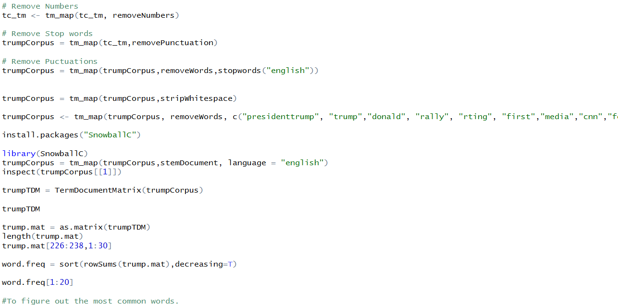
Stemming and Stopping
We have also explicitly mentioned and removed numbers,Punctutaions ,words like trump , rally ,rting ,first that have no significance in Sentimental score calculation .we have used Corpus function to do so.

Slide 10
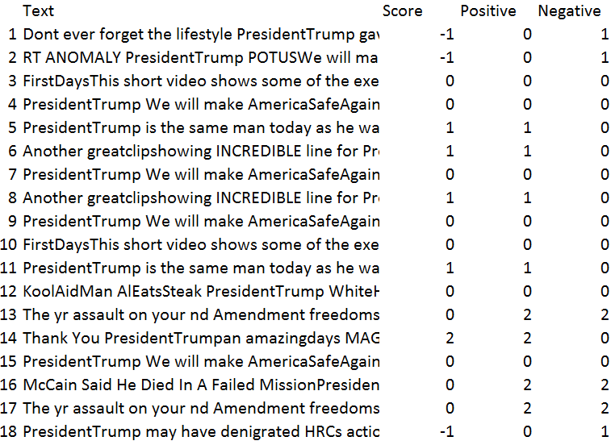
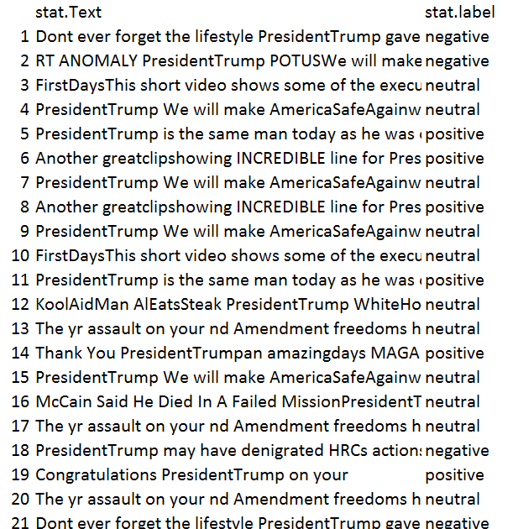
Data presentation
Data with the Sentiment score
Data with the Labels Positive/Negative/Neutral based on the Score.

Slide 11
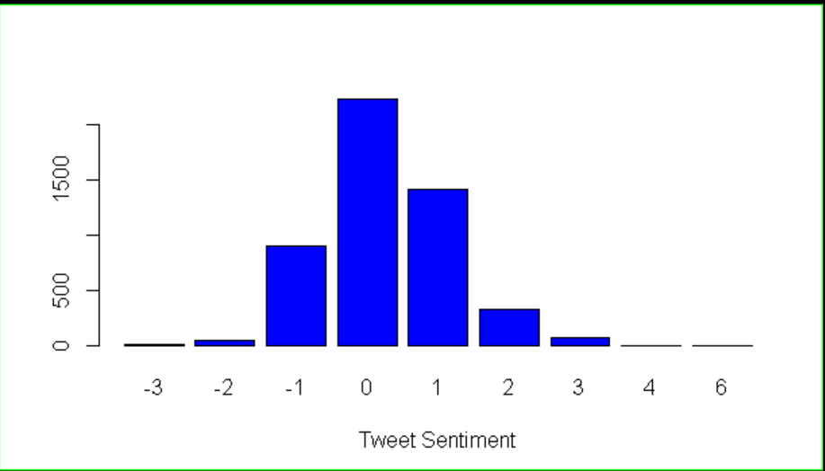
No. of tweets to tweets sentiments.
This shows us the graph of the No. of tweets to the score of the tweets.From this graph we can interpret that there are a lot of number of neutral tweets as the value on 0 score is high and then come positive no. of tweets with score 1.

Slide 12
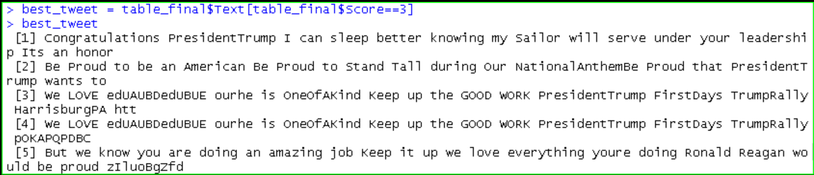
Best Tweets
This gives us the list of the best(most positive) among the tweets that are extracted from twitter.

Slide 13
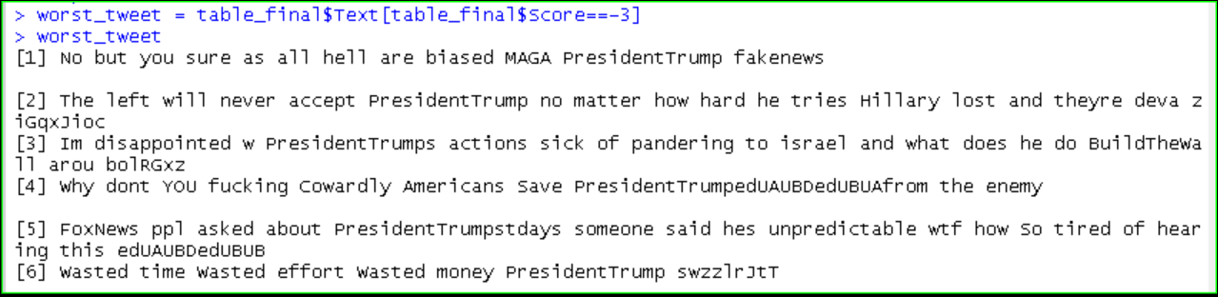
Worst Tweets
This gives us the list of the worst tweets from the 5000 tweets extracted by us.

Slide 14
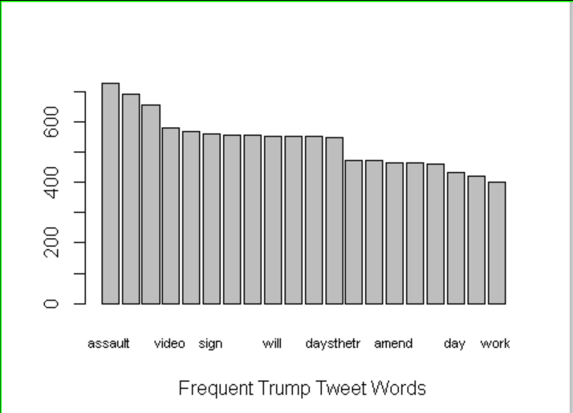
Mostly used Words
This is visually showing us the Frequently used words in the tweets.

Slide 15
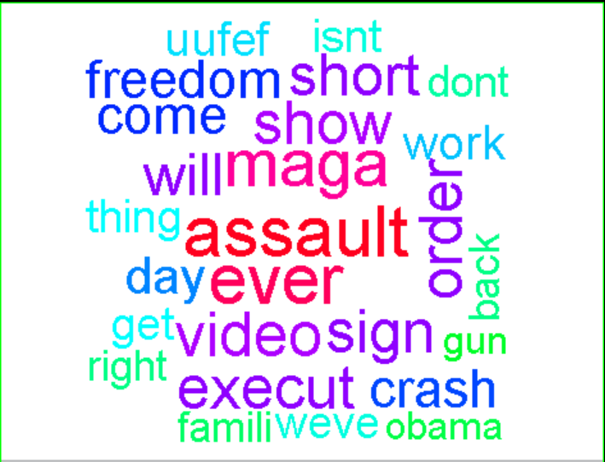
Word Cloud
This visually shows us the maximum no. of words used in form of WORD CLOUD.
From here we can see that assault is the word used mostly in the tweets.

Slide 16
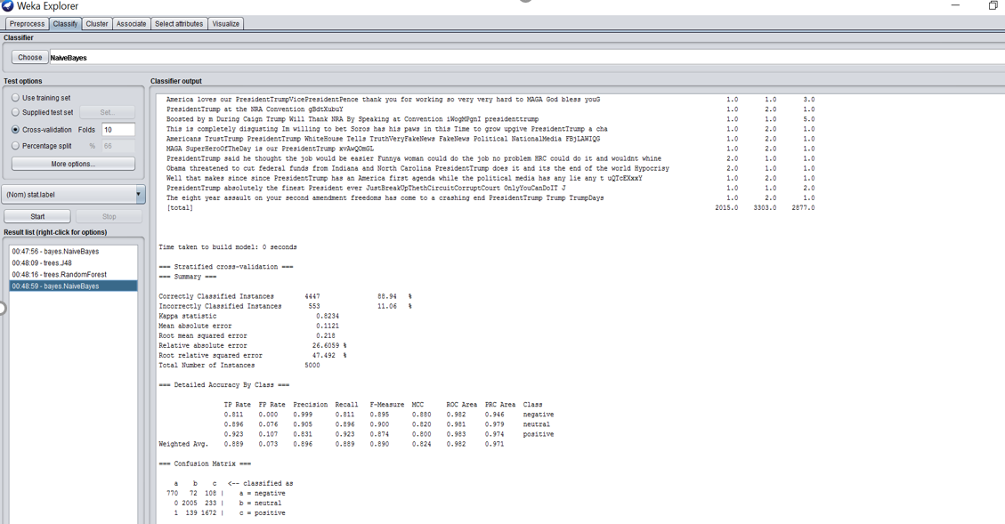
Naïve Bayes Classifier
On using Naïve Bayes Classification we find out that the Currently classified instances or the accuracy comes out to be 88.94% as seen in the figure.

Slide 17
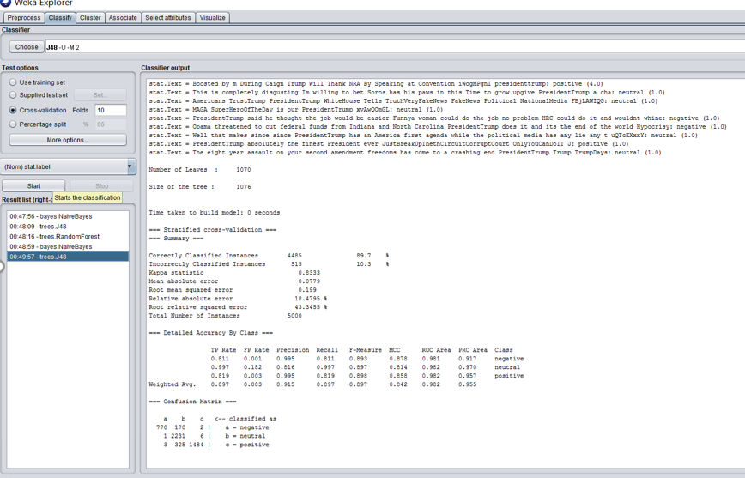
J-48 Classifier Accuracy=89.7%

Slide 18
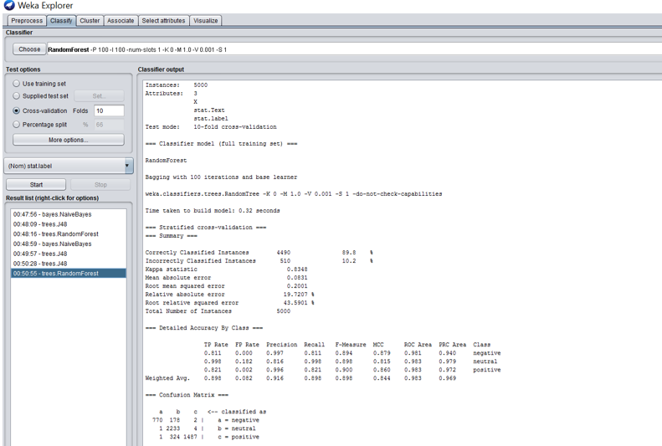
Random Forest shows Accuracy=89.8%

Slide 19
Plot showing Accuracy of the classifiers.

Slide 20
Thank You!

