Slide 1


Data Driven Analysis and Launch Strategy
Adrian Del Villar
adv@rockbusterstealth.com

Slide 2

Objective
Facing stiff competition from streaming services such as Netflix and Amazon Prime, the Rockbuster Stealth management team is planning to use its existing movie licenses to launch an online video rental service in order to stay competitive.
This presentation will give data-driven insights to guide our 2020 company strategy

Slide 3

Presentation Goals
Through data aggregation and analysis using SQL queries and Tableau visualizations we will address the following questions and give strategy recommendations based on our findings.
● Which movies contributed the most/least to revenue gain?
● What was the average rental duration for all videos?
● Which countries are Rockbuster customers based in?
● Where are customers with a high lifetime value based?
● Do sales figures vary between geographic regions?

Slide 4

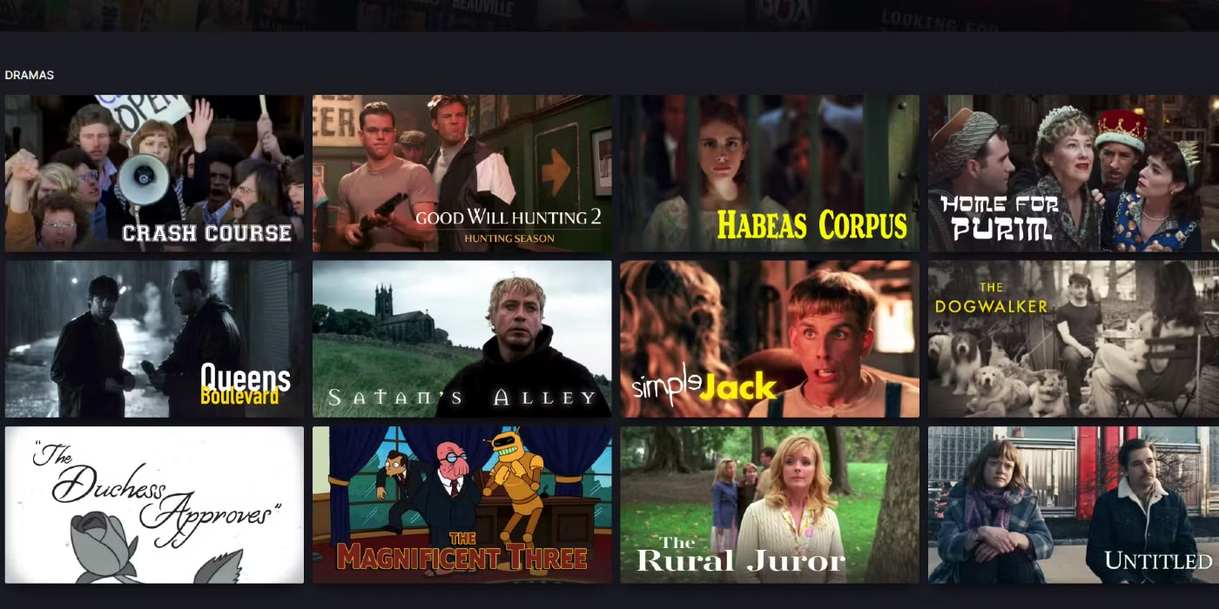
How long are customers renting movies for?
Maximum
7 Days
Average
5 Days
Minimum
3 Days

Slide 5
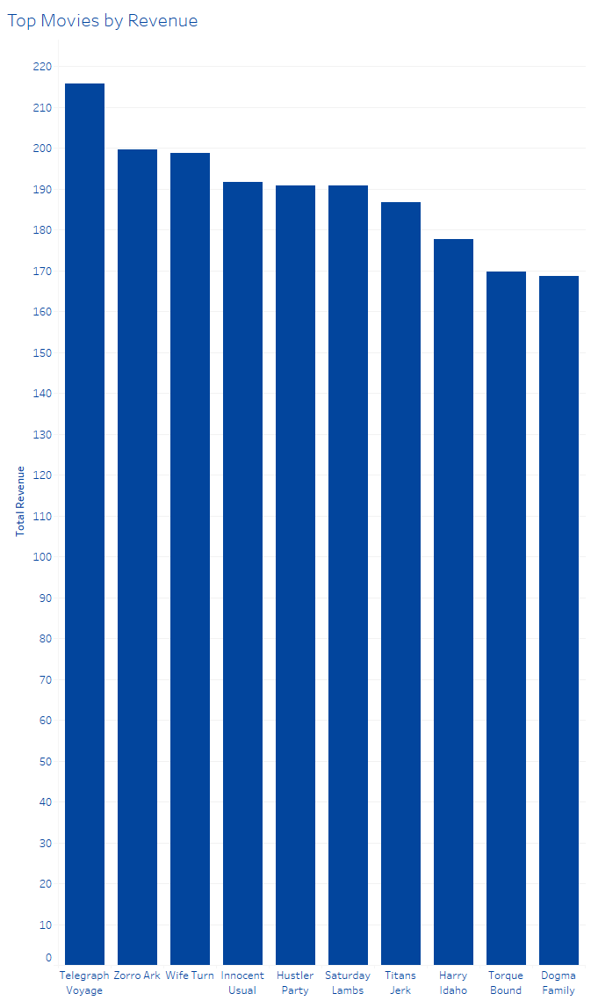
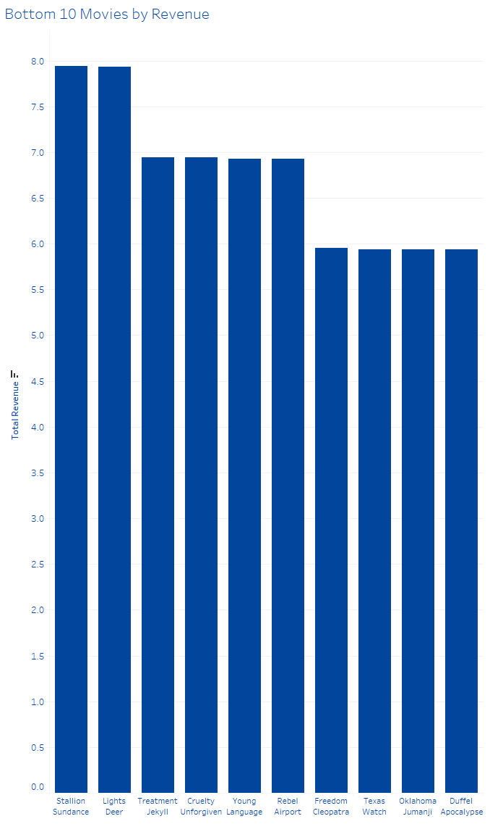
What movies are Rockbuster customers watching?
Total Revenue
$61,312.04
The top 10 movies made up 3% of total revenue while the bottom 10 made up .1%

Slide 6
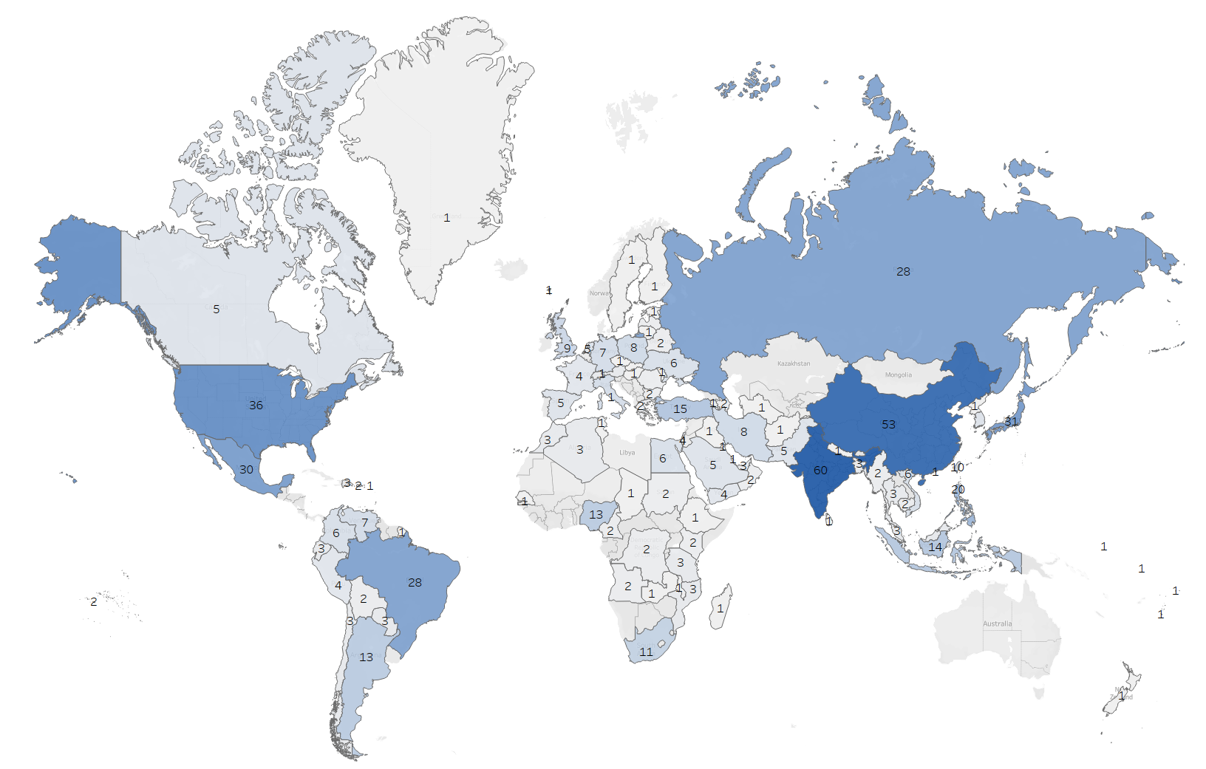
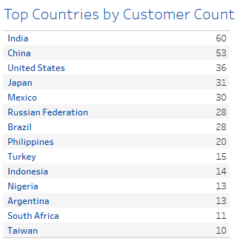
Where are your customers?
Total Customers
599
109
Different Countries
The top 3 countries by customer count India (60), China (53), and The United States (36) make up 24.8% of your customer base.
There is growth potential for emerging markets that already show a strong customer base such as Japan (31) Mexico (30) the Russian Federation (28), and Brazil (28)

Slide 7
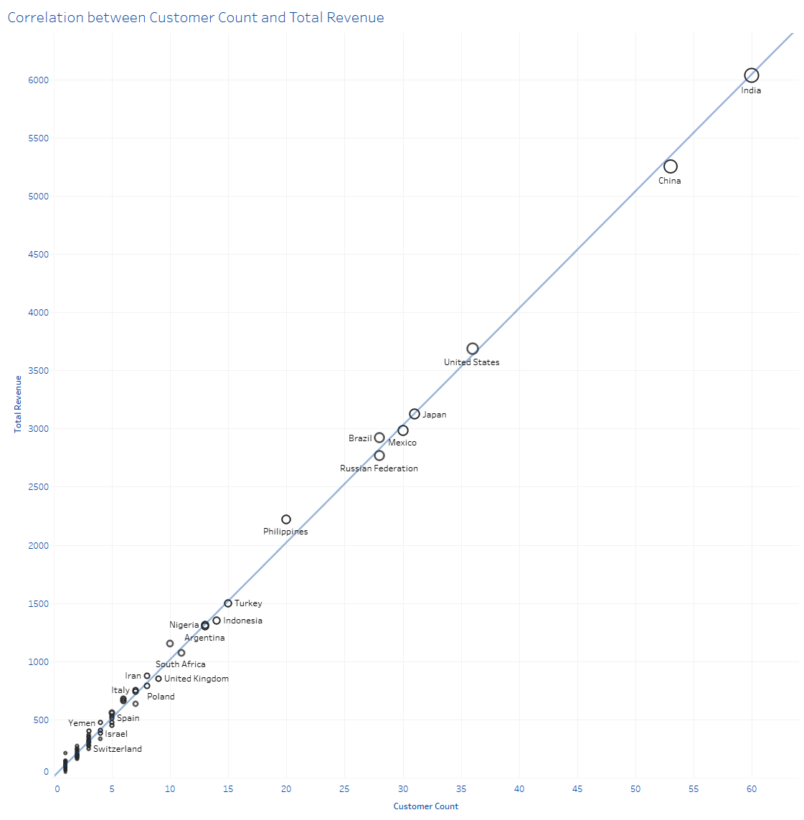
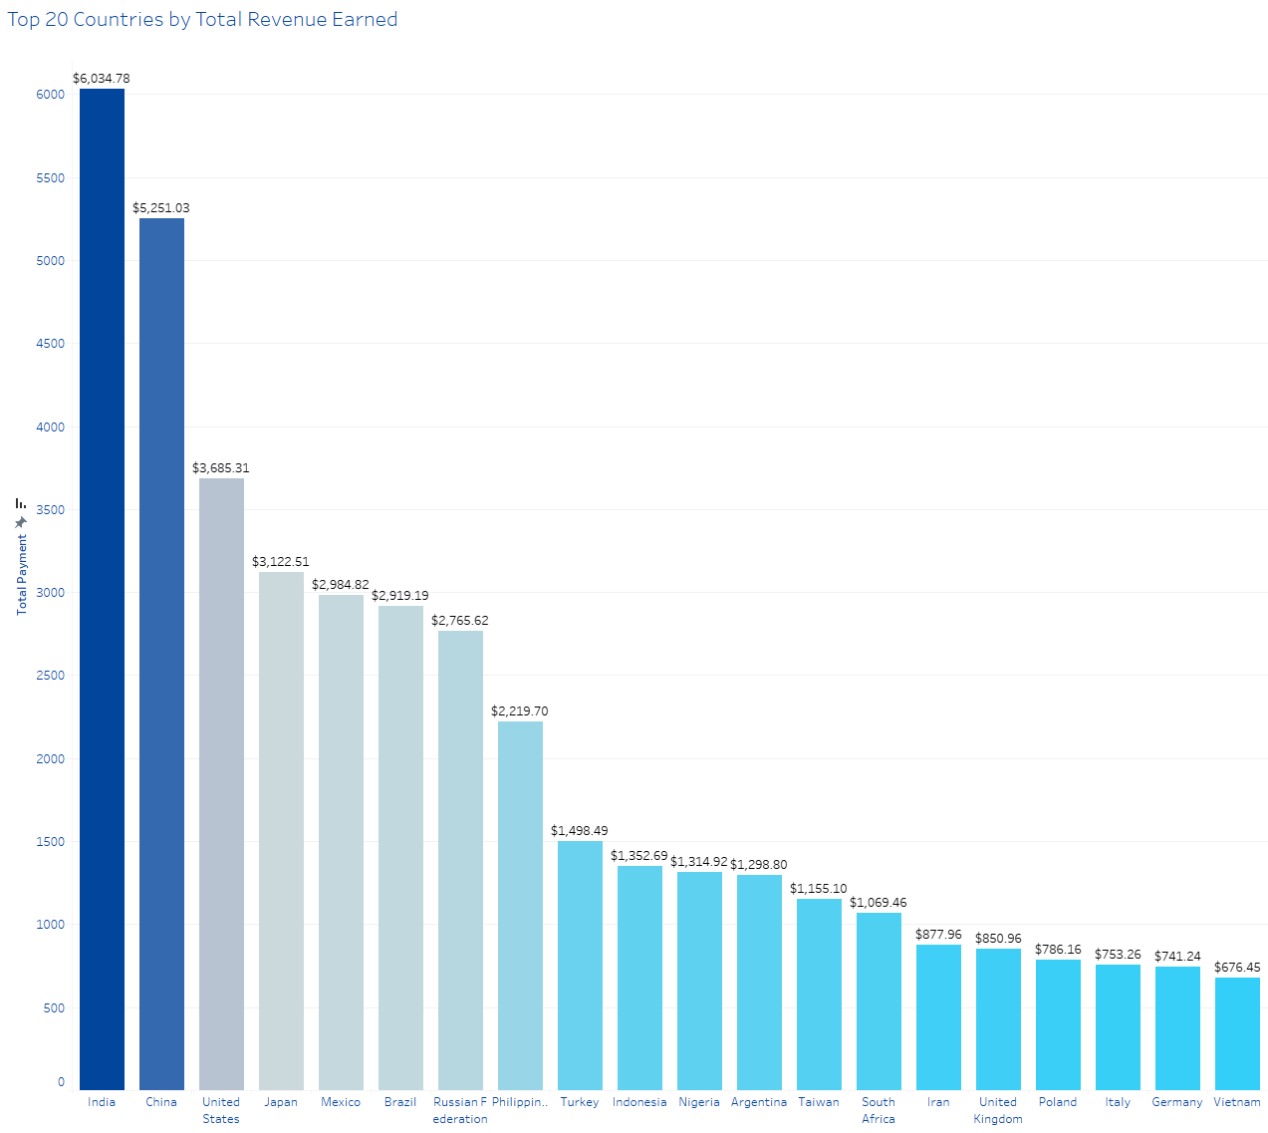
Which countries are generating the most revenue?
There is strong correlation between customer count and revenue. All countries with larger customer bases also generate the most revenue
Total Revenue
$61,312.04
India alone produced
9.8% of total revenue
Brazil, Philippines and Taiwan all outperform the trendline making them prime markets for growth

Slide 8
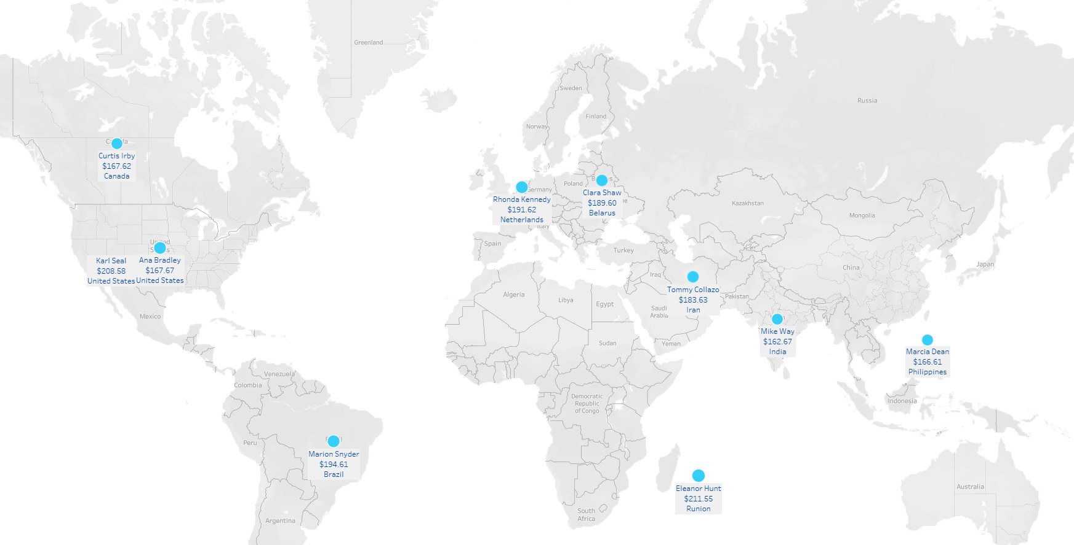
Who are the top customers?
50% of top spending customers come from countries that are not in the top 20 for generating revenue showing potential for growth in those markets

Slide 9
Strategy Reccomendations
Localized Marketing Campaigns
Personalized Customer Rewards Program
Maintain a Diverse Movie Selection
With the top 10 countries contributing over 50% of revenue it is important that we ensure that the majority of these customers begin using our streaming service. We can ensure this transition with localized marketing campaigns in these countries. Especially countries like Brazil, Philippines and Taiwan which outperform other markets given their customer counts.
With some customers generating a disproportionately large amount of revenue, a rewards program can ensure these customers feel valued by our company. Personalized rewards such as early access to movies in their favorite genres will ensure their continued business. Additionally, the program will incentivize other customers to spend more in order to receive rewards.
With no particular movies generating a disproportionate amount of revenue, and such a diverse customer base spanning 109 different countries, maintaining a diverse movie selection will ensure satisfaction across all markets.

Slide 10

Thanks!
Any questions?
Please reach out!
adv@rockbusterstealth.com
+91 620 421 838

