Slide 1
Automobiles

Slide 2
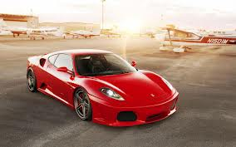
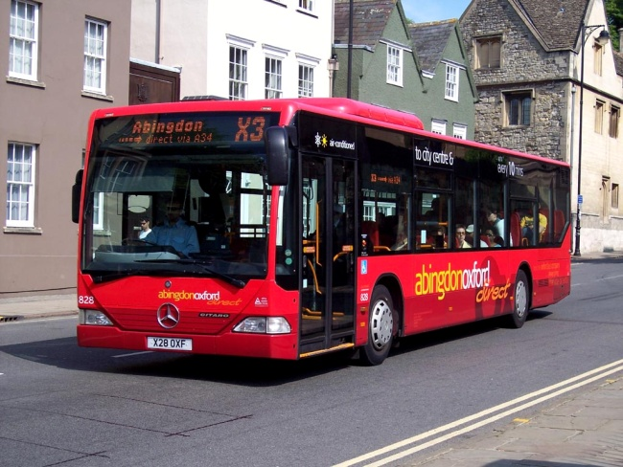
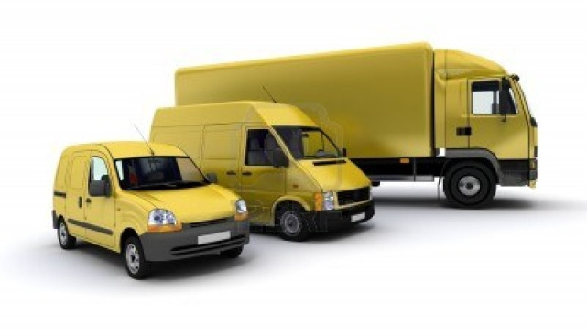
AUTOMOBILE ENGINEERING
Automobile engineering is the study of motor bikes, mopeds, scooters, cars, trucks, buses, tractors and such vehicles.
An automobile may be defined as a self propelled steerable device capable of moving on land.
Trains and Trams do not come under automobiles as they do not have a steering system.

Slide 3
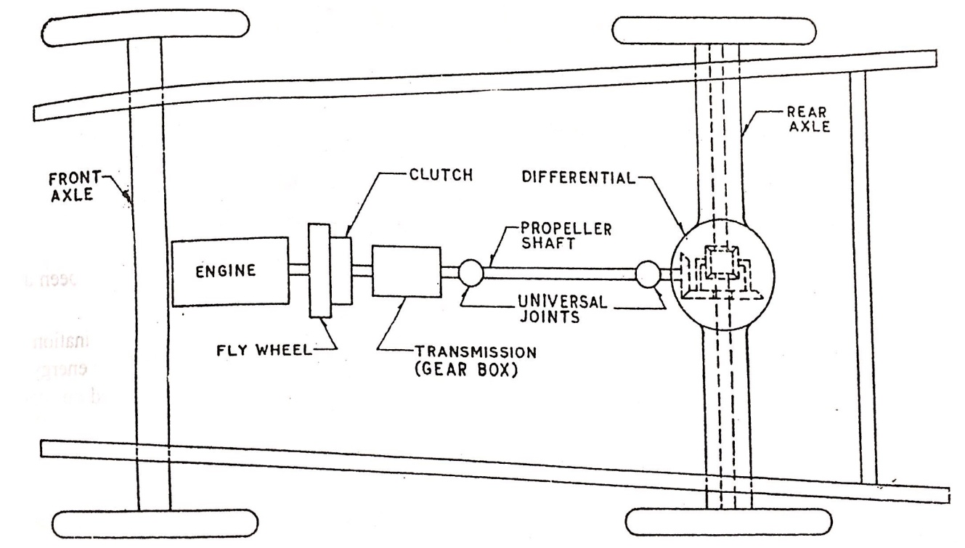
Automobiles
An automobile is a self-propelled vehicle driven by IC engine or electric motor and used for transportation of passengers and goods on roadways.
Classifications:
Purpose
  Passenger vehicle - Car, Jeep, Bus
  Goods vehicle - Truck, Pick-up
Load Capacity
  Light duty vehicle - Motor cycle, Scooter, Car
  Heavy duty vehicle - Bus, Truck, Tractor
Drive of vehicle
  Real wheel drive, front wheel drive, left hand drive,
  right hand drive.

Slide 4
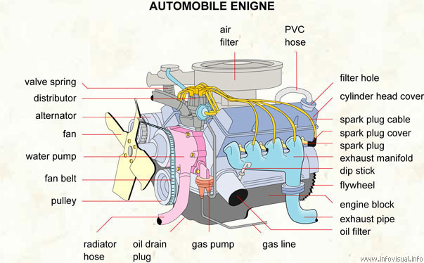
Automobile Engine

Slide 5
Automobiles
Major components of automobile:
Prime mover – produce the power to run the vehicle.
Chassis – supports the engine, wheels, car body and other components.
Power train (transmission system) – transmits the power from prime mover to wheels.
Suspension system – absorbs the vibrations due to the vertical motion of wheels.
Fuel supply system – supplies the required quantity of the fuel.
Ignition system – provides the ignition source (spark) for SI engine at right time.
Electrical system – starts the starter motor and provides energy to other parts.
Steering system – changes the automobile direction.
Braking system – reduces the speed of the automobile and used to stop as well.
Cooling system – prevents the overheating and overcooling.
Lubrication system – minimize the friction due to the moving parts.
Exhaust treatment system – reduces the exhaust emissions.
Body and accessories – provided the accommodation with protection.

Slide 6
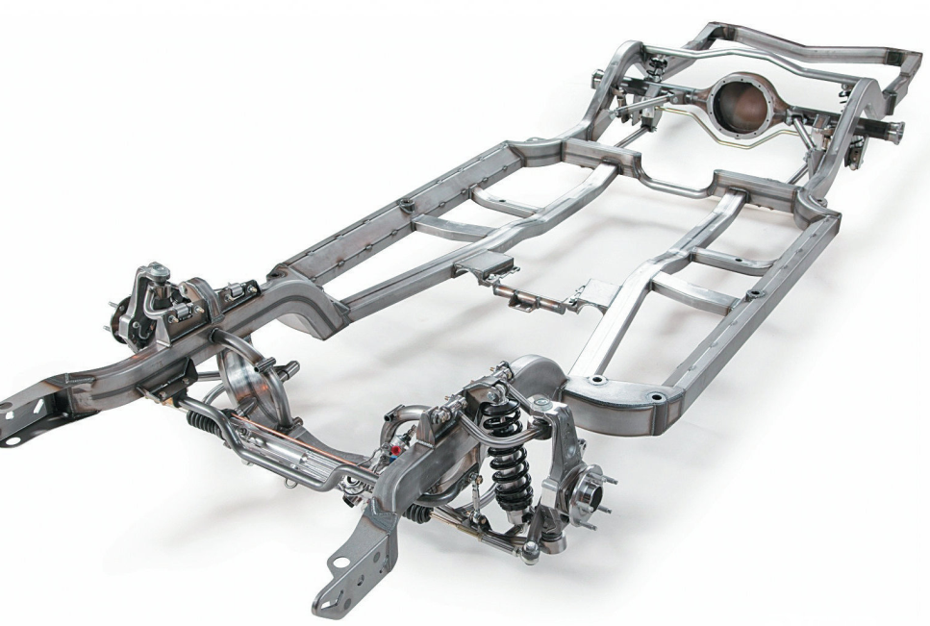
Chassis
Chassis is a foundation structure of an automobile that supports the engine, wheels, car body and other components.
The frame is supported on wheel axles by means of springs. This whole assembly is called the chassis.
The frame and axels are made of carbon steel or aluminium alloy.
The steels has a capability to absorb the shock and aluminium provides the light weight.

Slide 7
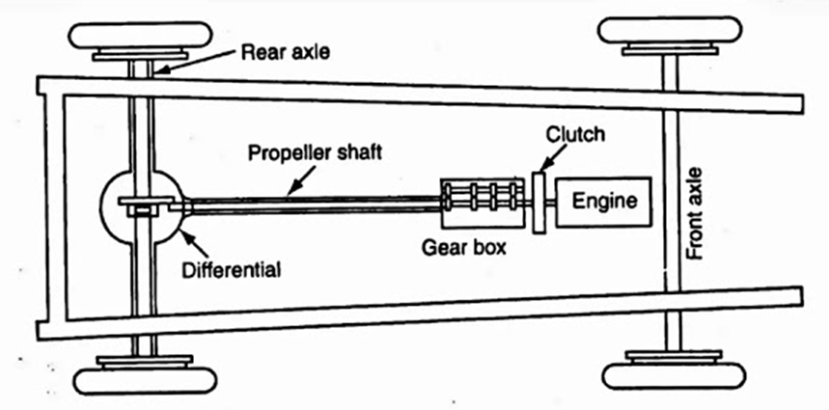
Transmission System in Automobiles
Transmission system (power train) is used to transmits the power (rotary motion) from the crank shaft of the engine to the wheels.
Different kind of modern transmission systems are adopted in the automobiles to make it more reliable and comfortable.
Transmission elements in automobiles:
  Clutch
  Gear box
  Propeller Shaft
  Differential
  Axle
  Wheel

Slide 8
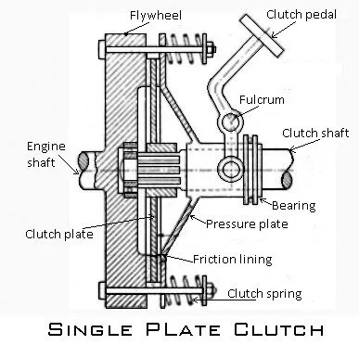
Clutch
Clutch is a mechanism used to engage or disengage the power train from the engine.
Function:
  To transmit the engine power to the road wheels smoothly without shock to the transmission system.
  To allow the engaging or disengaging of gears when the vehicle is in motion without damaging the gear wheels.
Main parts of single plate clutch:
  Clutch or disc plate
  Pressure plate
  Clutch shaft
  Clutch spring
  Clutch pedal

Slide 9
Single plate clutch
Construction
The clutch plate is attached to the hub between the flywheel and the pressure plate.
It consist of friction lining on both side and moves axially on the driven shaft.
The friction between the clutch plate and flywheel is responsible for the torque transmission.
The pressure plate connected with the flywheel and spring, and it helps to push the clutch plate with the flywheel.
A pedal is attached to thrust bearings with fulcrum lever mechanism on the driven shaft (clutch shaft).

Slide 10
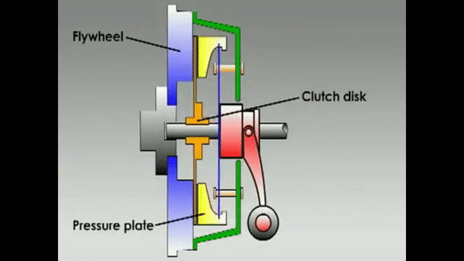
Working of single plate clutch
When applying the clutch:
The force applied on the clutch pedal forces the pressure plate to move away from the (clutch) friction disc against spring force by lever mechanism.
This action disengages the clutch plate from the flywheel.
During this period, the power is not transmitted from engine to the transmission system.
When releasing the clutch:
The springs push the pressure plate against the clutch disc and connects the flywheel and clutch disc.
This action engages the clutch plate from flywheel.
During this period, the power is transmitted from engine to the transmission system.

Slide 11
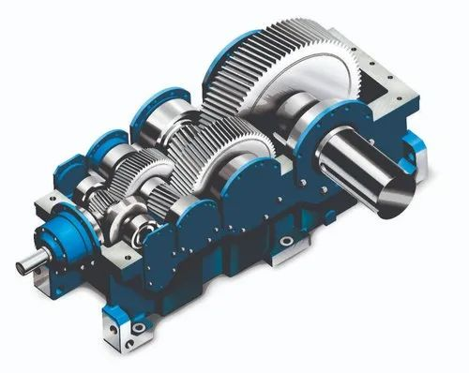
Gear Box
A set of gears arranged in a manner that torque from the engine is changed at the end of the gear shaft with respect to the load demand is called gear box.
Function:
  To provide the different torque or speed to the transmission drive according to the load demand.
Gear ratio
  Gear ratio or Transmission ratio N_{t} = ω_{in} / ω_{out}

Slide 12
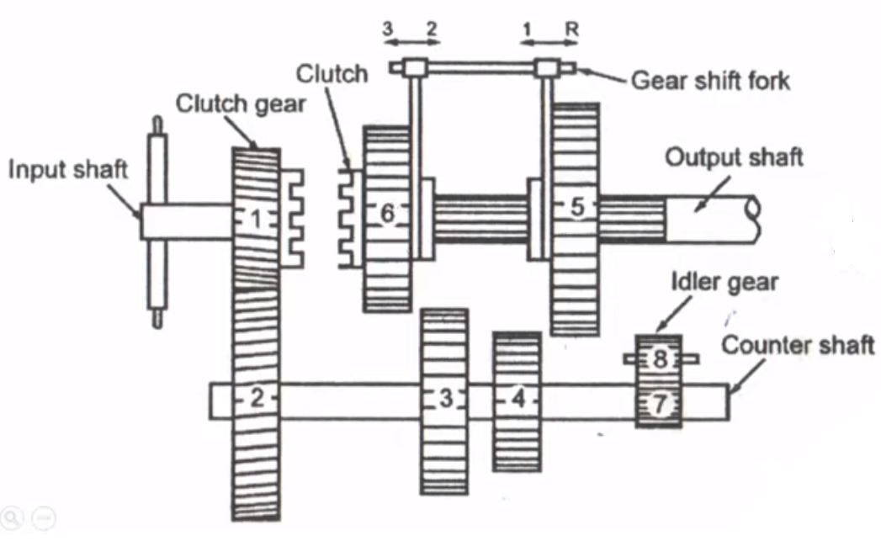
Sliding mesh gear box
The sliding mesh type gear box is the simplest and oldest type of gear box.
The meshing of gears takes place by sliding of gears on each other.
The driving shaft of the gear box is known as the primary shaft or clutch shaft.
The clutch gear rigidly fixed to the clutch shaft always remains connected to the driven gear of the countershaft or the layshaft.
Two gears are mounted on the main shaft (output shaft) which can be slides or moves axially to mesh with the corresponding gears on the layshaft.
A reverse idler gear mounted on another shaft always remains connected to the reverse gear of the layshaft.

Slide 13
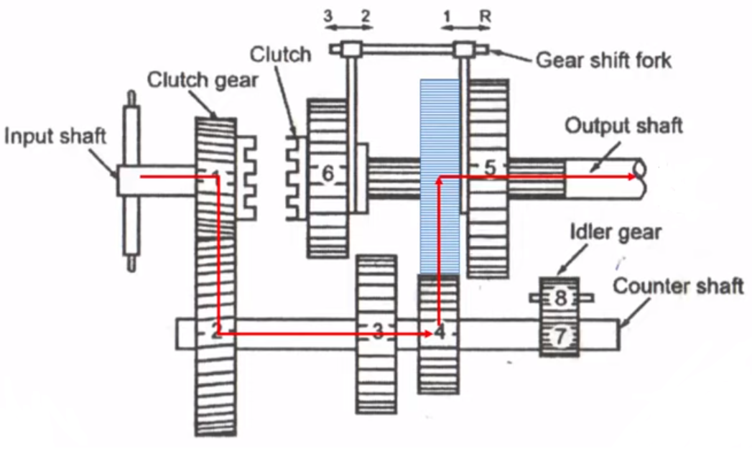
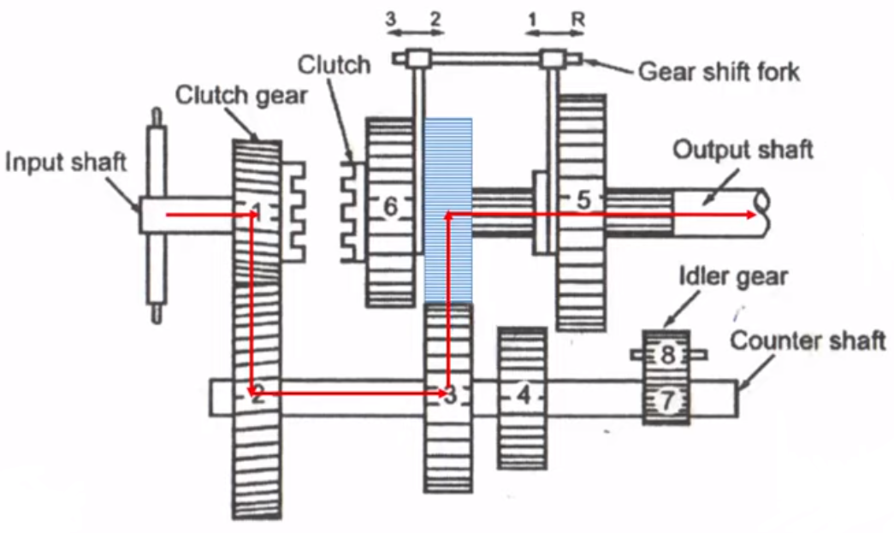
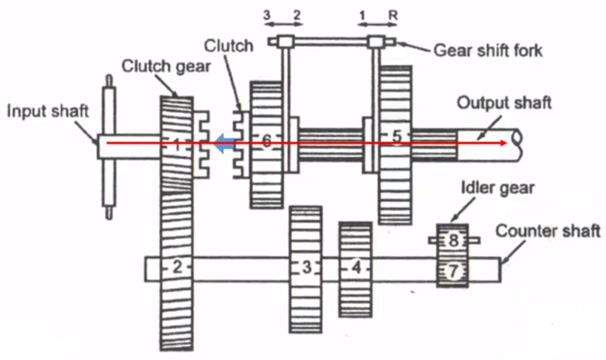
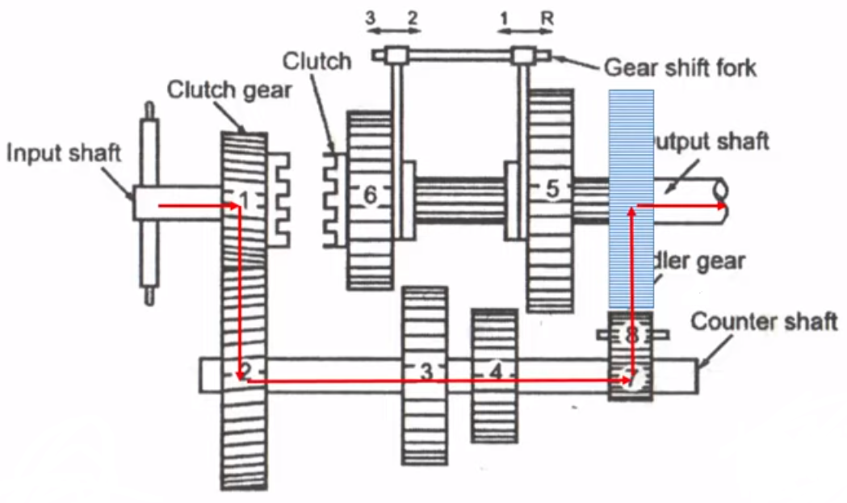
Sliding mesh gear box

Slide 14
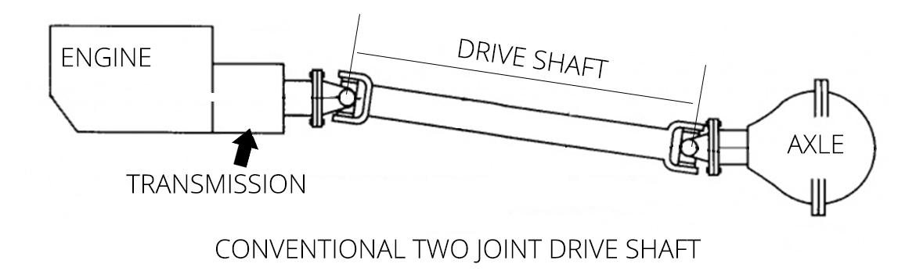
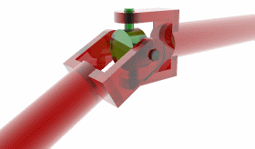
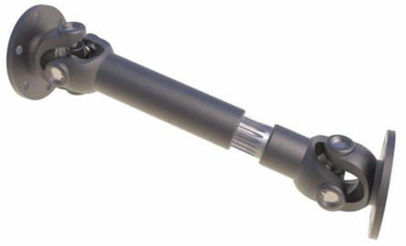
Propeller shaft
A shaft having universal joints at its two ends connecting the transmission output shaft of the gear box on one end and the differential input pinion at the other is called propeller shaft or drive shaft.
Function:
  To receive the power from the gear box output shaft and transmit it to the input pinion of the differential without any change in speed.
  To cope with the difference in line and level of the gear box output shaft and the differential input pinion shaft.
  To bear the driving and braking torques.

Slide 15
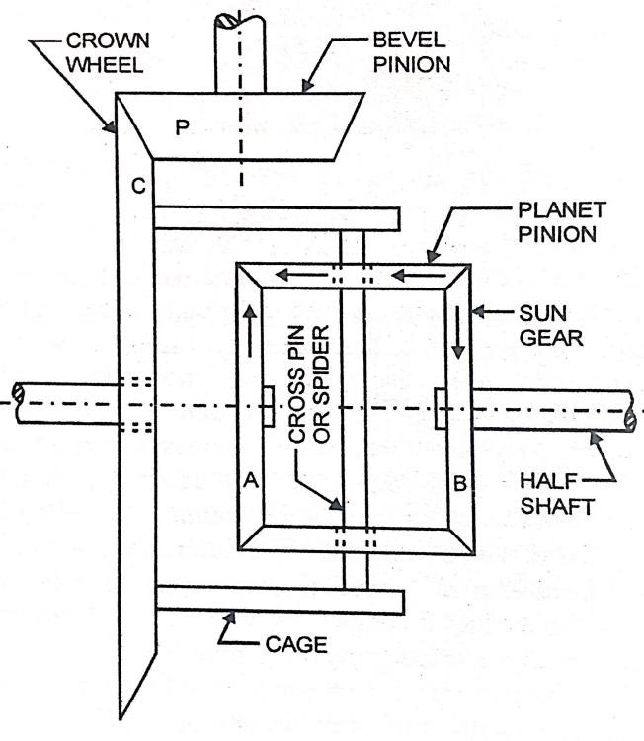
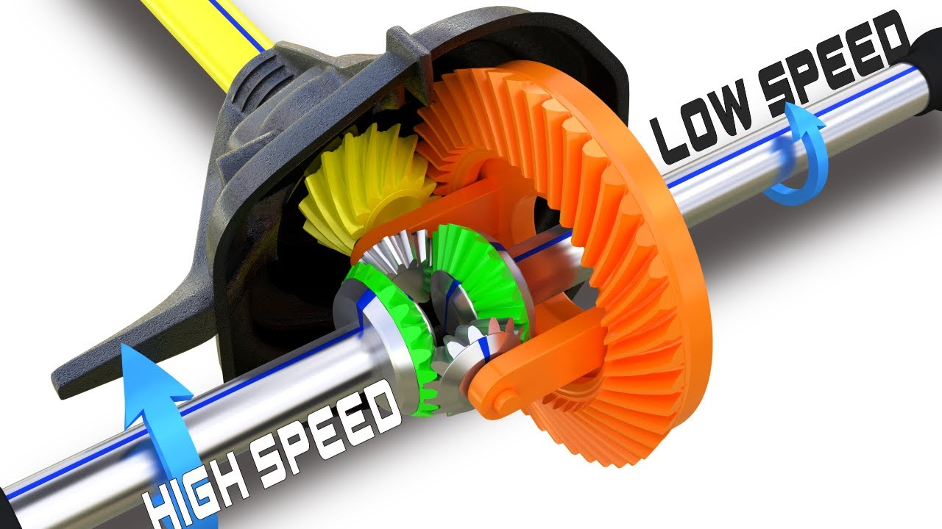
Differential
Differential is a gear arrangement which provides the different speed for the drive wheels.
Function:
To transmit the torque or power at 90° to the drive shaft.
To enable the driving wheels to rotate at different speeds.

Slide 16
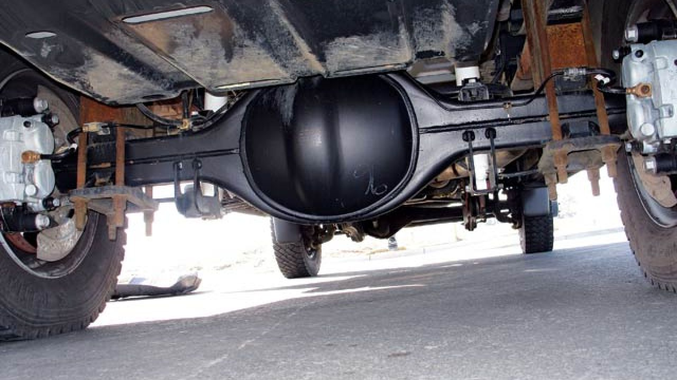
Final drive – Differential, Axle, Wheel

Slide 17
The power and transmission system comes in two common layouts.
They are the front transverse engine with front wheel drive and the front longitudinal engine with rear wheel drive as shown in the figure.
A transverse engine is one whose axis of rotation (crank shaft axis) is perpendicular to the length of the vehicle.
A longitudinal engine is one whose axis of rotation is along the length of the vehicle

Slide 18
The front transverse engine with front wheel drive is used in most of the cars and the front longitudinal engine with rear wheel drive is used in all heavy vehicles.

Slide 19

Front Longitudinal Engine with Rear Wheel Drive

Slide 20

Front Transverse Engine with Front Wheel Drive

Slide 21
The major factor which decides whether the front wheels are to be driven or the rear wheels is the load (weight) acting on these wheels for better traction.
In cars the front wheels are loaded more and hence front wheel drive is provided. For trucks the load on the rear wheel is more and hence rear wheel drive is used.
In this case the gear box is connected to the rear axle by a long propeller shaft.

Slide 22
Suspension system
Suspension system isolates the vehicle structure from shocks and vibrations due to irregularities of the road surface.
The system uses the springs and dampers/shock absorber to provide the proper suspension.
Function:
  To absorbs the shock and vibrations produced in the vehicle.
  To separates the wheel/axle assembly from the body.

Slide 23
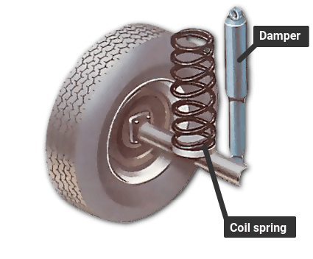
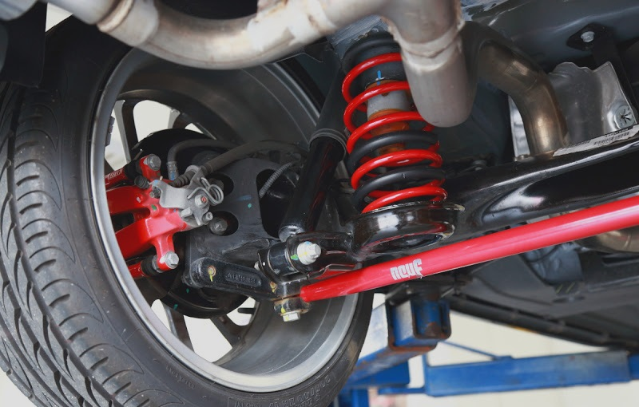
Spring suspension
Coil Spring
Coil spring suspensions are commonly found in modern passenger cars and many other vehicles due to their versatility, tunability, and ability to provide a comfortable and controlled ride.
When the wheels encounter bumps or uneven terrain, the coil springs compress and expand to absorb shocks and maintain tire contact with the road, enhancing control and comfort.
Simultaneously, the dampers control spring oscillations, preventing excessive bouncing, jolts, and instability, ensuring a stable and comfortable driving experience.

Slide 24
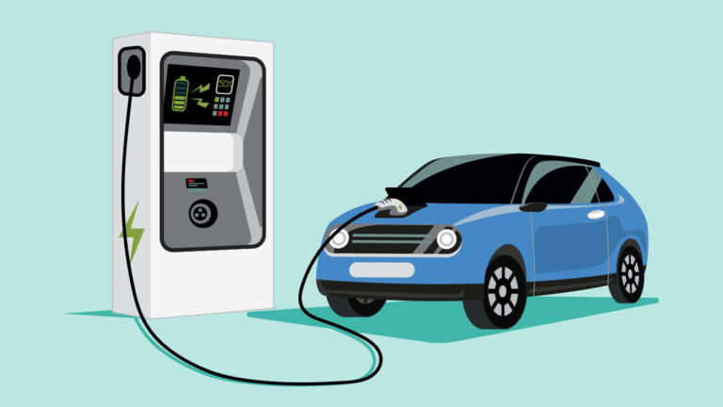
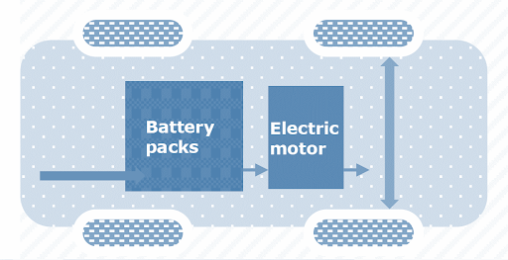
E-Vehicles
Electric vehicles are powered by electricity which used to run the electric motor.
Benefits of Evs:
EVs have zero tailpipe emissions and are much better for the environment.
The running cost of an electric vehicle is much lower than an equivalent petrol or diesel vehicle.
EV have very low maintenance costs because they don’t have as many moving parts as an internal combustion vehicle.
From an efficiency perspective, electric vehicles can convert around 60% of the electrical energy from the grid to power the wheels

Slide 25
Battery Electric Vehicle (BEV)
Battery Electric Vehicle (BEV) run entirely on a battery-powered electric drive-train, and it also known as All-Electric Vehicles (AEV).
The electricity used to drive the vehicle is stored in a large battery pack which can be charged by plugging into the electricity grid and provides power to electric motor.
The power for the electric motor is converted from the DC Battery to AC. As the accelerator is pressed, a signal is sent to the controller.
The controller adjusts the speed of the vehicle by changing the frequency of the AC power from the inverter to the motor.
The motor then connects and leads to the turning of wheels through a cog.
If the brakes are pressed, or the electric car is decelerating, the motor becomes an alternator and produces power, which is sent back to the battery.

Slide 26
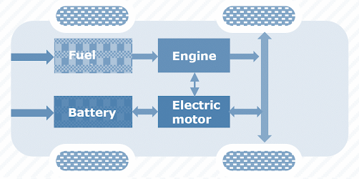
HEV
Hybrid Electric Vehicles (HEV) have both engine and electric motor. The fuel tank supplies energy to the engine like a regular car. The batteries charged by engine
Both the engine and electric motor can turn the transmission at the same time and drives the wheels.

