Slide 1
Hydraulic Power Plant

Slide 2
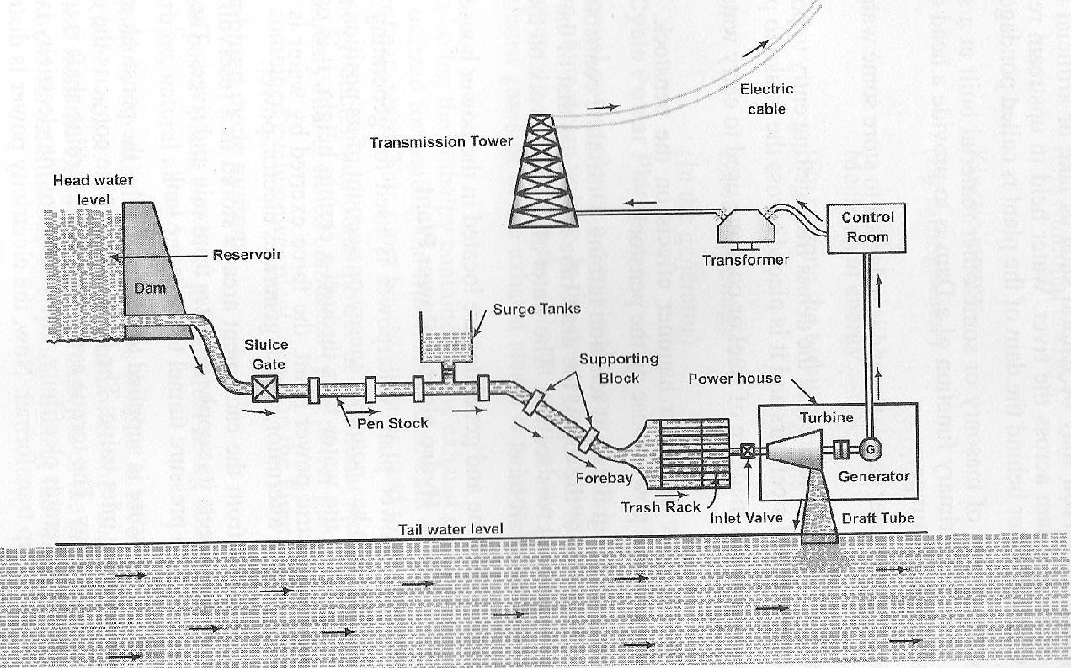

Slide 3
WORKING PRINCIPLE OF HYDROELECTRIC POWER PLANT
A hydroelectric power plant generates electricity by converting the kinetic energy of flowing water into mechanical energy and then into electrical energy. The process begins at the dam, which stores water in a reservoir at a higher elevation, creating potential energy. Water is released from the reservoir through an intake into a penstock, a large pipe that directs the high-pressure water toward the turbine. As water flows through the turbine, it spins the turbine blades, converting the water's kinetic energy into mechanical energy. The rotating turbine is connected to a generator, where the mechanical energy is transformed into electrical energy via electromagnetic induction. The water, now at a lower energy level, is discharged back into the river through an outlet. The electricity produced is then transmitted through transformers to the power grid for distribution. This entire process operates without consuming fuel, making it a clean and renewable energy source.

Slide 4
Elements of Hydel Plant
Water reservoir
Dam
Spillways
Trash Rack
Water ways.
  Open canals
  Tunnels
  Penstock
Surge Tank
Power house ( Turbine, generator)

Slide 5
Spillway and Surge tank
Spillway is used to discharge water during the flood period without passing through the power house. It acts as a safety valve for the Dam.
Surge tank serves as a supply tank to the turbine when the water in the penstock is accelerating due to increased load.
Serves as a storage tank when the water is decelerating during reduced load conditions.
Avoids the water hammer effect due to backflow of water in reduced load conditions.

Slide 6
Classification of hydraulic turbines.
Based on principle of working.
a. Impulse turbine. ( ex. Pelton wheel)
b. Reaction turbine. (ex. Francis and Kaplan Turbines.)
Based on Head used.
a. High head ( above 300 m) ( Pelton wheel)
b. medium head ( b.w. 50 to 300 m) ( Francis)
c. low head ( below 50 m) ( Kaplan)
Based on flow of water w.r.t. runner of turbine.
a) Tangential flow. (Pelton wheel)
b) Mixed flow ( Francis )
c) Axial flow ( Kaplan)

Slide 7
Impulse and Reaction Principles
In an impulse turbine, the entire pressure energy of water is converted into kinetic energy in a Nozzle before it enters the runner of the turbine. Hence, the pressure of water before and after the runner will be the same, usually atmospheric pressure.
In a reaction turbine, some part of the pressure energy is converted into velocity energy before the runner, and the remaining pressure energy is converted into kinetic energy in the runner. Hence, the water pressure before and after the runner will be different.

Slide 8
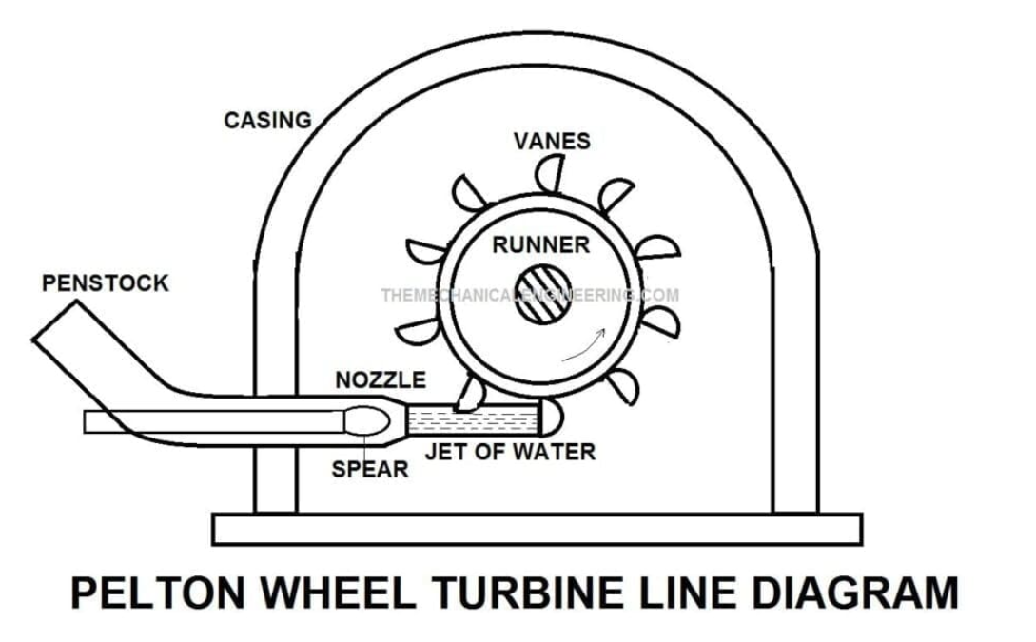

Slide 9

Pelton Wheel with buckets

Slide 10
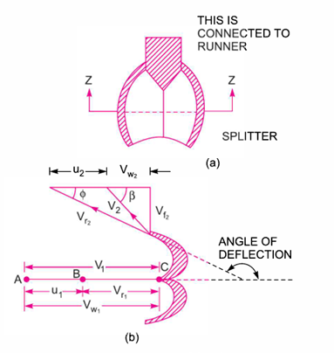
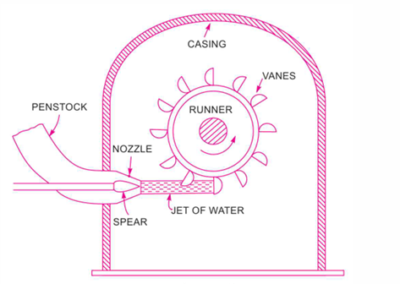
Pelton Turbine
Shape of Bucket

Slide 11
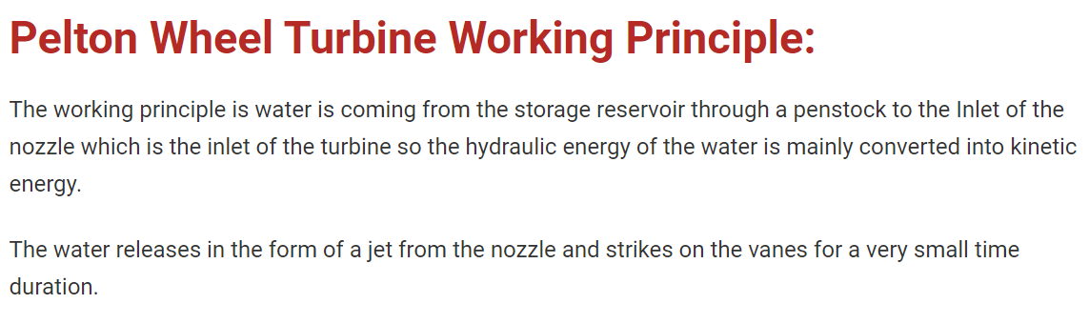

Slide 12
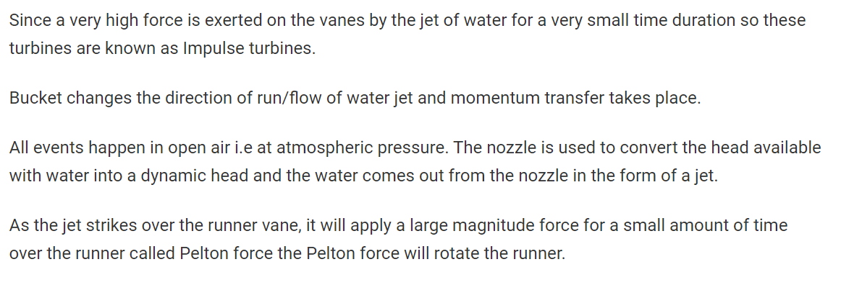

Slide 13
Relative merits and demerits of Hydel plant.
Merits
Demerits
Low running and maintenance.
Clean source (pollution-free)
Longer expectancy of turbine life
Renewable source of energy
Additional benefits like recreation, fishery, irrigation and flood control.
Long duration for commissioning of the plant.
Deforestation
Rehabilitation of people and payment compensation for land acquisition.
Power transmission loss
Seasonal (depends on availability of water)

