Slide 1
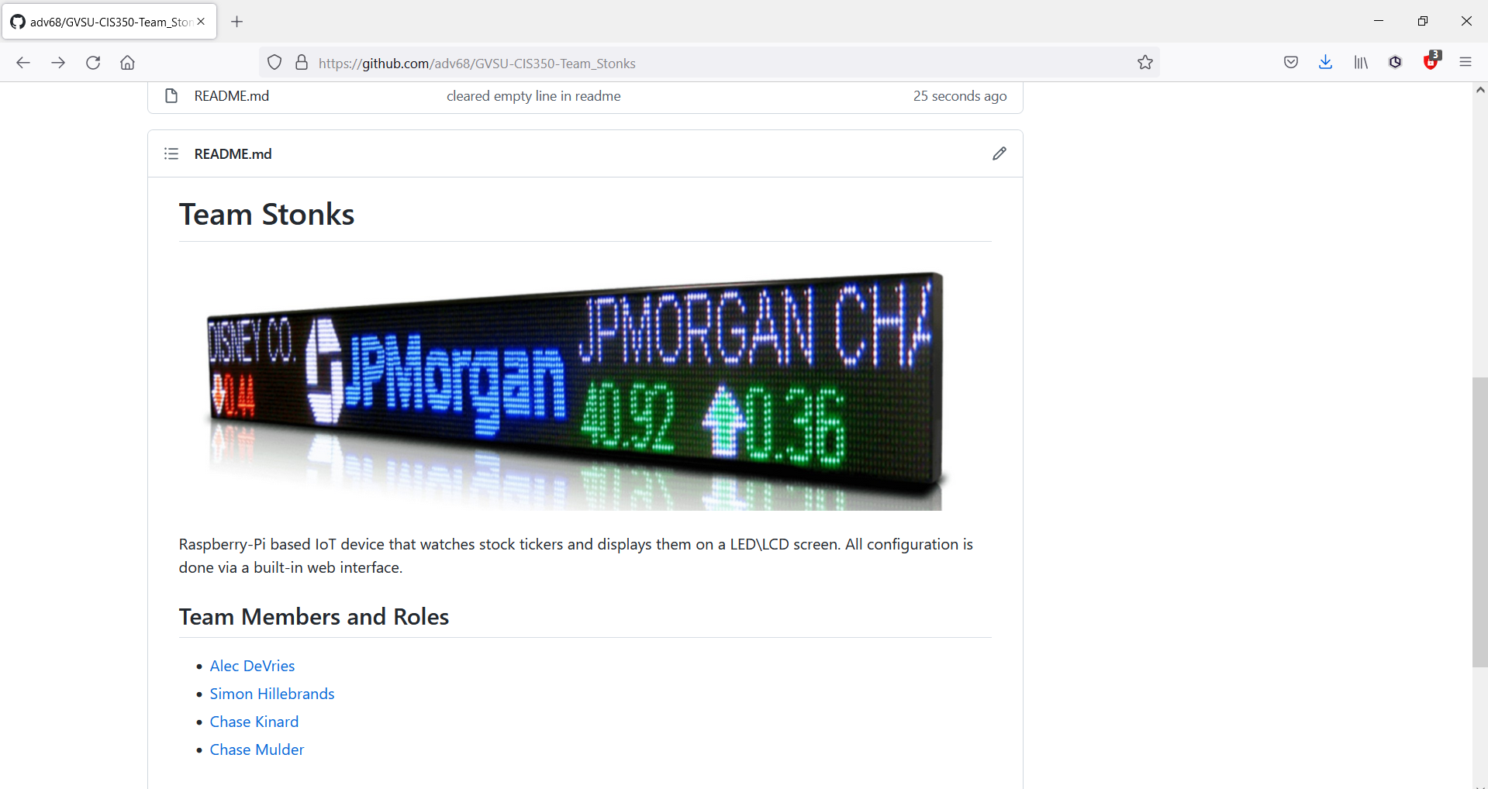
TEAM STONKS
Alec DeVries, Chase Kinard, Chase Mulder, Simon Hillebrands

Slide 2
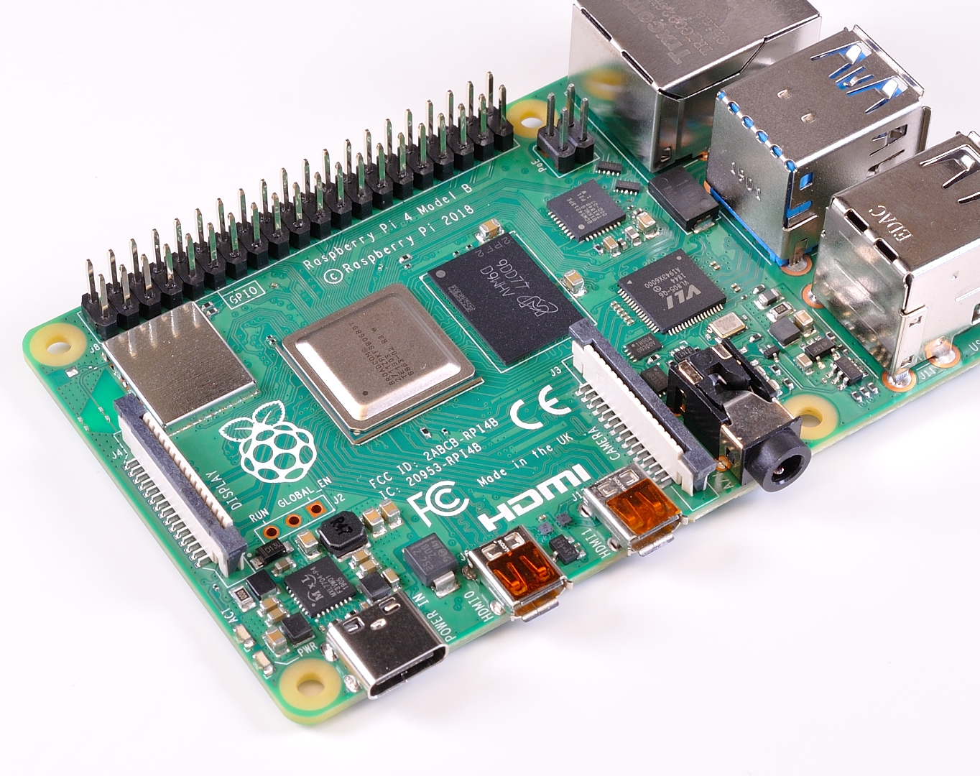
Raspberry Pi-based Stock Ticker

Slide 3
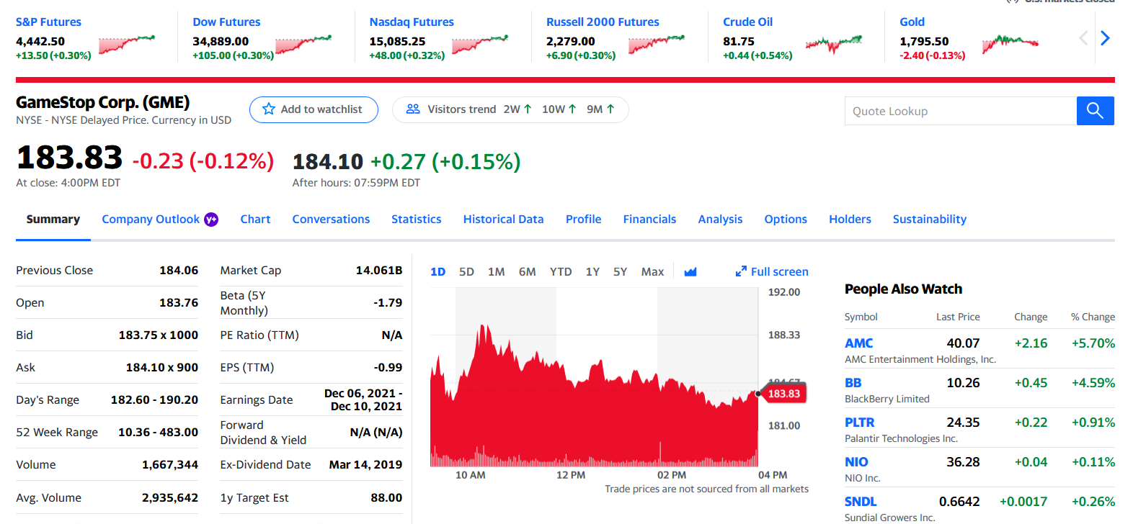
Collect Stock Quotes and other data from Yahoo! Finance

Slide 4
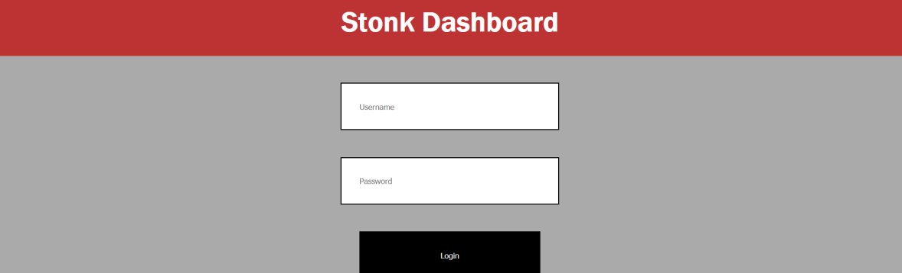
Stock Ticker is Configurable Remotely via a Built-in Web Application

Slide 5

Display Stock Data on LED Panel
Different layouts are available

Slide 6
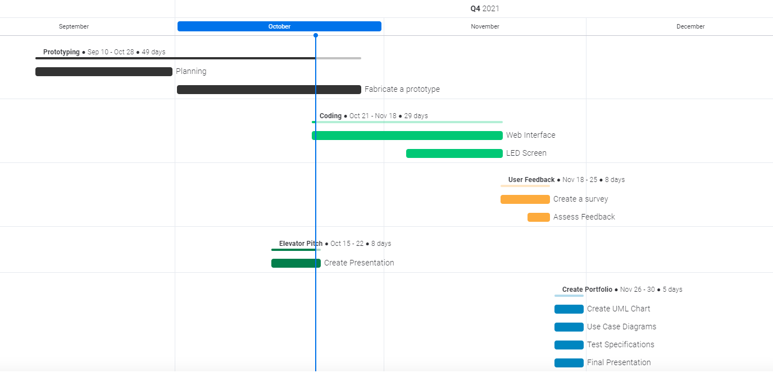
Gantt Chart

