Slide 1


SMART INDIA HACKATHON 2026
TITLE PAGE
Problem Statement ID - 26092
Problem Statement Title - AI – Driven Scheme Matching for Marginalized Entrepreneurs
Theme - Smart Automation
PS Category - Software
Team ID -
Team Name - OFF BY ONE
Theme- Smart Automation
PS Category- Software Team ID-
Team Name- OFF BY ONE

Slide 2
IDEA TITLE
OFF BY ONE
Detailed explanation of the proposed solution
AI for Inclusive Government Schemes
An AI-driven multilingual platform that helps marginalized entrepreneurs identify suitable government financial schemes and take the correct next step.
How it addresses the problem
Innovation and uniqueness of the solution
Proactive matching: AI finds schemes for users, no portal hunting.
Explainable results: Match score with clear "why you qualify" reasons.
Hybrid AI: Rule-based accuracy plus NLP for messy scheme documents.
Voice-first, vernacular: Regional languages via voice, WhatsApp, and IVR.
Auto-updating database: AI extracts scheme details from official notifications.
End-to-end journey: Discovery, documents, applying, alerts, and tracking in one place.
Human-in-the-loop: NGOs and CSCs assist offline users.
Data-driven inclusion: Analytics show underserved communities for better outreach.
Unified database: All central, state, and district schemes in one updated place.
Easy profile input: Short form, chat, or voice in regional languages.
AI eligibility matching: Ranked list of best-fit schemes with reasons.
Multilingual voice/chat: Chatbot, WhatsApp, and IVR for low-literacy users.
Application guidance: Document checklist, deadlines, and direct portal links.
Alerts and tracking: Updates on new schemes, deadlines, and application status.
Assisted access: Dashboard for NGOs and CSCs to help offline users.
Our Solution:
AI-based platform to:
Match users with suitable schemes
Calculate financial/EMI details
Route them to the right channel partner
Support regional languages

Slide 3
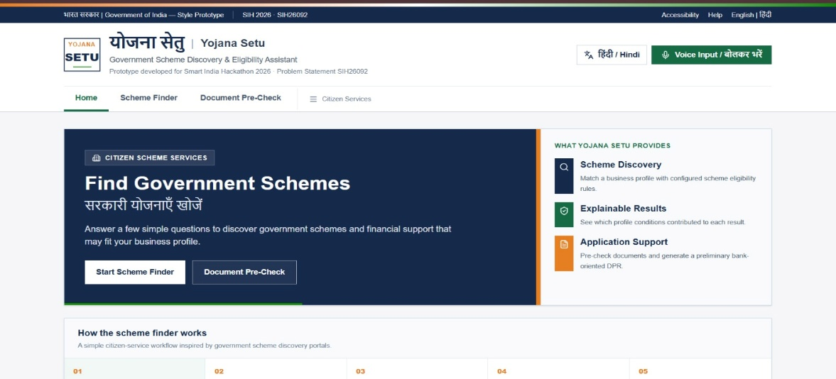





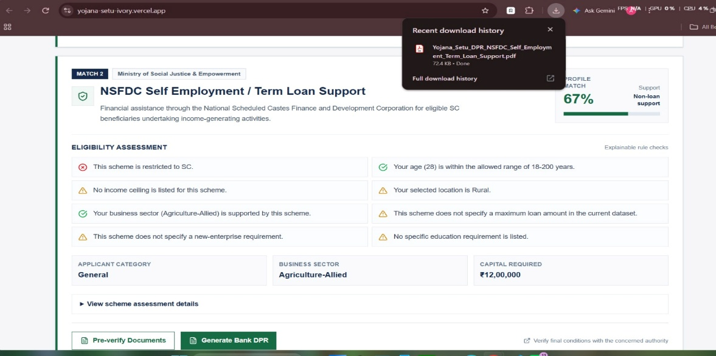
TECHNICAL APPROACH
OFF BY ONE
SYSTEM ARCHITECTURE
TECH STACK
USER
Text/ voice / language
AI / NLP INTERACTION LAYER
LLM – Speech to text – Translation
Understands user intent & extracts profile Information
FINANCIAL ENGINE
loan limit
EMI
Interest
Tenure
moratorium
PROFILE EXTRACTION
Income – Project cost – Purpose – Education need – Location – Category
MATCH ENGINE
Potential scheme + WHY
Income – conditions - Purpose - Cost
ACTIONABLE NEXT STEP
MATCH – EXPLAIN – CALCULATE – ROUTE
RULE ENGINE
Eligibility rules
Limits & conditions
Deterministic check
VERIFIED SCHEME DB
PostgreSQL
Scheme conditions
Source + version
PARTNER ROUTER
GIS / maps
Location
Category
Verification status

Slide 4

FEASIBILITY AND VIABILITY
OFF BY ONE
Technical feasibility
Operational feasibility
Easy adoption: Regional voice and chat via WhatsApp and IVR, with NGO and CSC support.
Simple upkeep: AI auto-updates schemes, with light manual checks.
Economical feasibility
Strategic Viability
Policy aligned: Supports Digital India, Atmanirbhar Bharat, and financial inclusion.
Scalable: Pilot in one district, then expand nationwide via government and NGO partnerships.
Technical Feasibility
Proven tech: Mature tools
make the MVP buildable.
Scalable access: WhatsApp, IVR, and cloud APIs scale nationwide, DPDP-compliant.
Economic Feasibility
Low cost: Open-source
tools.
Sustainable: Funded through government partnerships, CSR, and referral fees.
Potential challenges
User trust: Fear of fraud and reliance on middlemen. Fix: Verified government sources and NGO community champions.
Data privacy: Sensitive details like caste and income. Fix: Consent-based use, encryption, DPDP compliance.
Last-mile gap: Missing documents and approval delays. Fix: Digi Locker checklist and assisted follow-up.
Strategies to overcome challenges
Build trust: Show only verified government schemes with official source links, and use NGOs, self-help groups, and CSC agents as local champions to onboard users in person.
Protect data: Collect only essential details with clear user consent, encrypt all data, and follow the DPDP Act with a transparent privacy policy in regional languages.
Close the last mile: Give each user a personalized document checklist with Digi Locker integration, and assign CSC or NGO volunteers to follow up.
7
REAL ENTREPRENEUR

Slide 5
IMPACT AND BENEFITS
OFF BY ONE
Entrepreneurs
Discover and access schemes they never knew about
Less debt
Formal loans and subsidies replace costly moneylenders
Families
Steadier household income from stronger small business
AI SCHEME
MATCHER
Women-led growth
More women run business through inclusive access
Impacts
Benefits
Banks and Officers
Fewer rejected applications, since users apply only for schemes they qualify for.
Less dependence
Lower cost and less fraud
NGOs and CSCs
Faster, more organized support for the people they serve
Business growth
Support to start, run, and expand values
Villages and towns
New local jobs and a stronger local economy
Higher scheme take
More eligible people actually apply and receive support

Slide 6


RESEARCH AND REFERENCES
OFF BY ONE
No. | Reference / Source | Category | Relevance to SchemePath AI | Use in Project
1 | IJEETR – AI-Based Prediction of Beneficiary Eligibility for Government Welfare Schemes | Research Paper | AI/ML-based eligibility prediction using beneficiary attributes such as income and family background. | Supports the AI-assisted eligibility/matching concept.
2 | IJEETR – Article 872 | Research Paper | Related academic reference provided for the project literature review. | Used as supporting literature; detailed content could not be independently verified from the webpage.
3 | YojanaMitra – AI-Assisted Framework for Government Scheme Eligibility Matching and Guidance | Research / Framework | Directly related to AI-assisted government-scheme eligibility matching and user guidance. | Supports the scheme-matching and guidance workflow.
4 | PMEGP e-Portal | Government Portal | Digital government scheme/application ecosystem. | Reference for digital scheme access and application workflow.
5 | Startup India – Government Schemes | Government Portal | Provides information on Central Government schemes, including objectives, eligibility criteria, application process and benefits. | Reference for scheme discovery and verified scheme information.
6 | Ministry of MSME – Offerings | Government Source | Official Ministry of MSME source for schemes and support offerings. | Primary government reference for MSME-related scheme data.
7 | myScheme – Government of India | Government Portal | Government scheme discovery platform. | Reference for beneficiary-oriented scheme discovery and eligibility information.

