Slide 1

Gokhale Education Society’s
R. H. Sapat College of Engineering, Management Studies and Research,
Nashik - 422 005, (M.S.), INDIA
Seminar on
Stock Market Prediction With
Machine Learning Techniques
In partial fulfillment of requirements for the degree Third Year Computer Engineering
By
Jayesh Sunil Jagtap
Exam Seat No. :
Roll No. : 50
Under the guidance of
Prof.Mrs.V.S.Nikam
GESCOE, Department of Computer
1

Slide 2
INDEX
Introduction
2. Literature Survey
3. About Stock Market
4. Details of design/technology
5. Algorithm / Analytical /Expermimental work
6. Comparison/Result
7. Discussion and Conclusion
8. References
GESCOE, Department of Computer
2

Slide 3

INTRODUCTION
STOCK MARKET
BUY
SELL
Basically, the stock market by definition is a market where there are buyers and sellers interested in buying stocks of a certain company.
The prices of these stocks vary widely as time passes.
Due to extremely unpredictable trends and high market volatility, majorly all stock market enthusiasts wish to get their hands on something which can help them score higher profits by predicting the stock market trends reliably
GESCOE, Department of Computer
3

Slide 4
INTRODUCTION
However, constant efforts are being made towards developing a model or algorithm which can help investors to predict the changes more accurately than before.
One of the most widely known and adopted ways to form predictive models is through the application of machine learning (ML) algorithms
aims at developing ML models using 5 different types of algorithms and further applying them to the stock market area for predicting the stock market trends.
GESCOE, Department of Computer
4

Slide 5
LITERATURE SURVEY
After exshaustive research of the various ascpect related to apllication of ml in stock market ,a data extinsive implementation has been carried out as a part of this research work wherein the stock price dataset of 12 companies over the last 7 years was collected and used.
The companies that were picked for this work were, Adani Ports, Asian Paints, Axis Bank, HDFC Bank, ICICI Bank, Kotak Bank, Hindustan Unilever, Maruti, NTPC, Tata Steel, TCS, Titan, and the stock data taken was from 2005 until 2021, and these datasets were taken from Quandl Website, Bombay Stock Exchange.
GESCOE, Department of Computer
5

Slide 6
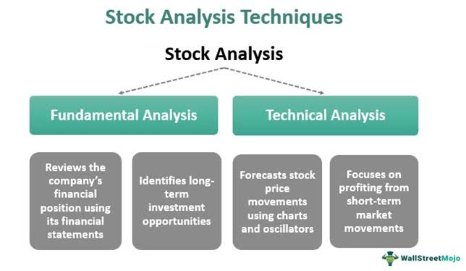
ABOUT STOCK MARKET
GESCOE, Department of Computer
6

Slide 7
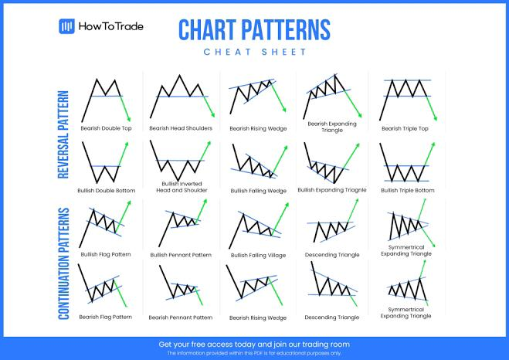
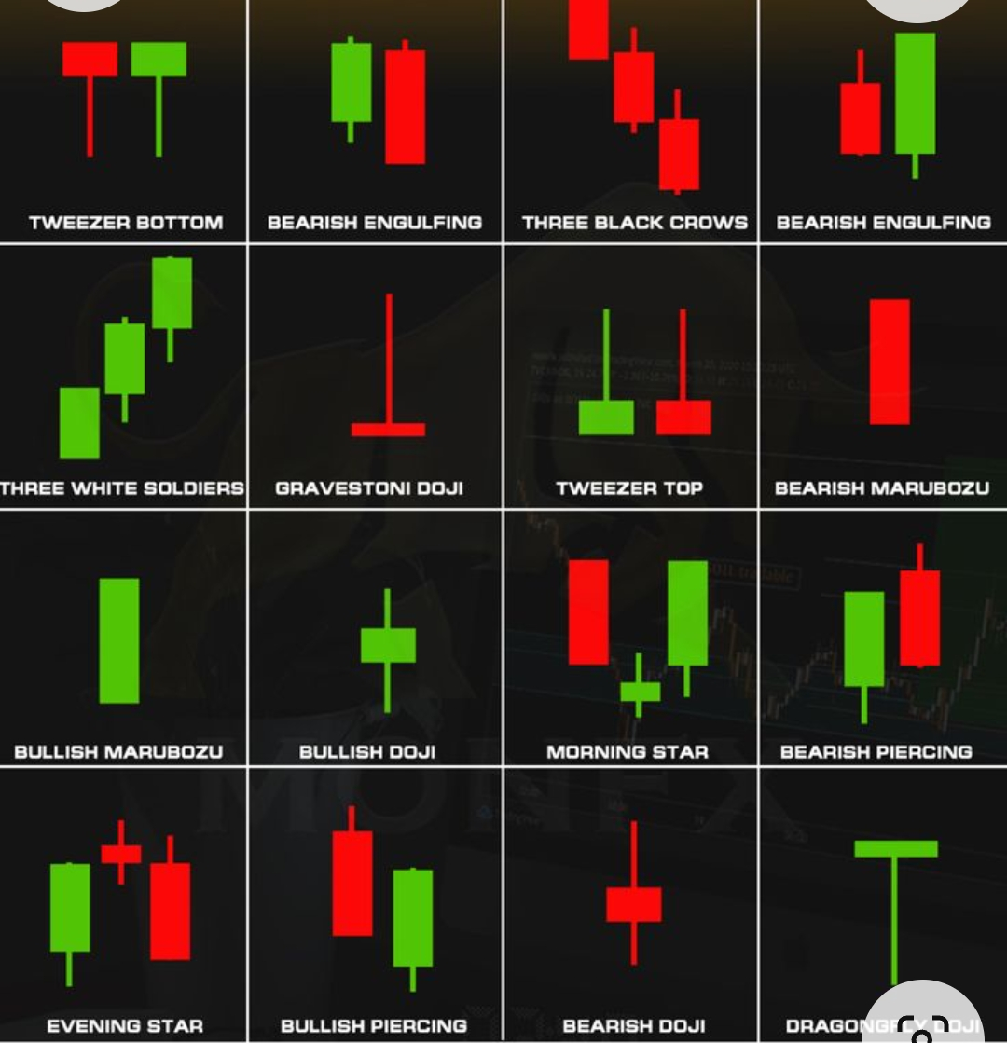
ABOUT STOCK MARKET
TECHNICAL ANYALISYS
CHART PATTERN
CANDLESTICK PATTERN

Slide 8
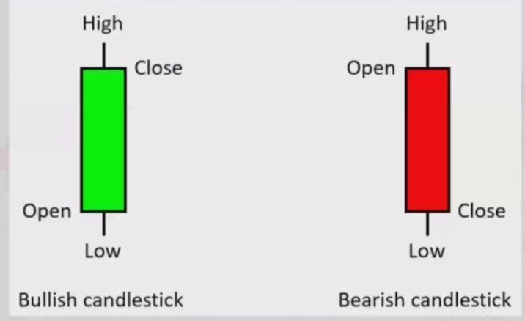
ABOUT STOCK MARKET
Open-high-low-close charts (OHLC) are a kind of bar chart that displays the open, high, low, and closing price values of shares for a frequent period. OHLC charts comprise a vertical line and two short horizontal lines.
Vertical height: The vertical height indicates the volatility of the stock market during a given period. The more the height of the vertical line, the more the volatility in the market.
GESCOE, Department of Computer
8

Slide 9
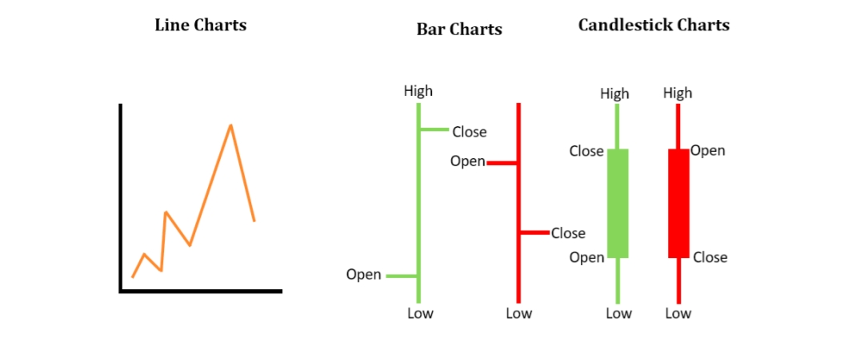
ABOUT STOCK MARKET
TYPES OF CHARTPATTERN
GESCOE, Department of Computer
9

Slide 10
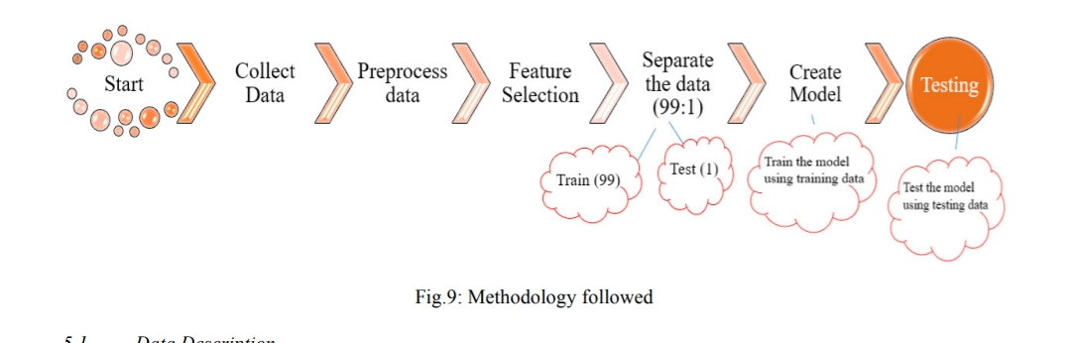
Details of design/technology
ALGORITHMS
Linear Regression Algorithm
K-Nearest Neighbours Algorithm
Support Vector Regression
Decision Tree Regression Algorithm
Long Short-Term Memory Algorithm
10
GESCOE, Department of Computer

Slide 11
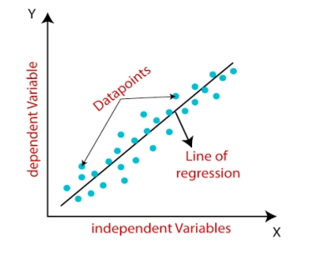
ALGORITHMS
1.Linear Regression Algorithm
The linear regression algorithm falls under the category of supervised learning in ML.
Certainly, here are the main points of how linear regression works in a step-by-step format:
1. Linear Equation: Linear regression starts by assuming a linear relationship between independent variables and a dependent variable, represented as `Y = aX + b`.
2. Training: The model is trained to find the best coefficients `a` and `b` that minimize the Mean Squared Error (MSE) between predicted and actual values.
3. Optimization: Optimization techniques like Ordinary Least Squares (OLS) or gradient descent are used to iteratively adjust the coefficients to minimize the MSE.
GESCOE, Department of Computer
11

Slide 12
ALGORITHMS
4. Prediction: Once trained, the model can make predictions by plugging new values of the independent variables into the linear equation.
5. Evaluation: Model performance is evaluated using metrics such as MSE or R-squared to assess how well it fits the data and makes accurate predictions.
GESCOE, Department of Computer
12

Slide 13
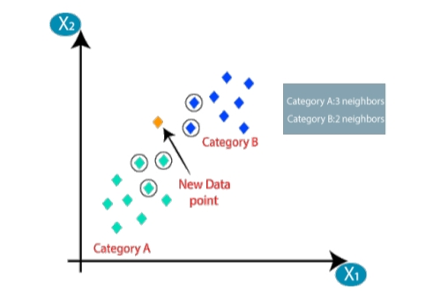
ALGORITHMS
2. K-Nearest Neighbours Algorithm
Collect labeled data.
Choose a value for k (number of neighbors) and a distance metric.
Calculate distances to all data points for a new data instance.
Select the k-nearest neighbors with the shortest distances.
For classification, use majority voting to assign a class. For regression, calculate the average of target values.
Evaluate the model's performance.
Tune hyperparameters if needed.
Deploy the model for predictions.
GESCOE, Department of Computer
13

Slide 14
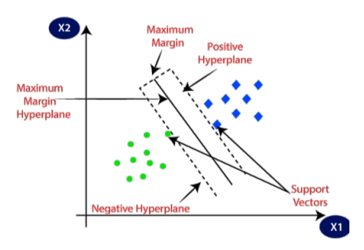
ALGORITHMS
3. Support Vector Regression
Certainly, here are the main steps of Support Vector Regression (SVR):
1. Data Collection: Gather a dataset with features and continuous target values.
2. Feature Scaling: Normalize or standardize feature variables.
3. Select Kernel and Hyperparameters: Choose a kernel function and set hyperparameters.
4. Training: Formulate and solve an optimization problem to find the hyperplane that minimizes errors within a predefined margin.
5. Prediction: Use the trained SVR model to predict continuous target values for new data.
GESCOE, Department of Computer
14

Slide 15
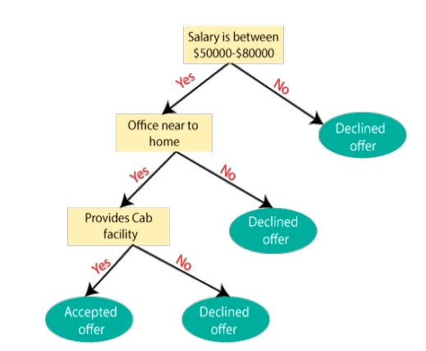
ALGORITHMS
4. Decision Tree Regression Algorithm
Decision Tree algorithm:
1. Data Collection: Gather a dataset with features and target values.
2. Tree Building: Construct a tree by selecting the best features to split the data into subsets.
3. Stopping Criteria: Define rules to determine when to stop splitting the data, such as achieving homogeneity in classes or reaching a maximum depth.
4. Prediction: Traverse the tree to make predictions for new data by following feature values down the tree to leaf nodes.
5. Evaluation: Assess the model's performance using relevant metrics like accuracy .
GESCOE, Department of Computer
15

Slide 16
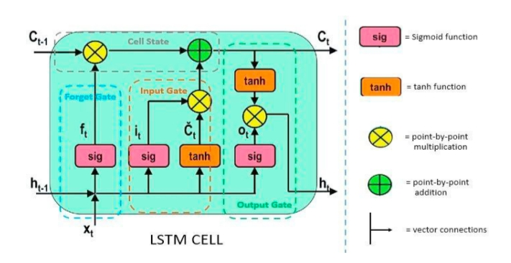
ALGORITHMS
5.Long Short-Term Memory Algorithm
step-by-step explanation of how Long Short-Term Memory (LSTM) works:
1. Sequential Data: LSTM is designed for sequential data like text or time series.
2.Cell State: It maintains a cell state that runs through the sequence.
3. Gates Control Flow: LSTM uses gates (forget, input, output) to control information flow into and out of the cell state.
4.Hidden State: A hidden state captures relevant information from the sequence.
5. Training: LSTM learns optimal parameters through backpropagation through time (BPTT).
6. Long-Term Dependencies: LSTM excels at capturing long-range dependencies in data.
16
GESCOE, Department of Computer

Slide 17
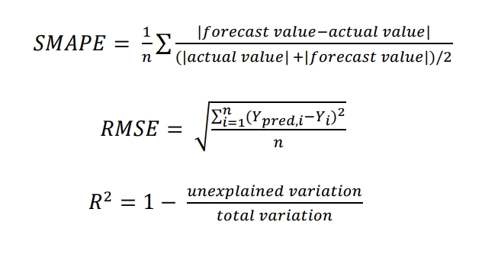
RESULT/COMPARISION
The models were tested on three essential performance metrics, namely.
Symmetric Mean Absolute Percentage Error (SMAPE)
R-squared value (R2)
Root Mean Square Error (RMSE)
17
GESCOE, Department of Computer

Slide 18
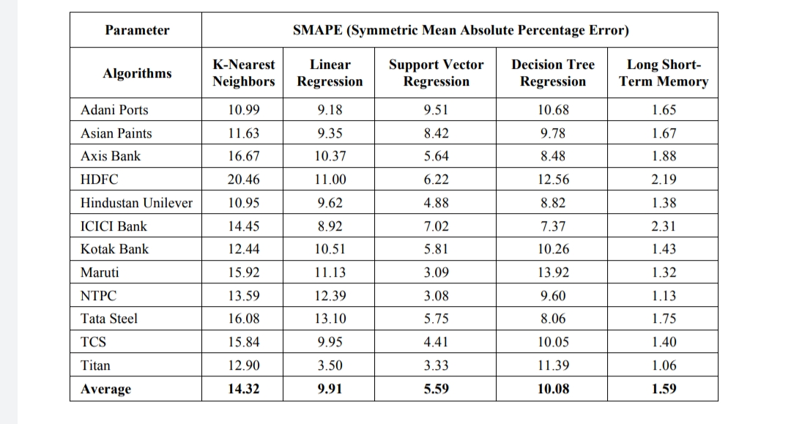
RESULT
SMAPE
GESCOE, Department of Computer
18

Slide 19
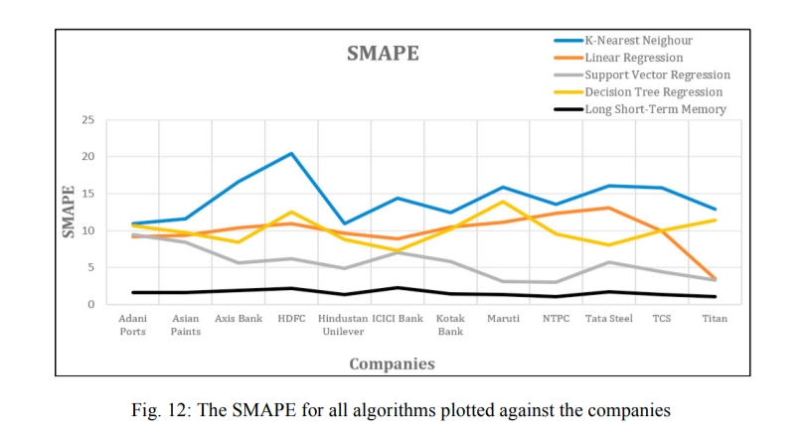
RESULT
GESCOE, Department of Computer
19

Slide 20
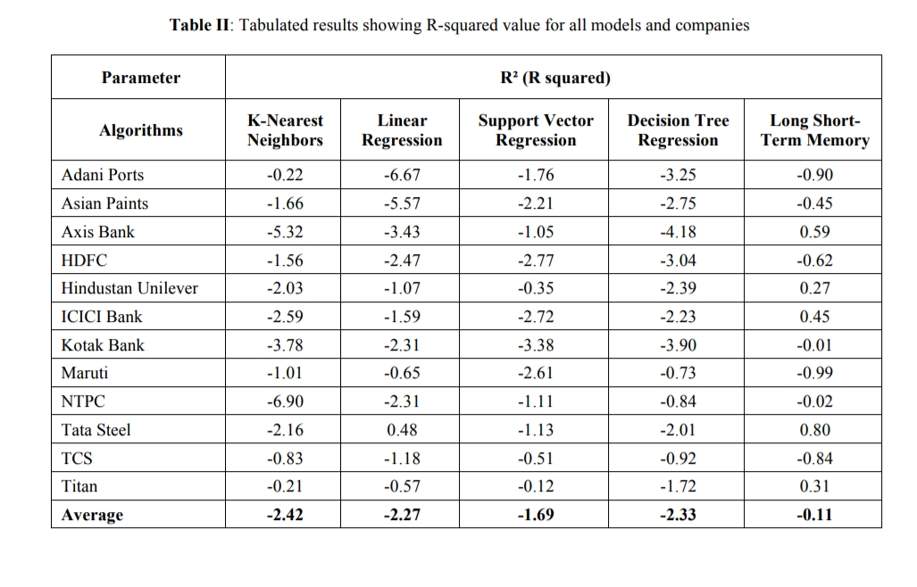
RESULT
R-SQUARE
GESCOE, Department of Computer
20

Slide 21
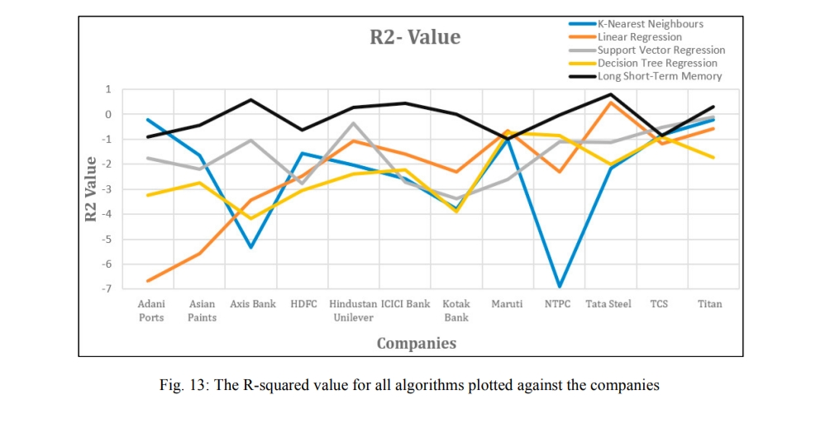
RESULT
GESCOE, Department of Computer
21

Slide 22
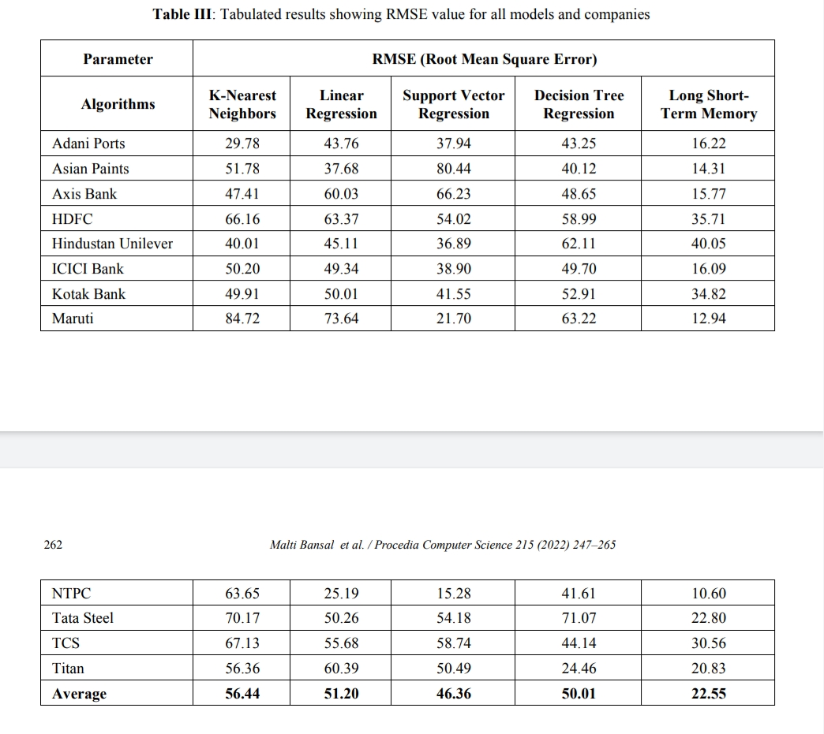
RESULT
RMSE
GESCOE, Department of Computer
22

Slide 23
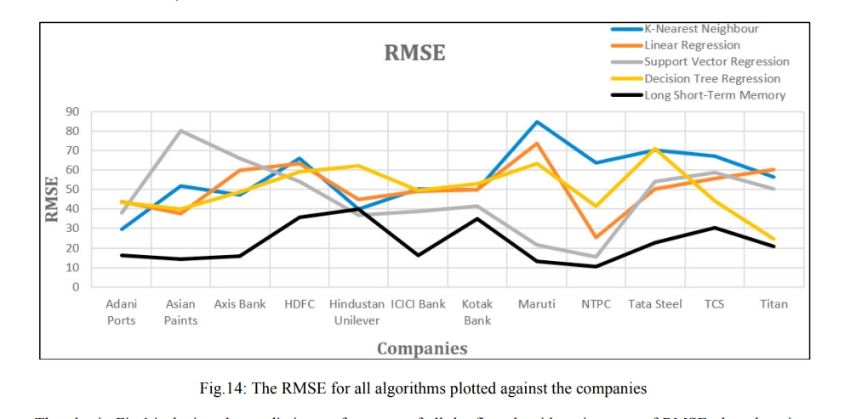
RESULT
GESCOE, Department of Computer
23

Slide 24
CONCLUSION
ML models which would be capable of predicting stock prices with an increased accuracy
DL algorithms have a substantial edge over simple ML algorithms
It is concluded that the LSTM algorithm is the best choice among the given algorithms for time series prediction, because it has the least value or errors with SMAPE , R2 , and RMSE .
The second-best algorithm for this task was Support Vector Regression .
Out of the five chosen algorithms, the Long Short-Term Memory algorithm was a DL algorithm that has provided the best results.
GESCOE, Department of Computer
24

Slide 25
REFERENCES
[1] Kumar, V. U., Krishna, A., Neelakanteswara, P., & Basha, C. Z. (2020). Advanced Prediction of Performance .
[2] Box GEP, Jenkins GM, Reinsel GC, Ljung GM. Time series analysis: forecasting and control. New York: Wiley; 2015.
[3] Chen LP. Multiclassification to gene expression data with some complex features. Biostatistics and Biometrics Open Access Journal. 2018; 9(1): 555751
[4] Bansal, M., Priya (2022). Machine Learning Perspective in VLSI Computer-Aided Design at Different Abstraction Levels. In: Shakya, S., Bestak, R.
[5]Chen LP. Mehryar Mohri, Afshin Rostamizadeh, and Ameet Talwalkar: Foundations of machine learning, second edition. Statistical Papers. 2019; 60(5):
[6] Chen LP. Model-based clustering and classification for data science: with application in R by Harles Bouveyron, Gilles Celeus.
GESCOE, Department of Computer
25

Slide 26


