Slide 1

Gokhale Education Society’s
R. H. Sapat College of Engineering, Management Studies and Research,
Nashik - 422 005, (M.S.), INDIA
Seminar on,
Readability of Non-Text Images on the World Wide Web
In partial fulfillment of requirements for the degree
Third Year Computer Engineering
By
Name of the Candidate: Jayesh D.Gosavi
Roll No: 43
Under the guidance of
Name of the Guide : R.D.Narwade
GESCOE,Department of Computer
1

Slide 2
CONTENT
Introduction
Importance of WWW
Literature Survey
Details of Design
Workflow of Relevancy Computation
Evaluation
Webpage with non-text Images
Webpage without non-text Images
User Evaluation
Results
Applications
Conclusion
Refernces
GESCOE,Department of Computer
2

Slide 3


Introduction:-
The World Wide Web associated the world in a manner that was unrealistic previously and made it a lot more straightforward for users to get data, share and impart.
Not all non-text images are appropriate for enhancing the attractiveness and readability of the text they accompany, such as decorative non-text images or graphical contents not relevant for the webpage content itself.
However, one of the most basic issues is that the irrelevancy of non-text images with the text of the website could badly affect web readability.
GESCOE,Department of Computer
3

Slide 4

Importance of WWW:-
GESCOE,Department of Computer
4

Slide 5

The World Wide Web is abbreviated as WWW and is commonly known as the web.
WWW can be defined as the collection of different websites around the world, containing different information shared via local servers(or computers).
It has since allowed people to share their work and thoughts through social networking sites, blogs, video sharing, and more.
GESCOE,Department of Computer
5

Slide 6

Literature Survey:-
Different researchers have worked on the evaluation of the text on the web from different perspectives,such as:
To assess the readability according to the guidelines.
To assess the quality and readability of websites.
To measure the readability of stroke education websites.
Checking the readability according to the factors content, style, design, and structure.
GESCOE,Department of Computer
6

Slide 7

Details Of Design:-
A new technique to measure the relevancy of non-text images on web pages has been proposed to evaluate above mentioned hypothesis.In order to compute non-text images relevancy, these are the fundamental steps followed:
A. CORPUS GENERATION
B. DATA PRE-PROCESSING
C. FEATURES EXTRACTION
D. RELEVANCY COMPUTATION
GESCOE,Department of Computer
7

Slide 8
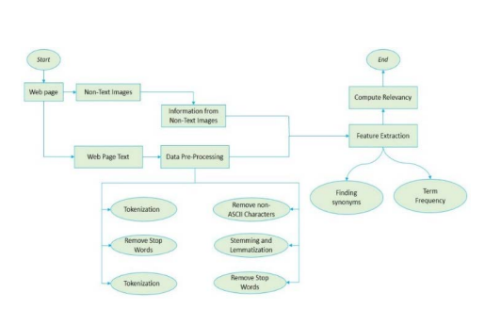
Workflow of Relevancy Computation:-
GESCOE,Department of Computer
8

Slide 9
Corpus Generation
Data-Preprocessing
Tokenization
Eliminate Stop Words
Lemmatization and Stemming
Uniform Case
Punctuation Letters Removal
Non-ASCII Letters Removal
Features Extraction
Finding Synonyms
Term Frequency
Relevancy Computation
GESCOE,Department of Computer
9

Slide 10
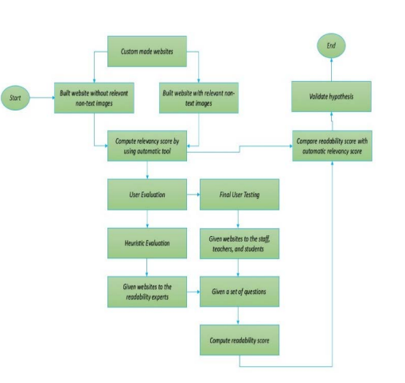
Evaluation:-
GESCOE,Department of Computer
10

Slide 11

Webpage with non-text Images:-
GESCOE,Department of Computer
11

Slide 12

Webpage without non-text Images:-
GESCOE,Department of Computer
12

Slide 13
User Evaluation:-
User evaluation consists of the following steps:
OBJECTIVE
2) ENVIRONMENT
3) DEPENDENT AND INDEPENDENT VARIABLES
4) PARTICIPANTS
5) PROCEDURE
GESCOE,Department of Computer
13

Slide 14
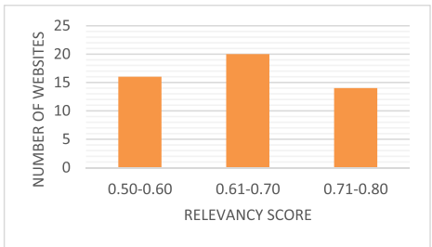
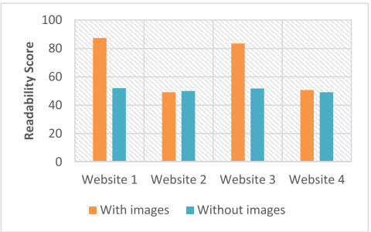
Results:-
Figure 1:Automatic Relevancy Distribution
Figure 2:User’s based readability scores with and without images.
GESCOE,Department of Computer
14

Slide 15
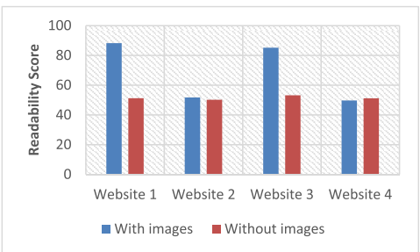
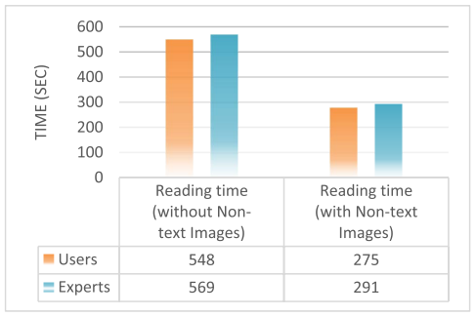
Figure 4:Experts-based readability scores with and without images.
Figure 5:Web Readability Time
GESCOE,Department of Computer
15

Slide 16
Conclusion:-
The non-text image being used on a webpage that is relevant to the webpage supports the greater readability of the webpage. Dissimilar assessment techniques are presented that evaluate the textual content of the web.
However, to the best of our knowledge, no work has been done on evaluating the readability of non-text images on the web.
In this approach, Google services are used to extract information from non-text images, and the cosine similarity approach is used to compute the relevancy of the extracted information with the webpage text.
The results show that the more the graphical content on a webpage is relevant to the webpage text, the better the readability score of the webpage in the user evaluation that verifies our hypothesis.
GESCOE,Department of Computer
16

Slide 17
Refernces:-
[1] G. Allen, A. Milton, K. L. Wright, J. A. Fails, C. Kennington, and M. S. Pera, ‘‘Supercalifragilisticexpialidocious: Why using the ‘right’ readability formula in children’s web search matters,’’ in Proc. Eur. Conf. Inf. Retr., Stavanger, Norway, 2022, pp. 3–18.
[2] Z. Jasem, Z. AlMeraj, and D. Alhuwail, ‘‘Evaluating breast cancer websites targeting Arabic speakers: Empirical investigation of popularity, availability, accessibility, readability, and quality,’’ BMC Med. Informat. Decis. Making, vol. 22, no. 1, pp. 1–15, Dec. 2022.
[3] M. Pantula and K. S. Kuppusamy, ‘‘A machine learning-based model to evaluate readability and assess grade level for the web pages,’’ Comput. J., vol. 65, no. 4, pp. 831–842, Apr. 2022.
[4] Y. Hidayat, A. G. Rajkoomar, M. A. Qadeer, and L. G. D’Souza, ‘‘Osteoporotic vertebral fractures: An analysis of readability and quality of webbased information,’’ Cureus, vol. 14, no. 6, p. e26029, Jun. 2022.
GESCOE,Department of Computer
17

Slide 18
[5] P. K. Ojha, A. Ismail, and K. K. Srinivasan, ‘‘Perusal of readability with focus on web content understandability,’’ J. King Saud Univ.-Comput. Inf. Sci., vol. 33, no. 1, pp. 1–10, Jan. 2021.
[6] M. S. Al-Ak’hali, H. N. Fageeh, E. Halboub, M. N. Alhajj, and Z. Ariffin, ‘‘Quality and readability of web-based Arabic health information on periodontal disease,’’ BMC Med. Informat. Decis. Making, vol. 21, no. 1, pp. 1–8, Dec. 2021.
[7] E. Halboub, M. S. Al-Ak’hali, H. M. Al-Mekhlafi, and M. N. Alhajj, ‘‘Quality and readability of web-based Arabic health information on COVID-19: An infodemiological study,’’ BMC Public Health, vol. 21, no. 1, pp. 1–7, Dec. 2021.
[8] S.-T. Lim, M. Kelly, S. O’Neill, and L. D’Souza, ‘‘Assessing the quality and readability of online resources for plantar fasciitis,’’ J. Foot Ankle Surgery, vol. 60, no. 6, pp. 1175–1178, Nov. 2021.
[9] Z. Wei, D. Liang, D. Zhang, L. Zhang, Q. Geng, M. Wei, and H. Zhou, ‘‘Learning calibrated-guidance for object detection in aerial images,’’ IEEE J. Sel. Topics Appl. Earth Observ. Remote Sens., vol. 15, pp. 2721–2733, 2022.
GESCOE,Department of Computer
18

Slide 19

GESCOE,Department of Computer
19

