Slide 1
Sales Analysis and Dashboard
Advait Deshpande

Slide 2

A
N
A
L
Y
S
I S
&
D
A
S
H
B
O R D
Data Information
Synopsis
Data Preprocessing
Exploratory Data Analysis
Key Insights

Slide 3
Data Information
Transactional Data of a global gift shop.
Data from Dec 2010 – Dec 2011.
Customer segment : Retail as well wholesale.

Slide 4
Data Preprocessing
Integral part of data analysis.
Helps to remove anomalies from the data.
Few methods used are:
Stripping data of all the trailing spaces.
Converting all the textual values to a uniform format i.e., lowercase.
Checking for missing values – none found.
Converting data to valid datatypes.
Checking the integrity of the data.

Slide 5
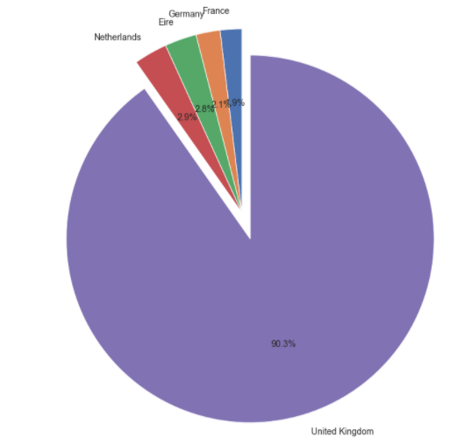
Share of countries towards sale.
Exploratory Data Analysis

Slide 6
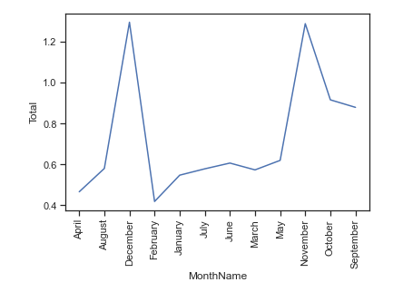
Gross Monthly Sale in Millions
Exploratory Data Analysis

Slide 7
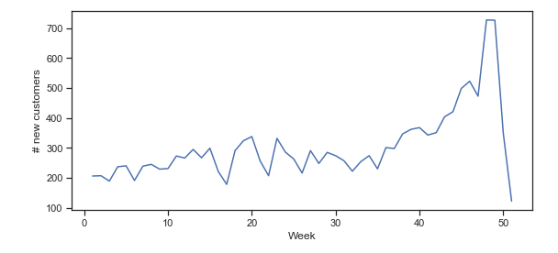
Exploratory Data Analysis
Increase in new customers in the week number 45 – 50, i.e., November and December

Slide 8
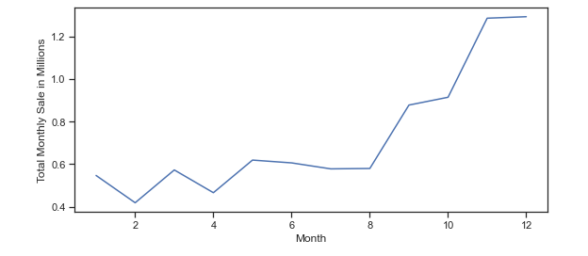
Exploratory Data Analysis
Justifies the total spend more in dec and nov from previous slide.

Slide 9
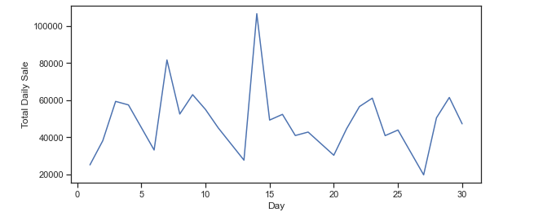
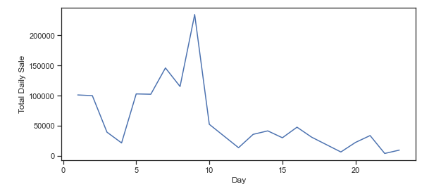
Exploratory Data Analysis

Slide 10
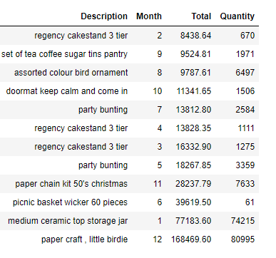
Exploratory Data Analysis
Best selling products over 12 months in UK

Slide 11
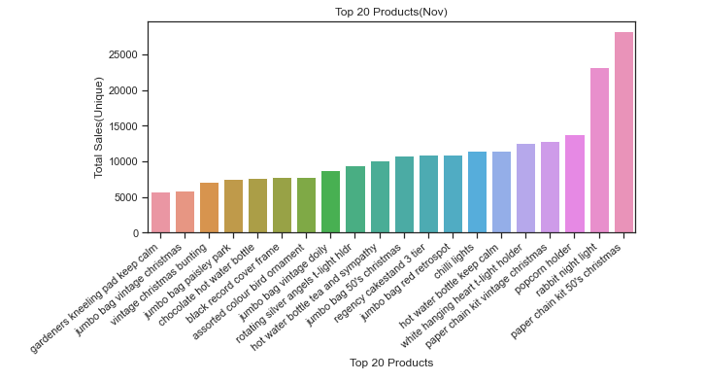
Exploratory Data Analysis
People bought few Christmas items in Nov pertaining to availability in the next month

Slide 12
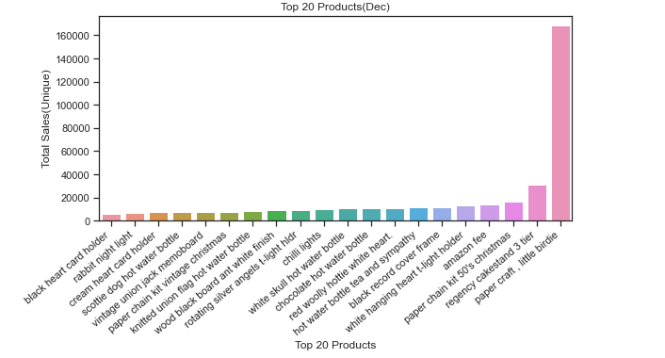
Only product sold in December was Little Birdie. Making it suspiscious.
Exploratory Data Analysis

Slide 13


Key Findings
A single person bought 80000 pieces of little birdie. And had other 2 transactions of gross 5 Pounds.

Slide 14
A single transaction in the month of December skewed the results for all the United Kingdom.
Needs more investing to check if the transaction is legitimate or not.
Need to check if the integrity of the data is compromised.
Results if the outlier is omitted.
Conclusion

Slide 15
GitHub :- GitHub
Dashboard:- Dashboard
Thank You

