Slide 1
INVESTOR DECK
Mana Rasta
A civic reporting platform for Hyderabad that improves pothole reporting quality, operational visibility, and citizen participation through guided capture, analytics, and incentives.
Mana
Rasta
? Citizen mobile app, admin dashboard, backend workflow stack, and capture-analysis service already exist
? Built around civic responsibility: faster reporting, better evidence, clearer follow-through
? Gamification encourages valid participation rather than vanity engagement
? The same platform can expand from potholes to broader civic issues over time
Mana Rasta Investor Deck
1

Slide 2
Why the app was built
Potholes are a repeated civic problem, but reporting systems usually suffer from poor evidence, weak ownership, and low public trust.
? Citizens need a simple way to report road defects with confidence that their effort matters
? Administrators need better image quality, precise location, and structured workflow data to act faster
? Visible progress after submission builds trust and turns reporting into repeat civic behavior
? Incentives make responsibility scalable when they are tied to valid reports and governed well
Core need
Turn an unstructured complaint into a guided, trustworthy civic workflow.
Value created
Better reporting quality for operations and a stronger feedback loop for citizens.
Mana Rasta Investor Deck
2

Slide 3
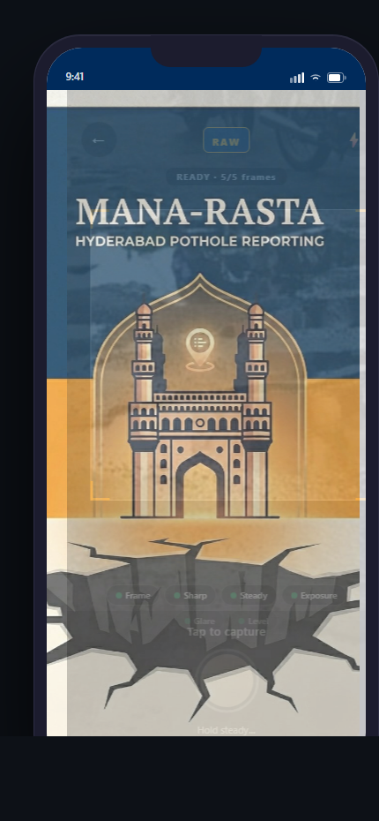
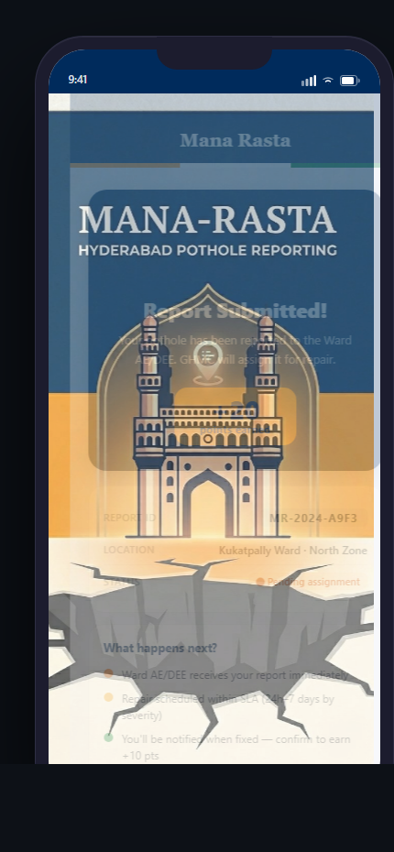
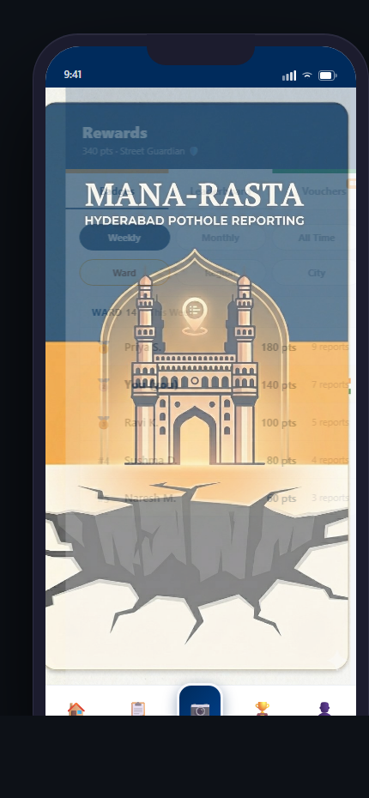
Citizen experience and incentive loop
? Guided capture improves evidence quality before a report enters the system
? Success states move users into tracking rather than uncertainty
? Leaderboards, badges, and rewards reinforce responsible civic participation
? The app already includes reporting, history, rewards, profile, notifications, and trust-building screens
Mana Rasta Investor Deck
3
Capture module
Success screen
Leaderboard

Slide 4
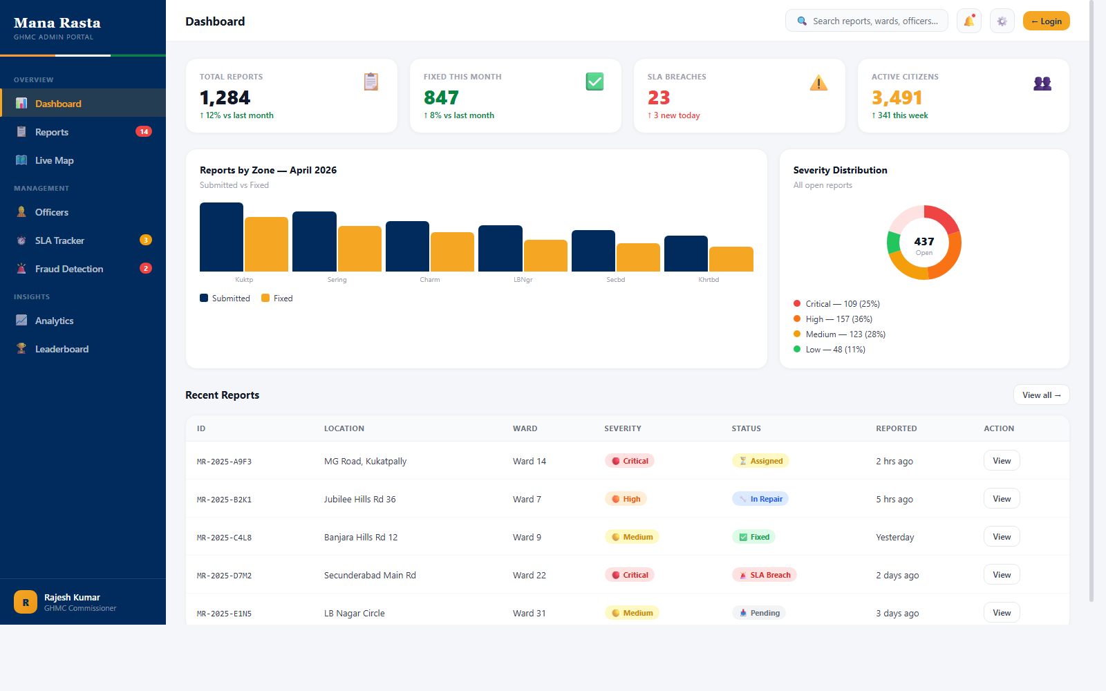
Depth of system: dashboard, ML, and abuse resistance
? The project already spans mobile app, backend services, admin dashboard, analytics, and a dedicated image-analysis layer
? Machine learning narrows the problem by flagging weak captures and identifying likely pothole candidates
? Fraud prevention includes moderation, duplicate-image checks, suspicious-pattern scoring, and capture logging
? Rate limiting helps protect OTP flows, report endpoints, and rewards from system abuse
ML matters because it raises the quality floor before operations teams spend time reviewing a report.
Mana Rasta Investor Deck
4

Slide 5
Future scope and investment path
? Mana Rasta is pothole-first today, but the same workflow can extend to broken streetlights, footpath issues, waterlogging, and similar civic defects
? The next milestone is production hardening: pilot rollout, stronger operations support, and formalized workflow ownership
? Funding accelerates trained ML models, deployment readiness, and category expansion on top of an already-built base
? The long-term opportunity is a broader civic issue platform with better public participation and better municipal actionability
Expansion categories
? Broken streetlights
? Footpath issues
? Waterlogging
? Other urban defects
Mana Rasta combines civic responsibility, operational practicality, and well-governed incentives into a product with real platform potential.
Mana Rasta Investor Deck
5

