Slide 1
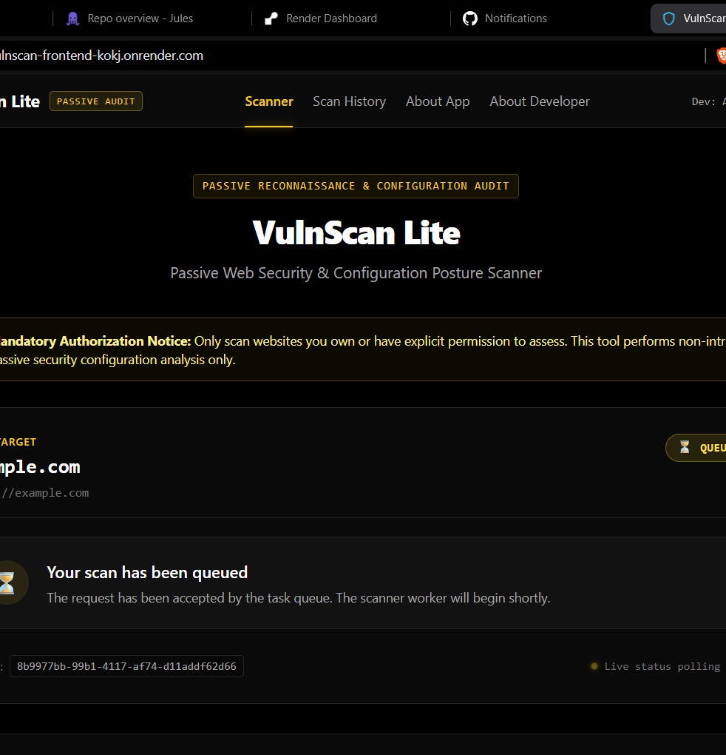
VULNSCAN LITE
Passive Web Security and Configuration Posture Scanner
Project Submission Presentation
Advaith K
B.Tech CSE - Cyber Security
Live web application interface

Slide 2
PROJECT CONTEXT
A focused security posture check for public web applications
VulnScan Lite turns publicly available web configuration signals into a readable security summary without launching intrusive tests.
Problem
Approach
Outcome
Basic header and TLS issues are easy to miss, yet they directly affect browser and user safety.
Validate the target, collect passive evidence, normalize findings, and produce an actionable score.
One report combines findings, a grade, remediation guidance, PDF export, and persistent scan history.
VulnScan Lite | Project Submission
2

Slide 3
WHAT IT EXAMINES
Three passive evidence layers give the report practical depth
Each scan is non-intrusive and evaluates information the target already exposes to a normal browser connection.
HTTP SECURITY HEADERS
TLS AND TRANSPORT
APPLICATION SIGNALS
CSP
HSTS
X-Frame-Options
X-Content-Type-Options
Referrer-Policy
Permissions-Policy
Certificate validity
Hostname verification
TLS version
Cipher strength
HTTPS redirect behavior
Response timing
Redirect chain
Content metadata
Passive CMS indicators
Structured remediation
VulnScan Lite | Project Submission
3

Slide 4
SYSTEM ARCHITECTURE
A browser request becomes a durable, reviewable security report
The deployed application separates the user interface, API validation, scan execution, and persistent result storage.
Browser
API
Scan execution
Results
->
->
->
React + Vite
FastAPI
validation + SSRF defense
Background runner
passive HTTP + TLS checks
PostgreSQL
report + scan history
The API returns immediately, while scan status and full reports are fetched asynchronously by the frontend.
VulnScan Lite | Project Submission
4

Slide 5
SCAN WORKFLOW
The app moves from target URL to remediation in four controlled steps
This design keeps the user interface responsive while preserving lifecycle state in the database.
01
02
03
04
Submit
Validate
Analyze
Report
Enter an owned or authorized public URL.
Normalize URL and block private or unsafe targets.
Collect HTTP, TLS, redirect, and CMS evidence.
Store score, findings, PDF, and history entry.
VulnScan Lite | Project Submission
5

Slide 6
USER-FACING RESULTS
Every completed scan produces a score, detailed findings, and a reusable record
The report is designed to turn low-level web configuration details into a clear next action.
0-100 score
Actionable findings
Persistent history
Severity-weighted deductions summarize the current posture and map it to an A-F grade.
Each finding explains what was observed and includes Nginx, Apache, or Caddy remediation examples.
Completed scans remain available for later review, full report access, and PDF download.
VulnScan Lite | Project Submission
6

Slide 7
Ready for review
The submission contains the source code, presentation, report, and working deployment links.
Source code
Live application
github.com/advaith-k-0911/vulnscan-lite
vulnscan-frontend-kokj.onrender.com
Only scan websites you own or have explicit permission to assess.
Thank you

