Slide 1

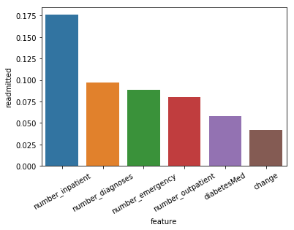
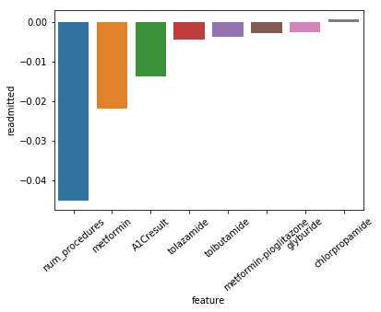
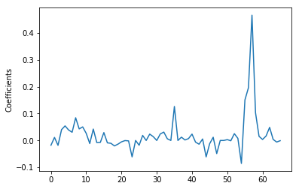
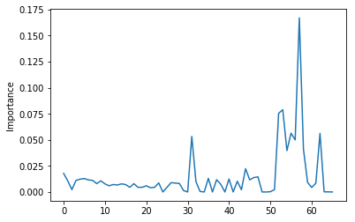
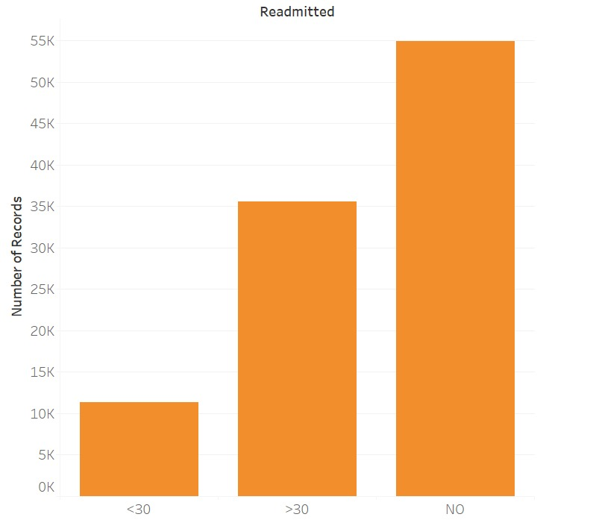
PATIENT READMITTANCE ANALYSIS
Instructor: Prof. Daniel Acuna
Team Members: Advaith Kamath, Amit Jadhav, Manan Dedhia, Simaant Patil
Problem and Objective
Diabetes is the underlying cause of many health issues. Our main objective is to determine if a patient will be readmitted or not by considering the medicines, diagnosis and various other features. To accomplish this we have decided to use two algorithms: Logistic Regression and Random Forest. This system can be used by healthcare providers to determine if a patient needs a follow-up appointment in the immediate future.
Top 10 Features of Both Models
Logistic Regression
Random Forest
Features | Coefficient
number_inpatient | 0.466
number_emergency | 0.196
number_diagnosis | 0.151
diabetesMed | 0.126
number_outpatient | 0.103
Diabetes | 0.084
Circulatory | 0.054
Diabetes3 | 0.050
time_in_hospital | 0.048
Diabetes2 | 0.042
Features | Importance
number_inpatient | 0.167
num_medications | 0.078
num_lab_procedures | 0.075
number_diagnosis | 0.056
time_in_hospital | 0.055
age | 0.053
number_emergency | 0.049
number_outpatient | 0.041
num_procedures | 0.039
insulin | 0.022
Goals
Predict if a patient will be readmitted or not.
Predict if a patient will be readmitted in less than 30 days or more than 30 days.
Logistic Regression Coefficient Distribution
Random Forest Feature Importance
Data Description
This data consists of 49 columns that can be used to determine the readmittance of the patient, twenty-four of which are various diabetic medicines and the remaining are the tests and columns containing demographic data. The data is in csv format and consists of 101,767 records.
Conclusion
Model Evaluation
From the models used and feature importance that was obtained, the top features were found to be number of in patient visit, number of emergency visits, number of medications and number of diagnosis on which the readmission of a patient depends. From both the models, number of in patients was the most important one and it makes sense as patients administered by a doctor for a certain disease have a greater chance of revisiting and thus, readmission in a hospital.
We can also infer that higher number of diagnosis results in a higher chance of readmittance.
Logistic Models | AUC
LR with all features | 0.654
LR with all features & reg. parameters | 0.652
LR with important features | 0.64
Random Forest Models | AUC
RF with all features | 0.660
Multiclass RF | 0.572
RF with important features | 0.642
Best Models | Precision | Recall | AUC
Random Forest | 0.62 | 0.36 | 0.660
Logistic Regression | 0.63 | 0.31 | 0.654
Data Source
We found that the Random Forest with all features included was the best model.
https://archive.ics.uci.edu/ml/datasets/diabetes

