Slide 1
Integration of Robotic Process Automation at World Hotels for Event Management
- Advaith Kamath

Slide 2
Overview
Project Business Case
The project aims to automate the Event Management system of WorldHotels. This would include automating events like conferences, corporate meetings, trade shows, etc. This project will be prototyped in only one hotel in the Americas region (Royal Park Hotel in Detroit, Michigan).
The project would result in automation of basic operations like accounting and maintaining a customer relationship and loyalty points for a customer, as well as maintaining a calendar for WorldHotels.
This would take in information from various existing systems and save immense time and man power. It is also capable of handling last minute changes. With an automated system such as this, customers can be better serviced, which is the main mission of WorldHotels.

Slide 3
Overview
Product Deliverables:
Revised Accounting System
Automated Event Entry in Calendar
Automated Room Reservation System
Automated Loyalty Points Allocation
Improved Customer Relationship Model
Process Deliverables:
Project Kick- off Meeting
Project Plan & Schedule
Project Status Reports
Maintenance Training for End Users
Prototype Schedule Meeting

Slide 4
Vision of the Project & Technology Outcomes
The vision of this project is to automate and improve the event management system of World Hotels so as to better service the customers.
A new system developed by Blue Prism Inc. is to be installed in the hotel. This system will be linked to the existing system.
The roles of the existing staff will be revised as many operations will be automated. Staff directly interacting with the system will have to undergo a training that will provide them with the knowledge to operate the system effectively.
The following strategic advantages can be achieved by this project:
Time and human resources can be used more efficiently
Prevents human error that may occur in the various operations
A competitive edge, as customers feel intrigued by interacting with the system

Slide 5
Scheduling Assumptions and Constraints
The existing system data is readily available to the team during the development and testing phase.
All phases from initiation to closure are completed on schedule and the deadlines are met.
Members of all teams involved in the project are available during the duration of the project and are not away on long leaves of absence.
There are no system failures while implementing the prototype in the hotel.
All approvals are sanctioned in time and changes to the requirements, software or hardware are informed well in advance.
There is a constant communication between the teams at World Hotels and Blue Prism Inc that prevents any delay in relaying critical information.

Slide 6
Scheduling Assumptions and Constraints
The following dates can be considered as the constraints that have to be met so as to maintain the schedule of the project.
Dates | Scheduled Tasks
7th November, 2018 | Executive overview presentation to be delivered to Mr. Piro Hernandez
9th November, 2018 | Executive overview presentation with the Board/Industry Advisory Council
18th November, 2018 | Submission of project plan and budget document
1st December, 2018 | Project overview presentation meeting
15th January, 2018 | Commencement of first step of implementation of the project

Slide 7
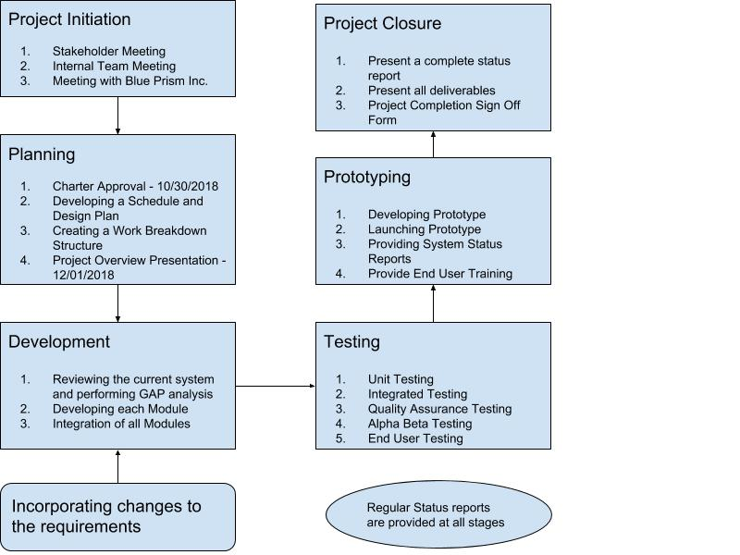
Project Stages

Slide 8
Project Stages
The project is divided into the following stages:
Initiation stage includes the Kick off meetings with the stakeholders and the teams of World Hotels and Blue Prism Inc.
The planning stage involves the approval of the Charter and the overview presentation as its main deliverables.
The development phase incorporates the GAP analysis and initiates the creation of various modules of the Event Management System like the loyalty points system, room reservation system or the customer relationship system. All modules are then integrated together. The development phase runs in sprints. Each sprint takes up to 2-3 weeks. The scope is frozen before crating the various modules.
All modules are tested individually and together in the next phase (Unit Testing and Integration Testing). It also incorporates the end user testing techniques like Alpha Beta testing and the reports generated are the deliverables.
The prototype is developed and launched at the Royal Park Hotel in Detroit, Michigan in the prototype phase. End user training is provided to the users of the system (staff).
Project Closure includes the final signoffs and issue logs as the deliverables of this phase.
The status reports generated at various stages, requirement documents and change request documents are some of the deliverables that are spread across all the stages.

Slide 9
Quality Planning, Quality Assurance and Quality Control Approaches
In order to maintain the quality assurance of the project the following measures are undertaken:
A Quality Assurance and Compliance Certificate is created for the prototype.
The integrity and quality of privileged customer data is checked periodically.
The functionalities of all the modules must meet the user requirements.
All softwares used in the project must be of the latest version.
The license of all softwares must be verified in order to ensure the legality of the software and to affirm that the software used is of premium quality.
A regular feedback loop is set up with the stakeholders so as to ensure that the stakeholders are in agreement with the functionalities of the project.

Slide 10
Executive Involvement and Support Needed
Stage of the Project | Person/ Team involved | Involvement
Project Initiation | Javier Pareja Susan Levy Advaith Kamath | The project is initiated and is given to the project manager Advaith Kamath
Stakeholder Meeting | Susan Levy Advaith Kamath | All the requirements for the project is provided to the project manager
Internal Team Meeting | Advaith Kamath Robert T. Murray Karen Watson Stephanie Lewis James Sanduzi Phillip Grome Mary Garcia | The requirements and information about the project is shared with the team and roles are assigned based on the skillset of the members

Slide 11
Executive Involvement and Support Needed
Stage of the Project | Person/ Team involved | Involvement
Meeting With Blue Prism, Inc. Team | Advaith Kamath Angela R. Berry Apurv Khanna Thomas V. Dugas Cynthia Wong | The project requirements are explained to the Blue Prism Inc team. Their questions are answered and regular meetings are fixed.
Planning | SusanLevy Advaith Kamath World Hotel Team Blue Prism Inc Team | The Project Charter is sent for approval which has a risk management plan and the plans suggested by Blue Prism Inc. The schedule and Work breakdown structure is also shared with the stakeholders and various teams
Development of modules | Advaith Kamath World Hotels Team Blue Prism Inc Team | Advaith Kamath manages the World Hotel team and coordinates with the Blue Prism Inc Team to start developing individual modules

Slide 12
Executive Involvement and Support Needed
Stage of the Project | Person/ Team involved | Involvement
Integration of Modules | Advaith Kamath World Hotels Team Blue Prism Inc Team | The integration of all modules with the existing system is carried out by both teams and is monitored by Advaith Kamath
Testing | Advaith Kamath World Hotels Team Blue Prism Inc Team End Users | Unit and Integration testing is carried out by both the teams to check the system quality and performance. End Users are also a part of this phase as they perform alpha beta testing. All this is overseen by Advaith Kamath.
Prototyping | Advaith Kamath Nikki Platenik World Hotels Team Blue Prism Inc Team | After a discussion and helpful guidance from Nikki the prototype is created for the Royal Park Hotel in Detroit, Michigan by both the teams

Slide 13
Executive Involvement and Support Needed
Stage of the Project | Person/ Team involved | Involvement
End User Training | Advaith Kamath World Hotels Team Blue Prism Inc Team End Users | Both team design a training that helps the end users operate the system effectively. This training schedule and its execution is under the supervision of Advaith Kamath.
Documentation | Advaith Kamath World Hotels Team Blue Prism Inc Team | A joint documentation is created after integrating the RPA with the existing system by both the teams. Change request document, SoW, status reports and other such documents are also overseen and preserved.
Project Closure | Javier Pareja Susan Levy Advaith Kamath | The project is signed off by Advaith Kamath and all final reports are submitted to Susan Levy and Javier Pareja and they sign off the project.

Slide 14
Questions
Any questions regarding any stage or aspect of the project will now be answered.

