Slide 1
Association Rule Mining
G Thulasiram
DDA1610215

Slide 2
Company Background
‘Global Mart’ is an online store that caters to customers from across the globe
Company Business Objectives
To figure out the most frequently occurring combination of the items that are bought together and recommend the related items to a customer
Company background
Company business objective

Slide 3
Problem Solving Methodology
Business Understanding and Data Understanding
Data Cleansing and Preparation
Pruning the redundant rules
Plotting the pruned rules for analysing business implications
Recommend related items to a customer
Converting the data to Transactions format and plotting
Optimizing the Support & Confidence for creating rules

Slide 4
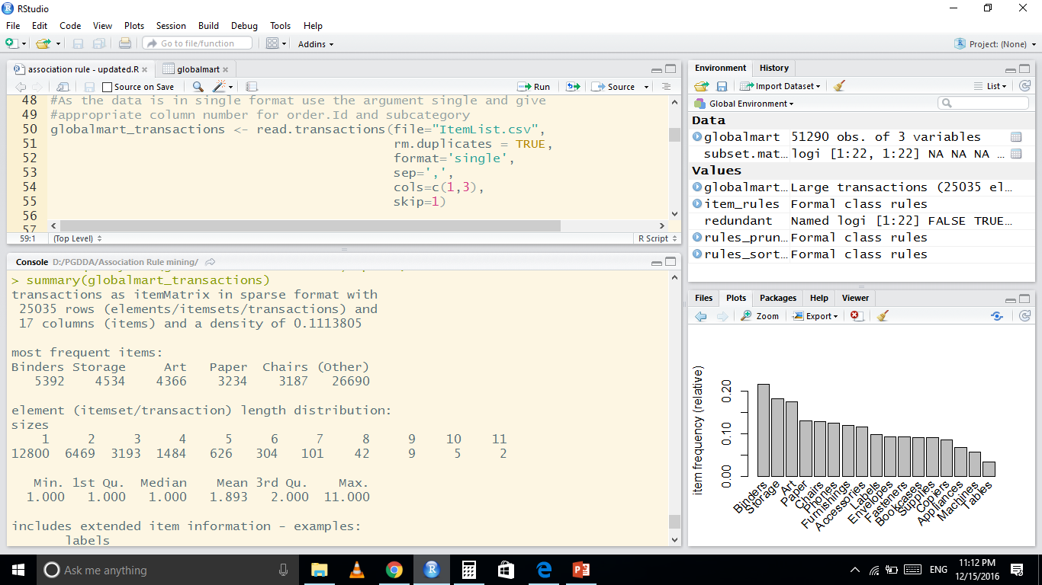
Summary of Transactions
25035 transactions (after removing duplicates)
17 Sub categories (items)
Mean size of itemset is 1.893
Most frequent items are Binders, Storage and Art

Slide 5
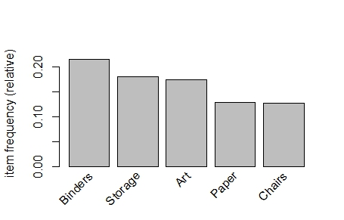
Frequency of Top 5 Items

Slide 6
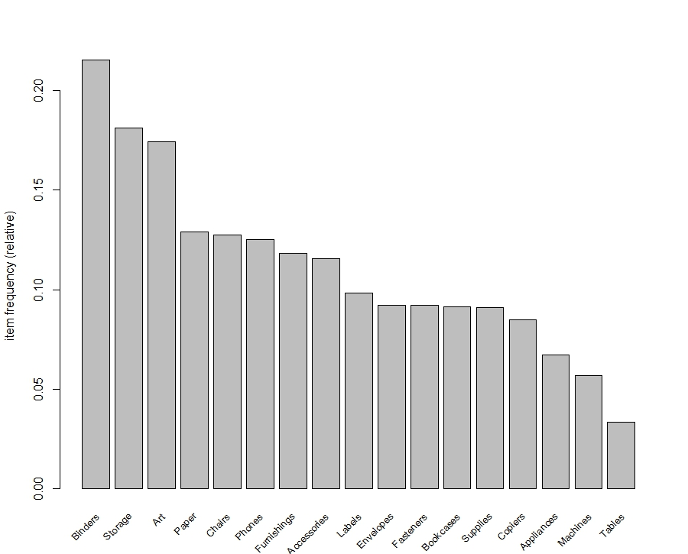
Frequency of All Items

Slide 7
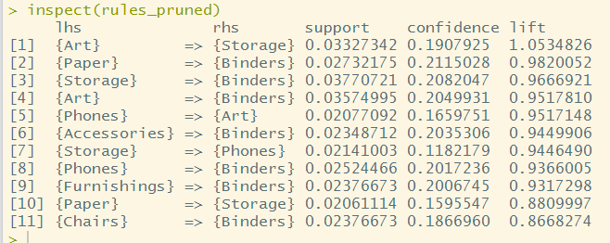
Pruned Rules
Pruned rules in descending order of lift

Slide 8
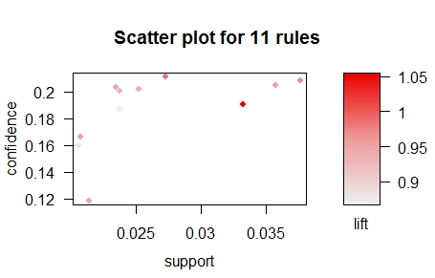
Scatter plot of pruned Rules

Slide 9
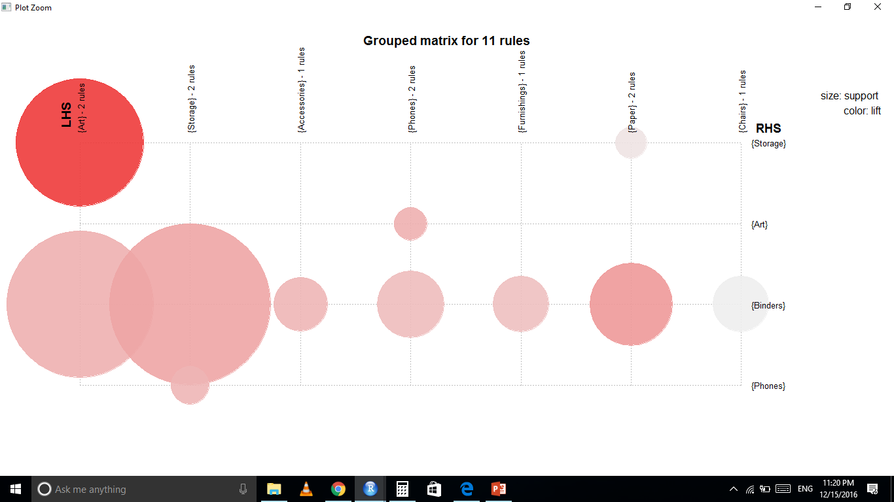
Grouped Matrix of pruned Rules

Slide 10
Recommendations for Business
Item Purchased by customer | Items Recommended for purchase
Art | Storage and Binders
Accessories | Binders
Storage | Phones and Binders
Phone | Binders
Furnishings | Binders
Paper | Storage and Binders
Binders should be recommended for purchase along with Art, Accessories, Storage, Phone, Furnishings and Paper items

Slide 11
Further Analysis
Binders, Storage and Art are turning up in most of the rules
Item frequency of them is also very high
so mining to find some rules without them which will help the business in making more diverse recommendations

Slide 12
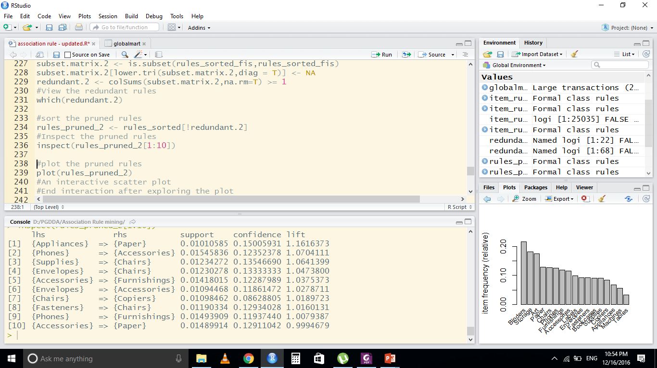
Top 10 Pruned Rules
Top 10 Pruned rules in descending order of lift

Slide 13
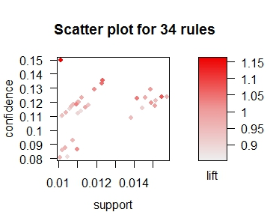
Scatter plot of pruned Rules
Scatter plot of pruned Rules

Slide 14
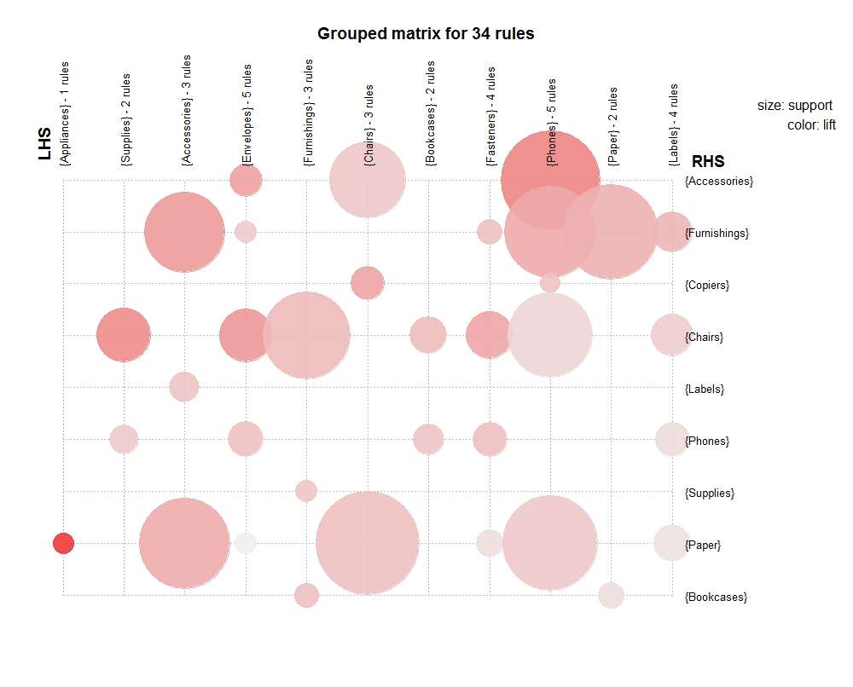

Slide 15
Recommendations for Business
Two sets of recommendations are generated for improving the sales of ‘Globalmart’
One set includes most frequently purchased items. These rules will be obvious for the subject matter experts
A second set of rules are further mined which are not apparent but actionable and will result in increase of sales for ‘Globalmart’

Slide 16
First set of Recommendations for Business
Item Purchased by customer | Items Recommended for purchase
Art | Storage and Binders
Accessories | Binders
Storage | Phones and Binders
Phone | Binders
Furnishings | Binders
Paper | Storage and Binders
Binders should be recommended for purchase along with Art, Accessories, Storage, Phone, Furnishings and Paper items

Slide 17
Actionable Recommendations for Business
Item Purchased by customer | Items Recommended for purchase
Appliance | Paper
Phones | Accessories and Furnishings
Suppliers | Chairs
Envelops | Accessories and Chairs
Chairs | Copiers
Fasteners | Chairs
Accessories | Paper and Furnishings
These rules are not apparent but actionable. This will result in increase of sales for ‘Globalmart’

