Slide 1
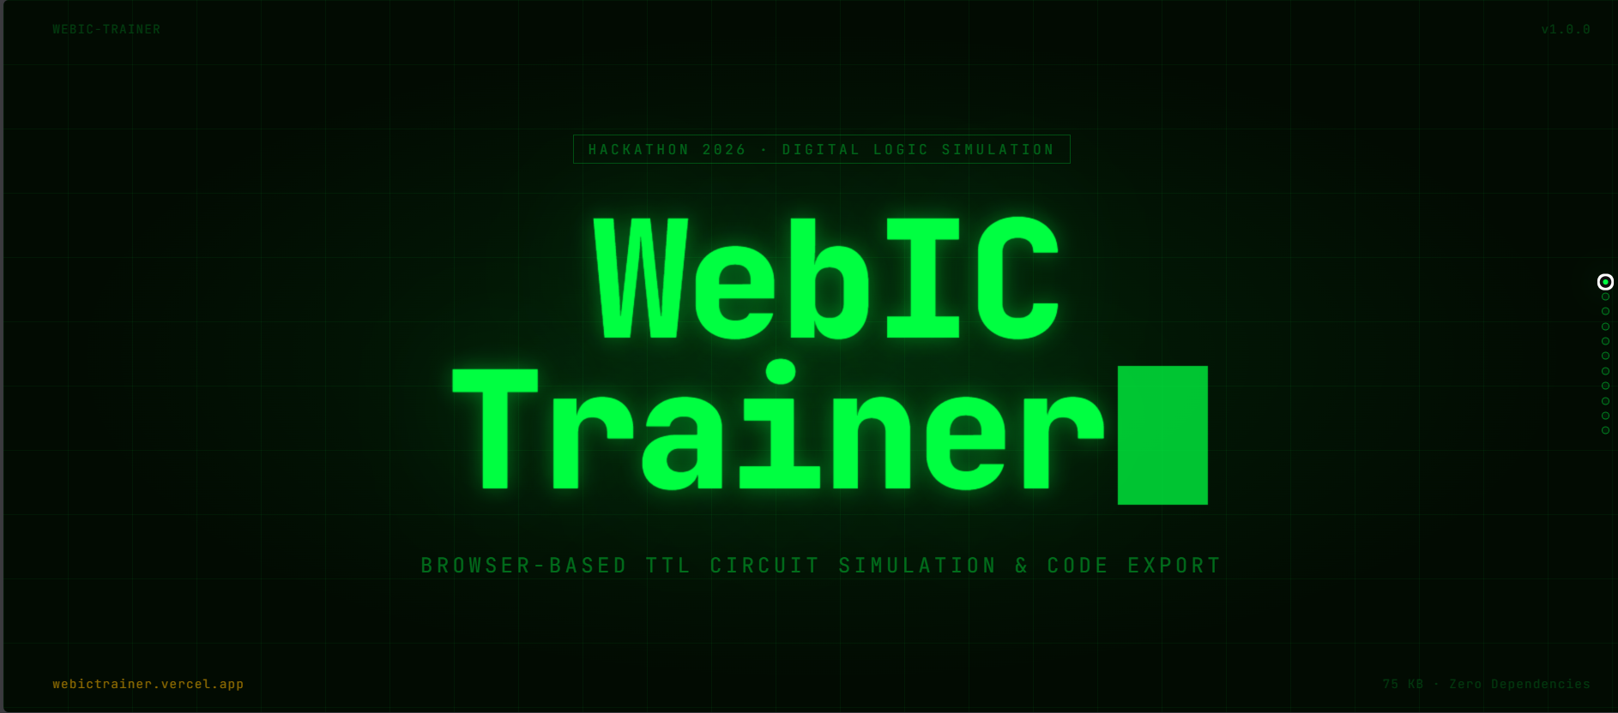
WEB IC TRAINER
A browser-based digital logic lab for fast TTL circuit learning and prototyping

Slide 2
Problem Statement
Students struggle to move from Boolean theory to practical IC wiring and debugging
Key Challenges
Our Problem Statement
1) Lab hardware is limited and not always accessible.
2) Manual breadboard debugging consumes time.
3) Simulation tools are often heavy, expensive, or hard to learn.
4) Students do not get instant visibility into signal behavior.
How might we give learners a fast, low-cost, browser-first platform to design, wire, simulate, and validate TTL logic circuits with immediate feedback?
Target Users
Electronics students
Faculty and lab instructors
Hackathon builders and hardware clubs

Slide 3
Solution Overview
Web IC Trainer turns circuit design, verification, and export into one integrated workflow
Single browser app combining IC placement, wiring, simulation, waveform analysis, and code generation
Design
Simulate
Export & Reuse
Add TTL ICs
Connect pins using drag/drop or click mode
Use trainer rails and I/O resources
Run logic engine
Observe outputs (LED/BCD)
Track timing behavior with waveform viewer
Export Arduino/Python/C++/Verilog
Generate truth table
Save/load full circuit JSON

Slide 4
Complete Feature Coverage
Core features included in this hackathon build
TTL IC placement on 4 sockets
Dual wiring modes (drag/drop + click)
Power rails, clock outputs, mono pulse
Input switches, LEDs, BCD display support
Preset experiments and custom save/load JSON
Boolean expression to auto-build circuit
Truth table generator
Waveform viewer with CSV export
Code generation: Arduino, Python, C/C++, Verilog
One-click IC datasheet access in Add IC modal

Slide 5
How Key Features Work
Feature mechanics and internal behavior
Add IC + Datasheet
Boolean Expression Builder
Truth Table Generator
User picks socket and IC type.
Metadata is loaded from registry.
Datasheet URLs are mapped in UI and opened in a new tab.
Expression parser supports OR(+), AND(.), NOT('), XOR(^), and implicit AND.
System auto-places compatible gates and creates connections.
Reads combinational behavior from active wiring graph.
Evaluates all input combinations and renders outputs for analysis.
Waveform + Code Export
Waveform viewer captures channel transitions over time with controls (Run/Pause/Stop/Clear).
Code generator emits implementation-ready logic for selected target language.

Slide 6
System Architecture Diagram
Modular client-side architecture with clear separation of concerns
UI Layer
(ui.js)
Wiring Engine
(wiring-engine.js)
Simulation Engine
(simulation.js)
IC Models
(ttl-chip.js + implementations)
Persistence
(JSON Save/Load)
IC Registry
(ic-registration + ic-registry)
Clock Manager
(clock-manager.js)

Slide 7
Simulation Flowchart
How user actions become stable logic outputs
User Action
(Add IC / Wire / Toggle Input)
Update Circuit State
(ICs, wires, pins)
Build/Update Node Graph
(merge connected pins)
Run Logic Evaluation
(apply IC behavior)
Refresh UI
(LED, BCD, waveform)

Slide 8
User Journey Flowchart
End-to-end flow from idea to verifiable output
Select ICs
Wire Circuit
Run Simulation
Check Outputs
Analyze Waveform
Optional Branches
Generate Truth Table -> Export Code -> Save JSON
Load JSON/Preset -> Re-run -> Compare outputs

Slide 9
Tech Stack And Module Ownership
Lightweight static app architecture for fast delivery and easy deployment
Frontend
Simulation Core
Persistence
HTML + CSS + Vanilla JavaScript
No heavy build chain required
Node graph resolution
TTL behavior modeling
Clock and pulse integration
Schema: ic-trainer-circuit-v1
Save/load complete state JSON
Exporters
Deployment
Arduino, Python, C/C++, Verilog
CSV export from waveform viewer
Static hosting ready
Works on local server or Vercel

Slide 10
Hackathon Execution Timeline
How the solution was built in rapid iterations
Phase 1
Phase 2
Phase 3
Phase 4
Phase 5
Core Board Setup
Logic Engine
Learning Tools
Validation Tools
Output Tools
Sockets, IC placement, basic wiring
Node mapping + IC behavior evaluation
Expression builder + truth table
Waveform viewer + presets + JSON
Multi-language code generation

Slide 11
Expected Impact
Educational value and practical adoption outcomes
Student Value
Instructor Value
Hackathon Value
Faster concept clarity
Hands-on virtual lab practice
Lower fear of wiring mistakes
Demo-ready classes
Reusable experiments
Easy preset sharing
Clear problem-solution fit
Working prototype with depth
Scalable architecture
Success Indicators: completed experiments, reduced setup time, stronger logic debugging skills, and higher engagement in digital design labs.

Slide 12
Roadmap
Post-hackathon execution plan
Next 30 Days
Next 60 Days
Next 90 Days
Add more IC families
More guided lab presets
Improve waveform UX
Simulation test harness
Deterministic replay mode
Classroom activity templates
Collaboration sharing links
Assignment and grading hooks
LMS integration exploration

Slide 13
THANK YOU
Web IC Trainer is ready for live demo.

