Slide 1
HEALTHCARE • INVENTORY • SMART MATCHING
Blood Bank
LIVE BLOOD INVENTORY
+
A+
24
Inventory & Donor Matcher
+
B+
18
A modern software concept for managing blood stock, donor records and compatible donor identification.
+
O+
31
+
AB+
12
ADVAITH CHIDURA
2620030295
BLOOD BANK INVENTORY & DONOR MATCHER

Slide 2
01 / OVERVIEW
02
Abstract
A simple real-world system that connects inventory management with donor compatibility.
PROJECT OVERVIEW
SYSTEM FLOW
The Blood Bank Inventory & Donor Matcher is a software application designed to manage blood stock and identify suitable blood donors based on blood-group compatibility.
Traditional blood-bank management can involve maintaining donor information and blood-stock details separately, making it difficult to quickly identify available blood or suitable donors during emergencies.
The system can add donors, register blood units, view inventory, search donors, check blood availability, and match compatible donors.
DONOR
BLOOD
DATABASE
MATCH
BLOOD
BLOOD UNIT
BLOOD BANK INVENTORY & DONOR MATCHER

Slide 3
02 / BENEFITS
03
Advantages
Key benefits of a structured blood-bank inventory and donor-matching system.
✓
Easy donor management.
✓
Faster donor searching.
✓
Easy blood-stock monitoring.
✓
Reduces manual record keeping.
✓
Helps identify compatible blood groups.
✓
Simple user interface.
✓
Reduces duplicate searching.
✓
Provides organized information.
✓
Easy to update inventory.
A+
B+
O+
AB+
BLOOD BANK INVENTORY & DONOR MATCHER

Slide 4
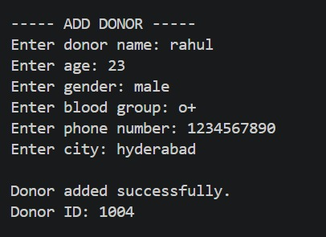
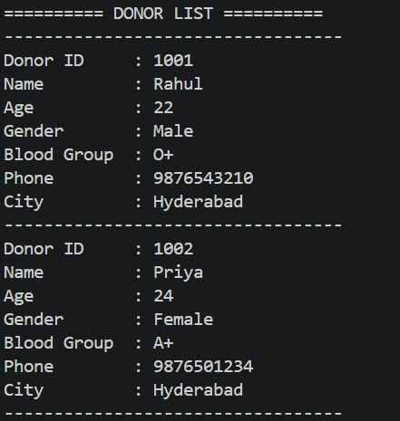
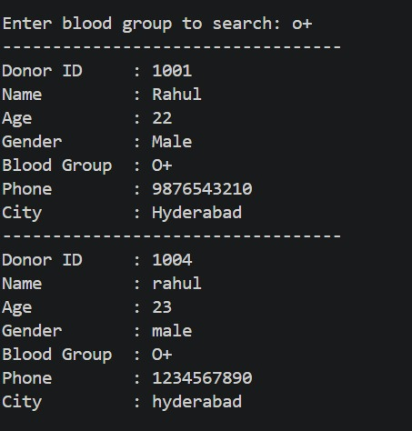
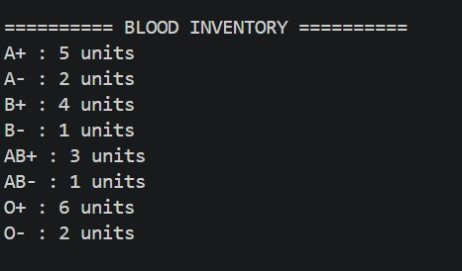

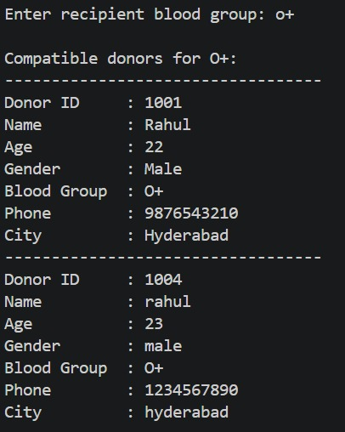

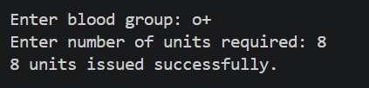
03 / OUTPUT
04
Output Screenshot — Inventory
Case1:
Case2:
Case3:
Case4:
Case5:
Case7:
Case8:
Case6:
BLOOD BANK INVENTORY & DONOR MATCHER

Slide 5
04 / OUTPUT
05
Output Screenshot — Donor Matching
A visual mockup for the compatible-donor search screen.
Find Compatible Donors
Required Blood Group: O+
SEARCH
O+
MATCH RESULT
Donor 001
O+
2.4 km
AVAILABLE
Donor 014
O-
4.1 km
AVAILABLE
COMPATIBLE DONOR FOUND
Donor 022
O+
6.7 km
AVAILABLE
BLOOD BANK INVENTORY & DONOR MATCHER

Slide 6
05 / CLOSING
06
Conclusion & Future Work
How the project can evolve into a broader digital blood-management platform.
FUTURE WORK
CONCLUSION
The Blood Bank Inventory & Donor Matcher project provides a simple and efficient solution for managing blood-bank information and donor records.
The system allows users to register donors, maintain blood-group inventory, check blood availability, issue blood units, and identify compatible donors based on blood-group requirements.
Web Application
Mobile Application
Location-Based Matching
Emergency Blood Requests
Blood Expiry Tracking
BLOOD
BLOOD BANK INVENTORY & DONOR MATCHER

