Slide 1
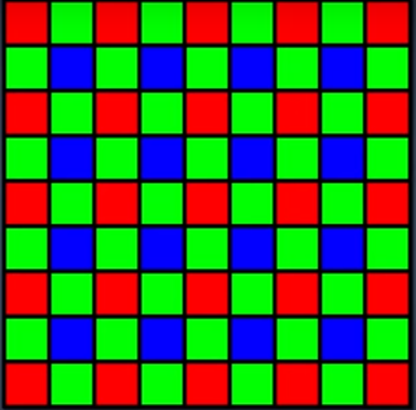
RGB Model Based Image Enhancement Technique For Steganography
Advait Gopal Ranade
Student,
Computer Science
ITM UNIVERSE
Vadodara, India
advaitranade4@gmail.com
Ms. Sweta Dargad
Assistant Professor, Computer
Science
ITM UNIVERSE
Vadodara, India
swetamaheshwari02@gmail.com
Krupali Mistry
Assistant Professor, Computer
Science
ITM UNIVERSE
Vadodara, India
Krupalimistry1993@gmail.com

Slide 2

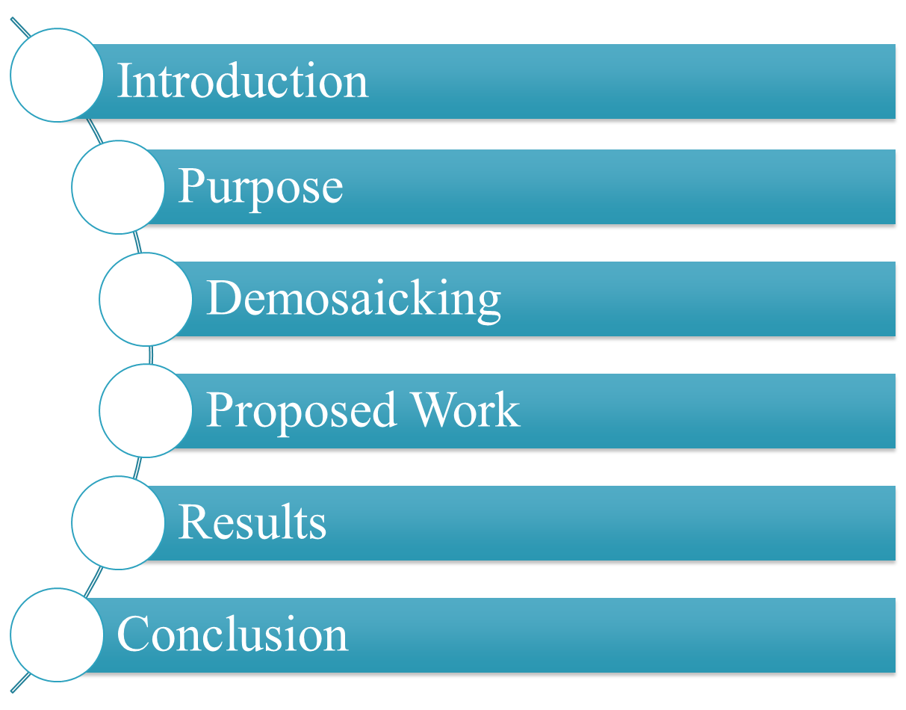

Slide 3

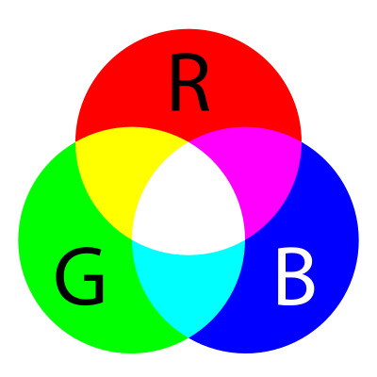
The RGB color model is an additive color model in which red, green and blue light are added together in various ways to reproduce a broad array of colors. The name of the model comes from the initials of the three additive primary colors, red, green, and blue.
The main purpose of the RGB color model is for the sensing, representation and display of images in electronic systems, such as televisions and computers, though it has also been used in conventional photography.

Slide 4

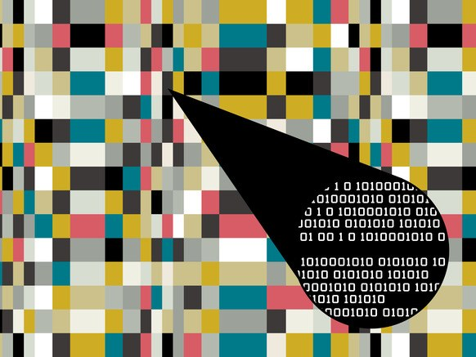
Steganography is the hiding of a secret message within an ordinary message and the extraction of it at its destination. Steganography takes cryptography a step farther by hiding an encrypted message so that no one suspects it exists. Ideally, anyone scanning your data will fail to know it contains encrypted data.
Stego image = Embedded message + Cover image + Stego key

Slide 5

The primary goal of steganography is to hide a message inside another message in a way that avoids drawing suspicion to the transmission of the hidden message. If suspicion is raised, then the goal is defeated. Furthermore, actual detection of an embedded message renders the primary goal of steganography useless. Steganalysis is the science of detecting hidden messages. This is frequently accomplished by looking at variances between bit patterns and unusually large file sizes.
Many tools are also available to aid in this purpose. Steganalysis is a field that is increasingly becoming popular as steganography gains more exposure.
As steganalysis is gaining importance there is a constant need to generate new methods for steganography.

Slide 6

A demosaicing algorithm is a digital image process used to reconstruct a full color image from the incomplete color samples output from an image sensor overlaid with a color filter array (CFA). It is also known as CFA interpolation or color reconstruction. Most modern digital cameras acquire images using a single image sensor overlaid with a CFA, so demosaicing is part of the processing pipeline required to render these images into a viewable format. Many modern digital cameras can save images in a raw format allowing the user to demosaic them using software, rather than using the camera's built-in firmware.
The aim of a demosaicing algorithm is to reconstruct a full color image (i.e. a full set of color triples) from the spatially under sampled color channels output from the CFA.

Slide 7

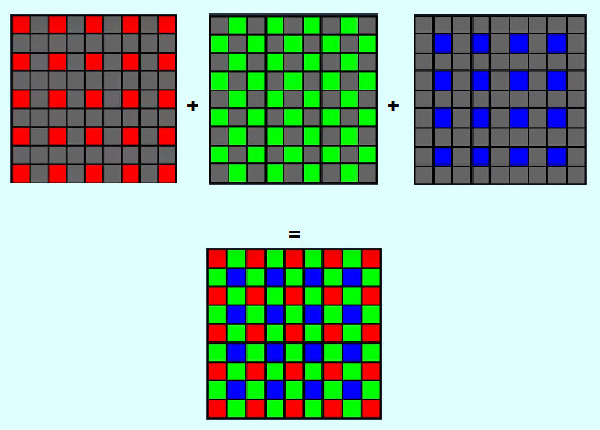

Slide 8
Digital cameras only collect either Red, Green or Blue information at a pixel, demosaicking is used in order to make a best estimate to fill in the remaining 2/3 of the color data. Demosaicing won’t work in dark surroundings because adequate light will not fall on the sensor so the images after the processing will lack details. This drawback of capturing images from a camera can be used for steganography.

Slide 9

The text which needs to be hidden should be behind the light source then focus on the light source properly and capture the image. The hidden text should be in view of camera while capturing the image. The image can be of any size and format.
To extract hidden content, take the illuminated image as an input.
Manipulate the intensity of RGB, R=255, G=0, B=0 or R=0, G=255, B=0 or R=0, G=0, B=255.
In the background of the illuminated image the hidden content will be detected.

Slide 10

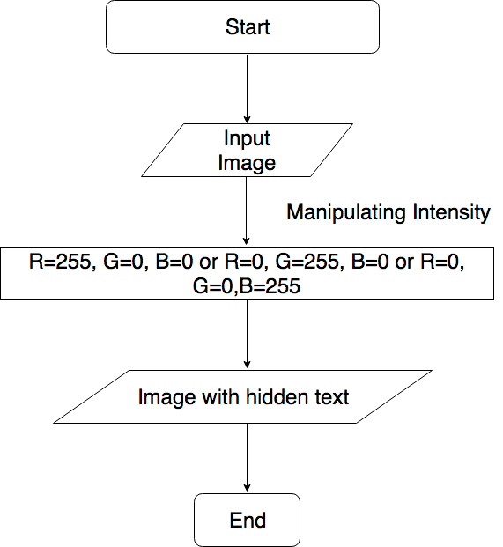

Slide 11

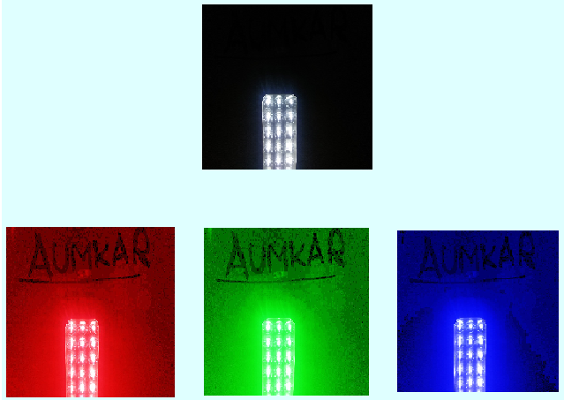
The conclusion is based on 50 test cases with similar results.

Slide 12

In this paper, we have proposed an algorithm to hide message in an image which is illuminated using white light or Yellow light.
The results are based on the evaluation obtained from some 50 test cases.
From results we archived accuracy of 96%.

Slide 13

Fridrich, Jiri. "Applications of data hiding in digital images." Signal Processing and Its Applications, 1999. ISSPA'99. Proceedings of the Fifth International Symposium on. Vol. 1. IEEE, 1999.
Petitcolas, Fabien AP. "Introduction to information hiding." Katzenbeisser, S and Petitcolas, FAP (ed.) (2000): 275-290.
Bender, Walter, et al. "Techniques for data hiding." IBM systems journal 35.3.4 (1996): 313-336.
Silman, Joshua. "Steganography and steganalysis: an overview." Sans Institute 3 (2001): 61-76.
Dugelay, Jean-Luc, and Stephane Roche. "A survey of current watermarking techniques." Information hiding techniques for steganography and digital watermarking (1999): 121-148.
Guan, Zhi-Hong, Fangjun Huang, and Wenjie Guan. "Chaos-based image encryption algorithm." Physics Letters A 346.1-3 (2005): 153-157.
De, Praloy Shankar, and Prasenjit Maiti. "DEDD Symmetric-Key Cryptosystem." International Journal of Advanced Computer Research (IJACR) 3.8 (2013).
Bao, Long, et al. "A new chaotic system for image encryption." System Science and Engineering (ICSSE), 2012 International Conference on. IEEE, 2012.
Kilaru, Seetaiah, Yojana Kanukuntla, and K. B. S. Chary. "An effective algorithm for Image security based on Compression and Decomposition method." International Journal of Advanced Computer Research (ISSN (IJACR) 3.8 (2013).
Mostaghim, Melika, and Reza Boostani. "CVC: Chaotic visual cryptography to enhance steganography." Information Security and Cryptology (ISCISC), 2014 11th International ISC Conference on. IEEE, 2014.

Slide 14
Hassan, Mohamed Fahim. "Synchronization of hyperchaotic systems with application to secure communication." Systems Conference (SysCon), 2015 9th Annual IEEE International. IEEE, 2015.
Li, Chun-Ta, Chin-Wen Lee, and Jau-Ji Shen. "A secure three-party authenticated key exchange protocol based on extended chaotic maps in cloud storage service." Information Networking (ICOIN), 2015 International Conference on. IEEE, 2015.
Haroun, Mohamed F., and T. Aaron Gulliver. "Secret key generation using chaotic signals over frequency selective fading channels." IEEE Transactions on Information Forensics and Security 10.8 (2015): 1764-1775.
Chung, K-H., and Y-H. Chan. "Color demosaicing using variance of color differences." IEEE Transactions on Image Processing 15.10 (2006): 2944-2955.
https://www.researchgate.net/post/How_to_define_Ture_Positive_TP_True_NegativeTN_False_PositiveFP_False_NegativeFN
https://www.researchgate.net/post/How_can_I_calculate_the_accuracy

Slide 15


