Slide 1
IPO Listing Prediction
Opening-price forecasts and positive-listing-gain signals
Indian mainboard IPOs | S0 information only
Final demonstration and measured results
24 October 2026
IPO Listing Prediction | 1
Notes:
Introduce the two outputs. Explain that all four implementation parts are delivered, while the original 90% aspiration was not achieved.

Slide 2
Problem and information cutoff
S0: 09:00 IST on the first bidding day
Regression: listing opening price in INR
Classification: opening price > final issue price
Final price and outcomes are labels, never predictors
Apply is a gain signal before costs and allotment
IPO Listing Prediction | 2
Notes:
S0: 09:00 IST on the first bidding day Regression: listing opening price in INR Classification: opening price > final issue price Final price and outcomes are labels, never predictors Apply is a gain signal before costs and allotment

Slide 3
Prepared data and provenance
253 mainboard IPOs first listed in 2023–2025
52 original S0 predictors; 12-variable core
7 optional financial variables compared
Annual income/PAT: 135 IPOs; managers: 222
Prepared tables, source hashes and reconciliation audits bundled
IPO Listing Prediction | 3
Notes:
253 mainboard IPOs first listed in 2023–2025 52 original S0 predictors; 12-variable core 7 optional financial variables compared Annual income/PAT: 135 IPOs; managers: 222 Prepared tables, source hashes and reconciliation audits bundled

Slide 4
Cleaning and exploratory analysis
Normalize issuer identities and reconcile listing venues
Separate annual/interim financial periods and units
Retain missing values and genuine outliers
Fit imputation, indicators and scaling inside each fold
Development positives: 78.5%; compare always Apply
IPO Listing Prediction | 4
Notes:
Normalize issuer identities and reconcile listing venues Separate annual/interim financial periods and units Retain missing values and genuine outliers Fit imputation, indicators and scaling inside each fold Development positives: 78.5%; compare always Apply

Slide 5
Time-aware evaluation
149 development / 103 reserved / 1 excluded IPO
Four expanding 2024 folds: 90 validation IPOs
Training sizes: 59, 80, 94, 121
Labels must mature strictly before each cutoff
Freeze choices before the 2025 evaluation
IPO Listing Prediction | 5
Notes:
The excluded December-to-January row has an immature label at final fit. Earlier aggregate outcomes were seen in preparation; do not describe the reserved set as unseen external data.

Slide 6
Small, recorded model comparison
10 price candidates; 9 classifier candidates
Baselines, Ridge/logistic regression and restrained forests
Core vs optional financial extension
76 candidate/fold fits; fixed random seed 42
Threshold fixed at 0.5; no threshold search
IPO Listing Prediction | 6
Notes:
10 price candidates; 9 classifier candidates Baselines, Ridge/logistic regression and restrained forests Core vs optional financial extension 76 candidate/fold fits; fixed random seed 42 Threshold fixed at 0.5; no threshold search

Slide 7
Development selected methods
Price: training-median premium × announced cap
Validation price MAE: INR 94.45
Classifier: core Random Forest, 200 trees, depth 3
Validation accuracy: 77.78%, equal to always Apply
All validation decisions were Apply
IPO Listing Prediction | 7
Notes:
The premium ratio uses only training opening prices and announced caps. The forest wins the accuracy/balanced-accuracy tie through lower Brier score; that does not improve decisions.

Slide 8
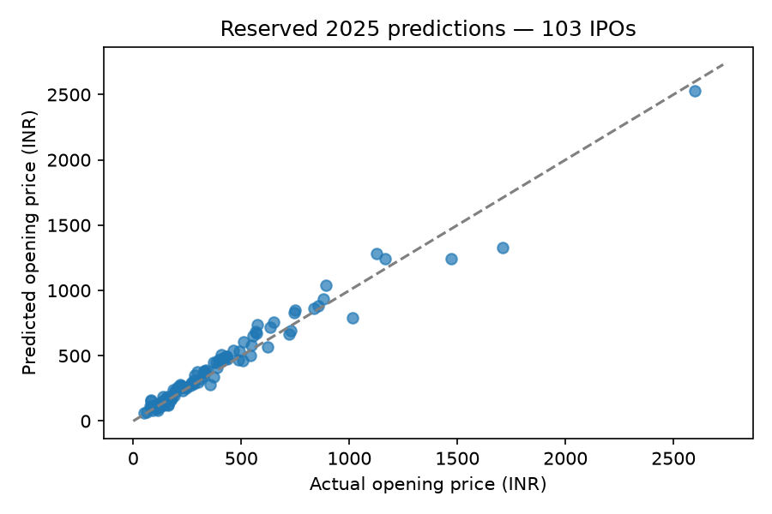
Reserved price forecasts
Selected MAE: INR 49.86
Announced-cap MAE: INR 44.95
Selected RMSE: INR 73.49
Selected MAPE: 14.97%
Keep the frozen choice despite the baseline result
IPO Listing Prediction | 8
Notes:
Announced cap has lower MAE/MAPE, while the selected method has lower RMSE. Never call 100 minus MAPE accuracy. Model choice is not revised using reserved outcomes.

Slide 9
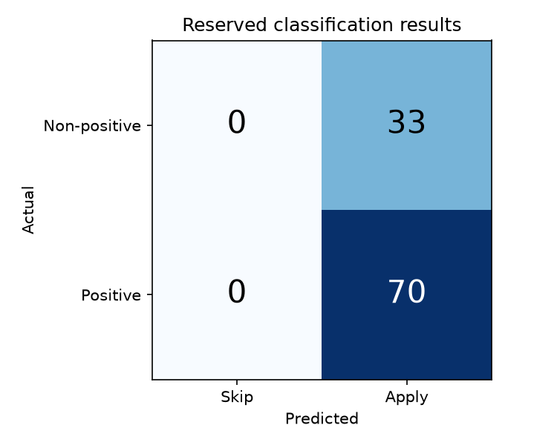
Reserved Apply/Skip results
Accuracy: 67.96%, equal to always Apply
Balanced accuracy: 50%; F1: 0.8092
70 positive / 33 non-positive IPOs
No Skip predictions; zero true negatives
Useful Skip detection and 90% accuracy not achieved
IPO Listing Prediction | 9
Notes:
Accuracy: 67.96%, equal to always Apply Balanced accuracy: 50%; F1: 0.8092 70 positive / 33 non-positive IPOs No Skip predictions; zero true negatives Useful Skip detection and 90% accuracy not achieved

Slide 10
Historical local demonstration
Enter an IPO name, then press Predict
Read price, signal and probability in a results table
Or select from the historical collection
View actual outcomes separately on request
Training illustrations are explicitly labeled
IPO Listing Prediction | 10
Notes:
Run start_app.cmd from Windows or bash start_app.sh from WSL. Show name search, historical browsing, the model-details dialog and the actual-outcome toggle. Probabilities are uncalibrated.

Slide 11
Reproducibility and verification
Four executed notebooks with outputs
Exact dependency lock and folder-independent paths
Saved pipelines reload and reproduce predictions
Evaluation receipt checks inputs and recorded artifacts
Tests cover time order, leakage, relocation and app behavior
IPO Listing Prediction | 11
Notes:
Four executed notebooks with outputs Exact dependency lock and folder-independent paths Saved pipelines reload and reproduce predictions Evaluation receipt checks inputs and recorded artifacts Tests cover time order, leakage, relocation and app behavior

Slide 12
Final audit: genuine new data
48 candidates; eight expanding folds; 384 fits
253 original IPOs now serve as development
17 unused early-2026 IPOs for a new test
Shared observed inputs; no stale market backfill
Choices frozen before new-test results
IPO Listing Prediction | 12
Notes:
The original 2025 period was already exposed, so it is no longer called an unseen test. Guardrails and thresholds were selected using development outcomes only.

Slide 13
What tuning actually changed
Same 17 IPOs: price MAE 68.97 → 50.95 INR
Gain comes from more history, not tuning
Announced cap still wins: 30.67 INR MAE
Accuracy stays 29.41%; all 17 signals Apply
Keep the weak-signal conclusion; no 90% claim
IPO Listing Prediction | 13
Notes:
Five positive and twelve non-positive outcomes. The refined Brier score is lower, but decision accuracy and Skip detection did not improve. Original artifacts are preserved; the app labels new audit cases separately.

Slide 14
Conclusion and next extension
Complete workflow, documentation and working demo
Price forecasts measured against a sensible baseline
Classifier has not learned useful Skip decisions
Small sample and source-availability assumptions remain
Extend information and evaluate afresh; do not tune on this test
IPO Listing Prediction | 14
Notes:
Conclude with measured limitations. Day-wise stages, anchors, post-listing decisions and economic backtests remain a later extension, not completed features.

