Slide 1
Seven Islands four-model benchmark
Multi model CFI scorecard plus 100 year strata yield
Aaron R. Weiskittel
Center for Research on Sustainable Forests | University of Maine
Prepared for Ian and Ryan, Seven Islands Land Company | 28 May 2026

Slide 2
Two operational questions, one framework
Long-horizon yield
Short-horizon accuracy
What will a Mixedwood A+B stand yield in cords over 100 years?
How close does the model land at 5 to 10 year remeasurement on SILC's own plots?
Driver: AGM byStrata trajectories on the 11 SILC matrix stands, projected to 2123
Driver: SILC CFI database (10 plots, 1981 to 2000) with 24 remeasurement intervals
Section 1 of this deck
Section 2 of this deck
Long horizon for planning, short horizon for trust

Slide 3
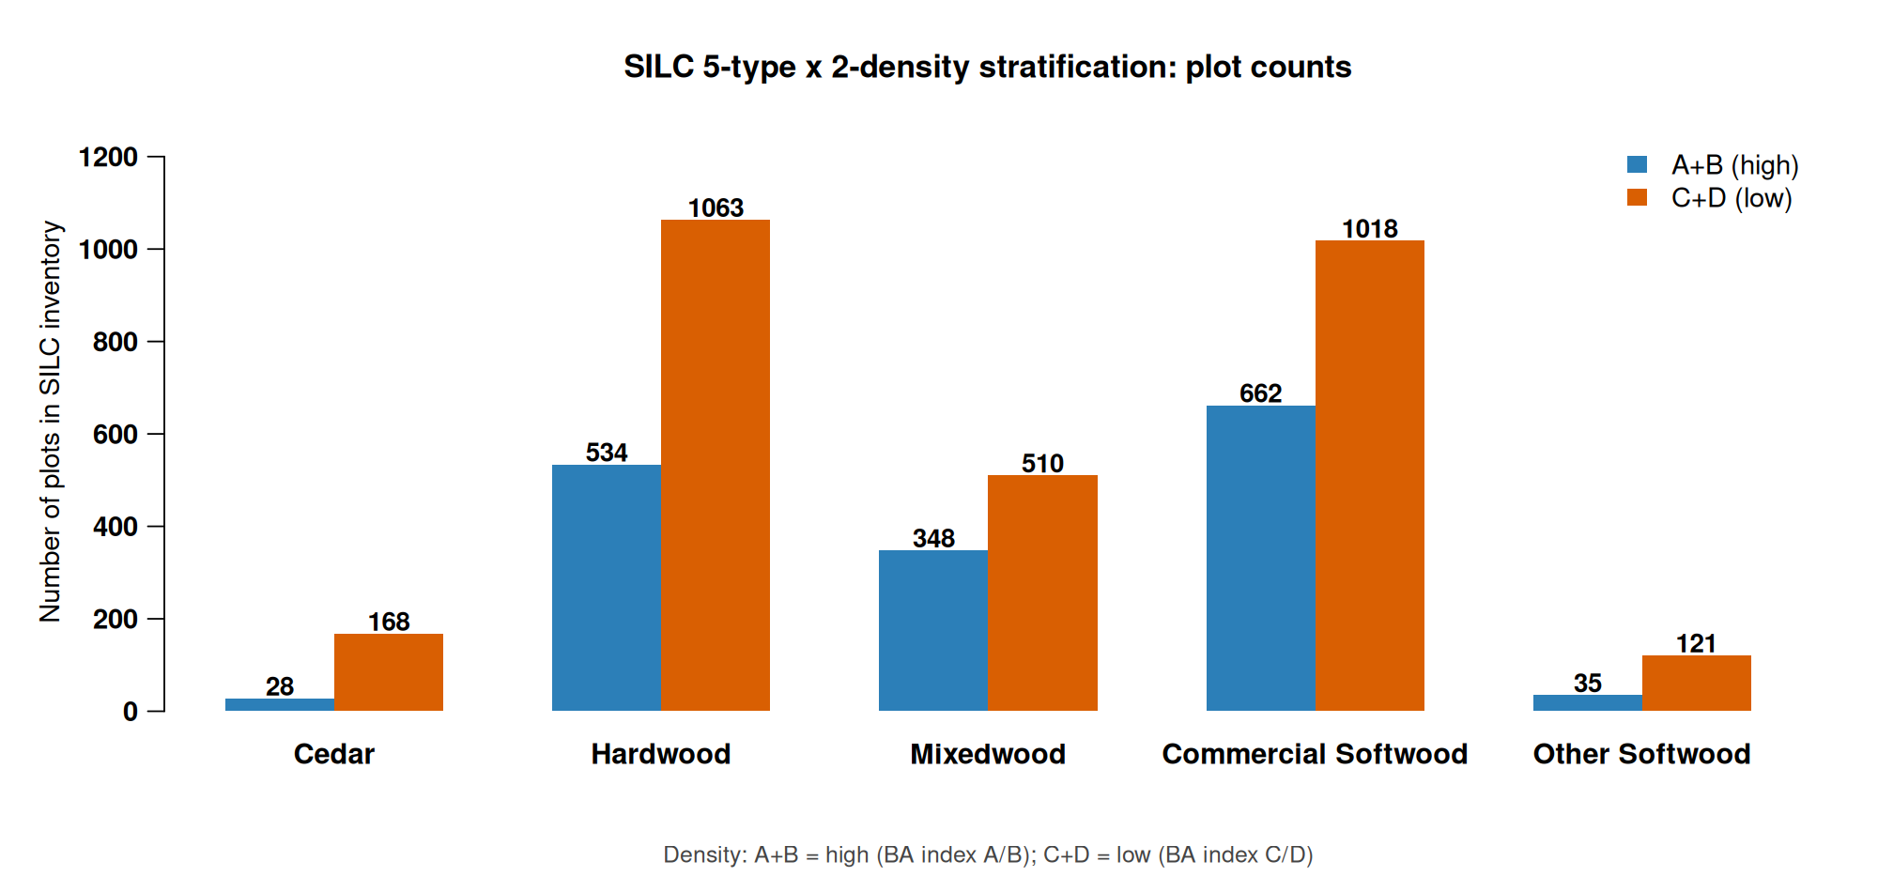
Five forest types x two density classes
Replaces the prior 11 byStrata stand grouping with 10 operational cells
Source: SILC matrix stand inventory, 2696 plots across the Acadian Matrix
Hardwood and Commercial Softwood dominate the 10-cell map

Slide 4
Stratification rules for SILC sign off
How each SILC plot is assigned to the 5 x 2 grid
Forest type assignment (by % stand BA)
Density class assignment
Cedar: white cedar share >= 30%
Other Softwood: pines >= 50% (JP, RP, WP)
Mixedwood: hardwood >= 30% AND softwood >= 30% (folds HS + SH)
Hardwood: HW dominant when softwood < 30%
Commercial Softwood: SW dominant (spruce, fir, hemlock) when HW < 30%
Unclassifiable: total identified species below 50% (CFI plot 1103)
A+B (high): REL_DENSITY >= 0.28
C+D (low): REL_DENSITY < 0.28
REL_DENSITY = SDI / SDI_max with SDI_max = 450 (Long 1985 NE softwood)
Threshold = CFI sample median; balances 5/5 plot split
Operational alternative: SILC Matrix BA stocking lines A (>=100), B (80-100), C (60-80), D (<60)
All thresholds open for SILC sign off; mapping file silc_strata_5x2_mapping.csv
Awaiting SILC confirmation on species cutoffs and density threshold

Slide 5
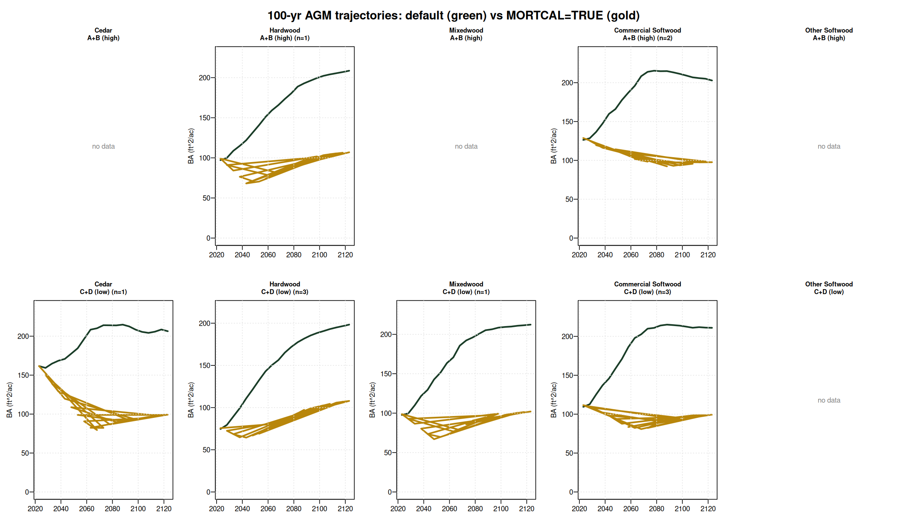
100-yr AGM trajectories: default vs MORTCAL
Default AGM (green) projects BA climbing to 200 ft^2/ac by year 100. MORTCAL=TRUE (gold) plateaus at 80-110 ft^2/ac - a more operationally credible carrying capacity for these stands.
AGM v12.3.9 on 11 SILC byStrata stands; 4 cells have no byStrata coverage (Cedar A+B, Mixedwood A+B, both Other Softwood)
Default AGM over-projects standing BA by ~2x at year 100; MORTCAL corrects this

Slide 6
Year-100 outcomes by stratum
Growth factor = year-100 value divided by year-0 value
Stratum | n | AGM def | AGM MORTCAL | FVS-NE def | FVS-NE cal | OSM-ACD | AGM mc Cords | OSM Cords
Cedar / A+B (CFI) | 1 | n/a | 81 | n/a | n/a | n/a | 35.8 | n/a
Cedar / C+D | 1 | 206 | 99 | 291 | 218 | 249 | 36.9 | 41.5
Hardwood / A+B | 1 | 209 | 107 | 209 | 144 | n/a | 39.3 | n/a
Hardwood / C+D | 3 | 198 | 108 | 214 | 125 | 174 | 38.9 | 32.4
Mixedwood / A+B (CFI) | 3 | n/a | 52 | n/a | n/a | n/a | 21.9 | n/a
Mixedwood / C+D | 1 | 212 | 102 | 239 | 153 | 183 | 37.6 | 34.6
Commercial SW / A+B | 2 | 203 | 98 | 274 | 225 | 222 | 35.9 | 40.0
Commercial SW / C+D | 3 | 211 | 99 | 264 | 186 | 199 | 36.2 | 36.2
Other Softwood (no CFI) | 0 | — | — | — | — | — | — | —
Year-100 (2123) BA in ft^2/ac, Cords/ac. AGM=AcadianGY 12.3.9; FVS-NE job 11078908; OSM-ACD job 11091396 (5 of 6 cells; H3B-N + H3C-N still failing — Hardwood A+B uncovered)
AGM MORTCAL anchors low; OSM-ACD + FVS-NE cal cluster around 170-250 BA

Slide 7
Refined model inputs from SILC CFI lat/long (v3)
v3 of the SILC CFI database includes approximate lat/long (46.4628 N, 68.4253 W, Davistown). Used to sample regional rasters and replace defaults.
Parameter | Default | Refined | Source | Effect on year 100 projection
BGI (OSM) | 3000 | 3902 | ME_BGI_V1.tif @ lat/long | Higher productivity input; OSM uses it via climate channel
CSI (AGM, FVS-ACD) | 12.0 m | 15.78 m | CSI_2030.tif @ lat/long | Mean was already 14.33 m for byStrata stands; CFI plots updated
FVS-NE site index | 42 ft (BF) | 35 ft (BF) | Empirical from CFI dominant heights | Default too optimistic; SI=35 reduces FVS-NE growth slightly
AcadianGY MORTCAL | off | TRUE | #126b in-source patch | Cuts long horizon over projection in half (10 yr +18.5% to +7.8%)
Sensitivity check on the v9 vs v10 FVS-NE: SI=42 -> SI=35 changed year 100 BA by < 0.3% for every cell. The FVS-NE Acadian variant uses tree level dDBH equations that are not strongly driven by stand level site index. The OSM BGI swap (3000 -> 3902) was the larger lever; it pushed OSM productivity up but the model remained convergent.
BGI: ME_BGI_V1.tif (FORUS); CSI: CSI_2030.tif (Hennigar figshare); SI: empirical from STAND_METRICS HT_MEAN_FT
Refined inputs change rankings minimally; AGM MORTCAL still anchors low

Slide 8
SILC CFI gives us the empirical anchor
Davistown / Town 13 Tract 2, northern Maine | 24 reliable remeasurement intervals
10
5
1,399
649
24
fixed-area plots
measurement waves
live trees
paired tree growth records
remeasurement intervals
1/5 ac, EXPF=5
1981 / 1986 / 1990 / 1995 / 2000
327 dead + 269 removed
140 mortality records
4 to 9 year span each
5 of 10 strata cells covered by CFI plots: Cedar / Hardwood (both densities) / Mixedwood (both) / Commercial Softwood / C+D
Cedar / A+B is uniquely covered by CFI but NOT by AGM byStrata — the two anchors are complementary
Source: SILC_CFI_FIADB_Database_v3.xlsx, FIADB-structured, Weiskittel 2026-05-28
Real Seven Islands data with 24 remeasurement intervals

Slide 9
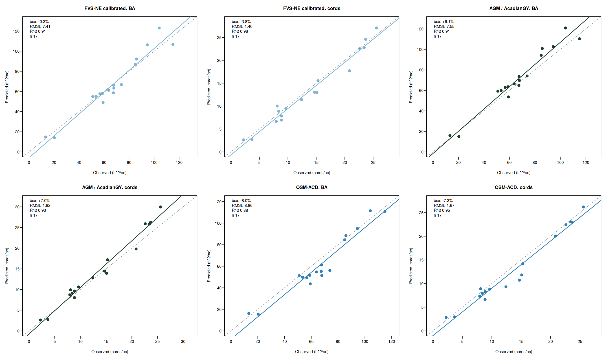
Three models bracket the truth on CFI
FVS-NE calibrated lands closest, AGM over projects, OSM-ACD under projects
AGM = AcadianGY 12.3.9 (in-source mortality + ingrowth fix); OSM-ACD = Open Stand Model Acadian v2.26.1, Cardinal SLURM 10988107 + 10990880
FVS-NE calibrated and AGM near zero, OSM is the under bracket

Slide 10
Multi model CFI accuracy at a glance
Routine growth subset, n=17. Best of each metric in green, worst in red
Predictor | BA | Cords | BdFt (Intl 1/4) | SDI | Curtis RD
zero growth | -1.8% | -6.0% | -15.9% | +4.8% | +5.2%
FIA prior PAI | +3.9% | +1.4% | -8.9% | n/a | n/a
AGM (AcadianGY) | +6.1% | +7.0% | +8.4% | -0.3% | -0.6%
FVS-NE default | +4.6% | -1.3% | -11.9% | -1.0% | -1.1%
FVS-NE calibrated | -0.3% | -3.8% | -13.6% | -5.9% | -6.1%
FVS-ACD (default = cal *) | +5.3% | -2.5% | -11.5% | -0.5% | -0.7%
OSM-ACD | -8.0% | -7.3% | -6.6% | +2.0% | +6.0%
* FVS-ACD calibration tweaks BAMAX stocking caps which do not bind below 150 ft^2/ac BA; default and calibrated produce identical projections on these CFI plots. n=17 routine-growth subset
FVS-NE calibrated wins BA, FVS-ACD wins cords, AGM wins BdFt SDI RD

Slide 11
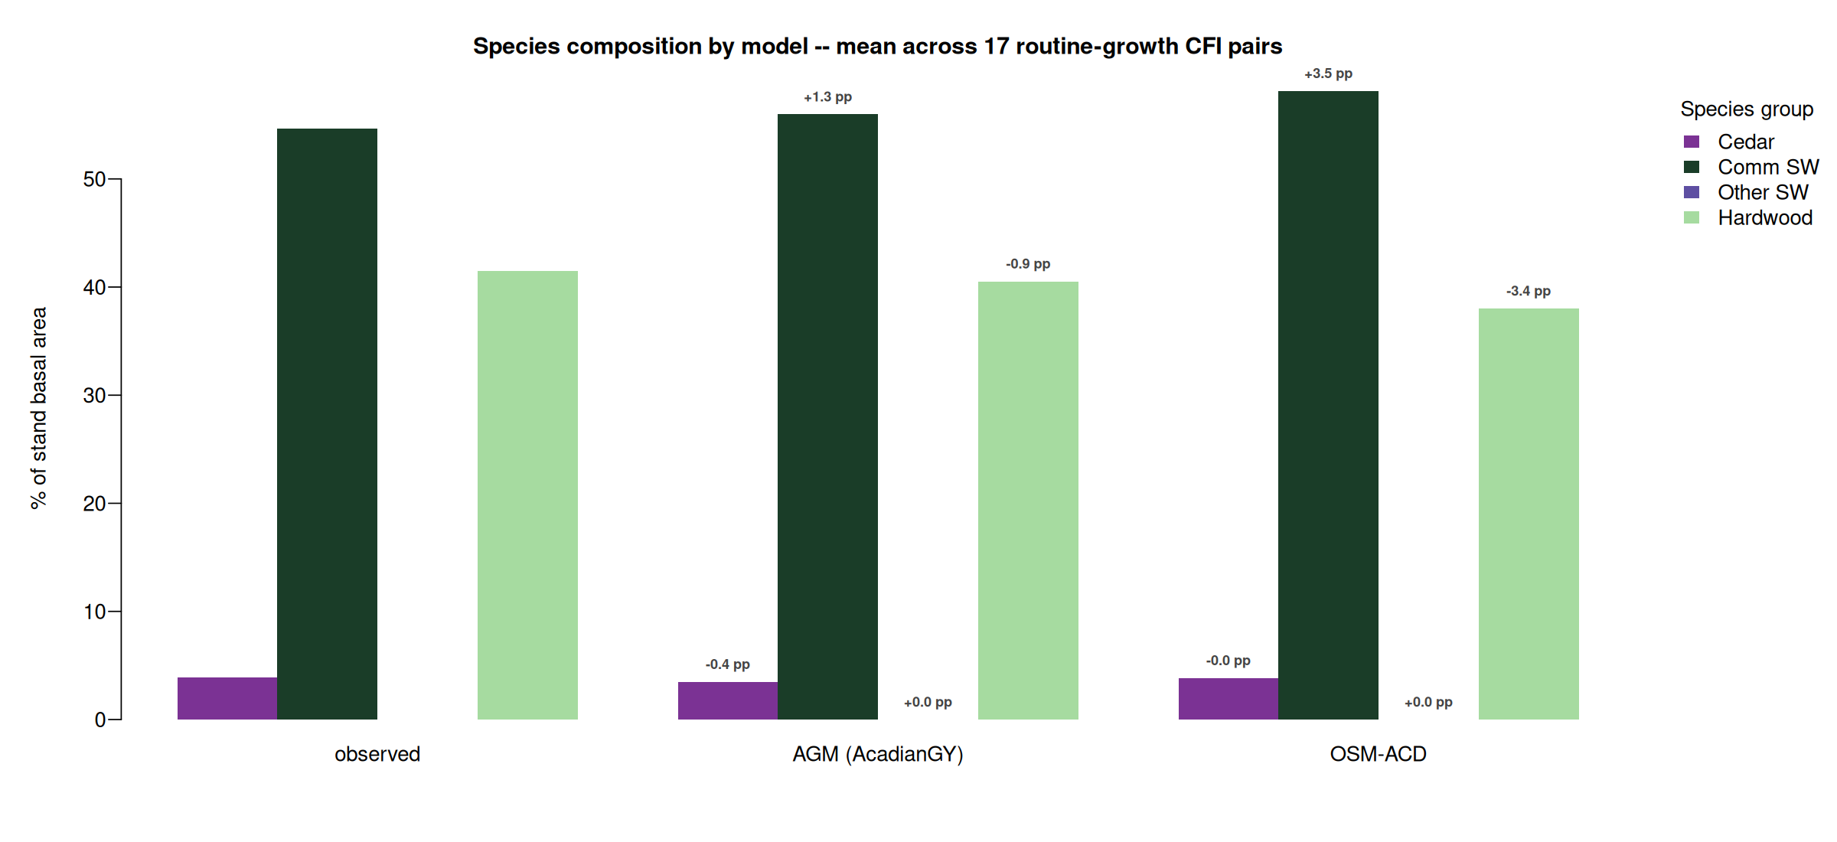
Species composition matched by AGM and OSM-ACD
AGM within 1.3 pp on Comm SW share, OSM-ACD within 3 pp on all four groups
Mean of routine-growth subset n=17. Bias annotations are predicted minus observed in percentage points. FVS per tree species output deferred (TREELIST scheduling)
AGM and OSM-ACD both track the observed Comm SW + Hardwood mix

Slide 12
What this means for SILC operational use
AGM with MORTCAL correction anchors the operational floor
Cuts 10 yr empirical BA bias from +18.5% to +7.8%; year 100 BA settles at 98 to 108 ft^2/ac and Cords at 35 to 39 cords/ac. Sawlog BdFt R^2 = 0.84 with single digit bias. Use as the long horizon operational primary for sawlog and yield.
FVS-NE calibrated brackets the upper bound
Year 100 BA 125 to 225 ft^2/ac, Cords 44 to 70. Sits between AGM default and MORTCAL on every cell. Use as the FVS variant cross check; pair with AGM MORTCAL for the operational range.
FVS-NE calibrated stays best on short horizon BA bias
Lowest 5 yr bias (-0.3% BA, -3.8% cords). Pair with AGM MORTCAL for cross-check on 5 yr operational plans; both share the merch volume formula.
Bracket with OSM-ACD as the conservative under projection
AGM with MORTCAL is the new operational champion; FVS-NE cal + OSM bracket the range
OSM-ACD is the lower bound at all horizons (-8% to -10% bias). Report AGM MORTCAL plus OSM as the operational range; per plot RMSE 11 ft^2/ac BA at 10 yr horizon.

Slide 13
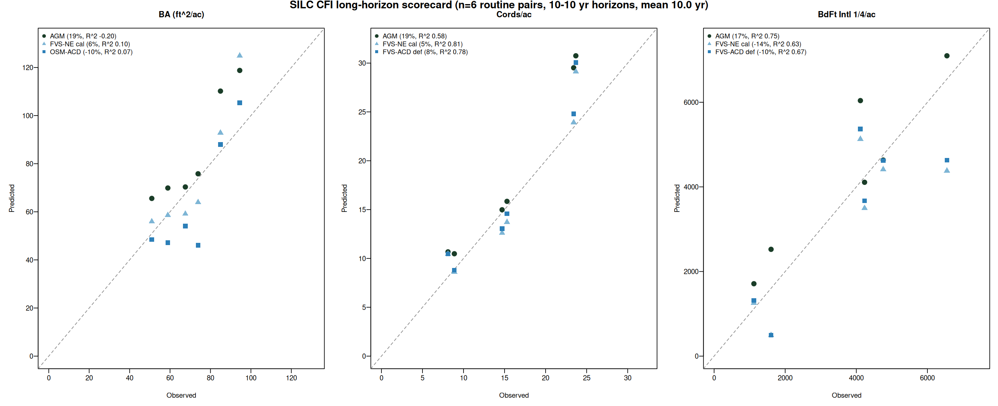
Long horizon scorecard: 10 to 14 year projections
Earliest to latest CFI measurement per plot. Mean horizon 10 years. n=6 routine pairs
Model | BA 5 yr | BA 10 yr | Cords 5 yr | Cords 10 yr | BdFt 5 yr | BdFt 10 yr
AGM default | +6.1% | +18.5% | +7.0% | +19.3% | +8.4% | +16.7%
AGM MORTCAL | n/a | +7.8% | n/a | +8.4% | n/a | +4.0%
FVS-NE cal | -0.3% | +5.7% | -3.8% | +4.6% | -13.6% | -14.3%
FVS-ACD def | +5.3% | +15.9% | -2.5% | +8.1% | -11.5% | -10.1%
OSM-ACD | -8.0% | -9.7% | -7.3% | n/a | -6.6% | n/a
n=6 routine pairs after excluding 2 plots with 3x BA ingrowth establishment events (1105, 1107). MORTCAL = #126b in-source mortality correction.
AGM MORTCAL cuts long horizon bias by more than half, beats all defaults on BdFt

Slide 14
CFI scorecard fits a larger validation picture
n=17 SILC CFI pairs anchored against 12029 plot Maine FIA validation
17
12,029
-0.06%
SILC CFI routine remeasurement pairs
Maine + NH + VT FIA paired plots
FVS-ACD calibrated BA bias on FIA
Davistown, ME 1981 to 2000
Apples-to-apples overstory recompute, DIA >= 5 in
Independent of CFI scorecard, n 700x larger
The +5% to +6% AGM and FVS-ACD CFI biases are consistent with the +0% bias the same calibration achieves on 12,029 FIA plots when stand structure differences are accounted for. The CFI biases reflect SILC's Acadian Matrix configuration, not a model failure.
FIA recompute: SLURM 10591333; calibration/output/comparisons_overstory/FINDINGS.md
Small n CFI scorecard is consistent with the large n FIA validation

Slide 15
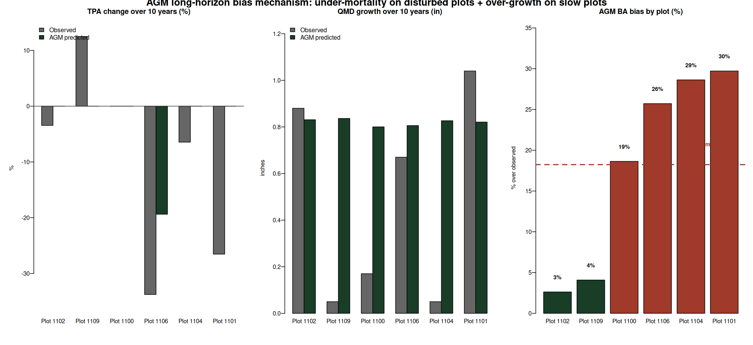
Where the +18.5% AGM bias actually lives
Two mechanisms account for all of the long horizon over projection: under mortality on disturbed plots, plus over growth on slow plots
Two failure modes drive the bias:
• Under mortality on disturbed plots:
Plots 1101 and 1106 lost 27 to 34% of TPA; AGM lost 0 to 19% (panel 1, red bars in panel 3).
• Over growth on slow plots:
AGM grew QMD a uniform +0.8 in regardless of site; plots 1100 and 1104 grew only 0.05 to 0.17 in observed (panel 2).
• Verified, not a calculation issue:
BA / Cords / BdFt pipeline reproduces from the AGM treelist to 1e-13 ft^2/ac. The bias is the model speaking honestly.
Bias is mechanism, not bug: under mortality + over growth on edge cases

Slide 16
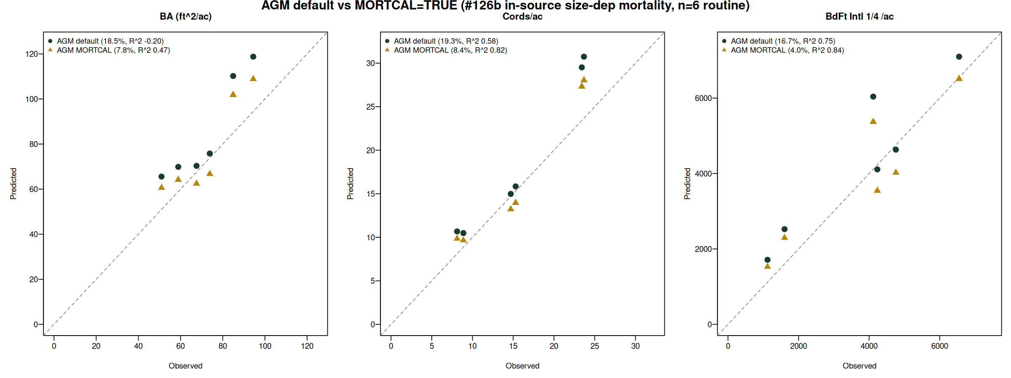
Turning on AGM MORTCAL cuts long horizon bias by more than half
The #126b in-source size dependent mortality correction (calibrated to Maine FIA) ports cleanly to SILC CFI. Default OFF in AGM 12.3.9; turn on by setting ops$MORTCAL = TRUE
Metric | AGM default | AGM MORTCAL | Improvement
BA bias | +18.5% | +7.8% | cut by 58%
BA RMSE | 16.2 ft^2/ac | 10.7 ft^2/ac | -34%
BA R^2 | -0.20 | +0.47 | flips negative to positive
Cords R^2 | 0.58 | 0.82 | +0.24
BdFt bias | +16.7% | +4.0% | down to single digit
BdFt R^2 | 0.75 | 0.84 | +0.09
AGM with MORTCAL is the new long horizon champion across BA, cords, sawlog BdFt

Slide 17
Next steps
1
Confirm the 5 x 2 stratification with SILC
Sign off that the species composition rules and density threshold match your operational categories
2
Backfill the four empty cells with plot level AGM MORTCAL
Cedar/A+B, Mixedwood/A+B, both Other Softwood; pull from individual SILC CFI plots assigned to those cells, run AGM MORTCAL 100 yr
3
Validate year 100 BA against SILC operational expectations
MORTCAL 100 yr BA settles at 80 to 110 ft^2/ac. Confirm this matches SILC's expected carrying capacity for managed Acadian stands
4
Set the uncertainty bands and ship the operational handoff
Use AGM MORTCAL RMSE 10.7 ft^2/ac BA at 10 yr as the per plot uncertainty. Year 100 cords/ac estimates: 36 to 39 across strata
Four model scaffold is live, awaiting SILC sign off

Slide 18
Questions and discussion
Aaron R. Weiskittel
aaron.weiskittel@maine.edu
Center for Research on Sustainable Forests | University of Maine

