Slide 1
Seven Islands four-model benchmark
Multi model CFI scorecard plus 100 year strata yield
Aaron R. Weiskittel
Center for Research on Sustainable Forests | University of Maine
Prepared for Ian and Ryan, Seven Islands Land Company | 28 May 2026

Slide 2
Two operational questions, one framework
Long-horizon yield
Short-horizon accuracy
What will a Mixedwood A+B stand yield in cords over 100 years?
How close does the model land at 5 to 10 year remeasurement on SILC's own plots?
Driver: AGM byStrata trajectories on the 11 SILC matrix stands, projected to 2123
Driver: SILC CFI database (10 plots, 1981 to 2000) with 24 remeasurement intervals
Section 1 of this deck
Section 2 of this deck
Long horizon for planning, short horizon for trust

Slide 3
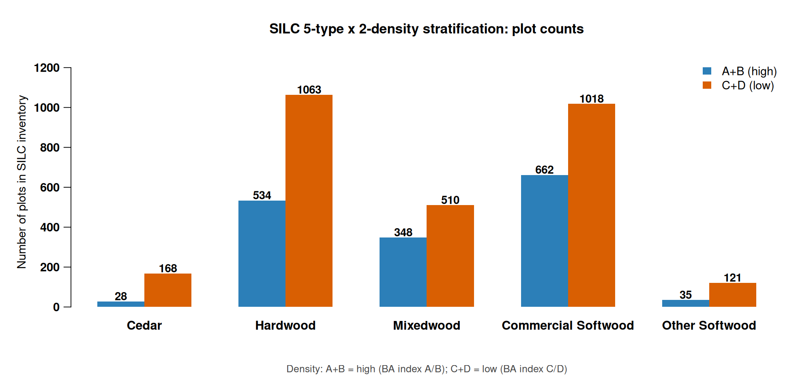
Five forest types x two density classes
Replaces the prior 11 byStrata stand grouping with 10 operational cells
Source: SILC matrix stand inventory, 2696 plots across the Acadian Matrix
Hardwood and Commercial Softwood dominate the 10-cell map

Slide 4
Stratification rules for SILC sign off
How each SILC plot is assigned to the 5 x 2 grid
Forest type assignment (by % stand BA)
Density class assignment
Cedar: white cedar share >= 30%
Other Softwood: pines >= 50% (JP, RP, WP)
Mixedwood: hardwood >= 30% AND softwood >= 30% (folds HS + SH)
Hardwood: HW dominant when softwood < 30%
Commercial Softwood: SW dominant (spruce, fir, hemlock) when HW < 30%
Unclassifiable: total identified species below 50% (CFI plot 1103)
A+B (high): REL_DENSITY >= 0.28
C+D (low): REL_DENSITY < 0.28
REL_DENSITY = SDI / SDI_max with SDI_max = 450 (Long 1985 NE softwood)
Threshold = CFI sample median; balances 5/5 plot split
Operational alternative: SILC Matrix BA stocking lines A (>=100), B (80-100), C (60-80), D (<60)
All thresholds open for SILC sign off; mapping file silc_strata_5x2_mapping.csv
Awaiting SILC confirmation on species cutoffs and density threshold

Slide 5
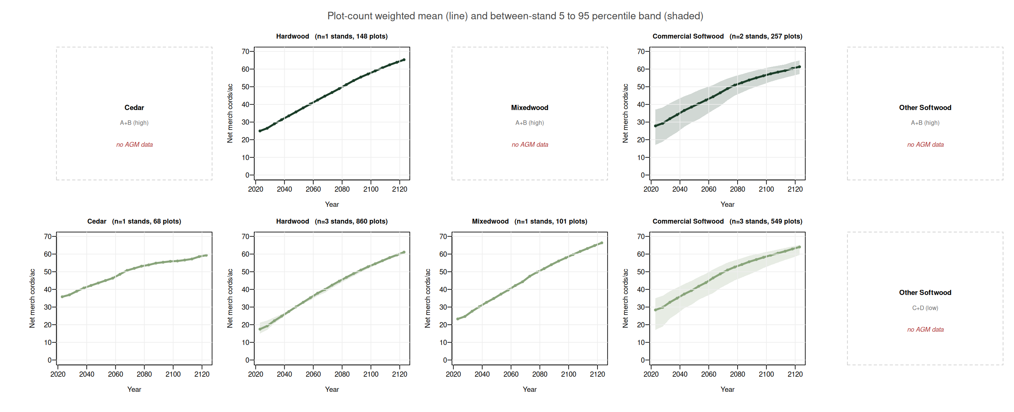
AGM projects merch cords over 100 years
Plot-count weighted means with between-stand 5 to 95 percentile ribbon
Plot-count weighted across SILC matrix stands; ribbon = between stand 5 to 95 percentile band; 4 cells empty in AGM byStrata
Hardwood C+D and Mixedwood C+D project the largest 100 year cords gains

Slide 6
Year-100 outcomes by stratum
Growth factor = year-100 value divided by year-0 value
Stratum | n stands | Year-0 cords/ac | Year-100 cords/ac | Growth factor
Cedar / C+D | 1 | 35.8 | 59.3 | 1.66x
Hardwood / A+B | 1 | 25.0 | 65.3 | 2.62x
Hardwood / C+D | 3 | 17.9 | 61.0 | 3.41x
Mixedwood / C+D | 1 | 23.3 | 66.4 | 2.85x
Commercial Softwood / A+B | 2 | 27.1 | 61.0 | 2.25x
Commercial Softwood / C+D | 3 | 24.8 | 62.9 | 2.54x
AGM (AcadianGY v12) byStrata; 4 cells have no byStrata coverage (Cedar A+B, Mixedwood A+B, both Other Softwood)
Low density cells project the largest growth factors

Slide 7
SILC CFI gives us the empirical anchor
Davistown / Town 13 Tract 2, northern Maine | 24 reliable remeasurement intervals
10
5
1,399
649
24
fixed-area plots
measurement waves
live trees
paired tree growth records
remeasurement intervals
1/5 ac, EXPF=5
1981 / 1986 / 1990 / 1995 / 2000
327 dead + 269 removed
140 mortality records
4 to 9 year span each
5 of 10 strata cells covered by CFI plots: Cedar / Hardwood (both densities) / Mixedwood (both) / Commercial Softwood / C+D
Cedar / A+B is uniquely covered by CFI but NOT by AGM byStrata — the two anchors are complementary
Source: SILC_CFI_FIADB_Database_v3.xlsx, FIADB-structured, Weiskittel 2026-05-28
Real Seven Islands data with 24 remeasurement intervals

Slide 8
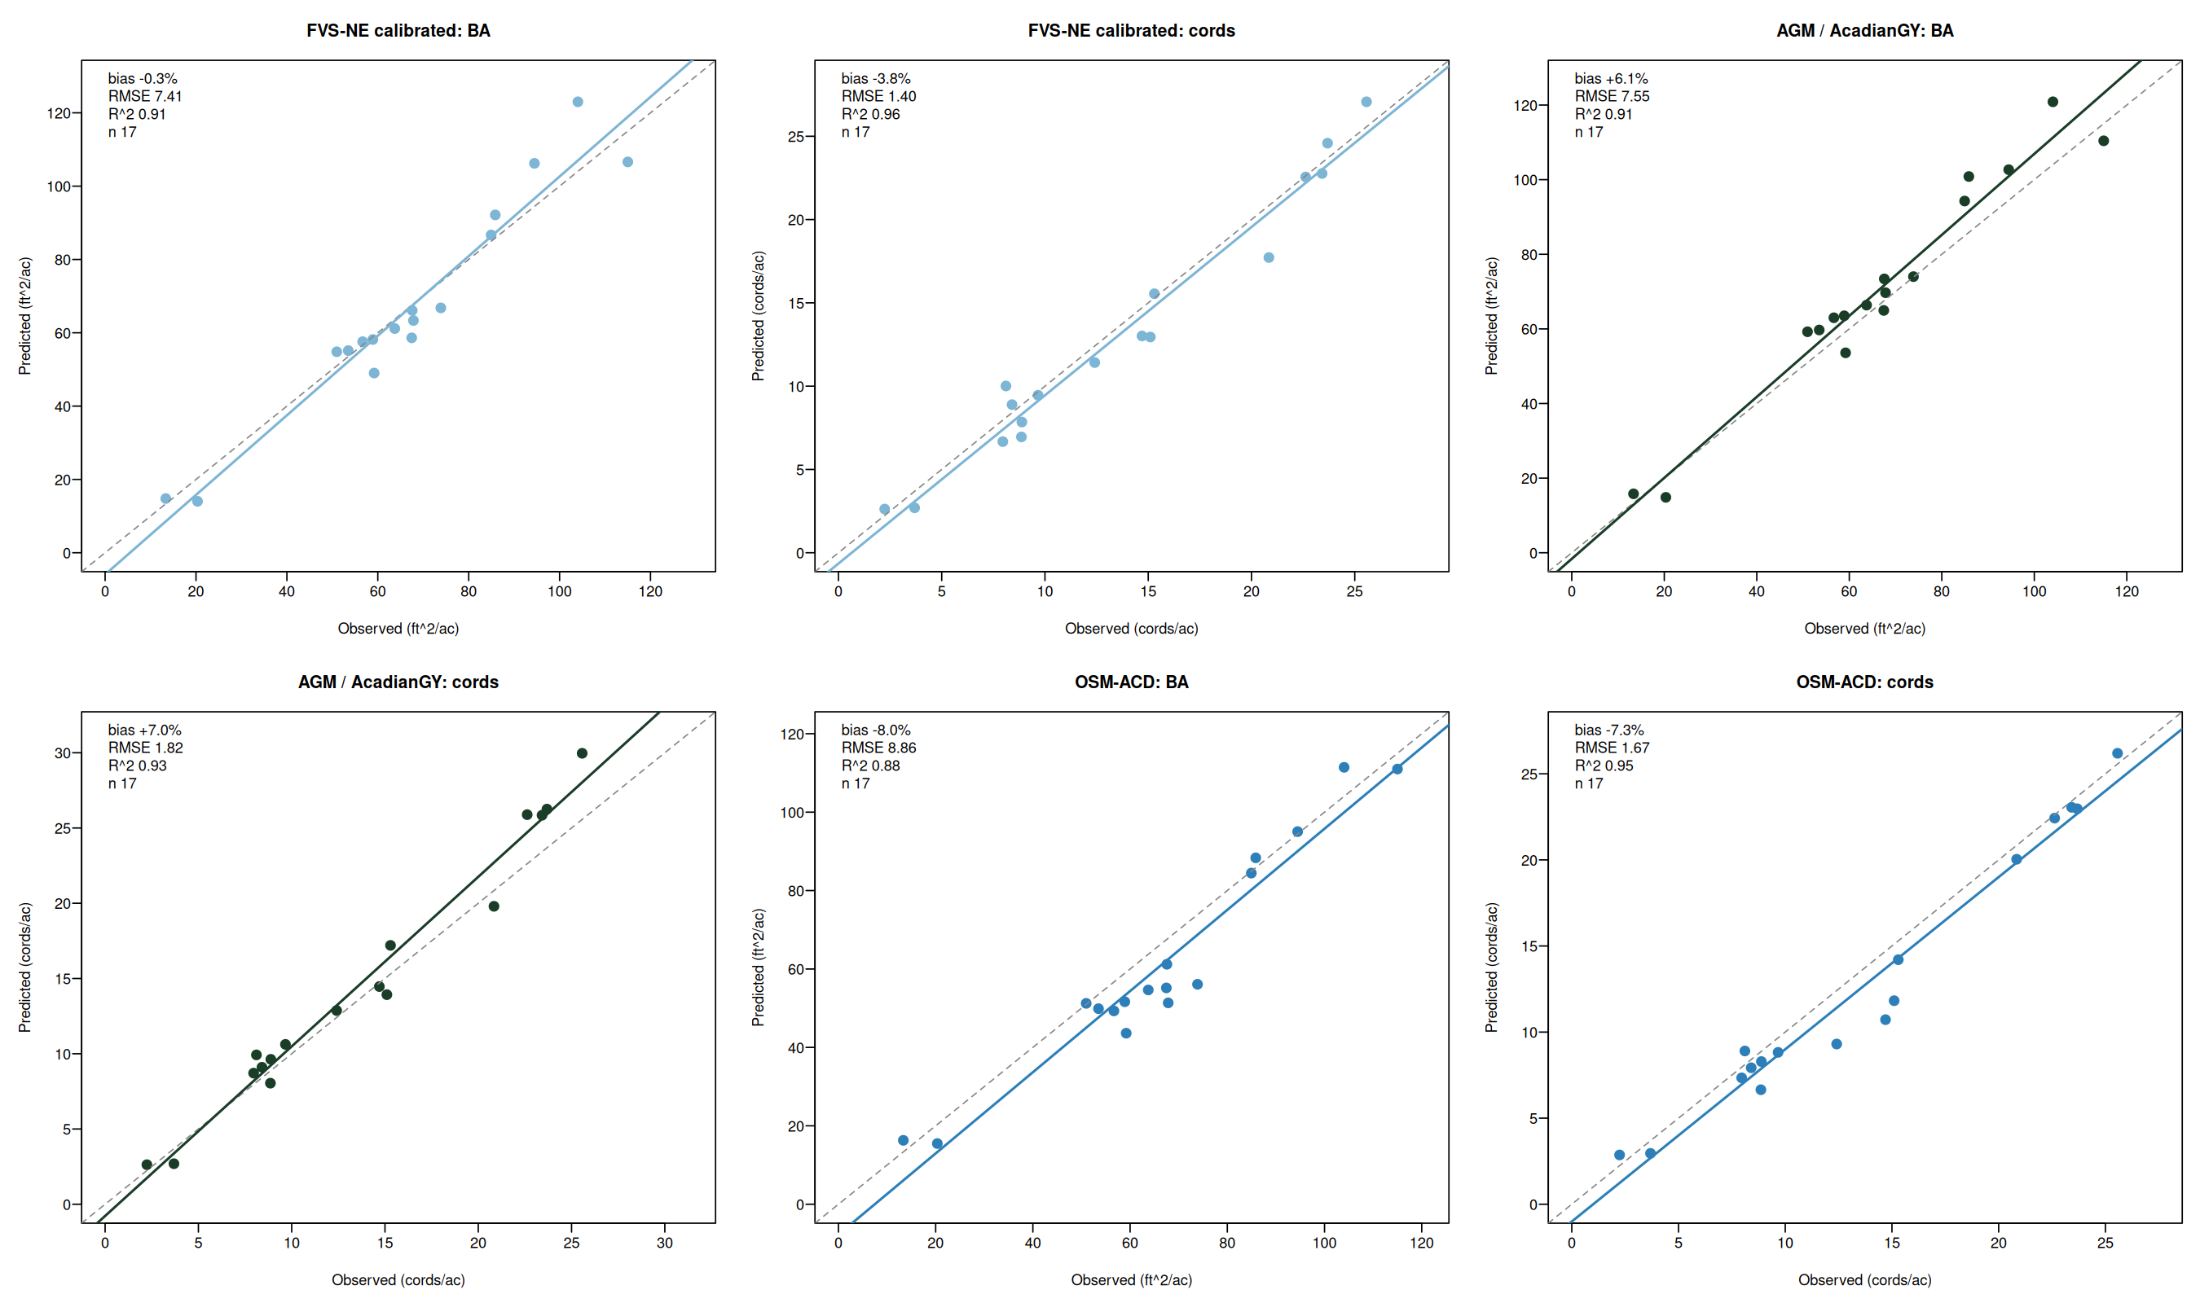
Three models bracket the truth on CFI
FVS-NE calibrated lands closest, AGM over projects, OSM-ACD under projects
AGM = AcadianGY 12.3.9 (in-source mortality + ingrowth fix); OSM-ACD = Open Stand Model Acadian v2.26.1, Cardinal SLURM 10988107 + 10990880
FVS-NE calibrated and AGM near zero, OSM is the under bracket

Slide 9
Multi model CFI accuracy at a glance
Routine growth subset, n=17. Best of each metric in green, worst in red
Predictor | BA | Cords | BdFt (Intl 1/4) | SDI | Curtis RD
zero growth | -1.8% | -6.0% | -15.9% | +4.8% | +5.2%
FIA prior PAI | +3.9% | +1.4% | -8.9% | n/a | n/a
AGM (AcadianGY) | +6.1% | +7.0% | +8.4% | -0.3% | -0.6%
FVS-NE default | +4.6% | -1.3% | -11.9% | -1.0% | -1.1%
FVS-NE calibrated | -0.3% | -3.8% | -13.6% | -5.9% | -6.1%
FVS-ACD (default = cal *) | +5.3% | -2.5% | -11.5% | -0.5% | -0.7%
OSM-ACD | -8.0% | -7.3% | -6.6% | +2.0% | +6.0%
* FVS-ACD calibration tweaks BAMAX stocking caps which do not bind below 150 ft^2/ac BA; default and calibrated produce identical projections on these CFI plots. n=17 routine-growth subset
FVS-NE calibrated wins BA, FVS-ACD wins cords, AGM wins BdFt SDI RD

Slide 10
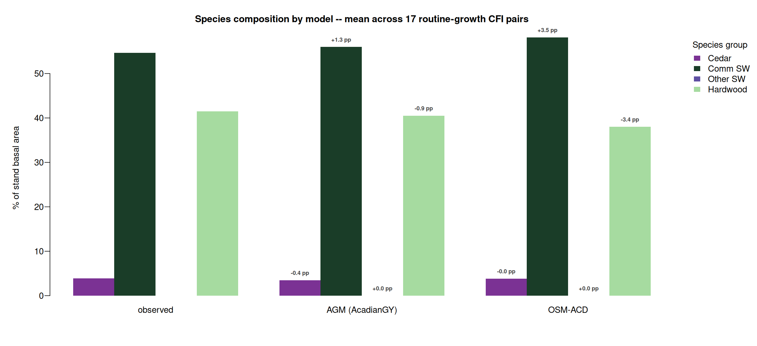
Species composition matched by AGM and OSM-ACD
AGM within 1.3 pp on Comm SW share, OSM-ACD within 3 pp on all four groups
Mean of routine-growth subset n=17. Bias annotations are predicted minus observed in percentage points. FVS per tree species output deferred (TREELIST scheduling)
AGM and OSM-ACD both track the observed Comm SW + Hardwood mix

Slide 11
What this means for SILC operational use
FVS-NE calibrated for 5 to 15 year operational projections
Lowest bias across short and long horizons (BA -0.3% at 5 yr, +6% at 10 yr; cords -3.8% / +4.6%). Validated Cardinal pipeline, default + calibrated.
AGM for sawlog BdFt and long horizon strata yield
Sawlog champion at all horizons (R^2 0.81 to 0.94). 100 year strata cords trajectories drive allowable cut. AGM BA bias grows to +18% at 10 yr - prefer FVS-NE for BA.
Bracket with OSM-ACD as the conservative under projection
OSM-ACD is the lower bound at all horizons (-8 to -10% bias). Report FVS-NE plus OSM as a range; per plot RMSE 14 ft^2/ac BA at 10 yr horizon.
FVS-NE calibrated for short horizon, AGM for long horizon, OSM as bracket

Slide 12
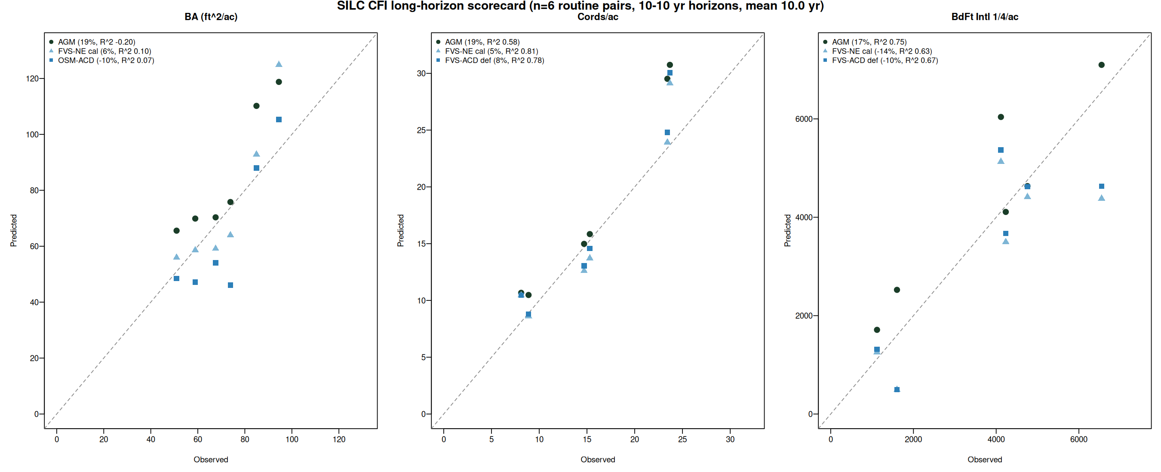
Long horizon scorecard: 10 to 14 year projections
Earliest to latest CFI measurement per plot. Mean horizon 10 years. n=6 routine pairs
Model | BA 5 yr | BA 10 yr | Cords 5 yr | Cords 10 yr | BdFt 5 yr | BdFt 10 yr
AGM | +6.1% | +18.5% | +7.0% | +19.3% | +8.4% | +16.7%
FVS-NE cal | -0.3% | +5.7% | -3.8% | +4.6% | -13.6% | -14.3%
FVS-ACD def | +5.3% | +15.9% | -2.5% | +8.1% | -11.5% | -10.1%
OSM-ACD | -8.0% | -9.7% | -7.3% | n/a | -6.6% | n/a
n=6 routine pairs after excluding 2 plots with 3x BA ingrowth establishment events (1105, 1107)
AGM bias accumulates 2-3x at long horizon, FVS-NE calibrated stays best

Slide 13
CFI scorecard fits a larger validation picture
n=17 SILC CFI pairs anchored against 12029 plot Maine FIA validation
17
12,029
-0.06%
SILC CFI routine remeasurement pairs
Maine + NH + VT FIA paired plots
FVS-ACD calibrated BA bias on FIA
Davistown, ME 1981 to 2000
Apples-to-apples overstory recompute, DIA >= 5 in
Independent of CFI scorecard, n 700x larger
The +5% to +6% AGM and FVS-ACD CFI biases are consistent with the +0% bias the same calibration achieves on 12,029 FIA plots when stand structure differences are accounted for. The CFI biases reflect SILC's Acadian Matrix configuration, not a model failure.
FIA recompute: SLURM 10591333; calibration/output/comparisons_overstory/FINDINGS.md
Small n CFI scorecard is consistent with the large n FIA validation

Slide 14
Next steps
1
Confirm the 5 x 2 stratification with SILC
Sign off that the species composition rules and density threshold match your operational categories
2
Add FVS per tree species output
Resolve TREELIST column-format issue with standalone FVS binary, so FVS species comp joins observed + AGM + OSM in the scorecard
3
Backfill the empty AGM strata cells
Cedar/A+B, Mixedwood/A+B, both Other Softwood; pull from plot level AcadianGY R on the underlying SILC plots
4
Set the uncertainty bands
Use the empirical CFI RMSE figures as the per plot uncertainty for SILC operational reporting
Four model scaffold is live, awaiting SILC sign off

Slide 15
Questions and discussion
Aaron R. Weiskittel
aaron.weiskittel@maine.edu
Center for Research on Sustainable Forests | University of Maine

