Slide 1
A configuration catalog for fvs-modern across the FVS variants of the conterminous United States
Bakuzis admissibility gates, a stress test of every verdict, and a selector
Aaron R. Weiskittel, Center for Research on Sustainable Forests, University of Maine
October 29, 2026; revised October 30, 2026
Notes:
Deck accompanies the CRSF technical report of the same date and the Zenodo record. Method: modified Bakuzis matrix after Leary (1997), Ecological Modelling 98:35-46.

Slide 2
The question a user asks
▪ fvs-modern runs every FVS variant with native mortality or GOMPIT crown closure survival, and with default or Bayesian calibrated MAP parameters: four arms per variant.
▪ The Bakuzis work so far tested NE and ACD on a synthetic 36 cell design and the NE Paper 2 cohort. Nothing said which arm to use in the other twenty variants.
▪ On October 28 a six argument GOMPSURV interface was found updated in one mortality routine and not the other 21: every GOMPIT result outside NE, CS and LS since July 25 read undefined memory. Fixed, 22 libraries rebuilt.
▪ So: can a user pick survival model and parameter set for their variant on evidence? The catalog is that evidence.
Admissible means:
stays inside the FIA fitting envelope for 50 and 100 years,
self-thins the way Reineke says,
does not pass the ceiling by killing the stand,
and is a real alternative to default.
Source: fvs-modern main, validation/bakuzis_stress_v2/ (gates_v8, stress_v8) and config/catalog/ (October 30, 2026, catalog version 1.2.0, catalog v8)
2

Slide 3
What was run
▪ Stand sample: up to 300 FIA plots per variant from the fvs-conus pairs frame (17 variants; ACD takes NE plots in ME, NH and VT, an assumption). Trees expanded by the condition's share of each plot size (MICRPROP, SUBPPROP, MACRPROP_UNADJ), species outside the variant relabelled to its other softwood or hardwood code.
▪ Year zero gate: engine basal area within 20 percent of FIA BALIVE (or 1 ft2 ac-1). The first catalog failed 263 eastern stands; the cause was phantom trees (FIA live records with null TPA_UNADJ filled at 6.0 TPA by the stand generator), fixed October 29, and all 4,748 sampled stands now pass.
▪ Four engine arms x 100 years at a 5 year step, no regeneration (NOAUTOES in EM and IE), no posterior draws. Cardinal arrays 15976824 and 15984133 after library build 15967530 with the GOMPSURV fix; calibrated arms rerun October 30 (array 16016015) after the overlay fix, then all four arms (array 16023222) after the plot-size expansion fix.
▪ Thresholds: plot level FIA percentiles by variant (BA p50, p99, p99.9; SDI p99.9). Age censored, so the 50 year horizon is primary.
▪ Projector arms (fvs-conus b1, b2 by native and GOMPIT) listed for comparison from the October 27 rescore, not on the common sample.
Source: fvs-modern main, validation/bakuzis_stress_v2/ (gates_v8, stress_v8) and config/catalog/ (October 30, 2026, catalog version 1.2.0, catalog v8)
3

Slide 4
The pre-registered rule (fixed before any run was scored)
Gate | Test on seed passing stands | Why it is there
Magnitude, BA | < 5 percent of stands above FIA BA p99.9 by year 50, Wilson 95 percent upper bound < 10 percent | The envelope the engine was fit to
Magnitude, SDI | Same for the SDI p99.9 | A second axis of the same envelope
Reineke | Flag rate among trajectories above relative density 0.55 under 10 percent, on at least 10 evaluated; fewer is NOT TESTED and inadmissible | Self-thinning is the strong law
Stocking | Median year 50 BA at or above FIA p50 | Catches an arm that passes the ceilings by killing the stand
Distinct | Calibrated trajectories differ from default | Caught ACD and IE, whose calibrated block never loaded
Choice | Simplest admissible arm (default before calibrated, native before GOMPIT); NE prefers GOMPIT on the Paper 2 near term cohort | Simplicity is the only tie break outside NE
Alternative Reineke gate (Wilson upper bound < 25 percent on at least 30 evaluated) is carried beside the primary rule in the gate table and flags seven rule sensitive variants. The catalog ships under the primary rule (decision of October 29, 2026) because the alternative admits western arms by declining to test their self-thinning.
Source: fvs-modern main, validation/bakuzis_stress_v2/ (gates_v8, stress_v8) and config/catalog/ (October 30, 2026, catalog version 1.2.0, catalog v8)
4

Slide 5
What the blind red team changed before the catalog shipped
▪ Plan review, seven confirmed defects folded in: one common stand sample per variant, a 50 year primary horizon with Wilson bounds, an under stocking lower bound, one shared variant assignment, projector GOMPIT confirmed R side.
▪ Output review of the first catalog (PR 120), four defects that each made the gates easier than the README claimed; regenerated rather than patched:
▪ the under stocking bound used the 100 year peak, which includes year 0 and could not fail; now the median year 50 BA against the p50
▪ a Reineke gate with under 10 evaluated trajectories passed as NA; now NOT TESTED (this removed TT default GOMPIT, which had been RECOMMENDED on 5 trajectories)
▪ stands failing the year 0 gate were scored; now excluded, with the Reineke counts on the same stands
▪ ACD and IE calibrated arms equalled default: the keyword loader raised on their per species BAMAX array; loader fixed, both rerun, a distinctness check added everywhere
▪ The same review explained the seeding failures carried since Section 14: partial conditions expanded per plot acre (the exact 0.75), and an all plot fallback in the runner. Both gone.
Source: fvs-modern main, validation/bakuzis_stress_v2/ (gates_v8, stress_v8) and config/catalog/ (October 30, 2026, catalog version 1.2.0, catalog v8)
5

Slide 6
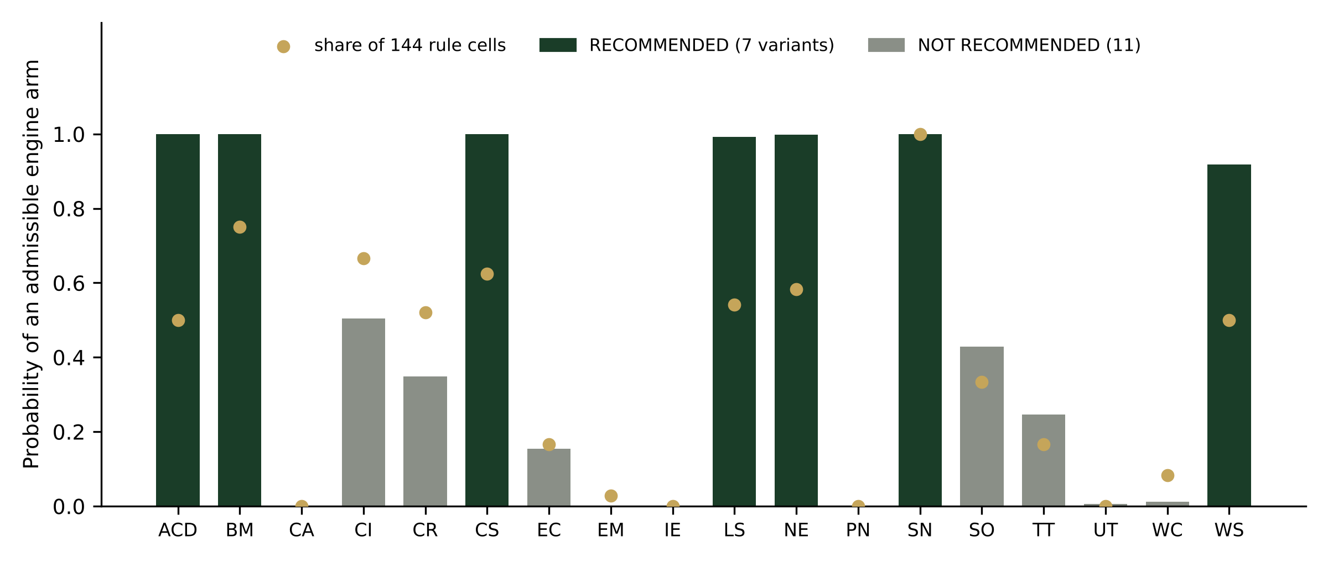
Seven variants have an admissible fvs-modern arm, eleven do not
▪ RECOMMENDED: ACD, BM, CS, NE, SN (all four arms), LS (calibrated arms), WS (calibrated native).
▪ NOT RECOMMENDED: CA, CI, CR, EC, EM, IE, PN, SO, TT, UT, WC. In eight of them every arm passes magnitude and stocking and fails on Reineke alone.
▪ Magnitude passes almost everywhere: BA p99.9 exceedance at or below 1.7 percent in 14 of 18 variants, SDI never above 5.3 percent, lower bound passes in every arm.
▪ AK and NC: no fitting plots, NOT EVALUATED.
Bars: probability of at least one admissible engine arm over 500 stand bootstraps. Points: share of 144 alternative rule cells. Data: stress_by_variant.csv.
Source: fvs-modern main, validation/bakuzis_stress_v2/ (gates_v8, stress_v8) and config/catalog/ (October 30, 2026, catalog version 1.2.0, catalog v8)
6

Slide 7
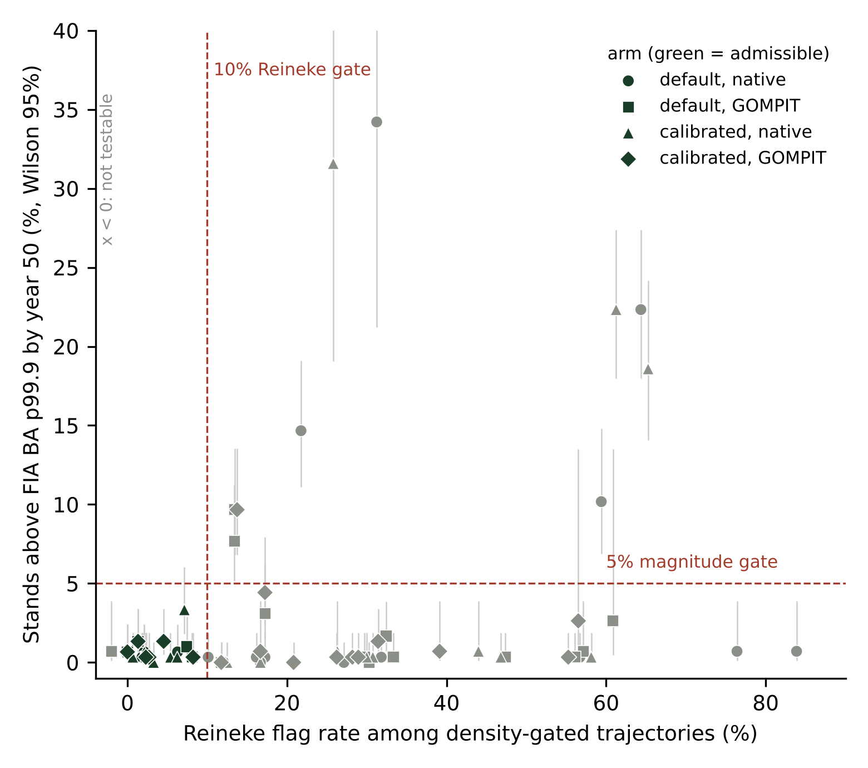
The two gates that decide: 72 engine arms in one plane
▪ Green symbols are admissible. Nearly every arm sits under the 5 percent magnitude line; the Reineke axis sorts them.
▪ Exceptions on magnitude: EM native (22 and 22 percent) and EM GOMPIT (8 and 10), LS default (15 and 10), WC native (10 and 19), PN native (34 and 32 on 38 stands).
▪ Reineke failures come in two forms: default native arms that do not self-thin (CA, TT, UT, WC, EM, CR: median slopes -0.83 to -1.46, flag rates 27 to 84 percent), and calibrated GOMPIT arms whose median slope is right (-1.56 to -1.90) but dispersed (14 to 39 percent flagged).
▪ Western samples are thin on the self-thinning limb: 18 to 202 density gated trajectories per variant; SO rests on 17 to 18, TT on 7 to 31.
Source: fvs-modern main, validation/bakuzis_stress_v2/ (gates_v8, stress_v8) and config/catalog/ (October 30, 2026, catalog version 1.2.0, catalog v8); catalog_gates_by_arm.csv
7

Slide 8
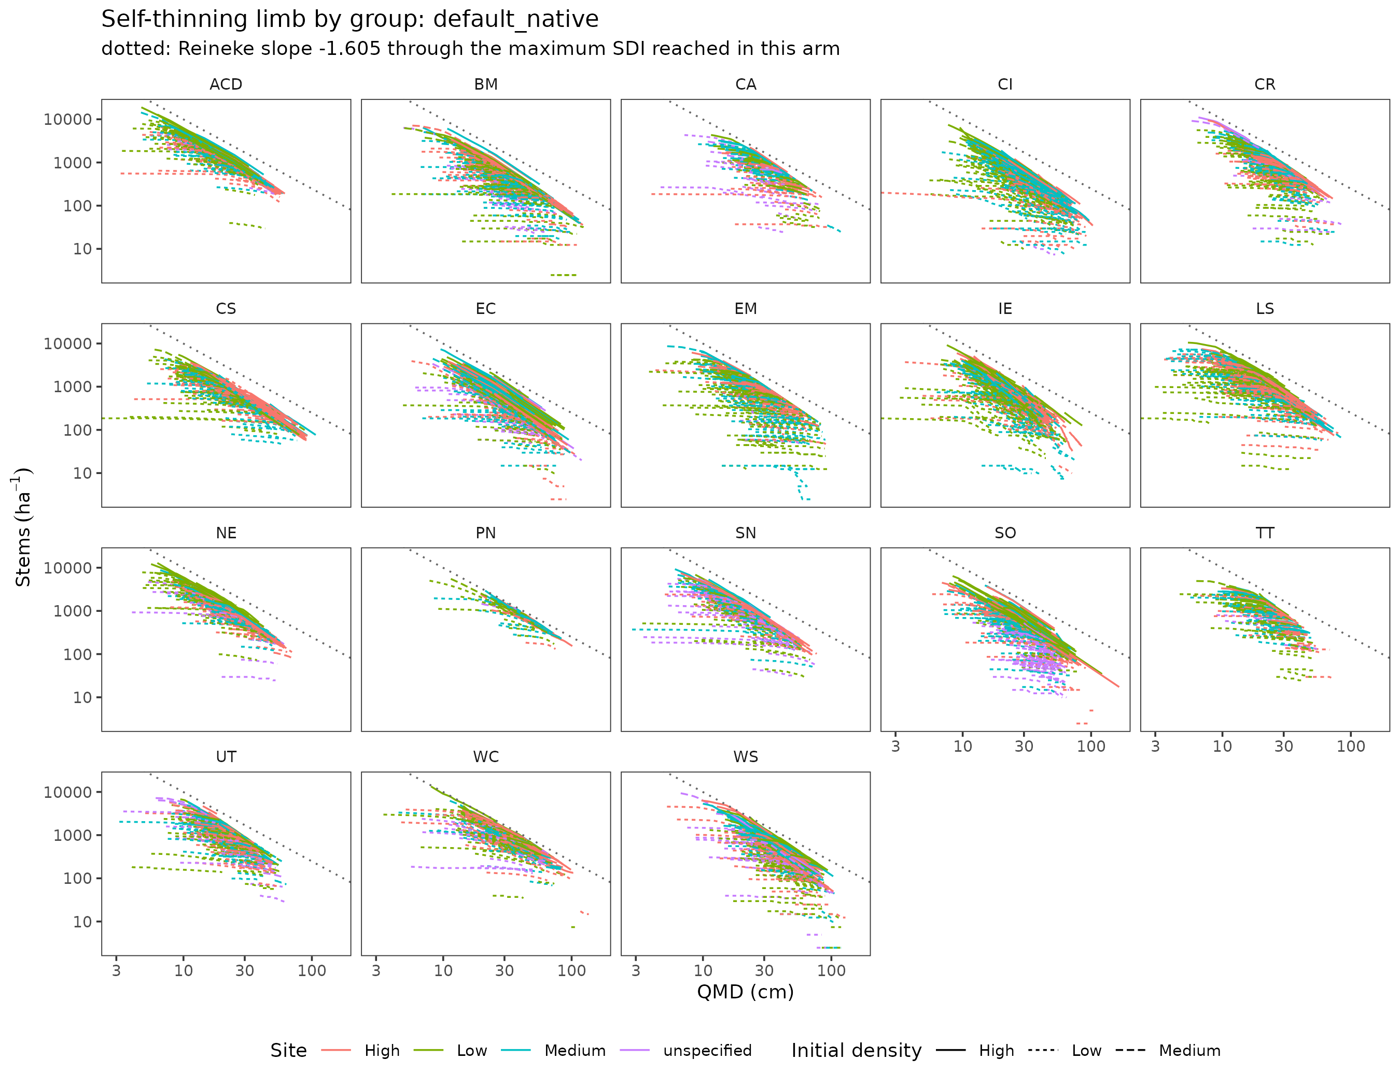
Self-thinning limb by variant, default native arm
Dotted line: Reineke slope -1.605 through the maximum SDI reached in the arm.
ACD, BM, CS, NE, SN, WS run parallel to it. CA, TT, UT, WC and EM run flat: stems hold while diameter grows, which is a mortality model that does not respond to density.
The per variant scorecards (validation/bakuzis_stress_v2/catalog/scorecards/) carry this panel for all four arms with the component attribution.
Source: bakuzis_scorecards.R, Cardinal job 16033493 (catalog v8)
8

Slide 9
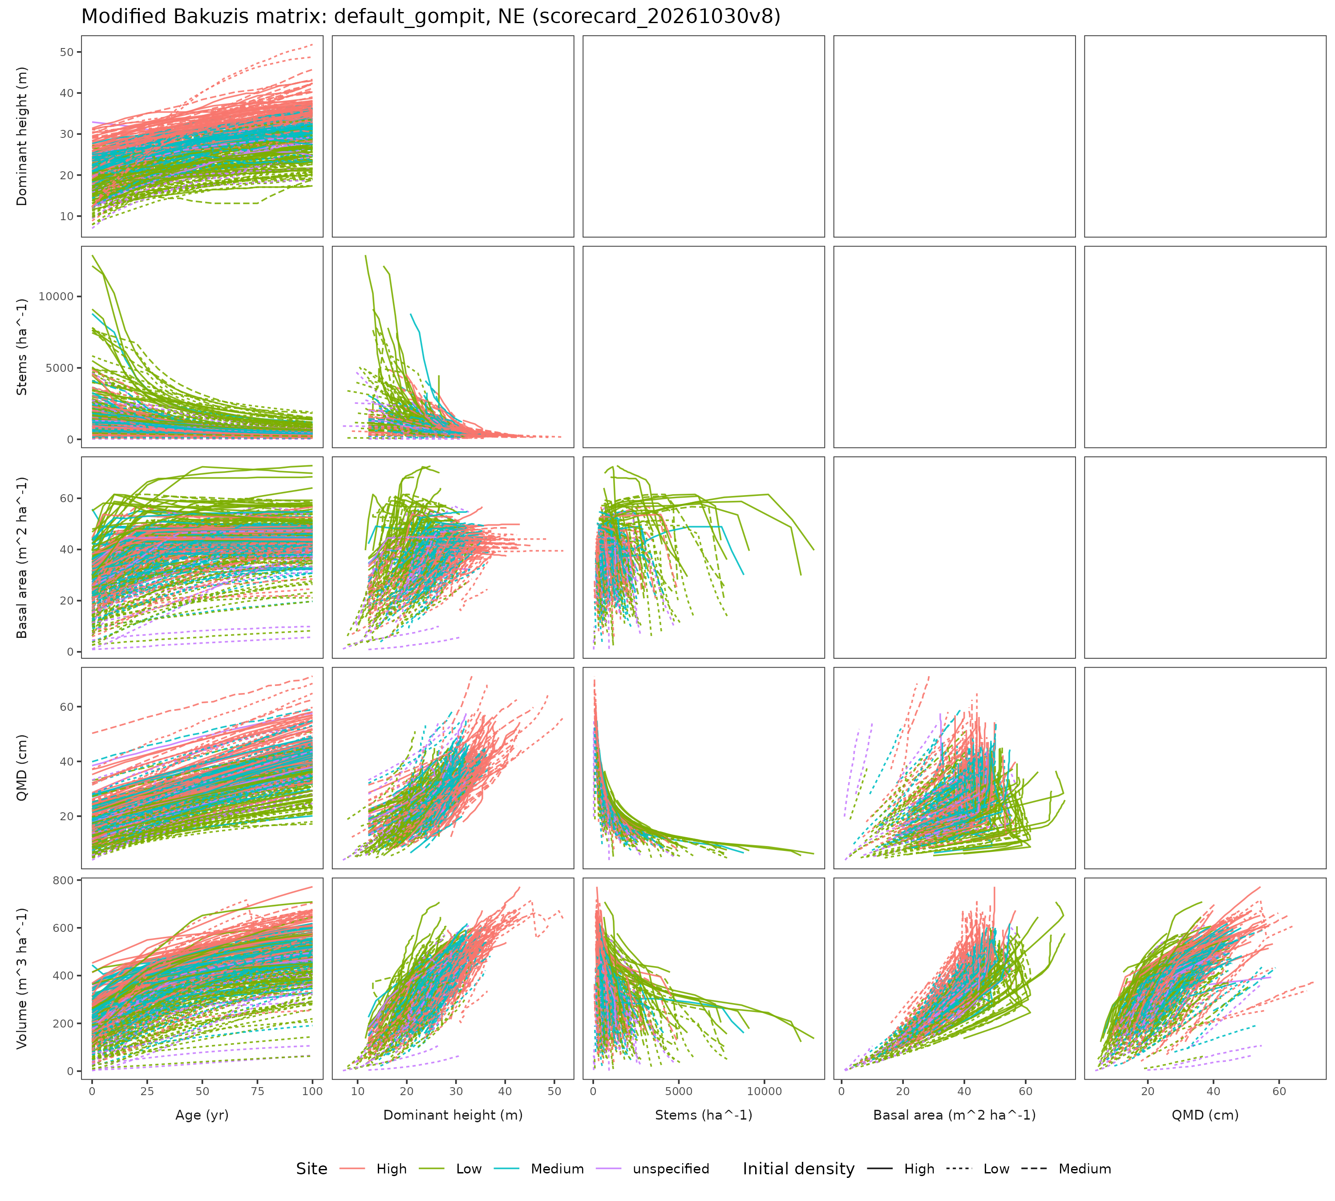
The full matrix for one recommended arm: NE, default GOMPIT
Nine relations, lower triangle. Site and density classes are within variant terciles of SICOND and BALIVE on real FIA stands, so the site based relations (site ordering, Eichhorn, Sukachev, yield density) are confounded by stand selection and are reported, not gated.
The engine verdicts rest on Reineke (T3, T3b), the magnitude envelope (T4), plateau (T8), inversions (T9) and the initial step shock (T0).
A pass is a failure to falsify, not a confirmation of accuracy.
Source: bakuzis_scorecards.R, Cardinal job 16033493 (catalog v8)
9

Slide 10
Stress test after shipping: could the analyst choices have gone another way?
Axis | Shipped | Alternatives in the 144 cell grid
Horizon | 50 years | 100 years
Exceedance tolerance | 5 percent | 3, 10 percent
Wilson upper bound | 10 percent | 15 percent
Basal area ceiling | p99.9 | p99
Reineke flag tolerance | 10 percent | 15, 25 percent
Minimum evaluated trajectories | 10 | 30
▪ Part B: 500 stand bootstraps per variant under the shipped rule, giving each arm's probability of admissibility and each variant's probability of keeping an admissible engine arm.
▪ No new engine runs; recomputed from the trajectory level data (stress_catalog.R, Cardinal jobs 15990793, 16003647, 16016080 and 16033492).
▪ The recomputed primary rule reproduced all 72 shipped verdicts, an independent check of catalog_gates.R.
Source: fvs-modern main, validation/bakuzis_stress_v2/ (gates_v8, stress_v8) and config/catalog/ (October 30, 2026, catalog version 1.2.0, catalog v8)
10

Slide 11
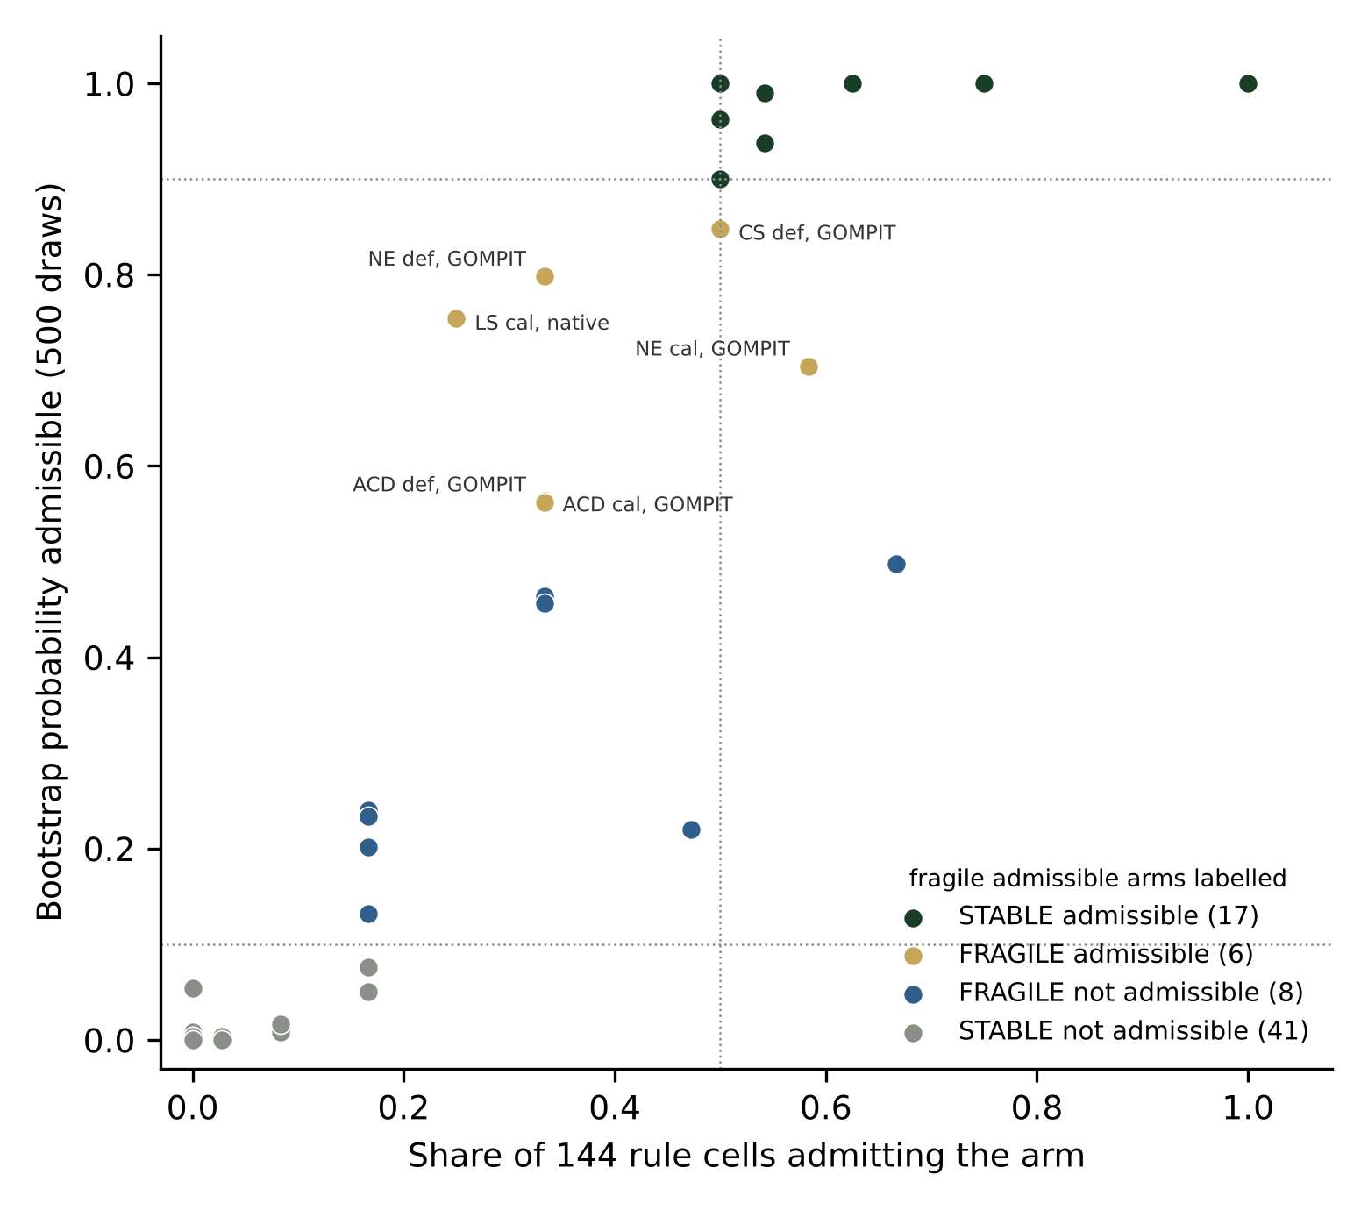
No verdict overturned; 6 of 23 admissible and 8 of 49 not admissible arms fragile
Fragile admissible arm | Bootstrap | Grid share
ACD calibrated GOMPIT | 0.56 | 0.33
ACD default GOMPIT | 0.56 | 0.33
CS default GOMPIT | 0.85 | 0.50
LS calibrated native | 0.75 | 0.25
NE calibrated GOMPIT | 0.70 | 0.58
NE default GOMPIT | 0.80 | 0.33
Recommended variants keep an admissible arm in 100 percent of resamples (ACD, BM, CS, NE, SN), 99 (LS), 92 (WS).
Fragile not admissible: CI default native 0.50, SO four arms 0.20 to 0.46, CR calibrated native 0.22, TT calibrated GOMPIT 0.23, EC default native 0.13; all among the 12 arms a 25 percent Reineke tolerance admits, all below even odds.
Reineke tolerance is the only axis that changes recommended variants; the p99 ceiling admits three arms anywhere; 100 years drops LS calibrated native only.
Source: stress_by_arm.csv, stress_by_variant.csv (job 16033492)
11

Slide 12
Using it: fvs2py.catalog.select_config
from fvs2py.catalog import select_config
c = select_config('NE')
c.arm # 'default_gompit'
c.config_version # passed to FVS()
c.env # {'FVS_GOMPIT': '1', ...}
c.admissible # four arms
c.notes # near term tie break
select_config('SO', survival='native')
# least bad engine arm, NOT RECOMMENDED,
# rule_sensitive note attached
▪ Reads config/catalog/catalog_recommendation_by_variant.csv and catalog_gates_by_arm.csv; regenerate only through the pipeline, never by hand.
▪ Returns a note when the caller forces an arm the catalog did not admit, when Reineke was not testable, when a calibrated arm is not distinct, or when the verdict is rule sensitive.
▪ No admissible arm: the least bad engine arm with the status attached, falling back from a projector arm where that is least bad overall (TT).
▪ AK and NC: NOT EVALUATED.
▪ Stability labels sit beside the catalog in catalog/stress/; read them before choosing a fragile admissible arm.
Source: fvs-modern main, validation/bakuzis_stress_v2/ (gates_v8, stress_v8) and config/catalog/ (October 30, 2026, catalog version 1.2.0, catalog v8)
12

Slide 13
What the catalog does not cover
▪ Per variant near term accuracy. Only the NE Paper 2 cohort exists, so outside NE the tie break is simplicity alone and the catalog says so.
▪ Posterior uncertainty: calibrated MAP is a point estimate here; the Paper 1 ensemble gives the band for NE and ACD only.
▪ Regeneration: no arm establishes it, so a 100 year plateau or decline in stems is partly a design choice.
▪ Site based relations are confounded on the unstratified sample; the synthetic 36 cell matrix stays the clean test.
▪ The year zero failures of the first catalog are explained (null TPA_UNADJ records filled as 6.0 TPA trees) and gone; the regenerated catalog changed no verdict. The October 30 overlay fix changed four verdict fields (EM and WC least bad arm, WC alternative rule, NE stability label), and the plot-size expansion fix (v8) changed the WC alternative rule back and the WS stability label; no status changed.
▪ Thresholds are the sample maximum in small variants; the projector b1 GOMPIT arm has no NE or SN rows.
▪ In NE the stable arm is default native (0.96); the shipped GOMPIT preference trades long horizon stability for near term evidence.
Source: fvs-modern main, validation/bakuzis_stress_v2/ (gates_v8, stress_v8) and config/catalog/ (October 30, 2026, catalog version 1.2.0, catalog v8); implementation-notes.md
13

Slide 14
Where everything is
▪ GitHub: advanced-forestry-systems/fvs-modern, main (PRs 118 to 137, 144 and 145; current catalog in gates_v8). config/catalog/ holds the two tables the selector reads; validation/bakuzis_stress_v2/ holds the memo (Sections 1 to 19), the catalog folder, scorecards, stress test and run index with md5 lists.
▪ Zenodo: concept DOI 10.5281/zenodo.23777723 (version 1.0.0 is the first catalog, 1.1.0 the seeding fix, 1.2.0 the overlay fix) carries the tables, scripts, scorecard cells, the technical report and this deck. No FIA plot identifiers or coordinates in any file.
▪ Scripts: conus_catalog_runs.py (engine runs), bakuzis_stress_v2.R (scorer), catalog_gates.R (gates), bakuzis_scorecards.R (per variant scorecards), stress_catalog.R (stress test), fvs2py/catalog.py (selector).
▪ Cardinal jobs: build 15967530, first runs 15976824 and 15984133, regenerated runs 15998817, finalize 16002593, stress 16003647, scorecards 16003648; version 1.2.0: calibrated reruns 16016015, v8 reruns 16023222, finalize 16023294, stress 16033492, scorecards 16033493.
Aaron R. Weiskittel, Center for Research on Sustainable Forests, University of Maine. aaron.weiskittel@maine.edu
Source: fvs-modern main, validation/bakuzis_stress_v2/ (gates_v8, stress_v8) and config/catalog/ (October 30, 2026, catalog version 1.2.0, catalog v8)
14

