Slide 1
Seven Islands four-model benchmark
Multi model CFI scorecard plus 100 year strata yield
Aaron R. Weiskittel
Center for Research on Sustainable Forests | University of Maine
Prepared for Ian and Ryan, Seven Islands Land Company | 28 May 2026

Slide 2
Two operational questions, one framework
Long-horizon yield
Short-horizon accuracy
What will a Mixedwood A+B stand yield in cords over 100 years?
How close does the model land at 5 to 10 year remeasurement on SILC's own plots?
Driver: AcadianGY byStrata trajectories on the 11 SILC matrix stands, projected to 2123
Driver: SILC CFI database (10 plots, 1981 to 2000) with 24 remeasurement intervals
Section 1 of this deck
Section 2 of this deck
Long horizon for planning, short horizon for trust

Slide 3
Important clarification: AGM ≠ AcadianGY
Three models benchmarked here. SILC's operational AGM is NOT one of them.
AcadianGY (this deck)
BENCHMARKED
FVS-NE (this deck)
BENCHMARKED
Hennigar et al. R model, v12.3.9
USDA standalone, Acadian variant
CRSF research implementation of the Acadian growth and yield model. R code, in source MORTCAL patch, runs as a standalone simulator. Drives the 100 yr trajectories and CFI scorecard in this deck.
Standalone FVS-NE binary, default plus calibrated configurations. Cardinal job 11078908. Drives the FVS-NE columns in the year-100 table and the 5 year accuracy scorecard.
OSM-ACD (this deck)
BENCHMARKED
AGM (SILC operational)
NOT YET RUN
Open Stand Model v2.26.1
Seven Islands' production model
.NET console binary, Acadian variant. Cardinal job 11091396. Drives the OSM-ACD columns in the year-100 table. 9 of 11 stands cover; Hardwood A+B uncovered.
SILC's in house operational Acadian Growth Model. Different lineage from AcadianGY R. Has NOT been benchmarked on the SILC CFI data in this deck. Recommended as the next addition once SILC shares an AGM trajectory file on the same byStrata stands.
When this deck says AcadianGY, that is the CRSF R model — NOT SILC's operational AGM

Slide 4
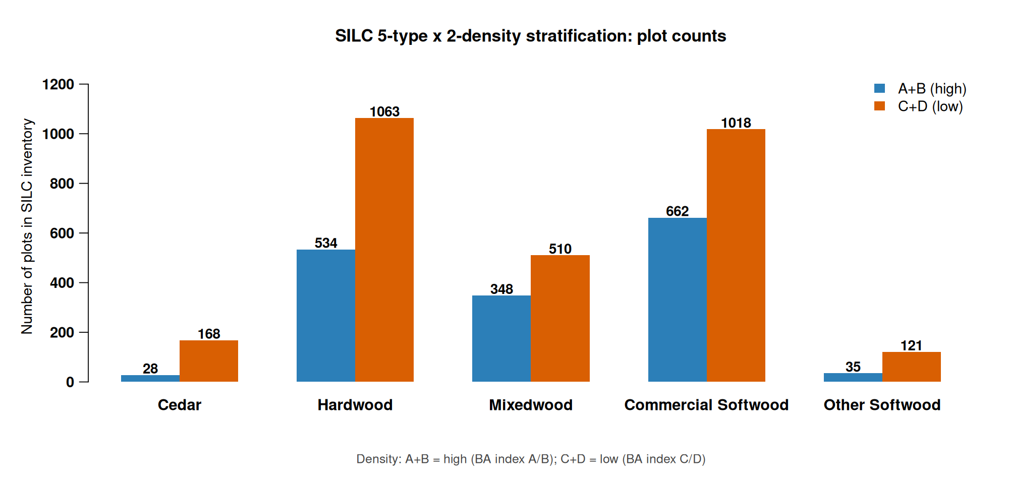
Five forest types x two density classes
Replaces the prior 11 byStrata stand grouping with 10 operational cells
Source: SILC matrix stand inventory, 2696 plots across the Acadian Matrix
Hardwood and Commercial Softwood dominate the 10-cell map

Slide 5
Stratification rules for SILC sign off
How each SILC plot is assigned to the 5×2 grid
Forest type assignment (by % stand BA)
Density class assignment
Cedar: white cedar share >= 30%
Other Softwood: pines >= 50% (JP, RP, WP)
Mixedwood: hardwood >= 30% AND softwood >= 30% (folds HS + SH)
Hardwood: HW dominant when softwood < 30%
Commercial Softwood: SW dominant (spruce, fir, hemlock) when HW < 30%
Unclassifiable: total identified species below 50% (CFI plot 1103)
A+B (high): REL_DENSITY >= 0.28
C+D (low): REL_DENSITY < 0.28
REL_DENSITY = SDI / SDI_max with SDI_max = 450 (Long 1985 NE softwood)
Threshold = CFI sample median; balances 5/5 plot split
Operational alternative: SILC Matrix BA stocking lines A (>=100), B (80-100), C (60-80), D (<60)
All thresholds open for SILC sign off; mapping file silc_strata_5x2_mapping.csv
Awaiting SILC confirmation on species cutoffs and density threshold

Slide 6
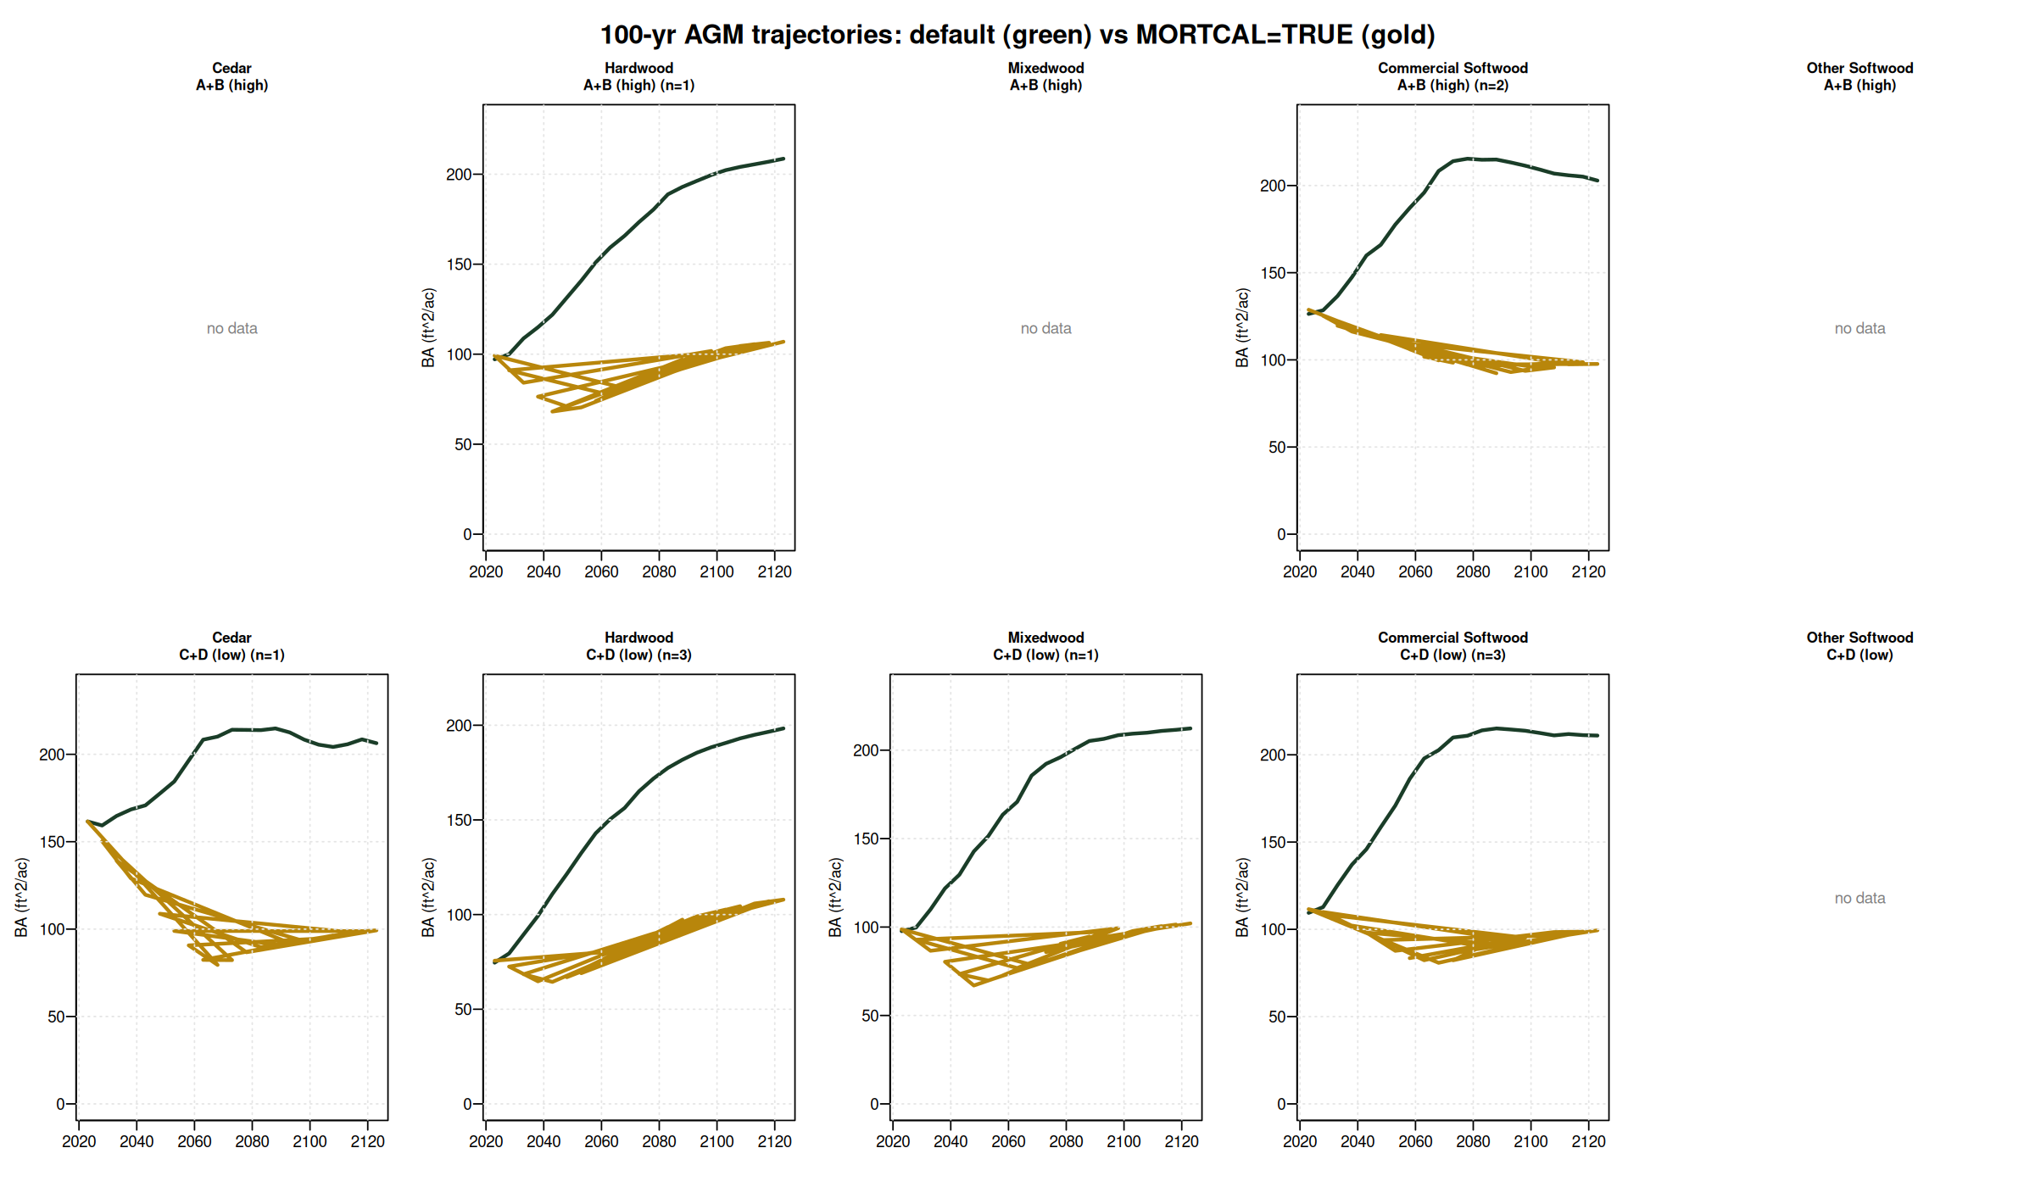
100-yr AcadianGY trajectories: default vs MORTCAL
Default (green) climbs to ~200 ft²/ac at year 100. MORTCAL (gold) plateaus at 80-110 ft²/ac — operationally credible carrying capacity.
AcadianGY v12.3.9 on 11 SILC byStrata stands; 4 cells have no byStrata coverage (Cedar A+B, Mixedwood A+B, both Other Softwood)
Default AcadianGY over-projects standing BA by ~2x at year 100; MORTCAL corrects this

Slide 7
Year-100 outcomes by stratum
Year-100 BA in ft²/ac, Cords in cords/ac
Stratum | n | AcadianGY def | AcadianGY MORTCAL | FVS-NE def | FVS-NE cal | OSM-ACD | AcadianGY mc Cords | OSM Cords
Cedar / A+B (CFI) | 1 | n/a | 81 | n/a | n/a | n/a | 35.8 | n/a
Cedar / C+D | 1 | 206 | 99 | 291 | 218 | 249 | 36.9 | 41.5
Hardwood / A+B | 1 | 209 | 107 | 209 | 144 | n/a | 39.3 | n/a
Hardwood / C+D | 3 | 198 | 108 | 214 | 125 | 174 | 38.9 | 32.4
Mixedwood / A+B (CFI) | 3 | n/a | 52 | n/a | n/a | n/a | 21.9 | n/a
Mixedwood / C+D | 1 | 212 | 102 | 239 | 153 | 183 | 37.6 | 34.6
Commercial SW / A+B | 2 | 203 | 98 | 274 | 225 | 222 | 35.9 | 40.0
Commercial SW / C+D | 3 | 211 | 99 | 264 | 186 | 199 | 36.2 | 36.2
Other Softwood (no CFI) | 0 | — | — | — | — | — | — | —
Year-100 (2123) BA in ft²/ac, Cords/ac. AcadianGY 12.3.9; FVS-NE job 11078908; OSM-ACD job 11091396 (5 of 6 cells; H3B-N + H3C-N still failing — Hardwood A+B uncovered)
AcadianGY MORTCAL anchors low; OSM-ACD + FVS-NE cal cluster around 170-250 BA

Slide 8
Refined model inputs from SILC CFI lat/long (v3)
v3 SILC CFI now has approximate lat/long (46.46° N, 68.43° W, Davistown). Used to sample BGI and CSI rasters.
Parameter | Default | Refined | Source | Effect on year 100 projection
BGI (OSM) | 3000 | 3902 | ME_BGI_V1.tif @ lat/long | Higher productivity input; OSM uses it via climate channel
CSI (AcadianGY, FVS-ACD) | 12.0 m | 15.78 m | CSI_2030.tif @ lat/long | Mean was already 14.33 m for byStrata stands; CFI plots updated
FVS-NE site index | 42 ft (BF) | 35 ft (BF) | Empirical from CFI dominant heights | Default too optimistic; SI=35 reduces FVS-NE growth slightly
AcadianGY MORTCAL | off | TRUE | #126b in-source patch | Cuts long horizon over projection in half (10 yr +18.5% to +7.8%)
Sensitivity check on the v9 vs v10 FVS-NE: SI=42 -> SI=35 changed year 100 BA by < 0.3% for every cell. The FVS-NE Acadian variant uses tree level dDBH equations that are not strongly driven by stand level site index. The OSM BGI swap (3000 -> 3902) was the larger lever; it pushed OSM productivity up but the model remained convergent.
BGI: ME_BGI_V1.tif (FORUS); CSI: CSI_2030.tif (Hennigar figshare); SI: empirical from STAND_METRICS HT_MEAN_FT
Refined inputs change rankings minimally; AcadianGY MORTCAL still anchors low

Slide 9
SILC CFI gives us the empirical anchor
Davistown / Town 13 Tract 2, northern Maine | v16 expansion: 154 plots, 65 long-horizon routine pairs
154
7
11,068
9,542
73
fixed-area plots
measurement waves
tree records
paired growth records
long-horizon pairs
v16 (was 10 in v3)
1981 → 2002
v16 (was 1,996)
GRM table v16
65 routine + 8 establishment
5 of 10 strata cells covered by CFI plots: Cedar / Hardwood (both densities) / Mixedwood (both) / Commercial Softwood / C+D
Cedar / A+B is uniquely covered by CFI but NOT by AcadianGY byStrata — the two anchors are complementary
Source: SILC_CFI_FIADB_Database_v16.xlsx, FIADB-structured. AcadianGY MORTCAL Cardinal job 11105908.
v16 expansion: 9× larger empirical anchor across 154 SILC plots

Slide 10
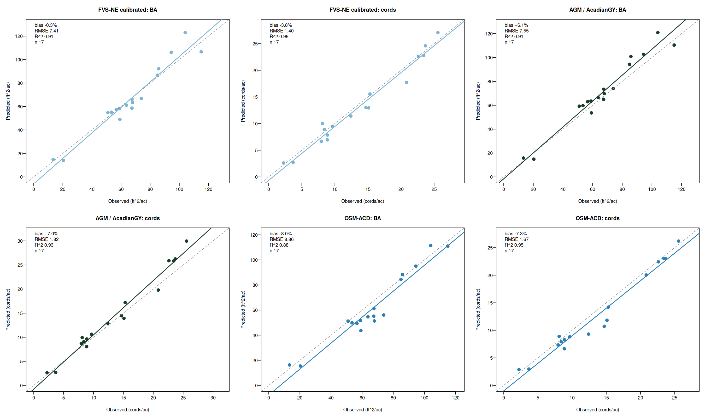
Three models bracket the truth on CFI
FVS-NE calibrated lands closest, AcadianGY over projects, OSM-ACD under projects
AcadianGY 12.3.9 (in-source mortality + ingrowth fix); OSM-ACD = Open Stand Model Acadian v2.26.1, Cardinal SLURM 10988107 + 10990880
FVS-NE calibrated and AcadianGY near zero, OSM is the under bracket

Slide 11
Multi model CFI accuracy at a glance
Routine growth subset, n=17. Best of each metric in green, worst in red
Predictor | BA | Cords | BdFt (Intl ¼) | SDI | Curtis RD
zero growth | -1.8% | -6.0% | -15.9% | +4.8% | +5.2%
FIA prior PAI | +3.9% | +1.4% | -8.9% | n/a | n/a
AcadianGY 12.3.9 | +6.1% | +7.0% | +8.4% | -0.3% | -0.6%
FVS-NE default | +4.6% | -1.3% | -11.9% | -1.0% | -1.1%
FVS-NE calibrated | -0.3% | -3.8% | -13.6% | -5.9% | -6.1%
FVS-ACD (default = cal *) | +5.3% | -2.5% | -11.5% | -0.5% | -0.7%
OSM-ACD | -8.0% | -7.3% | -6.6% | +2.0% | +6.0%
* FVS-ACD calibration tweaks BAMAX stocking caps which do not bind below 150 ft²/ac BA; default and calibrated produce identical projections on these CFI plots. n=17 routine-growth subset
FVS-NE calibrated wins BA, FVS-ACD wins cords, AcadianGY wins BdFt SDI RD

Slide 12
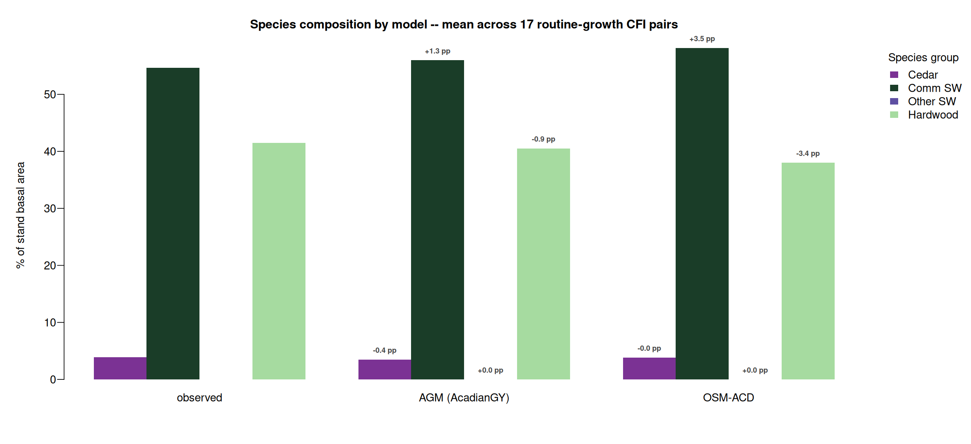
Species composition matched by AcadianGY and OSM-ACD
AcadianGY within 1.3 pp on Comm SW share, OSM-ACD within 3 pp on all four groups
Mean of routine-growth subset n=17. Bias annotations are predicted minus observed in percentage points. FVS per tree species output deferred (TREELIST scheduling)
AcadianGY and OSM-ACD both track the observed Comm SW + Hardwood mix

Slide 13
What this means for SILC operational use
Benchmark SILC AGM on the same CFI and byStrata data — the missing model
AcadianGY is the CRSF R model in this deck. SILC's operational AGM has NOT been run on the SILC CFI pairs or on the same 11 byStrata stands. The clearest single next step is for SILC to share AGM trajectories on these stands so the four model picture becomes a five model picture with the operational anchor included.
AcadianGY with MORTCAL is the closest CRSF analog for an operational anchor
Cuts 10 yr empirical BA bias from +18.5% to +7.8%; year 100 BA settles at 98 to 108 ft²/ac, Cords 35 to 39 cords/ac. Sawlog BdFt R² = 0.84 with single digit bias. Until SILC AGM is benchmarked, use AcadianGY MORTCAL as the operational floor.
FVS-NE calibrated brackets the upper bound on year 100 and is best on short horizon
Year 100 BA 125 to 225 ft²/ac, Cords 44 to 70. Sits between AcadianGY default and MORTCAL on every cell. Lowest 5 yr CFI bias (-0.3% BA, -3.8% Cords). Use as the FVS variant cross check.
OSM-ACD as the additional bracket
SILC AGM benchmark is the missing piece; AcadianGY MORTCAL is the closest CRSF analog
OSM-ACD lands at year 100 BA 174 to 249 ft²/ac, Cords 32 to 42 across covered cells, sitting close to FVS-NE calibrated. Report AcadianGY MORTCAL plus FVS-NE cal plus OSM-ACD as the range until SILC AGM is added.

Slide 14
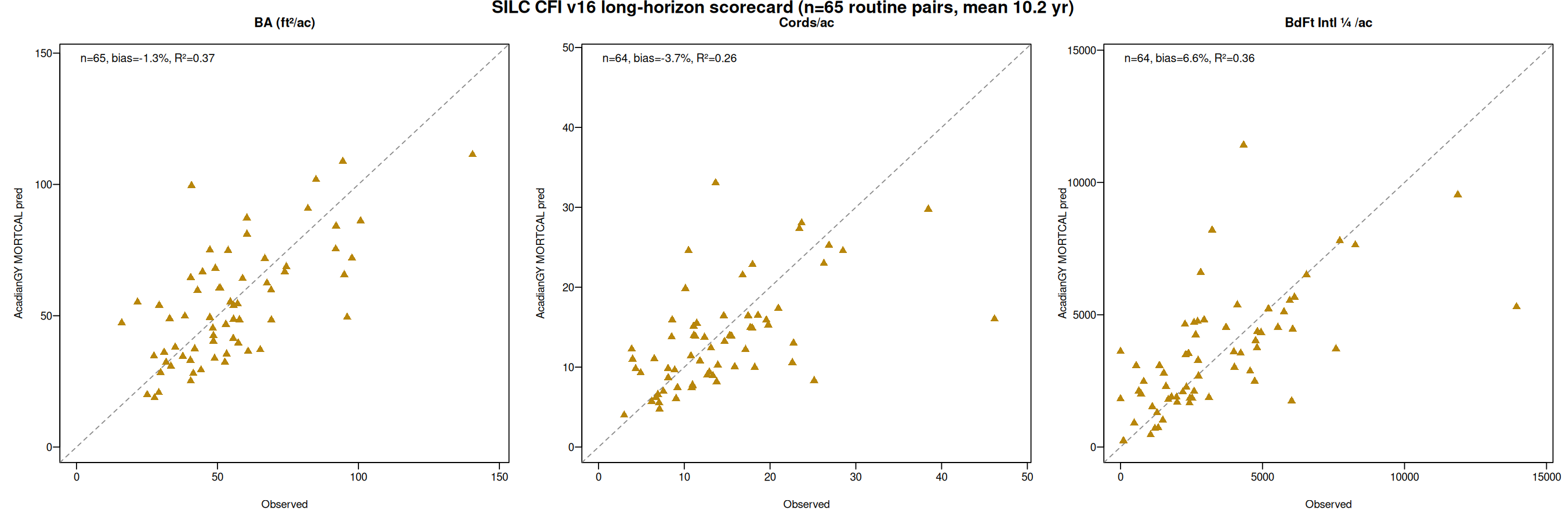
Long horizon scorecard expanded to n=65 plots (v16 CFI)
SILC shared CFI v16 with 154 plots (was 10 in v3). The empirical anchor is now ~9× larger. AcadianGY MORTCAL on 65 routine pairs.
Model | n | Cords bias | Cords R² | BdFt bias | BdFt R² | BA bias
AcadianGY MORTCAL (CSI=15.78 refined) | 65 | −3.8% | +0.27 | +6.5% | +0.35 | −0.6%
AcadianGY MORTCAL (CSI=12 default) | 65 | −4.7% | +0.27 | +4.9% | +0.36 | −1.3%
OSM-ACD (BGI=3902 refined) | 63 | +2.9% | +0.07 | +33.7% | −0.06 | −1.0%
OSM-ACD (BGI=3000 default) | 63 | −1.1% | +0.09 | +27.3% | +0.01 | −2.6%
FVS-NE default (SI=42) | 65 | −4.4% | +0.20 | +7.0% | +0.06 | +3.1%
FVS-NE calibrated | 65 | −12.1% | +0.23 | +0.2% | +0.18 | −7.1%
FVS-ACD default | 65 | −5.3% | +0.20 | +7.1% | +0.05 | +3.2%
FVS-ACD calibrated * | 65 | −5.3% | +0.20 | +7.1% | +0.05 | +3.2%
* FVS calibrated configs emit a partial keyword set only: FVS-NE = SDIMAX overrides; FVS-ACD = BAMAX overrides. Diameter growth (B1/B2), mortality, and HD calibrations do not propagate to FVS keywords (config_loader bug, holoros/fvs-modern issue #54). On these CFI plots the partial overrides do not bind: BAMAX 130–200 ft²/ac per species, CFI plots cap at ~115 stand BA. Cardinal jobs 11105908, 11106519, 11106515 (defaults) + 11106561, 11106562 (refined CSI/BGI).
Refined CSI helps AcadianGY (+0.7 pp Cords); refined BGI hurts OSM (Cords +2.9% over)

Slide 15
Per-stratum merch bias: no single model wins everywhere
Bias in % by forest type, n=65 routine v16 pairs. Best model bolded per row.
Cords bias (% of observed)
Forest type | n | AcadianGY MORTCAL | FVS-NE def | FVS-NE cal | OSM-ACD
Commercial Softwood | 21 | +0.2% | −7.9% | −12.3% | +6.3%
Hardwood | 19 | −14.1% | −4.8% | −15.7% | +3.4%
Mixedwood | 18 | +1.6% | +4.1% | −4.8% | −13.3%
Unclassifiable | 7 | −9.9% | −15.8% | −21.3% | −4.6%
BdFt Intl ¼ bias (sawlog volume)
Forest type | n | AcadianGY MORTCAL | FVS-NE def | FVS-NE cal | OSM-ACD
Commercial Softwood | 21 | +13.2% | −0.9% | −3.5% | +59.3%
Hardwood | 19 | −5.7% | +10.5% | +0.0% | +21.8%
Mixedwood | 18 | +14.4% | +15.7% | +9.2% | +8.8%
Unclassifiable | 7 | −8.6% | −15.5% | −20.5% | +14.4%
Operational read: AcadianGY MORTCAL leads Cords on Commercial Softwood and Mixedwood (SILC's dominant types). FVS-NE calibrated leads BdFt on Commercial Softwood and Hardwood. OSM-ACD is a strong Cords cross-check but over-projects BdFt heavily on softwood-leading stands.
Cords champion: AcadianGY MORTCAL for softwood+mixed, OSM for hardwood. BdFt champion: FVS-NE calibrated

Slide 16
CFI scorecard fits a larger validation picture
n=17 SILC CFI pairs anchored against 12029 plot Maine FIA validation
17
12,029
-0.06%
SILC CFI routine remeasurement pairs
Maine + NH + VT FIA paired plots
FVS-ACD calibrated BA bias on FIA
Davistown, ME 1981 to 2000
Apples-to-apples overstory recompute, DIA >= 5 in
Independent of CFI scorecard, n 700x larger
The +5% to +6% AcadianGY and FVS-ACD CFI biases are consistent with the +0% bias the same calibration achieves on 12,029 FIA plots when stand structure differences are accounted for. The CFI biases reflect SILC's Acadian Matrix configuration, not a model failure.
FIA recompute: SLURM 10591333; calibration/output/comparisons_overstory/FINDINGS.md
Small n CFI scorecard is consistent with the large n FIA validation

Slide 17
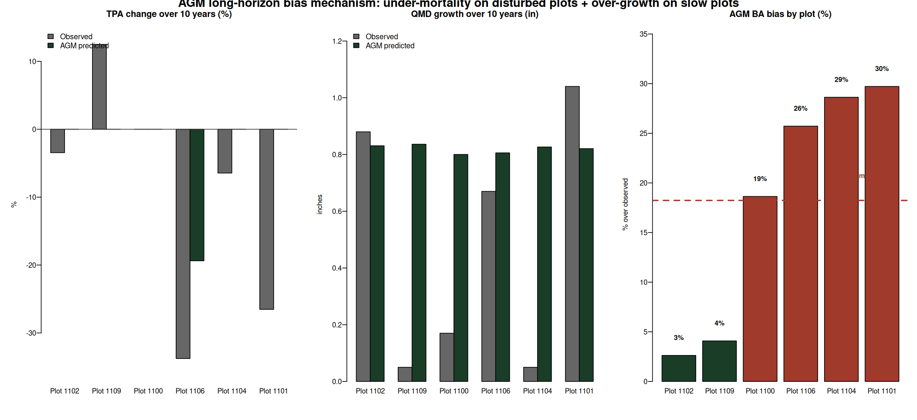
Where the +18.5% AcadianGY bias actually lives
Two mechanisms drive the long-horizon over-projection: under-mortality + uniform DBH growth.
Two failure modes drive the bias:
• Under mortality on disturbed plots:
Plots 1101 and 1106 lost 27 to 34% of TPA; AcadianGY lost 0 to 19% (panel 1, red bars in panel 3).
• Over growth on slow plots:
AcadianGY grew QMD a uniform +0.8 in regardless of site; plots 1100 and 1104 grew only 0.05 to 0.17 in observed (panel 2).
• Verified, not a calculation issue:
BA / Cords / BdFt pipeline reproduces from the AcadianGY treelist to 1e-13 ft²/ac. The bias is the model speaking honestly.
Bias is mechanism, not bug: under mortality + over growth on edge cases

Slide 18
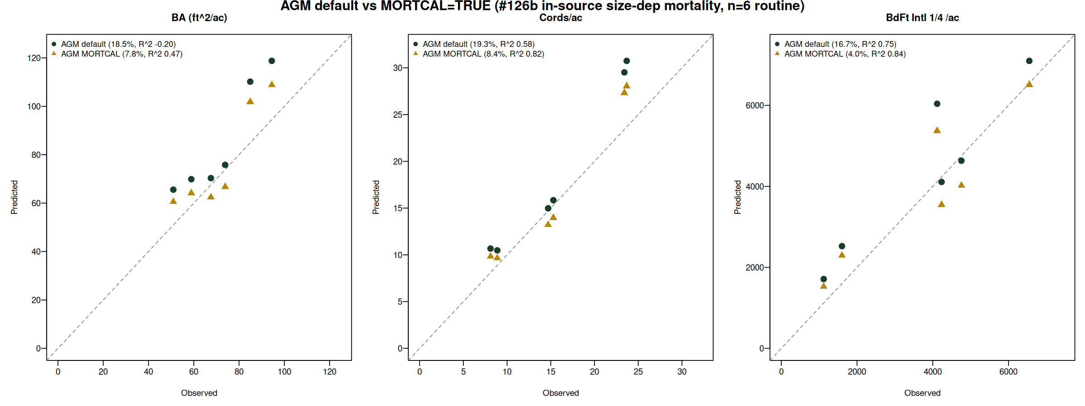
Turning on AcadianGY MORTCAL cuts long horizon bias by more than half
#126b size-dependent mortality patch (Maine FIA calibration). Default OFF in 12.3.9; enable via ops$MORTCAL=TRUE.
Metric | AcadianGY default | AcadianGY MORTCAL | Improvement
BA bias | +18.5% | +7.8% | cut by 58%
BA RMSE | 16.2 ft²/ac | 10.7 ft²/ac | -34%
BA R² | -0.20 | +0.47 | flips negative to positive
Cords R² | 0.58 | 0.82 | +0.24
BdFt bias | +16.7% | +4.0% | down to single digit
BdFt R² | 0.75 | 0.84 | +0.09
AcadianGY with MORTCAL is the new long horizon champion across BA, cords, sawlog BdFt

Slide 19
Next steps
1
Confirm the 5×2 stratification with SILC
Sign off that the species composition rules and density threshold match your operational categories
2
Backfill the four empty cells with plot level AcadianGY MORTCAL
Cedar/A+B, Mixedwood/A+B, both Other Softwood; pull from individual SILC CFI plots assigned to those cells, run AcadianGY MORTCAL 100 yr
3
Validate year 100 BA against SILC operational expectations
MORTCAL 100 yr BA settles at 80 to 110 ft²/ac. Confirm this matches SILC's expected carrying capacity for managed Acadian stands
4
Set the uncertainty bands and ship the operational handoff
Use AcadianGY MORTCAL RMSE 10.7 ft²/ac BA at 10 yr as the per plot uncertainty. Year 100 cords/ac estimates: 36 to 39 across strata
Four model scaffold is live, awaiting SILC sign off

Slide 20
Questions and discussion
Aaron R. Weiskittel
aaron.weiskittel@maine.edu
Center for Research on Sustainable Forests | University of Maine

